Slide 1
Marriott & Data Axle
MAU Foundation Final Presentation
March 29, 2023

Slide 2
Today, we will discuss …
Strategy - Business objectives, program goals, and test & learn agenda
Creative - New creative concepts
Process – Workflow go-forward approach
Next steps

Slide 3


Strategy
SHERATON MAUI RESORT & SPA

Slide 4

Strategy Overview
Business Objectives
Campaign Strategy Pillars
New Key Segment Opportunities
Test & Learn Agenda
Program Goals & Baseline KPIs
Program Roadmaps
THE ST. REGIS MARDAVALL MALLORCA RESORT, PALMA DE MALLORCA, SPAIN

Slide 5


Business Objectives
Building pride and growing engagement by utilizing personalization and dynamic content via a test and learn approach in order to deepen loyalty and drive revenue.
THE ST. REGIS MARDAVALL MALLORCA RESORT, PALMA DE MALLORCA, SPAIN

Slide 6
Campaign Strategy Pillars
Key Campaign Strategy Pillars For 2023
Determine Focus Areas For Improvement & Optimization Tied To A Test & Learn Agenda
Capture Primary & Secondary Baseline KPIs (Revenue, CTR, Unsub Rate, Program Engagement)
Identify New Key Segments For Content Versioning, Personalization & Reporting Only
Look For Connections: With Luxury MAU, Themed Additions, Offers & Testing Opportunities
Expand Regional / Localization Content Efforts
Feedback Loop To Stakeholders
Notes:
Themed Additions tied to Lux MAU, Traveler & Ritz eNews e.g., Road Trips, Weekend Getaways and Romance in Feb…

Slide 7
New Key Segment Opportunities
We will leverage third party data to learn more for select segments
Strategy will collaborate to develop segments
1
2
3
4
New Members: Joined The Program 0-100 | 101+ Days Ago
Inactive Members:
Has Not Earned Points Or Redeemed In The Last 3, 6, 9, Months
High ADR Audience,
High Value Targets (HVT) & Opportunity Segments
Cobrand Acquisition | Cobrand Cardholder vs. Non-Cardholder

Slide 8
Test & Learn Agenda | Approach
    Explore: Identify what we want to know and learn
      What information is currently missing?
      What have we wondered about?
      What assumptions would we like to confirm?
    Vet: Make sure we are seeking the right knowledge, in the right order
      Will the acquired knowledge be useful in developing future strategy?
      Is the acquired data or learning map to business objectives and goals?
      What’s first? De-prioritize the ideas that do not meet above criteria
    Construct: Develop iterative test plan focused on key test areas
      Identify the appropriate learning approach
      Prioritize tests based on whether it is impactful, executable, and measurable
    Document: Document learnings and recent recommendations
      Refer to past learnings to develop strategies as well as inform future learning initiatives
      Update test section on campaign roadmap quarterly

Slide 9
Test & Learn Opportunities | For Building Pride & Growing
IQ & Segmentation
Leisure Modules
Moments
Brand Propensity
Lifestyle Data / Personas
Condensed Version For New Members
Tailored Content By Segment
  Inactive Members
  Ambassadors
Incrementality
Active Member - Propel To New Product / Brand
New Key Segment Opportunities
  Cobrand Acquisition
Scalable Content & Layout
Inclusion Of Videos
Module Hierarchy
Countdown Timer
Polling
Milestone Messaging
Themed Editions
  Seasonal Drivers
  Brand Activations
‘Did You Know’ Content
Brand Education & Content
App Downloads
Offers & Localization
Targeted Offers
  Gated Offers
  ATM
Region Specific Modules

Slide 10
Test & Learn Prioritization | For Building Pride & Growing
IQ & Segmentation
1. Tailored Content By Segment
  Inactive Members
  Ambassadors
3. New Key Segment Opportunities
  Cobrand Acquisition
Scalable Content & Layout
4. Milestone Messaging
5. Brand Education & Content
6. App Downloads
7. Inclusion Of Videos
Offers & Localization
2. Targeted Offers
  Gated Offers
  ATM

Slide 11
Tailored Content By Segment | Testing Opportunities
    Testing Opportunities:
    Test tailored content for Inactive Members
      Test various CTAs and messaging within Points Expiration modules to propel activation
      Incorporate a More Ways To Engage module - test messaging, module design and creative elements
    Test tailored content for Ambassadors
      Run an initial backend analysis on top performing content to understand their interests. Apply analysis insights to test into tailored content
      Test enhanced creative elements e.g., interactive animated features to further excite and engage these members
Notes:
Earning points and stay is the focus for inactivity – do we layer in email inactivity as well?

Slide 12
Targeted Offers | Testing Opportunities
    Testing Opportunities:
    Test targeted offers to drive CTR and Revenue
      Offer messaging / CTAs
      Offer types e.g., Gated Offers, Bonus Points
      Module design / placement
      Animated creative elements
    Considerations:
    Seasonality
    Competing offers in market
    Targeted Offers:
    Gated Offers e.g., Gift Cards
    ATM

Slide 13
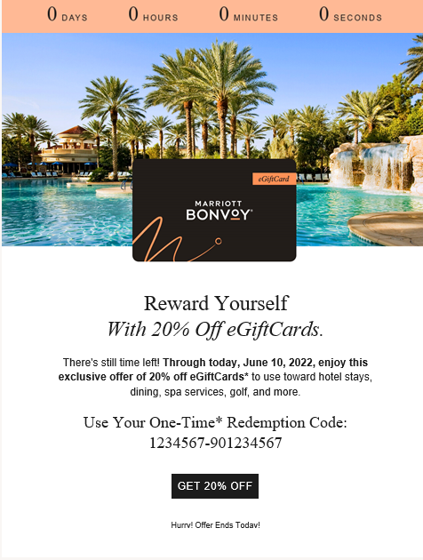
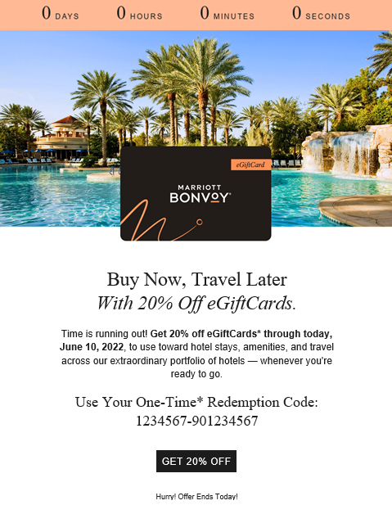
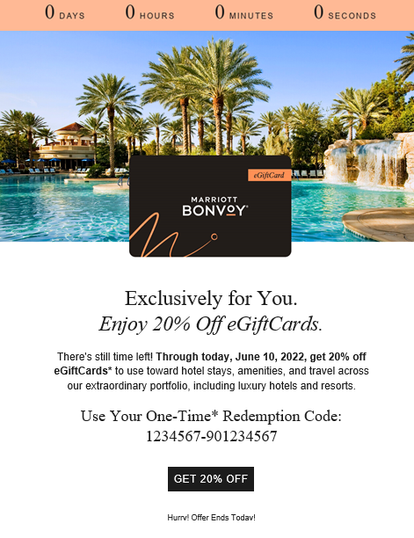
Targeted Offers | Gift Card Messaging Examples
SHERATON ADDIS, A LUXURY COLLECTION HOTEL,
ADDIS ABABA, ETHIOPIA
Reactivate eGiftCard Promo Reminder Default
Reactivate eGiftCard Promo Reminder OTA Loyalists

Slide 14
New Key Segment Cobrand Acquisition | Testing Opportunities
    Testing Opportunities:
    Test cobrand module placement for existing card holders moving up within the template
    Test refer-a-friend module placement / messaging for card holders
    Test sign up for card module placement / messaging for non-card holders
    Considerations:
    Initially track click activity to establish baseline KPIs for Cobrand Acquisition messaging
Notes:
Start with module placement (easier to execute).

Slide 15
Milestone Messaging | Testing Opportunities
    Testing Opportunities:
    Test Milestone Messaging touch points aligned with lifecycle stages
    Testing opportunities to excite and activate:
      CTAs and messaging
      CTA button placement / treatment
      Creative elements e.g., animated elements
      Module placement in template
    Milestone Messaging Stages:
    Welcome - Activate & Onboard
    Grow
    Recognize & Retain
    Latent

Slide 16
Milestone Messaging | Welcome - Activate & Onboard
    Apply Milestone Messaging testing opportunities to welcome new members - propelling excitement, education and activation
Attribute | Priority / Journey | Current Copy | Logic
Welcome Goal: Excite & Inform | 1 | Welcome to Marriott Bonvoy®. We’ve compiled some of our best offers and news just for you. https://www.marriott.com/loyalty.mi | Assign to basic members who are new
Onboard Goal: Introduction to digital platform | 2 | Earning is easy. Create your online account and discover the many ways to earn points https://www.marriott.com/loyalty/earn.mi | Assign to non-profilers
Onboard Goal: Education on redeeming | 3 | Learn how to redeem your points for nights & upgrades
Activate Goal: Encourage booking | 4 | Plan a trip now….. | New member with no stay in X months
Activate Goal: Recognize booking | 5 | We hope you’ve enjoyed your recent with Marriott Bonvoy® | Member with recent stay

Slide 17
Brand Education & Content | Testing Opportunities
    Testing Opportunities:
    Pull through the Brand Portfolio Campaign in June’s Core MAU - highlight the featured brands of the campaign in subsequent Core MAUs
      Test various CTAs, module design and creative elements in subsequent Core MAUs to propel education and excitement
    Test inclusion of new hotel spotlights and over time module design e.g., animated carousel
    Considerations:
    Landing page experience for new hotel spotlights
    Brand Awareness Tactics To Test:
    Brand Portfolio Campaign
    Brand Propensity Model
    New Hotel Spotlights
    Brand Showcase

Slide 18
App Downloads | Testing Opportunities
    Testing Opportunities:
    Test app module placement on a monthly or quarterly cadence targeting members who have not downloaded the app
    Leverage targeting and CTAs related to upcoming trip, recent stay and all other members who have not downloaded the app
    Considerations:
    Data Axle Account Management set up is required
    Could start testing in the June Core MAU
    Will be implementing an evergreen app download footer feature

Slide 19
Inclusion Of Videos | Testing Opportunities
    Testing Opportunities:
    Incorporate the usage of video within Core MAU to bring the brand to life in the inbox
    Test the inclusion of videos to drive brand education and engagement KPIs e.g., CTR
      Video content e.g., travel inspiration, brand showcase
      Module design / placement
      Animated creative elements
    Considerations:
    Landing page experience

Slide 20
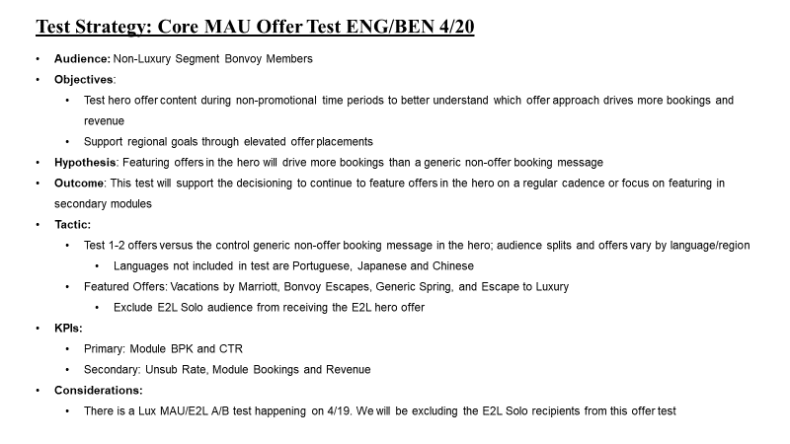
Test Plan Construct Example | Overall Test Strategy

Slide 21
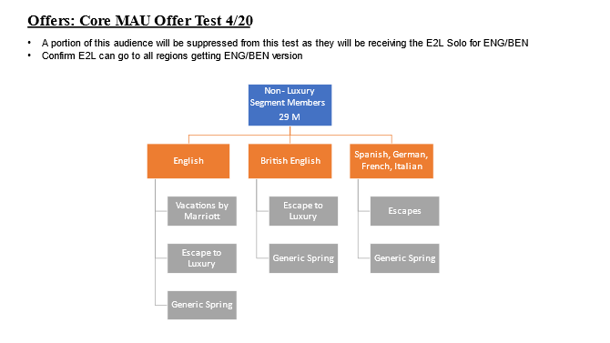
Test Plan Construct Example | Test Offers

Slide 22
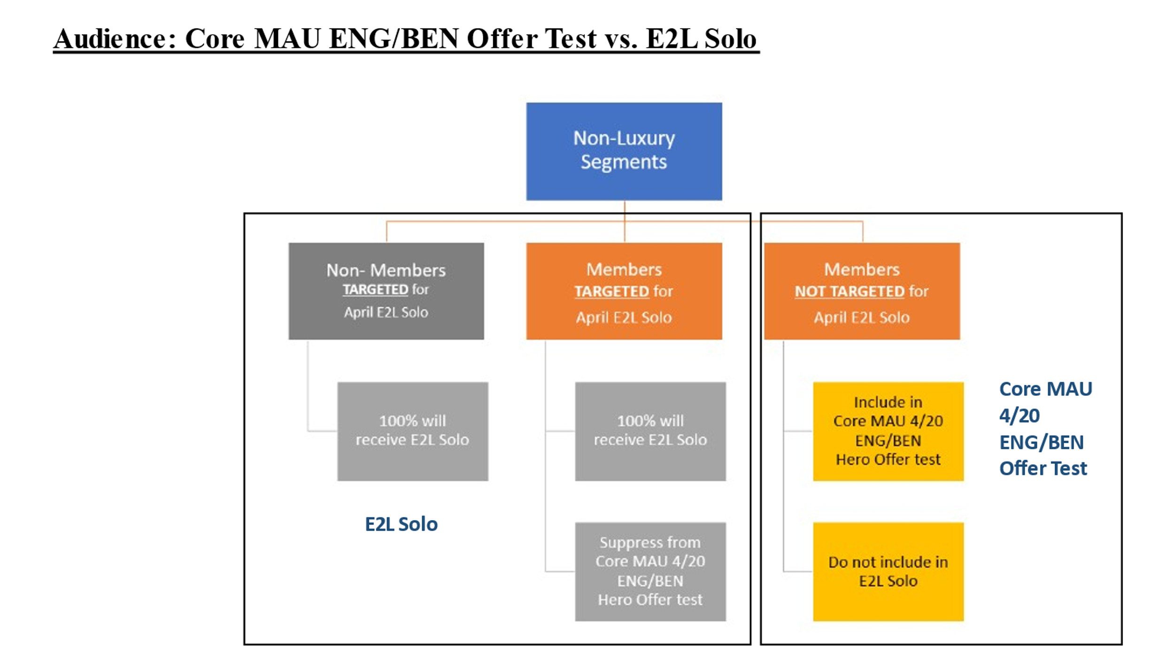
Test Plan Construct Example | Test Audience

Slide 23
2023 Program KPI Goals
Fiscal Year KPIs | CTR | Unsub Rate | Revenue | Room Nights
2019 | 2.06% | 0.21% | $47.4 M | 278.0 K
2022 | 1.31% | 0.13% | $25.9 M* | 133.2 K*
First 6 Months 2022 (Jan. - Jun.) | 1.50% | 0.13% | $16.5 M | 84.0 K
2023 Program KPI Goals | 1.3% | 0.13% | $2.1 M Monthly Avg. (Once Reporting Is Fixed) | 11.0 K Monthly Avg. (Once Reporting Is Fixed)
*Revenue and Room Nights KPIs have been impacted by current reporting issues

Slide 24
2023 Member Level KPI Goals
2022 Member Level KPIs | CTR | Unsub Rate | Revenue | Room Nights
Basic | 0.89% | 0.15% | $16.7 M | 77.3 K
Silver | 2.53% | 0.05% | $2.8 M | 17.7 K
Gold | 3.30% | 0.05% | $3.7 M | 21.8 K
Platinum | 5.12% | 0.02% | $1.1 M | 7.0 K
Titanium | 5.63% | 0.02% | $1.1 M | 8.0 K
Ambassador | 5.78% | 0.02% | $338.9 K | 1.9 K
2022 Member Total | 1.31% | 0.13% | $25.9 M | 133.9 K
2023 Member Level KPI Goals | 1.3% | 0.13% | $2.1 M Monthly Avg. (Once Reporting Is Fixed) | 11.0 K Monthly Avg. (Once Reporting Is Fixed)
*Revenue and Room Nights KPIs have been impacted by current reporting issues

Slide 25
2023 Loyalty Goals | Cobrand Acquisition
    Initially track click activity to establish baseline KPIs for Cobrand Acquisition messaging
    Data Axle to track click activity on these modules for existing card holders and non-card holders
      Will start to measure engagement based on module placement via clicks
      Scope effort to attribute MAU cobrand clicks to new card holders

Slide 26
2023 Loyalty Goals | App Downloads
    Develop communication strategy for mobile app content
      Frequency
      Personalization e.g., Upcoming Trip
      Types of CTAs
    Data Axle Account Management to coordinate with the App Team to utilize the correct links and to set up a reporting cadence
      Once defined Data Axle to track for three months to establish baseline KPIs

Slide 27
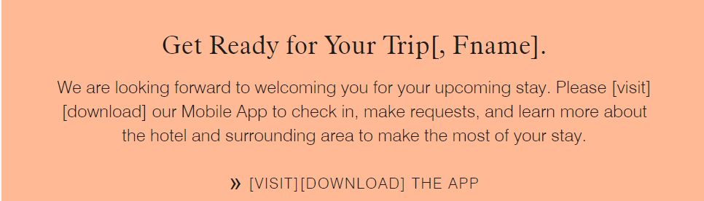
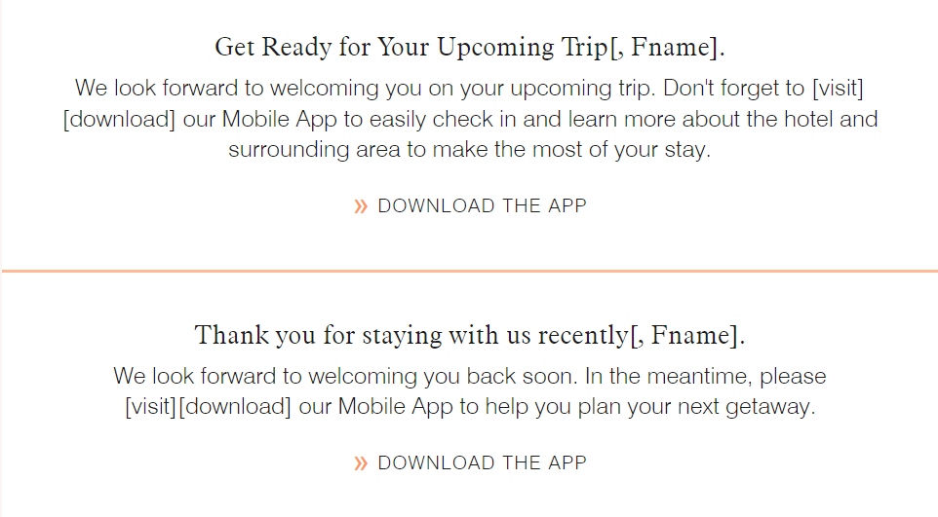
App Download CTA Examples
Upcoming Trip & Recent Stay CTA Examples
SHERATON ADDIS, A LUXURY COLLECTION HOTEL,
ADDIS ABABA, ETHIOPIA
Notes:
EMEA & CALA examples.

Slide 28
2023 Loyalty Goals | Brand Awareness & Affiliation
    Start to measure brand awareness and affiliation in 2023
    Data Axle can start tracking if members are staying at more than one brand
    Can track across all brands if a member has stayed at 0, 1, 2 to 3 or 4+ brands in the last 30 days to measure movement quarter over quarter
    Data Axle to provide metrics and insights via Quarterly Reviews
    Brand Awareness Tactics To Apply:
    Brand Portfolio Campaign
    Brand Propensity Model
    New Hotel Spotlights
    Brand Showcase

Slide 29
2023 Loyalty Goals | Driving Point Actives
    Start to measure driving point actives in 2023
    Data Axle can start tracking if members are earning, redeeming, doing both or none at all
    Can track all emailable members for the last 30 days at the member level for Core MAU
    Data Axle to provide counts for those members who have activity in the past 30 days vs. no activity in the past 30 days via Quarterly Reviews

Slide 30
2023 Baseline KPIs To Be Tracked & Established
    Tenure Segments:
    The logic for these segments needs to be updated to capture additional activity e.g., click activity for accurate tracking
    Data Axle can create a secondary segment of our own criteria to enable the Data Team to provide monthly reporting for Core MAU moving forward
    New Key Segments (High ADR, HVT & Opportunity Segments):
    Data Axle will track and establish baseline KPIs for the new key segments once they become available
    Lifecycle Stages:
    Tied to the First 100 Days initiative* (*Will need to be determined moving forward)
    Tenure Segments:
    Non-Member Stayers
    Basic New
    Basic Tenured Engaged
    Basic Tenured Unengaged
    Elite New
    Elite Tenured Silver_Gold
    Elite Tenured PL_TT_AM

Slide 31
2023 Program Pillar Goals
1
2
3
4
5
Develop Test & Learn Agenda To Propel / Inform Personalization & Dynamic Content
Introduce Tailored Content By Segment
Enhance Brand Education By Utilizing: Brand Portfolio Campaign, Brand Propensity Model, New Hotel Spotlights & Brand Showcase
Implement Surveys / Polls To Garner Content Interests
Kickoff 2024 Planning Efforts

Slide 32
Program Roadmap
Track key initiatives and program activities that will influence campaign development and performance
Update during quarterly planning sessions
Core MAU Program Roadmap | Q1 | Q2 | Q3 | Q4
Promotional Support
Program Support
Quarterly Planning & Business Reviews | First Deployment Apr. | Jul. | Oct. | Jan.
Points.com Promo
Program Growth Initiatives
Week of Wonders Oct.
Brand Portfolio Campaign May - Nov.
Cobrand: ACQ / ECM, LTO & BAU
Ongoing Support: Global Promo, Cobrand, Brand Awareness, Partnerships, Moments & New Languages
Uber LTO Feb., Mar. & Jan.
EAT LTO Jun.
EAT LTO Oct.
Year In Review Dec.

Slide 33
Initial Test & Learn Roadmap | Review & Discussion
Track test and learn opportunities that will influence campaign optimization and performance
Update during quarterly planning sessions
Core MAU Test & Learn Roadmap | Q1 | Q2 | Q3 | Q4
IQ & Segmentation
Scalable Content & Layout
Offers & Localization
Tailored Content By Segment
New Key Segment Opportunities
Milestone Messaging
Brand Education & Content
App Downloads
Inclusion Of Videos
Targeted Offers
Always On Optimization: STO, PCIQ Subject Line / Content Optimization & Agile Widget Technology

Slide 34
Creative
SHERATON MAUI RESORT & SPA

Slide 35
New Creative Concepts
Creative concepts can be found here

Slide 36
Process
SHERATON MAUI RESORT & SPA

Slide 37

Submissions
Submission Form Updates
Submission Review
  Shift to 2 days after the solicitation is closed.
Future changes:
  Workfront Submissions
  Cobrand Submissions through Workfront

Slide 38
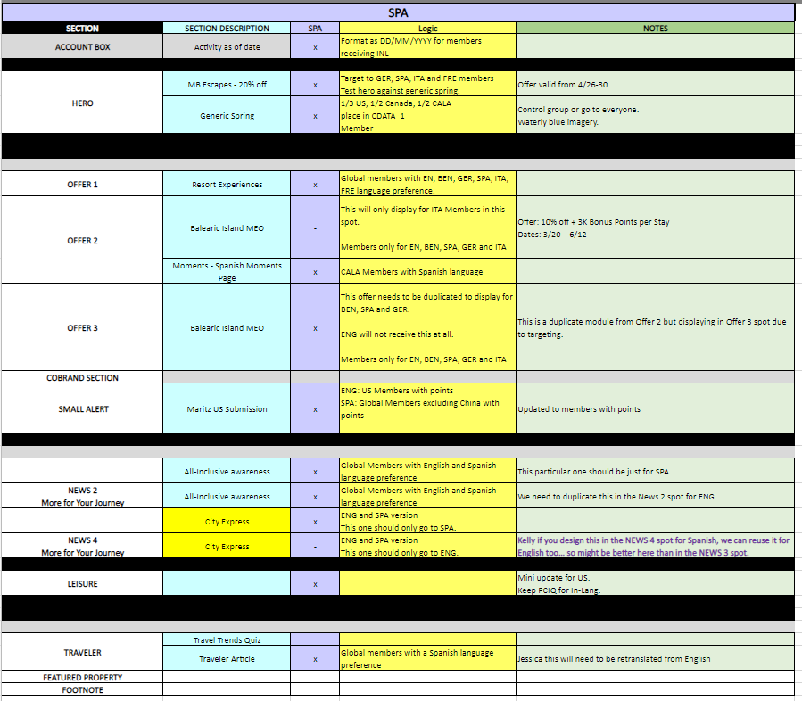
Grid
Regional Review
  Provide Grid by language for regional review to EMEA and Americas regions before design starts.
Grid Layout Refresh
Evergreen Content

Slide 39
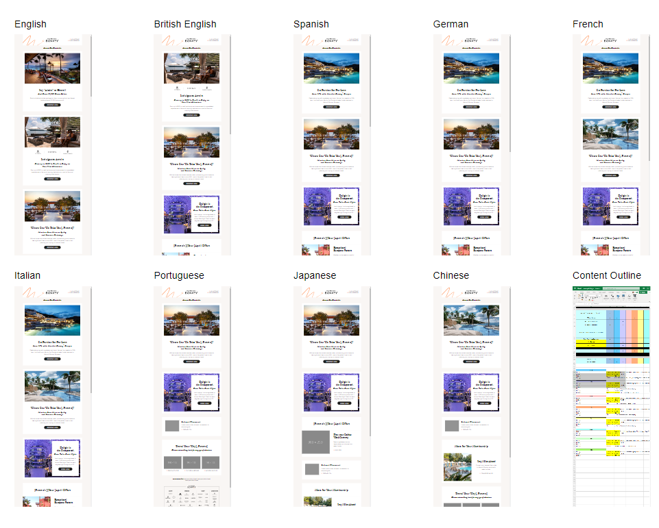
Design
Designing by region with April and May
  This will hopefully help regions get a sample of what to expect earlier on and make content easier to digest.
  The grid will also be included to help on an offer/content level.

Slide 40
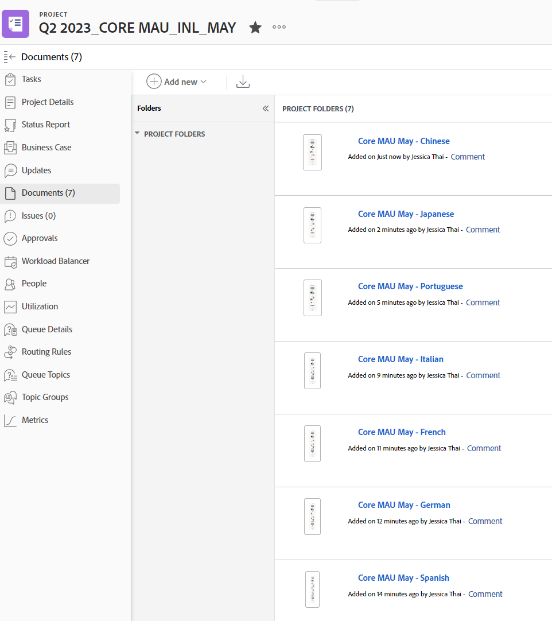
Design Review Rounds
DR2 Proof Review
  Placing associated proofs on WF based on versions
    Workfront has separated campaigns by month and by deployment date now
  Only including stakeholders with their submitted modules
    This should help align with the Proof process when we receive live proofs

Slide 41
Data
Data into AAC
  Pending for May
Data Process
  Targeting and testing
Deployment Delays
THE ST. REGIS MARDAVALL MALLORCA RESORT, PALMA DE MALLORCA, SPAIN

Slide 42
Next Steps
April Campaign Launch
  English and BEN – 4/20
  In-Language – 4/27
April Email Review – 5/18
Quarterly Email Review & Planning (April, May, June) – 7/13
  Email Review & Strategic Roadmap Planning
  Content and Creative Planning
  Workflow Assessment and Planning

Slide 43
Thank You!

