Slide 1
Considerations for global email
May 16th, 2018

Slide 2

Identify considerations and process to develop roadmap
Begin the conversation to define our vision and objectives for expanding the globalization of our email program

Slide 3
Approach
Define the vision
Understand desired state vs. current state
Identify gaps and needs to achieve desired state
Build roadmap
Prioritize activities, define milestones & project plans

Slide 4
Areas for consideration
Program Process & Operations
Strategies & Campaigns
Customer Experience / Design & Content

Slide 5
Current state
Current Languages Supported
English
Chinese Simplified (PRC)
Spanish (International)
French (Europe)
German
Japanese
Portuguese (Brazil)
Russian
Italian*
Lite Support Just rolled out. Only Welcome slotted at this point.

Slide 6
Current state
Campaigns that are Translated
Header and footer: all languages
Selected Lifecycle Campaigns
Welcome in all languages (Italian coming)
Achievers all languages except IT/RU
Renewers & Near Level - EN only *on roadmap for full translation this year
Post Redemption & Abandon Search - EN only
Program Update Solos: (Member updates, SNA, Unification Lite / TBOP Choice of)
Full language support
Solos: Megabonus, MVC, Freddies
Selected languages are supported per solo with Chinese and Spanish as the base

Slide 7
Current state
Localized Campaigns
eNews -> send global/English eNews to European and Chinese regions
METT
Any others??

Slide 8
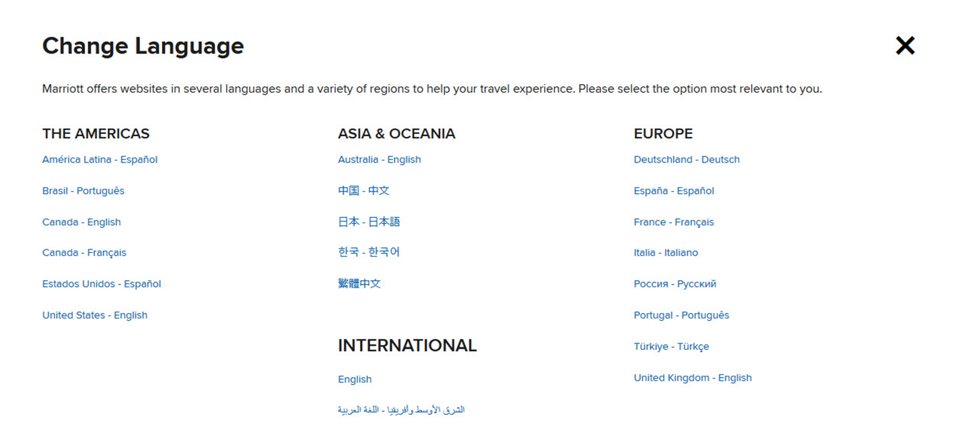
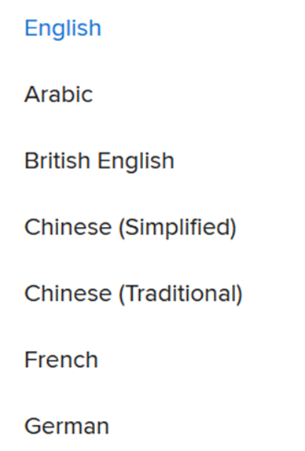
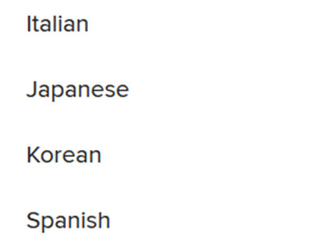
Current state
Languages Supported by M.com
Language preferences for “Print” communications

Slide 9
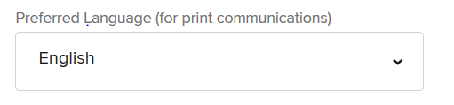
Current state
How do we determine member language preference?
Member address
“Print” Language preference
Website language preference
What is the default if you don’t have a preference?
What data attribute(s) currently drive language selection?

Slide 10

Current state
which languages/campaigns should be supported?
Audience size
Membership
Business opportunity or ask
Content relevance

Slide 11
Depth of localization
which communications require which level of depth?
There may be opportunities for localized modules within translated campaigns vs. fully localized campaigns
Translated global campaigns
Localized modules
Localized campaigns

Slide 12
Localization Considerations
Process Challenges – what resources are required?
What’s the best way for us to enable local markets to access local audiences?
Proposed model
Local team responsible for content
Work with Member Marketing team on coordination, best practices, etc.
Agency build
Campaigns deployed through Epsilon

Slide 13
Localization Considerations
Process / Strategy Considerations
Targeting Criteria
Tracking & Reporting Needs
Frequency & Governance
Deliverability
Asset Management
Timing / Seasonality
PESTLE - Consider the political scenario, economical factors, social factors, technology usage, legal and environmental factors

Slide 14
Localization Considerations
Technology Considerations
Updates needed to preferences / enrollment
Sitecore (does not currently support in-language)
Others?

Slide 15
Localization Considerations
Design & Content Considerations
Message formatting, style & layout
Content, copy & image selection; imagery, vernacular
Personalization data
Template System – layouts to support different characters and character counts

Slide 16
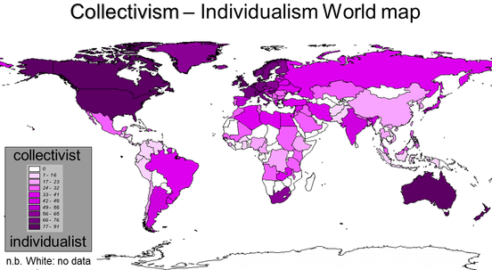
Localization Considerations
Hofstede’s 6 dimensions of National culture
Individualism
Power Distance
Masculinity
Uncertainty Avoidance
Long-term orientation
Indulgence
https://geerthofstede.com/culture-geert-hofstede-gert-jan-hofstede/6d-model-of-national-culture/

Slide 17
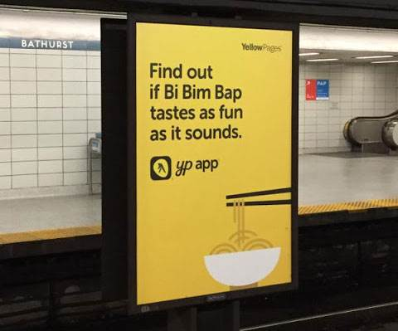
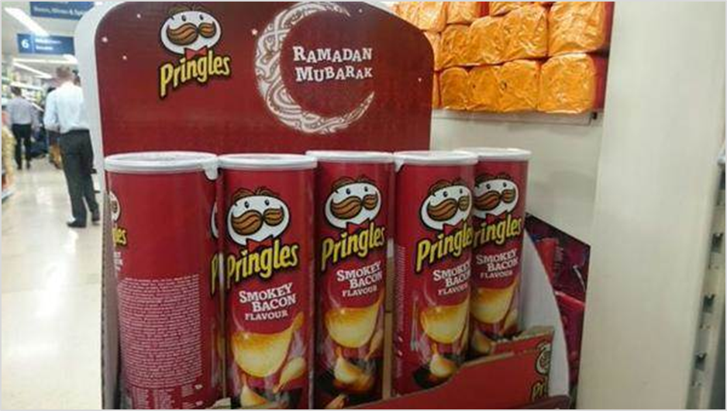

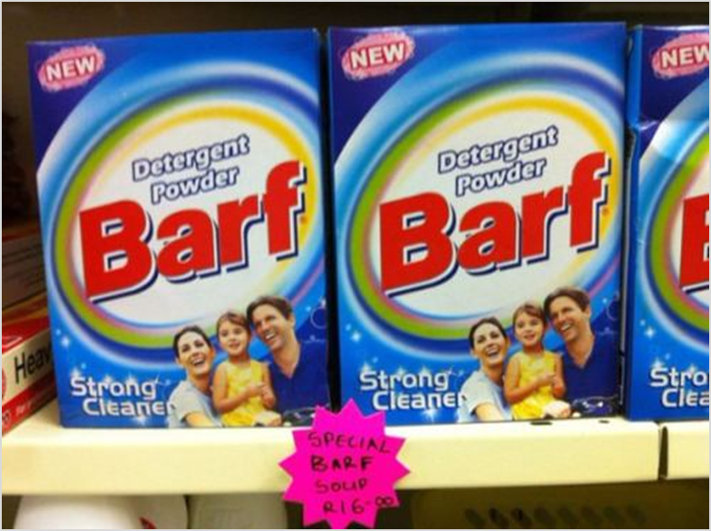
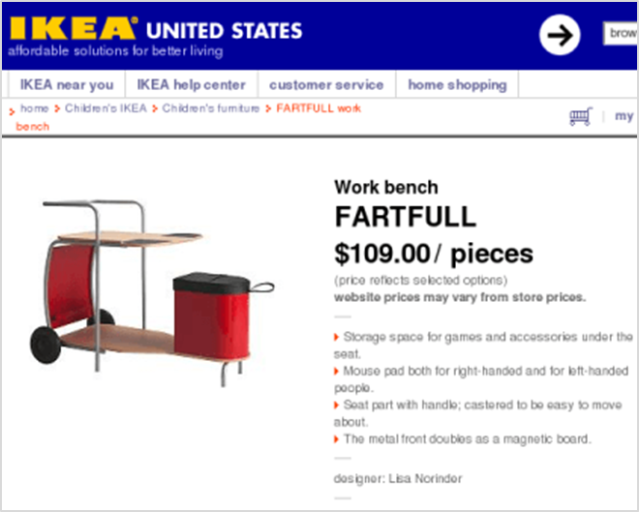
Localization Fails

Slide 18


Slide 19
Thank you!

