Slide 1
TBOP UPDATE
May 16, 2018

Slide 2
Agenda
Overview of Updates & Approach
Updates Pre 8/1
Updates for 8/1
What’s Still Pending

Slide 3
Batch organization & Prioritization

Slide 4
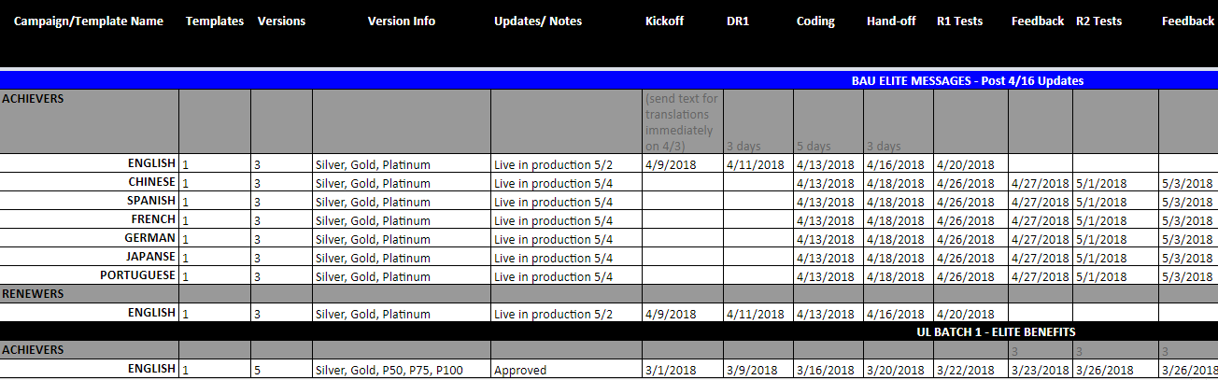
Batch approach
Batch schedule & prioritization
Notes:
We prioritized the campaigns that are most impactful to be live for 8/1. Batch organization. Pivoted as new updates became available.

Slide 5
Updates in market Pre 8/1

Slide 6
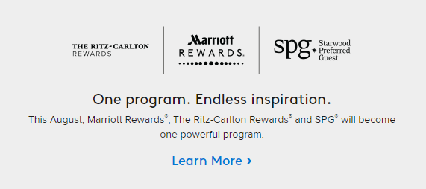
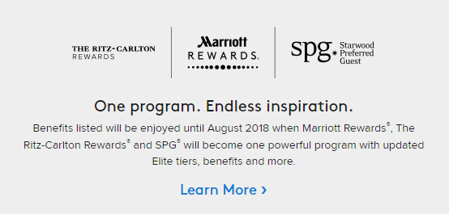
Program update teaser
One program. Endless inspiration.
Welcome Series, Achievers, Renewers, Near Level, Lifetime Achievers, Early Engagement, Early Activation
Notes:
Went live on 5/1. Left is for Welcome & right is for other campaigns where benefits are listed throughout.

Slide 7
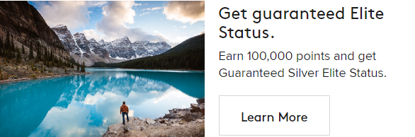
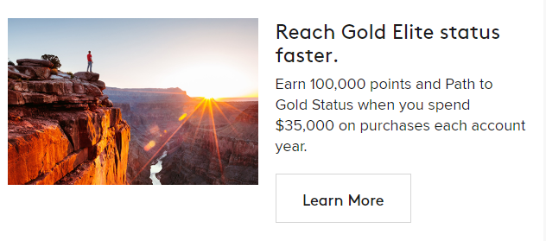
Near level
Near level
Adding 3 new MRCC offers
Adding 12 MVP Offers
Notes:
New Visa card (went live in market 5/3). Added MVP offers for campaign enhancement.

Slide 8
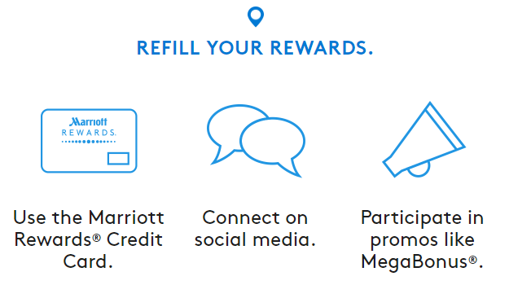
Redemption recognition
Redemption recognition
Additional segmentation for Premier Plus.
Adding 15 MVP offers for the Restarters email and 13 MVP offers for the Leftovers email.
Notes:
Driving Premier Plus cardholders to new landing page. Added MVP offers for campaign enhancement.

Slide 9
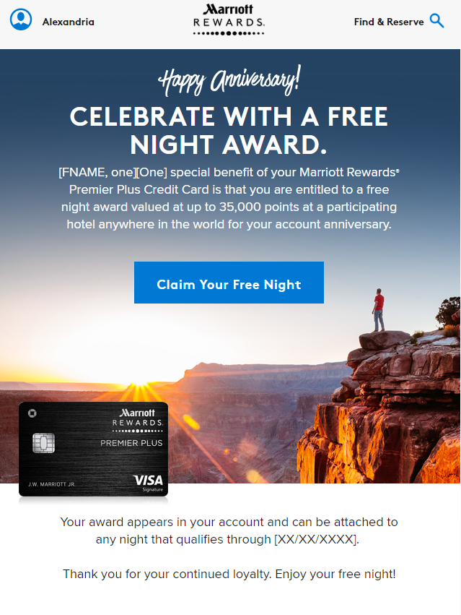
MRcc campaigns
Mrcc campaigns
New MRCC triggered emails
Free Night Certificate
Premier Plus Version
Automatic Silver (Non MR)
Welcome Consumer
Automatic Silver (MR)
Welcome Consumer
Spend to Gold (upgrade)
Gold Elite Upgrade 2018
Spend to Gold (renew)
Gold Elite Renewal
Silver Renewal
Silver Elite Renewal
Notes:
Screenshot of MRCC Free Night Certificate. Touchpoints coincide with new credit card.

Slide 10
Updates for 8/1

Slide 11
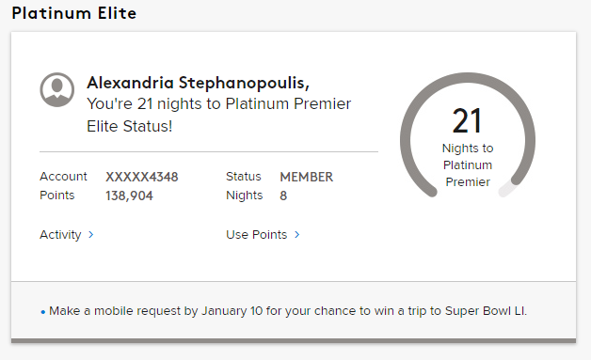
Member status
Member status
Updated dials & logic across all levels.
New Platinum Premier Elite 75 & 100 modules.

Slide 12
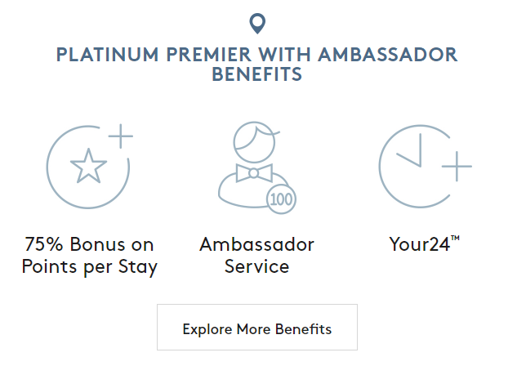
Achievement campaigns
Achievement campaign updates
Updates to Achievers, Renewers, & Lifetime Achievers.
Updated elite benefits across all levels
New P75 & P100 versions
18

Slide 13
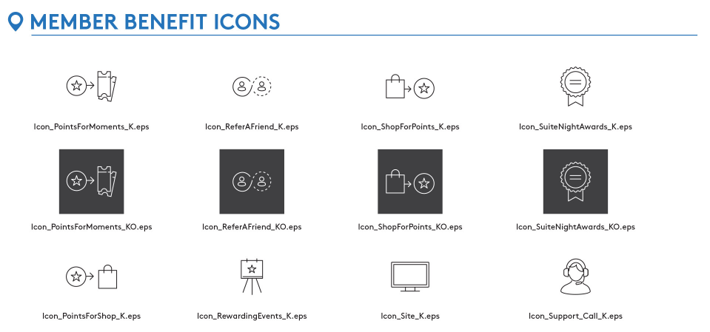
WELCOME campaigns
Welcome campaign icon updates
Update existing icons to reflect new image library

Slide 14
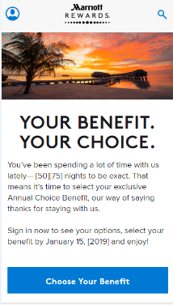

Choice of campaigns
Choice of campaigns
Choice of
Initial
Reminder
Defaulted
Gifted Status Silver
Gifted Status Gold
Notes:
Hit P50 and P75 to choose new benefit (ie suite night upgrade) or gift status.

Slide 15
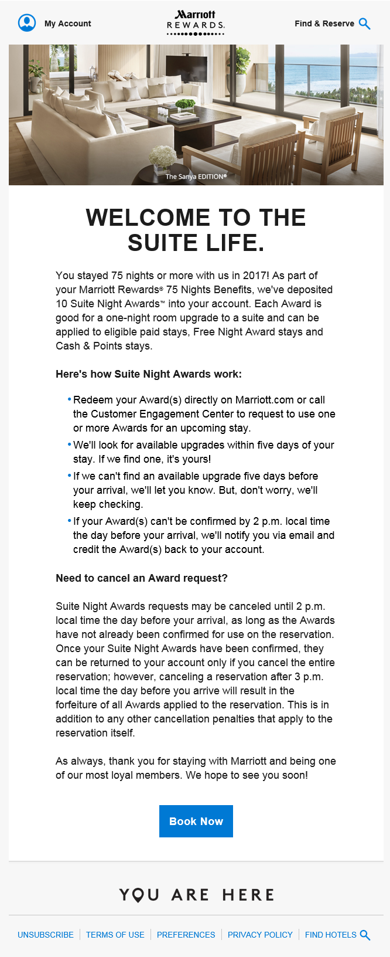
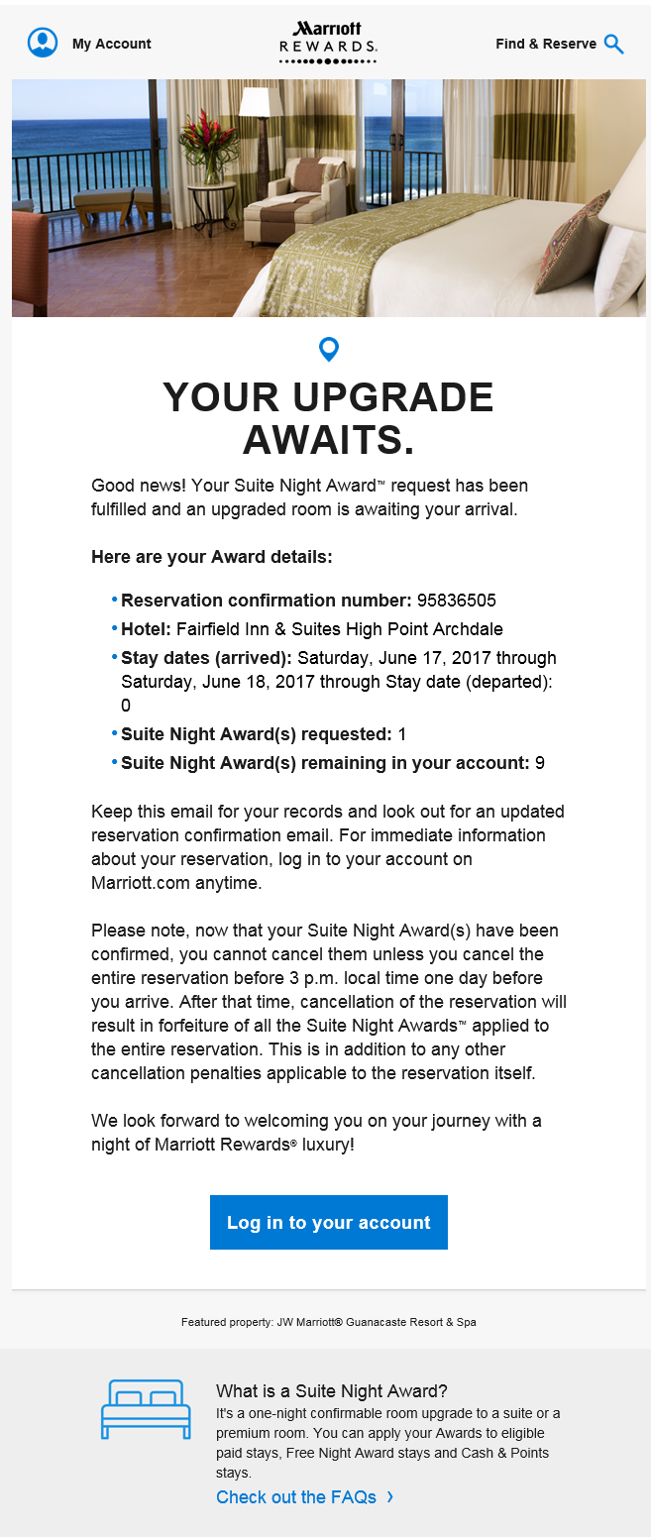
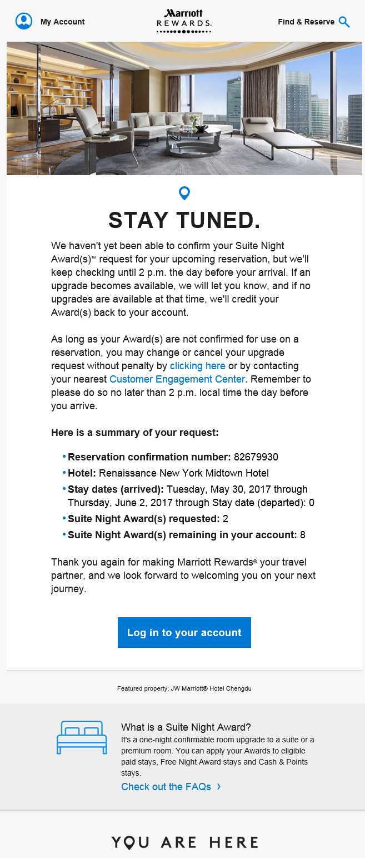
SUITE NIGHT AWARDS
SUITE NIGHT AWARDS
Deposited
Request
Upgrade
Cancelled
Pending
Denied
Extended
Returned
Reissued
Removed

Slide 16
What’s still pending

Slide 17
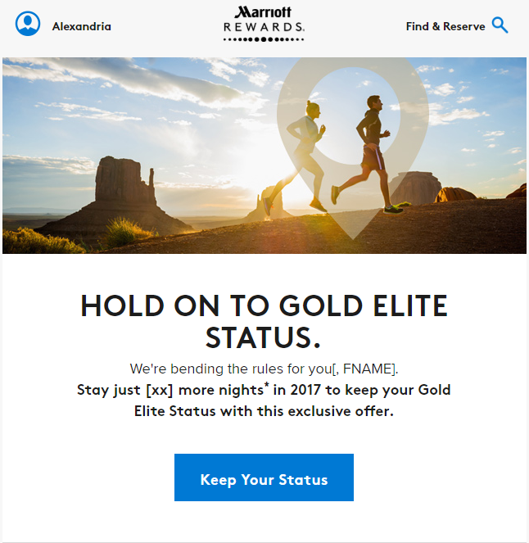
promotions
promotions
Elite Off Track
Reactivation
Early Activation
Early Engagement
Silver Focus Invitation
Silver Focus Taste Gold
Silver Focus Points
Notes:
Awaiting direction on these promotions. Screenshot is Elite Off Track 2.0 version.

Slide 18
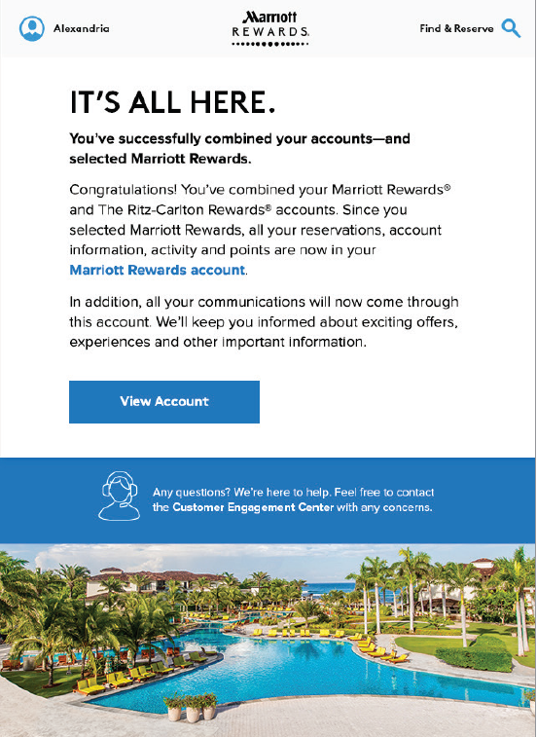
Account combined
Account Combined Real time trigger
Communication to members upon combining their MR and SPG accounts to launch immediately following TBOP live – early August
FPO...

Slide 19
Thank you!

