Slide 2










Speak with Open-time Relevance
Countdown
timers
Device
targeting
Geo-targeting
Real-time
Inventory / points
Weather-driven
messaging
Rich
personalization
Real-time
social feeds
(web sync)
Video in
email
Live polling
A/B Testing

Slide 3
A and B, not A or B
A
B

Slide 4
Case Study: Loyalty Program
15.6%
14.7%
15.2%
click rate
EARN
/
BURN
/
LEARN
Notes:
One of our clients is leading points-based loyalty rewards company…

Slide 5
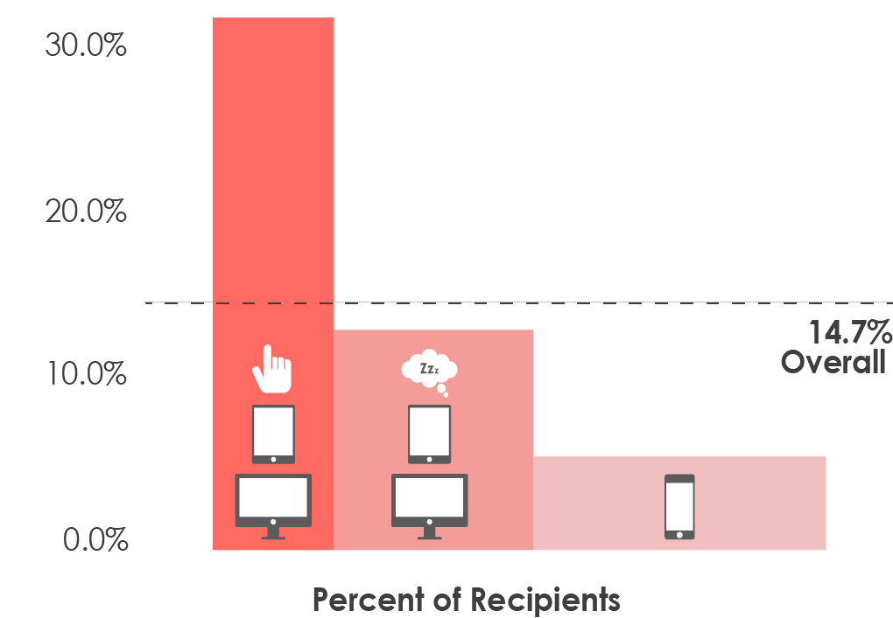
Case Study: Loyalty Program
14.7%
click rate
EARN

Slide 6
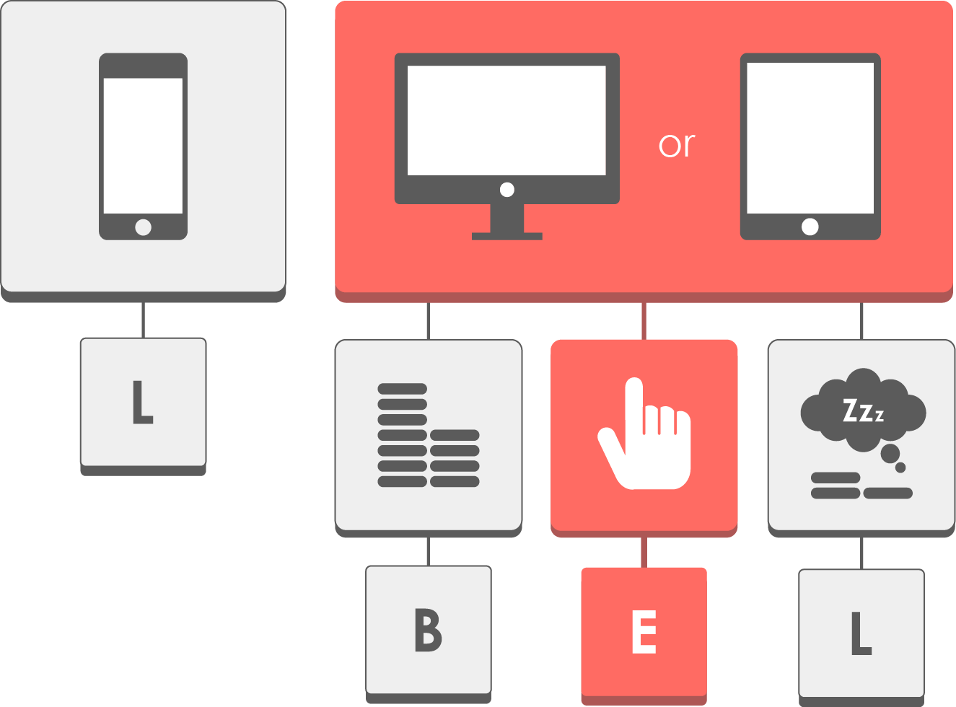
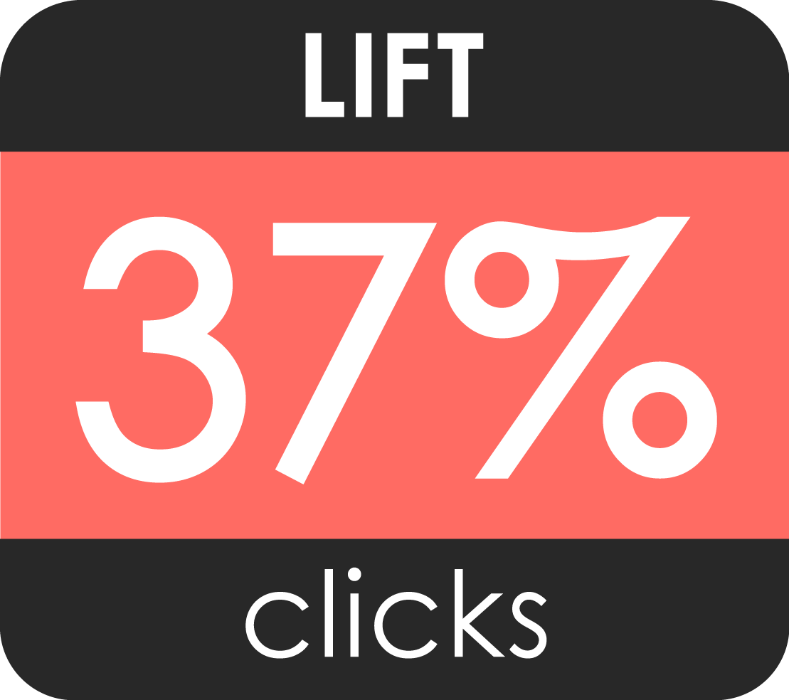
Case Study: Loyalty Program
:

Slide 7




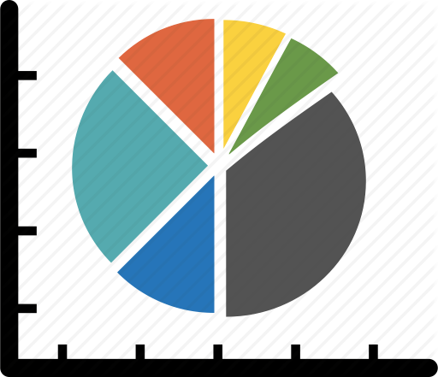
Rich Mobile Data Capture
Drive More App Installs
Know who is using the Marriott app and who isn’t, which features they haven’t yet explored, and tailor omni-channel messaging accordingly
Enable Multi Channel Geofencing
Real-time triggered messaging based on proximity to Marriott properties or amenities during stay
Determine Share of Wallet
Know when and where rewards members are staying at competing properties
Target Rewards & Offers
Know which rewards members play golf, who goes on cruises, and who likes to frequent the Apple Store
Define Behavioral Segments
Determine segment membership based on travel patterns and stops (for example, frequent jet-setting versus frequent grocery shopping)

Slide 8
Agenda
Capabilities review
Applications
Solos
Concierge/eBreaks
eNews
Hotel Specials
MRCC
2016 Planning

Slide 9





Solos - 2015
Cadence: Monthly
Distribution: 10M
Opens / Deployment: 3.3M
Unseasonably warm weather
East/West coast
On windows, web clients, mobile
31% potential lift in clicks
Real-time
A/B testing
Consistently cold weather
Central US
On tablets, macbooks, outlook
Flash Sales
App
Targeting
Notes:
One of our clients is leading points-based loyalty rewards company…

Slide 10
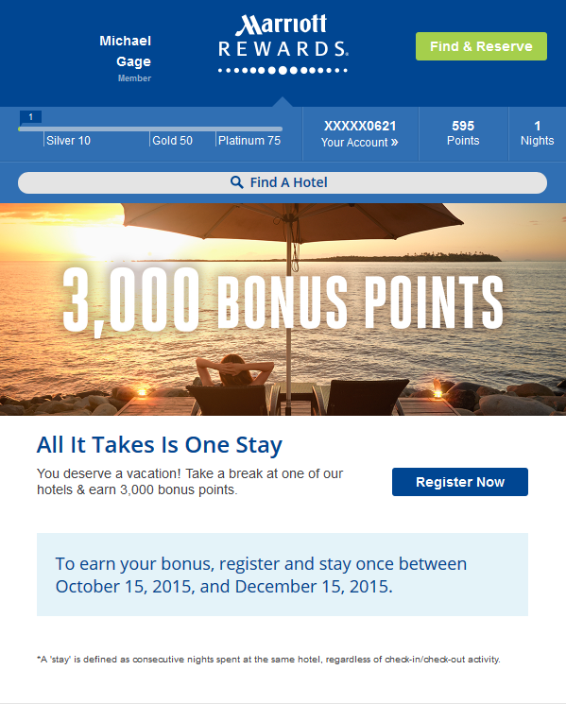
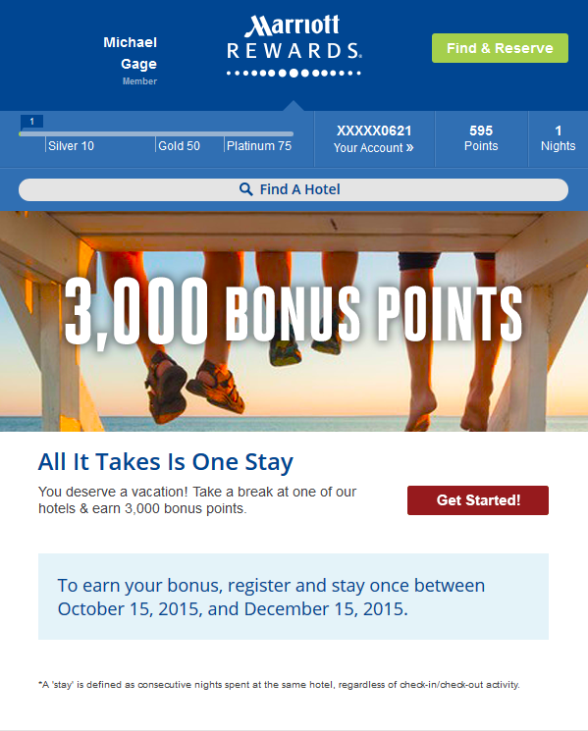
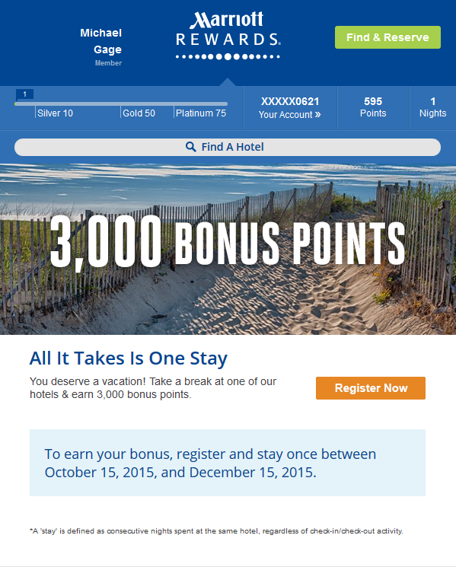
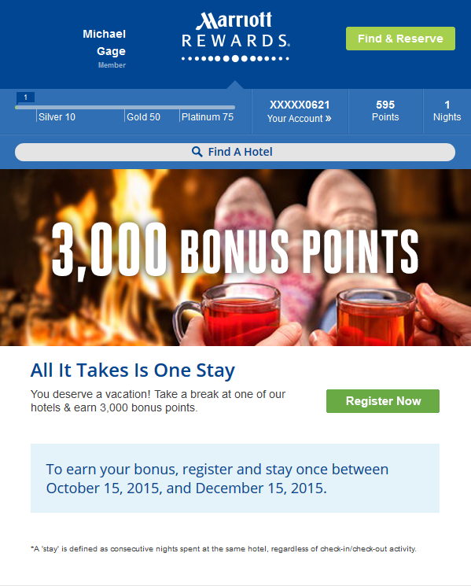
Solos - 2016
Cadence: Monthly
Distribution: 10M
Opens / Deployment: 3.3M
Real-time
A/B testing
Notes:
One of our clients is leading points-based loyalty rewards company…

Slide 11

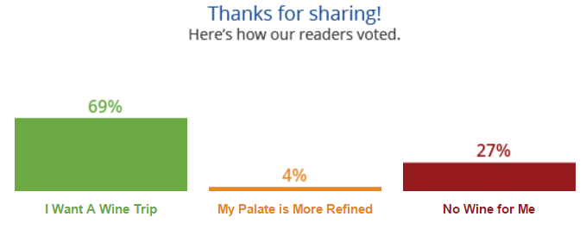
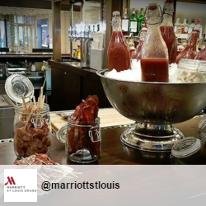
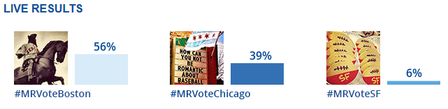
Concierge - 2015
Cadence: Weekly
Distribution: 1.6M
Opens / Deployment: 600K
Members who liked the wine trail content:
Silver status or above
In the Eastern half of the US
Non-Apple users
Live
Polling
Real-time
Social
Notes:
One of our clients is leading points-based loyalty rewards company…

Slide 12
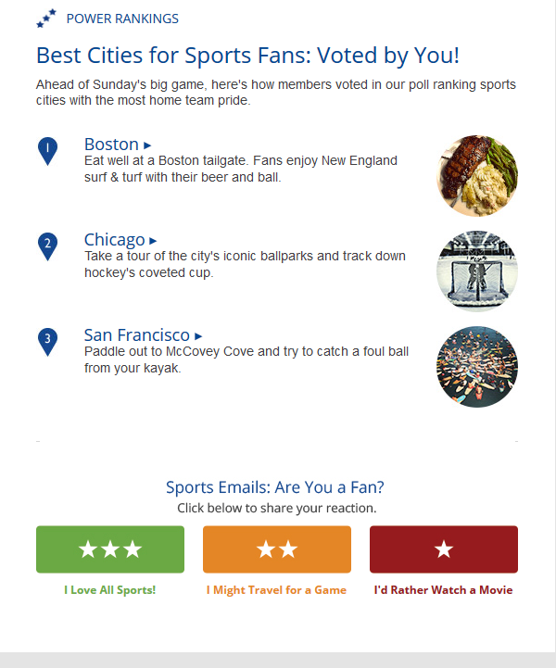
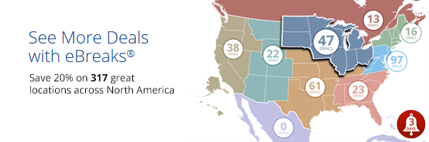
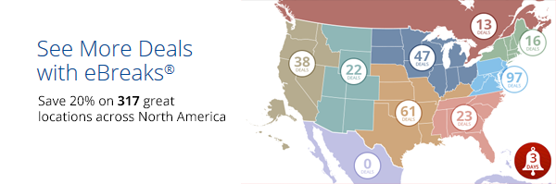
Destinations - 2016
Cadence: Weekly
Distribution: 1.6M
Opens / Deployment: 600K
- Always “learn” content?
- Continued live polling & insights
- Live map module sync’d to website, highlights most likely region for each member
Notes:
One of our clients is leading points-based loyalty rewards company…

Slide 13

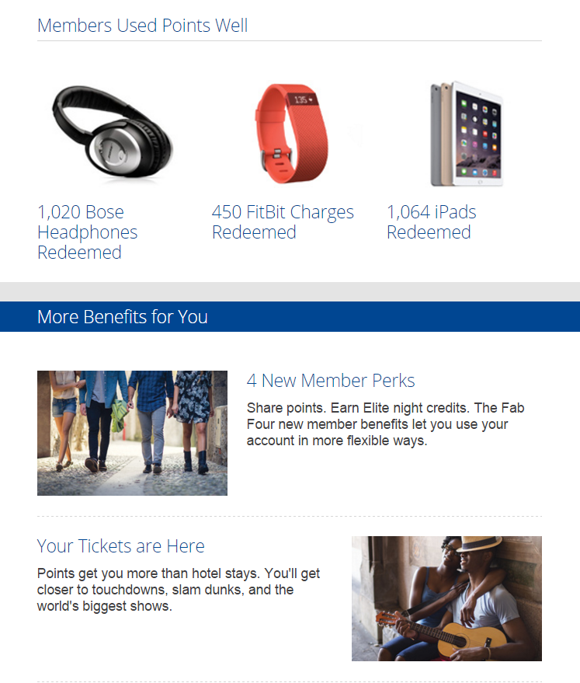
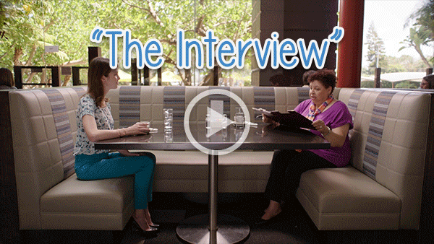

eNews - 2015
Cadence: Monthly
Distribution: 9.3M
Opens / Deployment: 4M
DJ / Record
Producer
Bronze
Silver
Video in
email
Real-time
Segment
Hotspots
Gold+
Rock Star
Notes:
One of our clients is leading points-based loyalty rewards company…

Slide 14
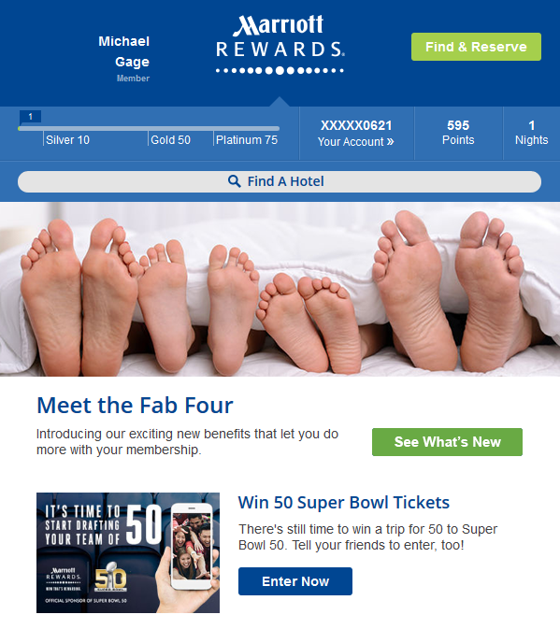
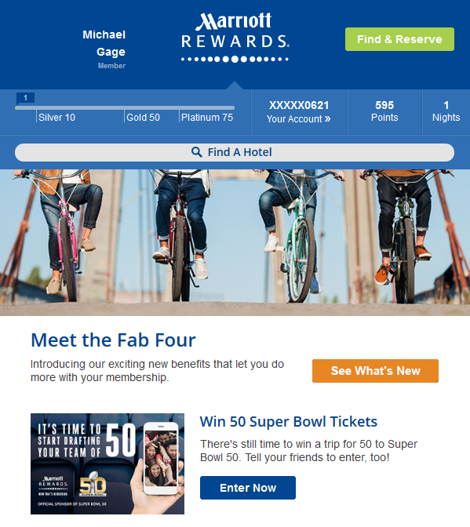
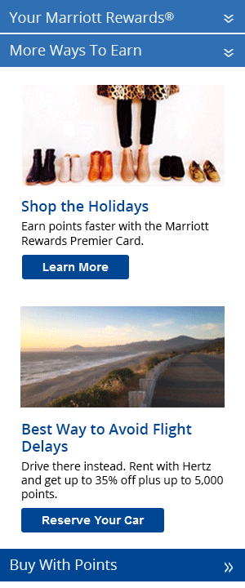
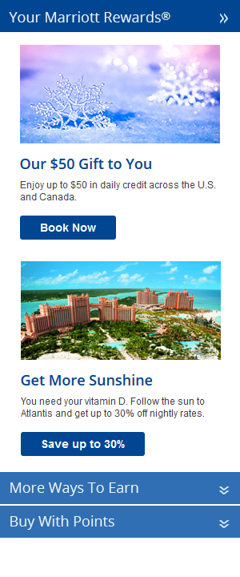
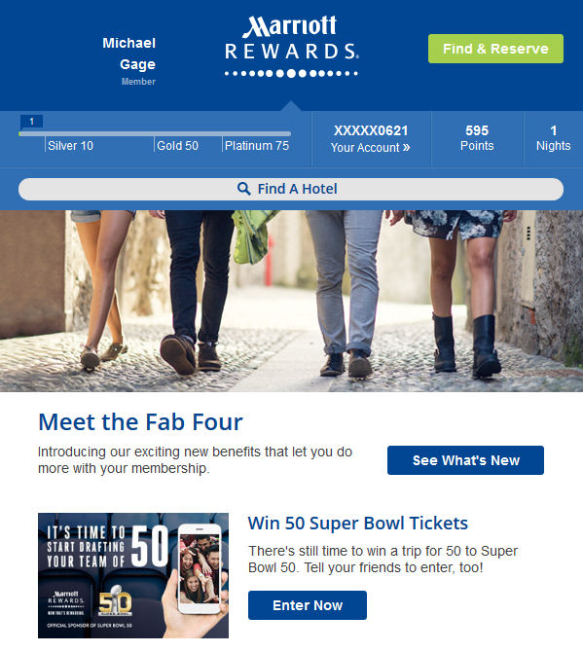
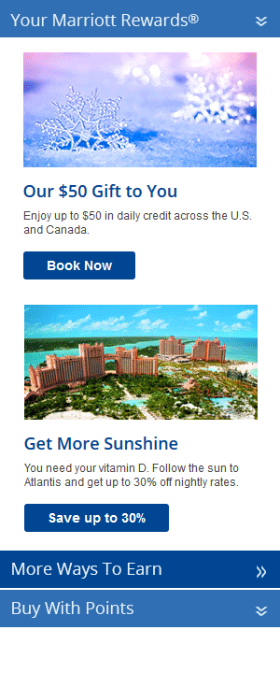
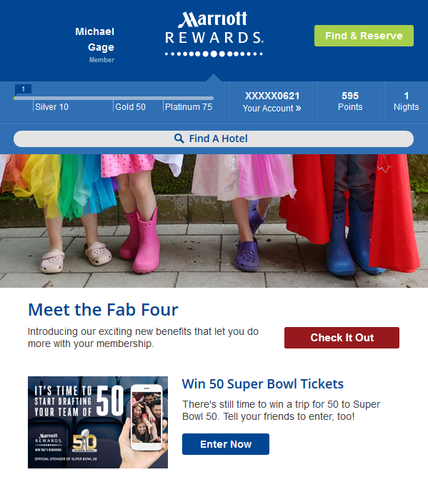
eNews - 2016
Cadence: Monthly
Distribution: 9.3M
Opens / Deployment: 4M
- Hero creative & CTA optimization to drive conversion
- Test “Earn” vs “Burn” vs “Learn” content for 2nd position
- Potentially test focused top-down content organization
Real-time
A/B testing
Notes:
One of our clients is leading points-based loyalty rewards company…

Slide 15
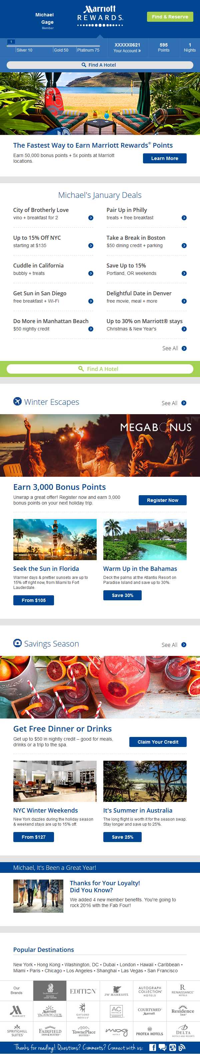
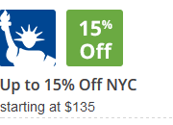

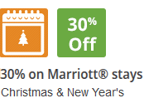
Hotel Specials - 2016
Cadence: Monthly
Distribution: 7.6M
Opens / Deployment: 3M
- Hero image / main CTA conversion optimization
- Convert text matrix to more visually-oriented icons
- Test 4 vs. 6 vs. 10 offers
- Float best performing offers to the top
- Add “trending” tag to ones driving most clicks
- Experiment with “X travelers looking at this deal” / “X deals left at this price”
Notes:
One of our clients is leading points-based loyalty rewards company…

Slide 16
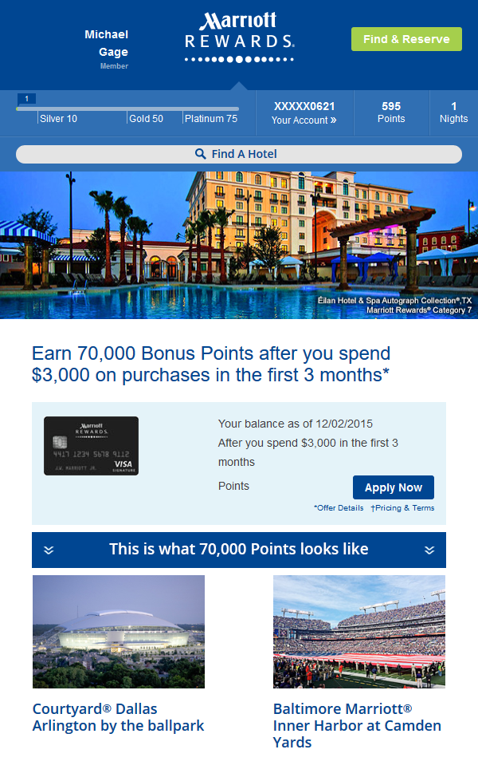
MRCC - 2016
Cadence: Monthly
Distribution: 10.5M
Opens / Deployment: 3.5M
- Test different hero creative, CTA, headline phrasing to maximize conversion
- Personalize the sample credit card
- Animate the points tallying up to add emphasis
- “This is what 70K points looks like”
595
+70,000
+70,595
Notes:
One of our clients is leading points-based loyalty rewards company…

