Slide 1
Q2 2017 email Program Review
August 15, 2017

Slide 2
Q2 Review Meeting Agenda
Email Engagement Performance
Review of Key Initiatives
Campaign Highlights
Key Opportunities and Takeaways

Slide 3
Q2 Engagement
Performance

Slide 4
Email performance
Q2 ’17 Email Program Performance
Program declines correlate with fewer Solo’s sent
Lower email engagement metrics resemble enterprise revenue declines
20.2MM
Mailable Members
+1.2% QoQ
+17.4% YoY
223.5MM
Emails Delivered
-19.4% QoQ
-2.9% YoY
23.6%
Open Rate
+3.9% QoQ
-1.8% YoY
8.9%
CTO Rate
+4.3% QoQ
-4.8% YoY
993.4K
Room Nights
-21% QoQ
-18.0% YoY
9.2%
Conversion Rate
-7.5% QoQ
-6.2% YoY
1.9
Bookings/Delivered (K)
+0.2% QoQ
-12.3% YoY
Notes:
Qtr performance
adding booking-related solos in Q3-4 that should help offset the underperformance
we’re behind our RN goal and are at the CC goal, largely due to reduced solo volume in May-June, though eNews and HS showed some lags, and lifecycle performance is being addressed by Template 2.0
Reasons for declines:
Not delivering as much as we used to
Conversions may align with enterprise level revenue declines
Sent fewer solo’s May and none in June
Non-room night driving solo’s were sent like Hertz and Account linkage

Slide 5
Key Initiatives &
Campaign highlights

Slide 6
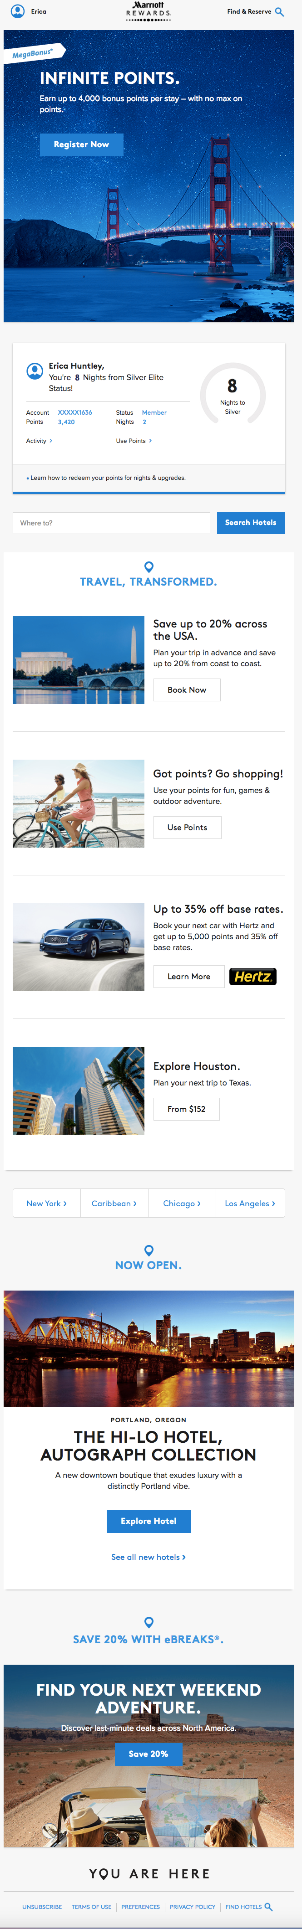
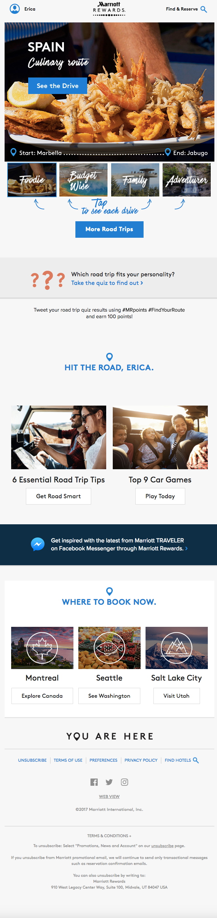
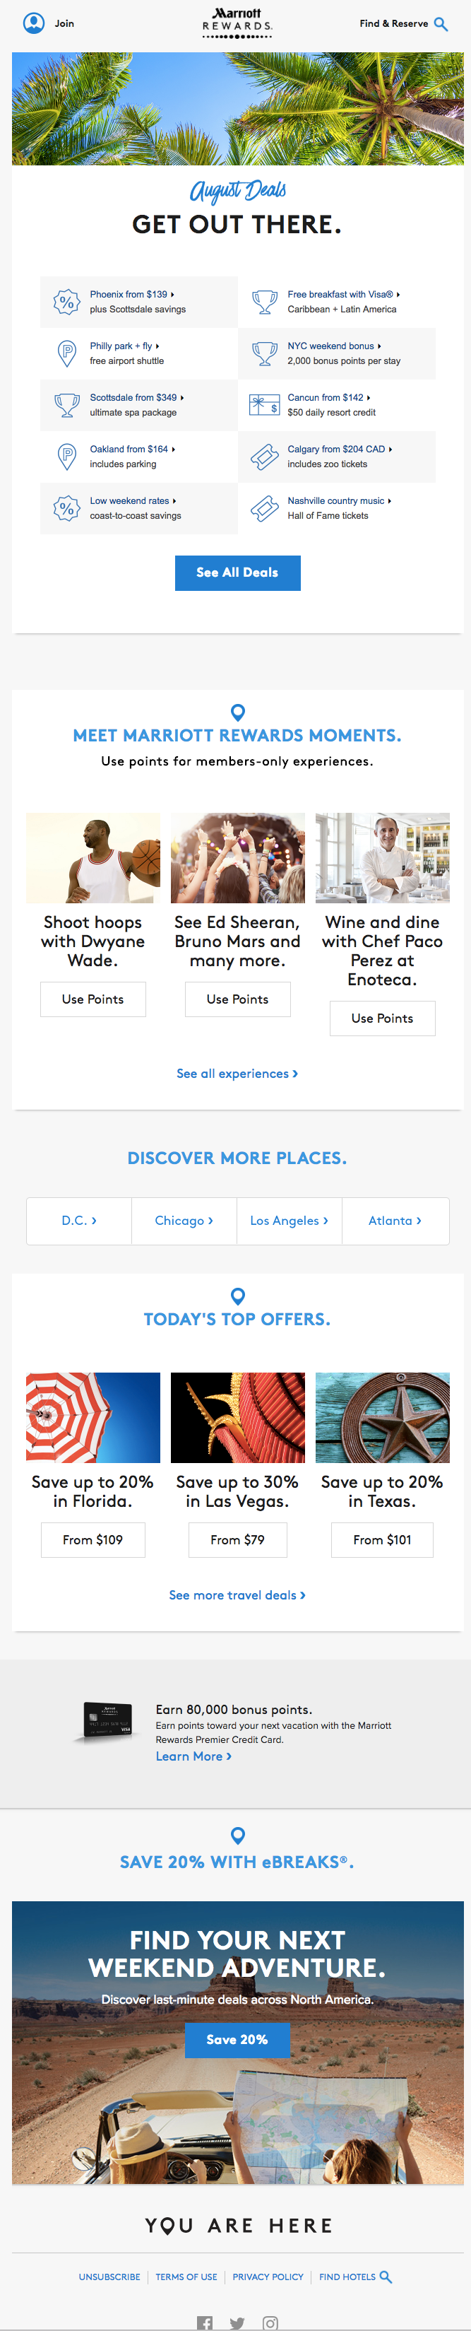
Template 2.0 Live and in Action!
eNews
Destinations
Hotel Specials

Slide 7
Key initiative: Template 2.0
2.0 template implementation update
All emails created in new template
First BAU email was July 6th eNews
Launched 107 automated campaigns in the new template by end of June (31% of 350)
  53% completed as of Aug 15 (185 messages)
Prioritized Orchestration campaigns
  Abandon Search, Achievers, Lifetime Achievers, and Renewers
Member Module may not be needed with single-focused campaigns

Slide 8
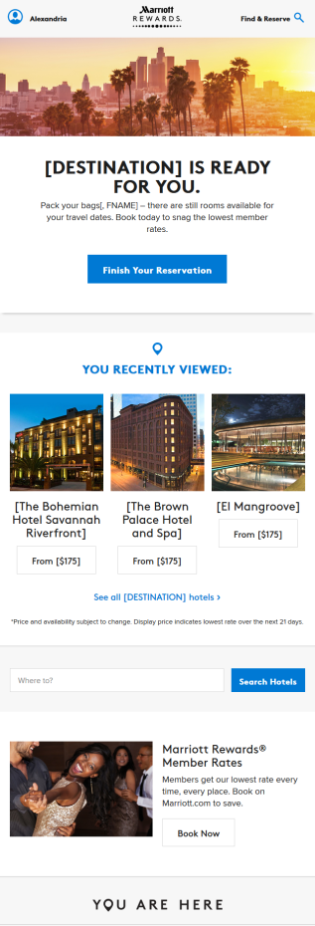
Template 2.0
Header: -58% clicks
Spike in key Abandoned search Metrics
Initial Observations:
3% increase in total clicks without Member Module
Top Offer increased in clicks, room nights and revenue compared to 1.0 version
The locations module section is declining in overall performance
Deeper dive is needed to understand and pinpoint module declines by email versions
Next steps:
Subject line and post-click test in planning stages
Continue to monitor
Top Offer: +45% clicks
Personalized: -3% clicks
Search: -86% clicks
Member Rates: +157% clicks
*Pre/Post % of
Clicks Change
Footer: +41% clicks
Notes:
May 1 – Jun 27, 2017 compared to June 28-July 30, 2017 data
Historical issues/changes:
Oct 10-15 2016 - Hotel images not showing in email
Oct 18 - 22 2016- eMail ABS did not run
Oct 22-24 2016 - Missing data - investigation ongoing
Jan 4-9 2017- eMail ABS did not run
Feb 7 2017 - partial information
Feb 8, 9, 11 2017 - no data - outage due to mobile issue
Mar 14, 16-29 2017- Outage - API issue
Apr 6-7 2017 - + partial day 4-8 - due to Analystics Data center move - not receiving search data
Apr 22-23 2017 - email campaign did not run
May 9 2017 AbS failed at 6:11pm (5/9/17) due to the “Records not found for update” error. The team has identified a potential solution to the problem and we are discussing on implementation
July 3 & 4 - 2017 - campaign outage: 1)Omniture data feed not sending Marsha code in numbers well over the acceptable limit,
2)connectivity issues with Omniture and 3)account log-in issues within Campaign
Jan - Mar 2017 - financial data under-reported due to Omniture tracking issues
Apr, May 2017 - financial data may be slightly under-reported due Omniture fidelity issues
Jun 28 2017 - New campaign template launched

Slide 9
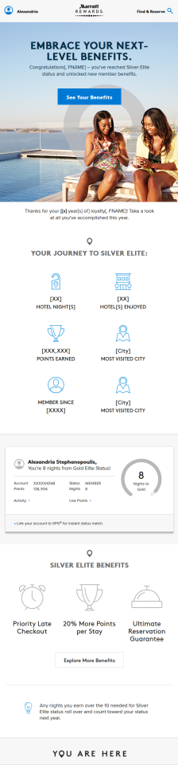
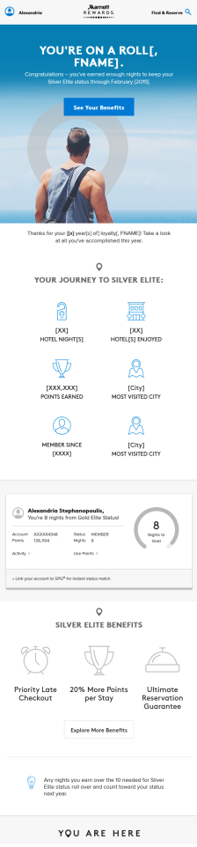
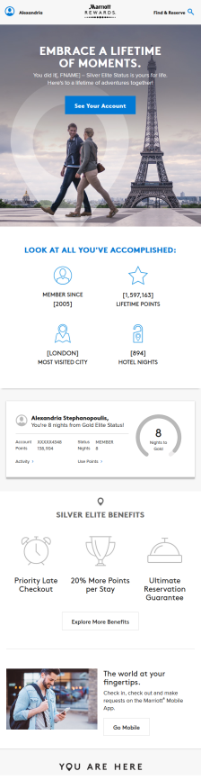
Template 2.0
June Launches: Template 2.0 (6/28) + Orchestration (6/30)
Initial observations:
CTO% increased in all cases with new creative
Loss of Member Module may be compensated with an increase in compelling content
Next Steps:
Conduct Renewer and Achiever analysis at elite status level
Achiever
(Pre/Post % change)
Open%: -8%
CTO%: +41%
Conv%: -38%
BPK: -20%
Renewer
(Pre/Post % change)
Open%: +0.7%
CTO%: +10%
Conv%: +9%
BPK: +20%
Lifetime Ach.
(Pre/Post % change)
Open%: +6%
CTO%: +26%
Conv%: +61%
BPK: +115%
Notes:
Pre period = Jan-Jun 27, 2017
Post = Jun 28-Aug 14, 2017
During strat review for Achievers had CTO% declines across all elite levels
Renewers had CTO% declines for Gold and Plat only…Silver had 37% increase

Slide 10
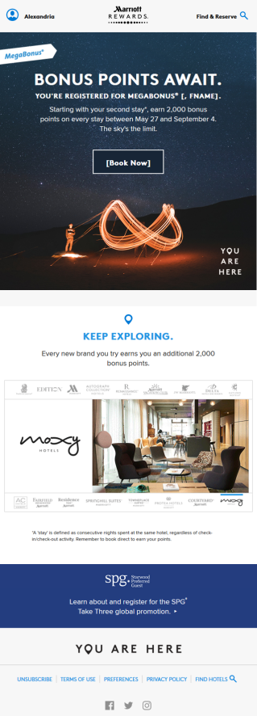
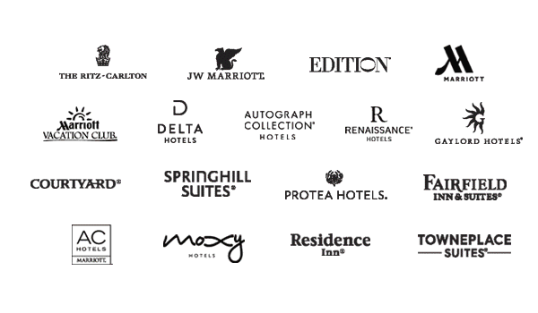

Template 2.0
CTO% improved without the inclusion of member module in MegaBonus Reg. Confirmation
MB Reg Conf
(Pre/Post % change)
Open%: -9%
CTO%: +7%
Conv%: -22%
BPK: -25%
Initial observations:
CTO% increased 7% after template change
Changes include new Header, Footer and no Member Module
Next Steps:
Continue to monitor to determine impact of template changes
Notes:
Pre period = Jan-Jun 27, 2017
Post = Jun 28-Aug 14, 2017
As discussed in May, the inclusion of a book now CTA (and hotel offers) may improve clicks & bookings

Slide 11
Key initiative: mvp
MVP is successfully optimizing offers
Higher revenue from Optimized audience vs. Random and BAU groups (curated content)
eNews-MVP* Sections
Optimize
vs. Random
vs. BAU
CTO%
1.5%
+25.0%
+9.1%
Revenue/Open
$0.71
+105.8%
+48.6%
Revenue/Offer Clicks
$48.79
+64.7%
+36.2%
*Includes May/June Top Offer 2 & Rewards
Notes:
Optimize = 40%
Random = 10%
BAU = 50%

Slide 12
mvp
There’s More to learn with mvp…
Next steps:
Confirm & support MVP objectives
  If revenue driving, increase offers in rotation and limit non-revenue content
  If supporting other initiatives, enable optimization for other metrics
Increase eNews revenue (as MVP optimization ramps up)
  Consider booking content in other sections
  Consider increasing content to pre-MVP levels
Improve performance reporting
Notes:
MVP is not currently optimizing for anything other than room revenue – and we know this is a serious limitation given that we want to promote non-room-revenue actions such as achieving a level, enrolling in the credit card or engaging with program benefits. This is definitely on the MVP team’s roadmap and Lynne, I and others are helping get that prioritized.

Slide 13
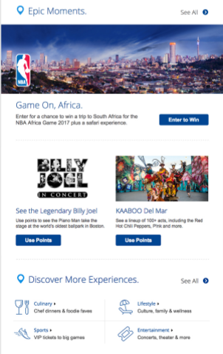
Key initiative: Moments
Moments supported in select campaigns; increased Hotel Specials engagement
Hotel Specials
Engagement Snapshot:
Moments added to June Hotel Specials and generated ~50% higher click volume than section avg.
2-3 experiences added to eNews as regular MVP content each month (NBA Sweeps was #1 clicked content in June - Optimize and BAU)
Module added to Incent Redemption 2.0 email
Next Steps:
Tracking and partnership needed to determine effectiveness of email support
Scheduled Solo’s: July and Sept
Notes:
Comments:
Hotel Specials (sweeps clicks may have impacted lower conv%; campaign conv%, room nights, revenue slightly below 12 month avg. in June)
Moments generated ~50% higher click volume and % of clicks than the Getaways 12-mo avg (which it replaced); contributed to high campaign CTO% (highest YTD)
‘NBA Sweepstakes’ accounted for 64% of section clicks
‘Billy Joel’ offer generated 16% of section clicks
Incent redemption 2.0 launched 8/11
Factor how this type of solo and content impacts driving revenue and supporting room night goals

Slide 14
Key initiative: Megabonus
Megabonus optimization efforts needed to improve Inconsistent performance results
-
+
Offer details mentioned in June eNews subject line resulted in higher open rates vs. 12-month avg.
June eNews Top Offer Conv% was above avg indicating high intent from the clicks generated
Promo contributed to 11% higher click volume in June Hotel Specials
May Summer Announcement saw lower Open rates than prior campaigns
June eNews Top Offer generated lower click volume than the prior 3 campaigns
Registration Confirmation had the lowest CTO% and BPK in past year
Notes:
+
SL for June eNews: Your Account: Up to 4,000 Points per Stay
-
Use promo details or value in SL to drive higher open rates
Include Travel Deals content as secondary module to generate additional clicks and bookings
Reg Conf had no Book Now in main CTA and no clear 2nd CTA

Slide 15








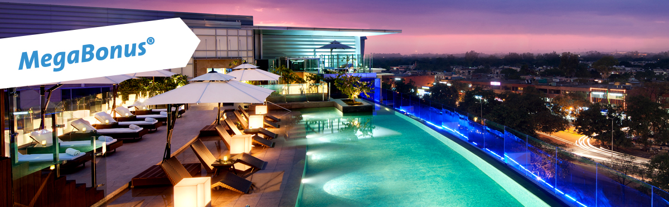
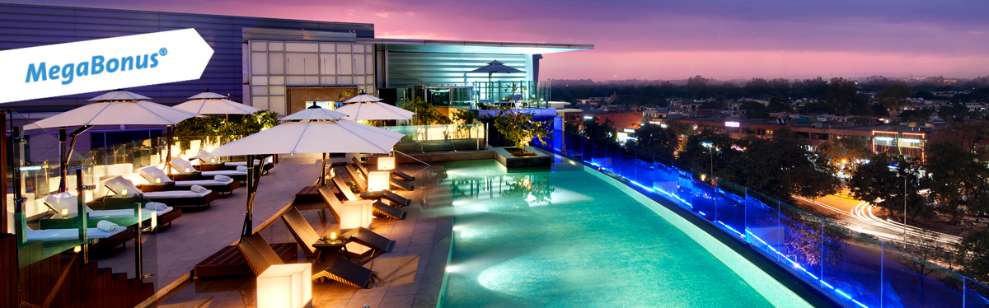
megabonus
June eNews – MegaBonus Hero Optimization
Objective:
Lift overall email engagement and Top Offer CTO% by optimizing hero image and banner size
Criteria:
Optimize using only 1st party Marriott data
5 background images and 2 banner sizes were provided
Total of 10 possible variations
The campaign was divided into Register and Book segments. The campaign optimization was applied to the entire audience and post-campaign analysis was performed on the individual segments.

Slide 16
megabonus
Optimized content drove 8.4% CTO lift for Campaign
Banner sizes did not play a significant role in lift. Red abstract image resonated more with most segments
Best Performing Image by Segment
Silver and Gold Level
Nights > 5
Core (B) Level
Gold Level + with
Points > 80,000
Notes:
Learnings used in July MB reminder solo

Slide 17
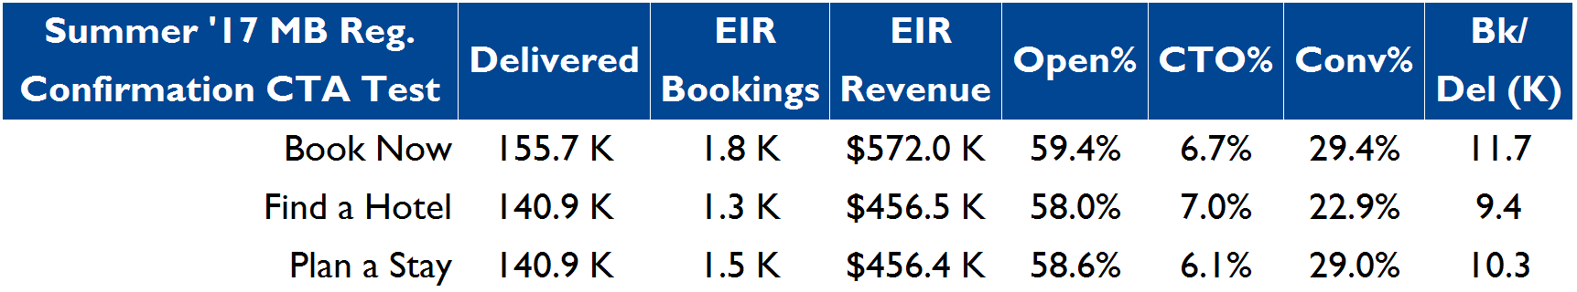
megabonus
Confirmed CTA testing shows “Book Now” Generates higher BPK
3 Way CTA test conducted in MegaBonus Registration Confirmation Solo’s: October ‘16, January and May ‘17
“Book Now” version generated the highest bookings per email delivered
“Find a Hotel” consistently generated the highest CTA CTO% in January and May
Book Now
BPK = 11.7
Find a Hotel
BPK = 9.4
Plan a Stay
BPK = 10.3
May ’17 Results

Slide 18
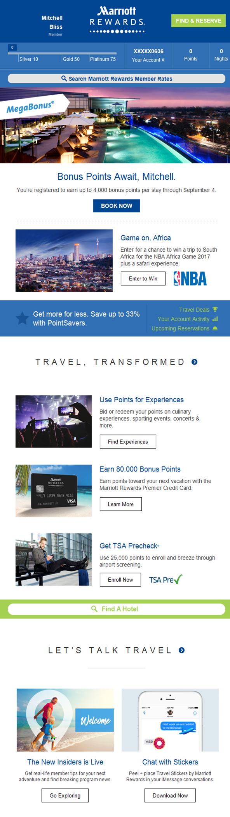
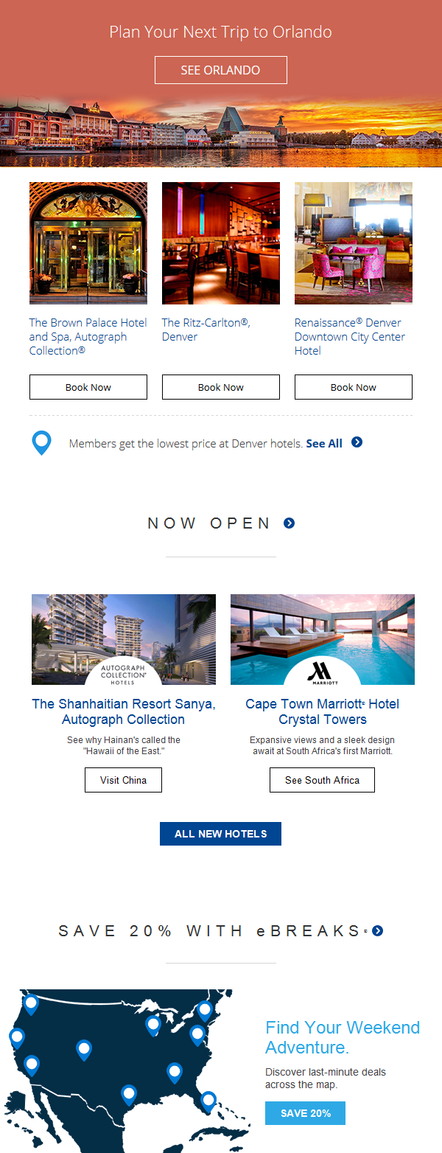
Campaign highlight: Enews Personalized content
Positive results with Enews destination propensity module in May & June emails
Initial observations:
Targeting 5.2MM members with destination specific content (3 per person)
Module generated 13% more clicks in May and a 71% higher conversion in June
Majority clicks and bookings from Properties section
Next steps:
CTA test for destination feature
Wylei optimized Navigation Bar test for remaining audience
Destination Feature
Properties
‘See All’ Link
Notes:
17 destinations identified with 3 property recommendations each
Compared to City Scene 12 month avg.
May eNews comments
May eNews generated 14% fewer clicks and an 9% lower Conv% than YTD avg
- Top Offers featured evergreen benefits & generated 73% fewer clicks than YTD avg
- All other sections experienced click volume increases vs YTD avg
The following sections had a lower Conv% than their respective YTD avgs:
- Top Offer 2 = 20% of clicks / 19% lower Conv% than YTD section avg
- Account Box = 26% of clicks / 11% lower Conv% than YTD section avg

Slide 19
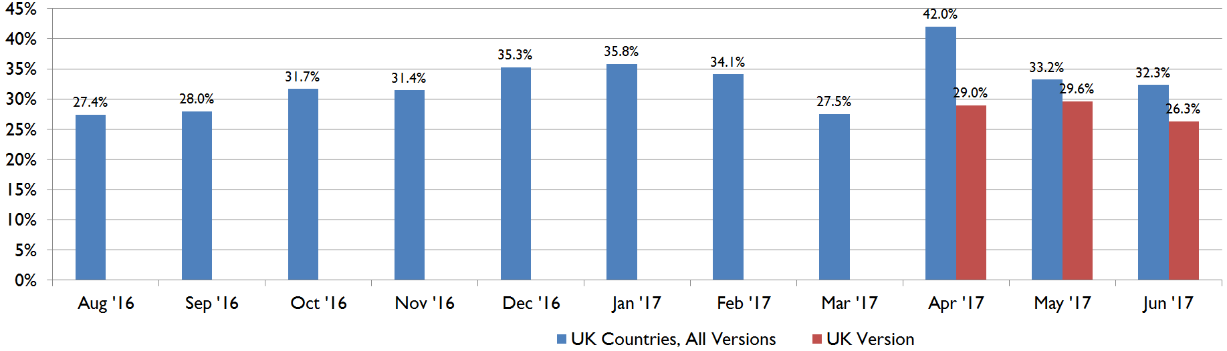
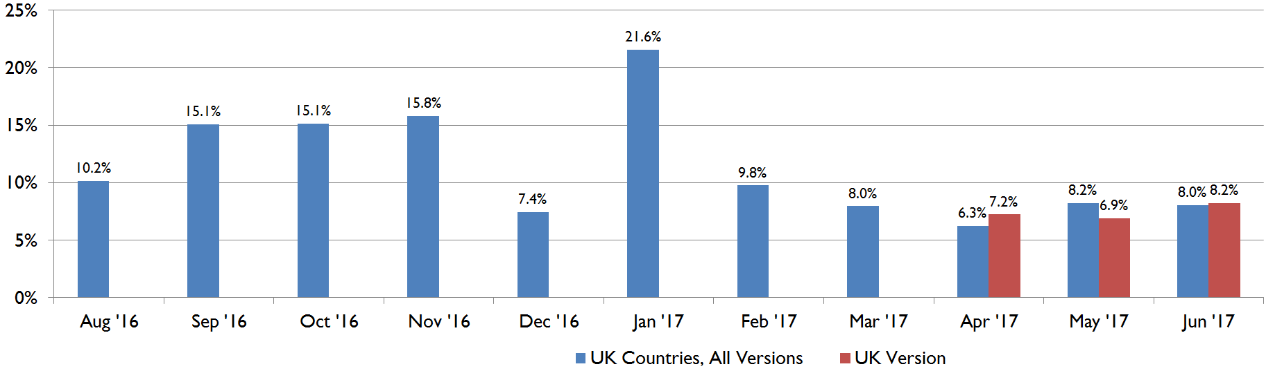
Campaign highlight: uk Enews
New UK version added incremental engagement alongside Global eNEws
European audience engagement with Global eNews was not significantly affected by the introduction of UK version
Global eNews Open% & CTO% were not impacted by UK eNews
UK eNews Open% & CTO% were consistent with Global eNews
Open%
CTO%
Notes:
Comment:
The addition of UK eNews created an additional touchpoint with incremental exposure
Notes:
April SL: Your Account: Here Comes The Sun
May SL: Your Account: Up to 4,000 Points per Stay
Launch Dates:
Core eNews= 4/4/2017; UK eNews = 4/18/2017
Core eNews= 5/2/2017 UK eNews = 5/21/2017
Core eNews = 6/6/17; UK eNews = 6/

Slide 20
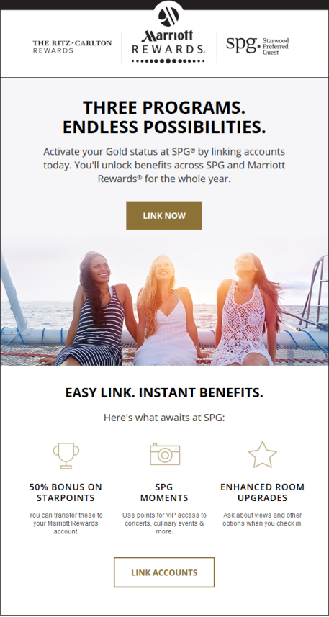
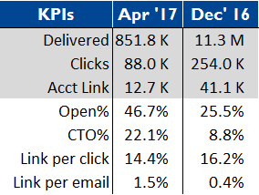
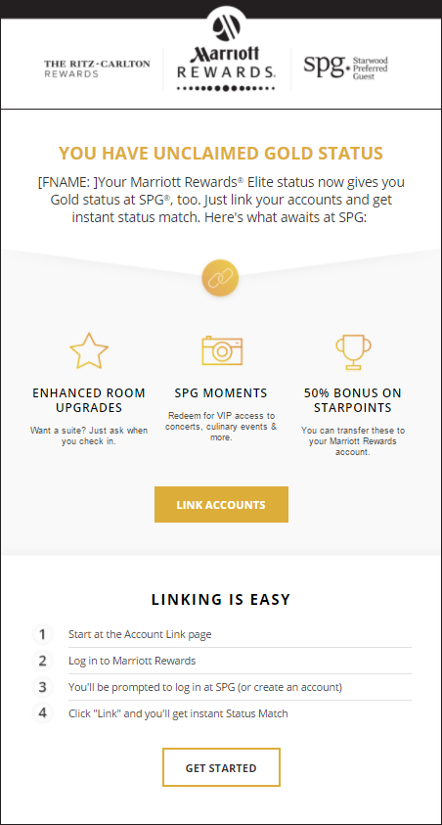
SPG Link Account Reminder Solo
Generated significantly higher Open%, CTO%, & Link per email
Targeted only Gold/ Plat Elites & MRCC owners vs. Dec’16 sent to all
April Reminder was 4x more efficient than Dec’16 with targeting
Apr ‘17 (Gold)
Dec ‘16 (Gold)
Notes:
Comments:
Consider expanding audience based on previous open response with targeted messaging. We don’t know their long term value, ROI of Solos are only going to get worse, we risk sending an increasingly less relevant communication to the broader audience (like MRCC) when we could focus on a more targeted audience like Previous opener (generated the highest Open% at 49.7%) and non-openers
April 2017:
MRCC: Reminder: Activate Your New Benefits
Gold: Activate Your Gold Status Match
Platinum: Activate Your Platinum Status Match
December 2016:
MRCC: Activate Your New Benefits
Gold: Your Status Match Offer: Gold at SPG®
Platinum: Your Status Match Offer: Platinum at SPG®

Slide 21
SPG Link Account Reminder Solo
Compared to Dec ‘16, segment engagement generally improved
Open% improved except for MRCC
Gold/Platinum SL’s did not refer to SPG
Activate Your Gold Status Match
MRCC used “Reminder” in SL
Reminder: Activate Your New Benefits
Overall design updates appeared to improve click engagement
Expectation would be for gradual decreases in response
Apr ‘17 (Gold)
Compared to Dec ’16*
Gold
  +8.4% Open%
  +3.0% CTO%
Platinum
  +10.3% Open%
  -9.8% CTO%
MRCC
  -2.1% Open%
  +16.3% CTO%
Dec ‘16 (Gold)
Notes:
Comments:
April ‘17 MRCC version had Discover A New Destination bottom module w/ 3 SPG props which will lead to higher CTO%
Dec ‘16 had additional segments: Basic, Previous Non-Opener, Previous Opener, ROTW
Audience sizes were ~20% smaller., which may have impacted engagement
- Previous opener generated the highest Open% at 49.7%
April 2017:
MRCC: Reminder: Activate Your New Benefits
Gold: Activate Your Gold Status Match
Platinum: Activate Your Platinum Status Match
December 2016:
MRCC: Activate Your New Benefits
Gold: Your Status Match Offer: Gold at SPG®
Platinum: Your Status Match Offer: Platinum at SPG®

Slide 22
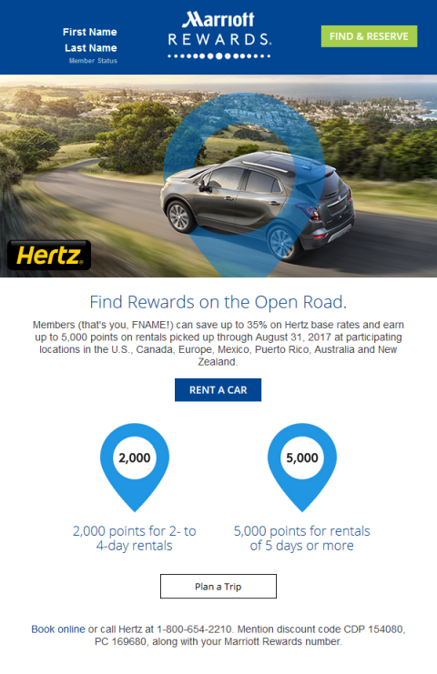
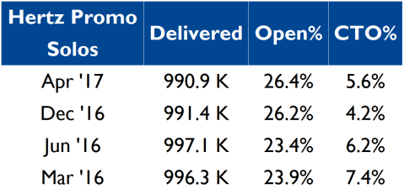
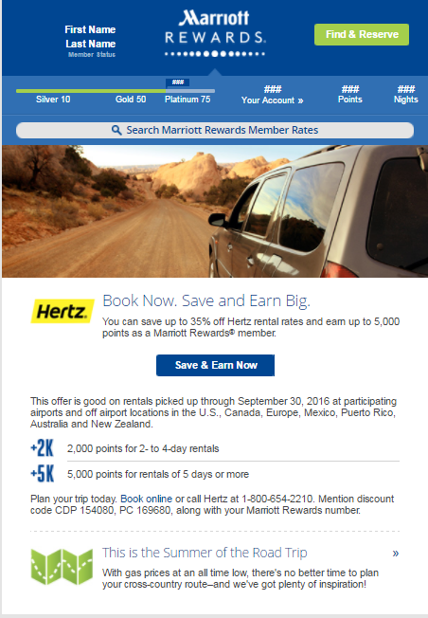
Hertz Solo
Updated Hertz Solo reversed downward engagement trend
CTO% increased 33% from last Hertz Solo
April Hertz updated design
Main image & style: Explorer-Magician tone
Orientation & layout of copy & content
Updated CTA
No secondary content
Apr’17
Jun ‘16
Notes:
Comments:
Subject line leveraged Explorer-Magician tone and generated the highest subject line of previous Solos (SL: Up to 35% off and 5,000 points with Hertz)
Will monitor performance of next email in 2.0 template

Slide 23
Key Opportunities
& Takeaways

Slide 24
Key Takeaways
Removing the Member Module did not negatively impact clicks
Prelim CTO results show improvements with template updates
MVP is optimizing offers, however, more work is needed to optimize eNews performance
Monitor impact of non-booking Solo’s on program KPI’s
Additional MRCC support planned for Q3-4 to make YE goals
Moments partnership needed to improve email channel tracking
Notes:
MRCC - Clark and Marc are working with the MRCC team to find additional placements for MRCC, which should help get them closer to the YE goals. For example they will be purchasing premium placements in Hotel Specials, they may have an offer to promote in Nov eNews, and they will be pulled through in the Holiday tentpole.

Slide 25
Thank you!

Slide 26
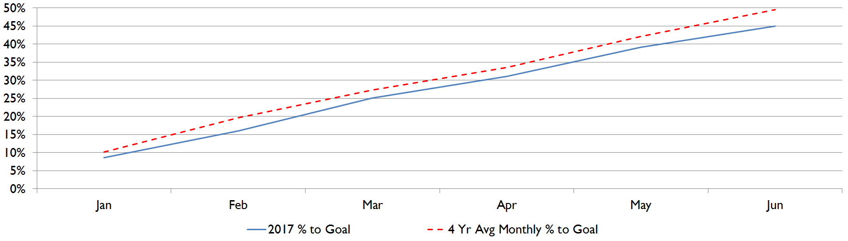
Room night Performance
program is 9% behind 5 M Room Night goal
As of June, program has generated 2.25 M RN, 45% of Goal. The 4 Yr trend indicates program should be at 50% by June to achieve forecast
4 yr trend 2.48 M RMNTS
Actual: 2.25 M
RMNTS
Note: Based on EIR data
Notes:
Trailing all year but gap widened May and June
Biggest factors to program are weaker MB responses over time…less people are responding to it

Slide 27
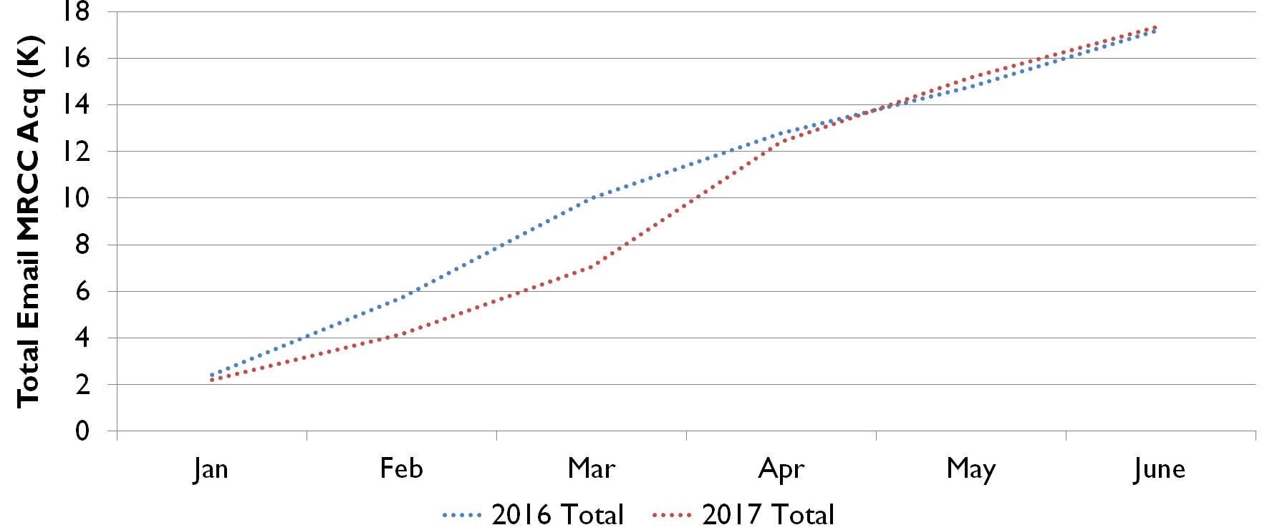
Mrcc performance
MRCC acquisitions ahead of forecast
As of June, MRCC accounts are 53% of 33 K goal
eNews contributed 55% of MRCC acquisitions in April
May eNews drove over 700 acquisitions with Top Offer 2 and MVP placements
Increasing MRCC support…
Near Level & Post Redemption
Monthly in eNews (MVP)
Point expiration & Confirmation email driving YTD highs in accounts
Additional support is likely required to meet goal
YTD CUME MRCC Accounts by month
2017 33 K goal
53% to goal
Notes:
2016 35 K goal
49.3% to goal
Similar to last year (35 K goal)
Near Level & Post Redemption (7/11)

Slide 28
Growth of email engagement
Low solo volume over quarter had an impact on email engagement
Fewer members and non-members opened and clicked on emails compared to previous months

Slide 29
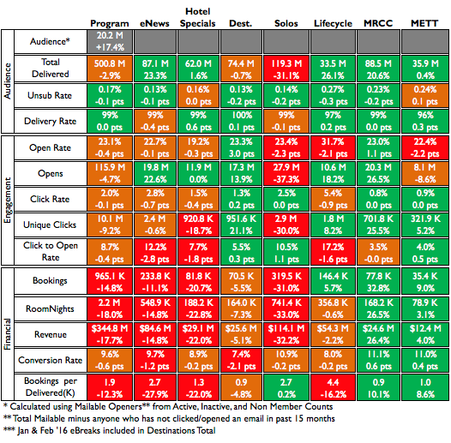
Email performance: executive dashboard
Observations:
YTD comparison shows drop in Solo volume impacting key program KPI’s
eNews higher than avg. Open rates but CTO% declines resulting from fewer clicks and lack of MVP lift on overall campaign KPI’s
Low performing offers contribute to Hotel Specials declines
Lifecycle declines are being addressed with 2.0 Retrofit efforts
Notes:
Comments:
Sent fewer Solo’s (none in June)
eNews open% up = SL testing and offer details in SL (MRCC 100K offer and MB 4K pts offer)
HS decline in field offer engagement (recent link level report shows CTO and conv declines)
LC declines being addressed during strategy review for retrofit (ex. Welcome SL declines addressed with July/Aug test)
Notes:
Q2 QoQ Declines
Delivered = Solo -63%
Opens = Solo -65%
Clicks = Solo -51%, HS -16%, eNews -5%
Bkg = Solo -55%, HS -21%, eNews -17%
Rmnts = Solo -57%, HS -23%, eNews -20%
Rev = Solo -57%, HS -22%, eNews -19%
Open% = Solo -6%, METT -6%, HS -4%
CTO% = eNews -24%, HS -14%, LC -10%
Conv% = METT -10%, eNews -13%, Solo -9%
BPK = eNews -32%, HS -22%, LC -14%

Slide 30
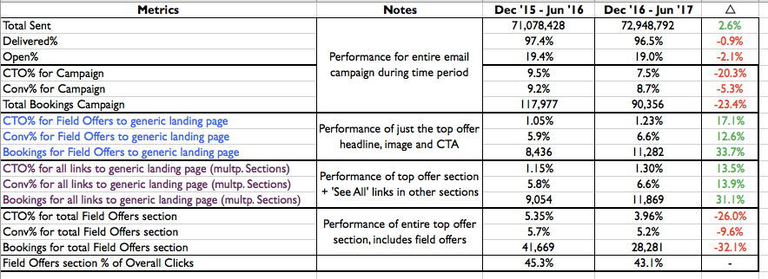
Hotel specials ‘see all’ link analysis
Top offer section (just headline, image, and CTA) shows double digit increases YoY (see blue font); content links directly to the generic landing page
Similar increases when including the ’See All’ links from other sections (see purple font); those that actually click are looking for deals and have a higher likelihood of booking.
Report Data (used EIR data):

Slide 31
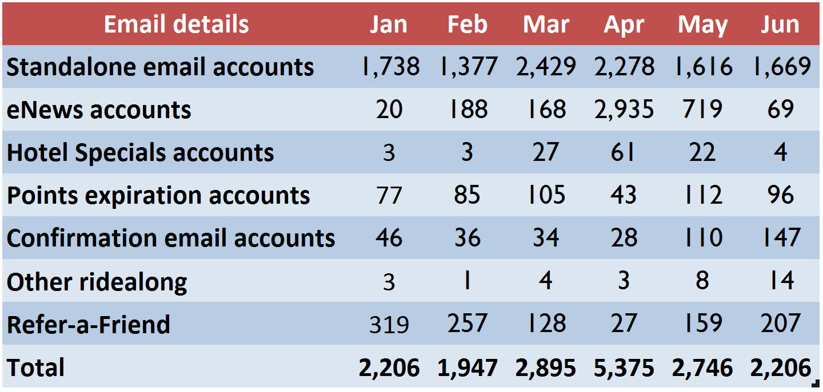
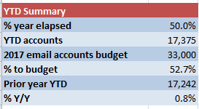
2017 MR Campaign Reviews
MRCC results against forecast (email)

Slide 32
Abandoned search section analysis
 |  | TOTAL CLICKS
 | Section Nm (group) | May1-Jun27 Avg / Month | % of Total | Jun28-Jul30 2017 | % of Total | % Change
Clicks | ACCOUNT BOX PERSONALIZATION, HEADER, PRE-HEADER | 5,222 | 15% | 2,205 | 6% | -58%
 | BODY CTA, TOP IMAGE, TOP OFFERS | 13,891 | 40% | 20,106 | 57% | 45%
 | PERSONALIZED DEALS | 11,876 | 34% | 11,485 | 32% | -3%
 | SEARCH | 2,910 | 8% | 415 | 1% | -86%
 | BOTTOM OFFERS | 329 | 1% | 845 | 2% | 157%
 | FOOTER & OPTOUT | 318 | 1% | 447 | 1% | 41%
 |  | 34,545 | 100% | 35,503 | 100% | 3%
 |  | TOTAL ROOM NIGHTS
 | Section Nm (group) | May1-Jun27 Avg / Month | % of Total | Jun28-Jul30 2017 | % of Total | % Change
EIR Total Room Nights | ACCOUNT BOX PERSONALIZATION, HEADER, PRE-HEADER | 1,743 | 12% | 572 | 4% | -67%
 | BODY CTA, TOP IMAGE, TOP OFFERS | 6,544 | 45% | 8,580 | 60% | 31%
 | PERSONALIZED DEALS | 4,843 | 33% | 4,475 | 32% | -8%
 | SEARCH | 1,139 | 8% | 183 | 1% | -84%
 | BOTTOM OFFERS | 136 | 1% | 320 | 2% | 135%
 | FOOTER & OPTOUT | 102 | 1% | 68 | 0% | -33%
 |  | 14,507 | 100% | 14,198 | 100% | -2%
 |  | TOTAL REVENUE
 | Section Nm (group) | May1-Jun27 Avg / Month | % of Total | Jun28-Jul30 2017 | % of Total | % Change
EIR Total Revenue | ACCOUNT BOX PERSONALIZATION, HEADER, PRE-HEADER | $274,930 | 11% | $82,485 | 4% | -70%
 | BODY CTA, TOP IMAGE, TOP OFFERS | $1,141,652 | 46% | $1,439,247 | 62% | 26%
 | PERSONALIZED DEALS | $807,607 | 33% | $710,552 | 31% | -12%
 | SEARCH | $208,283 | 8% | $29,252 | 1% | -86%
 | BOTTOM OFFERS | $19,865 | 1% | $43,041 | 2% | 117%
 | FOOTER & OPTOUT | $17,652 | 1% | $17,584 | 1% | 0%
 |  | $2,469,989 | 100% | $2,322,162 | 100% | -6%

Slide 33
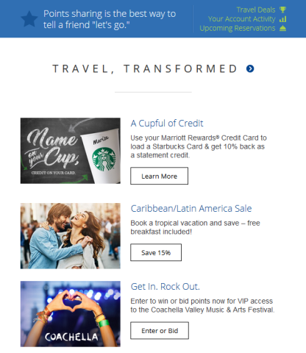
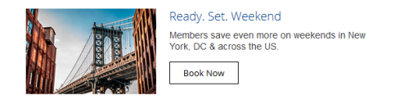
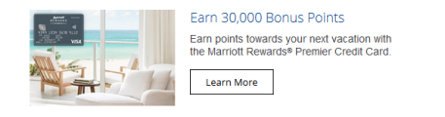
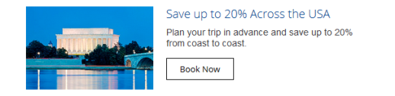
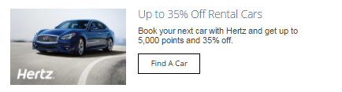
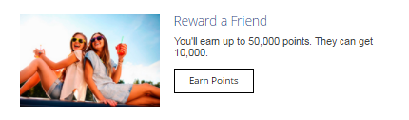
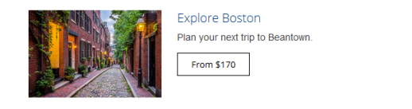



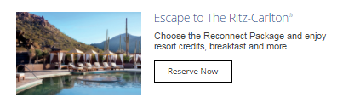
eNEws: MVP
Overview of MVP experiences
BAU: Curated offers
MRCC (targeted by region)
Hertz/RAF (targeted?)
Moments (targeted by pts)
Optimize: MVP-decisioned offers (tbd)
April did not leverage M.com results
Random: Random rotation of all MVP offers
MVP Offer types: 29 total
MR travel deals & destination lead rates
RC Offers & benefits
MR evergreen benefits
Partner offers
(1) BAU: Curated Offers (with dynamic targeting)
Sample of 22 other MVP Offers:
(2) Optimize & (3) Random
1b
1a
2b
2a
3a
3b
3c

Slide 34
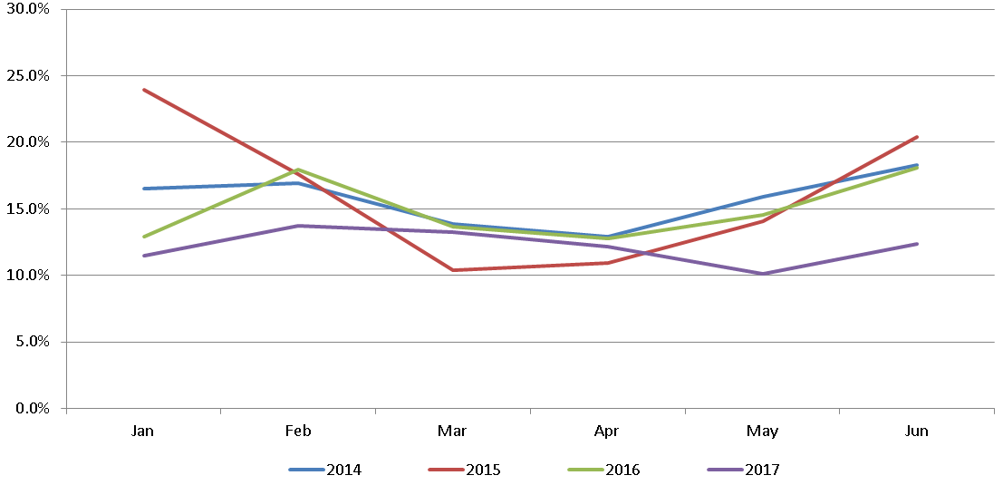
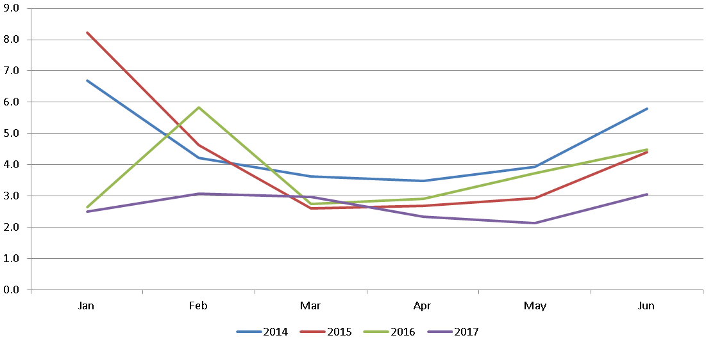
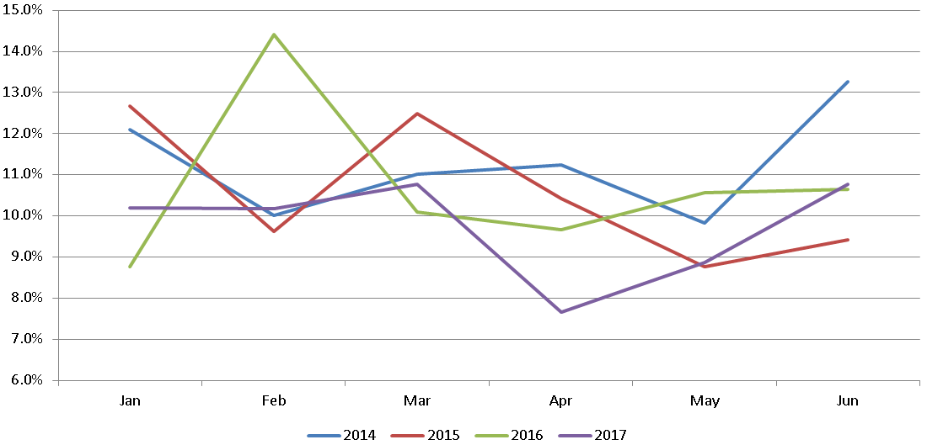
MVP: enews campaign level
CTO%
Booking per Delivered
Conv%
Notes:
100K MRCC (72% of TTL Delivered: 9.0 M) Clicks = 61 K / Conv% = 6.7%
Atlantis (17% of TTL Delivered 2.1 M) Clicks = 6 K / Conv% = 5.7%
MVC 20% Off (10% of TTL Delivered 1.2 ) Clicks = 6 K / Conv% = 9.5%
Hawaii might have been given the most around 900 K

Slide 35
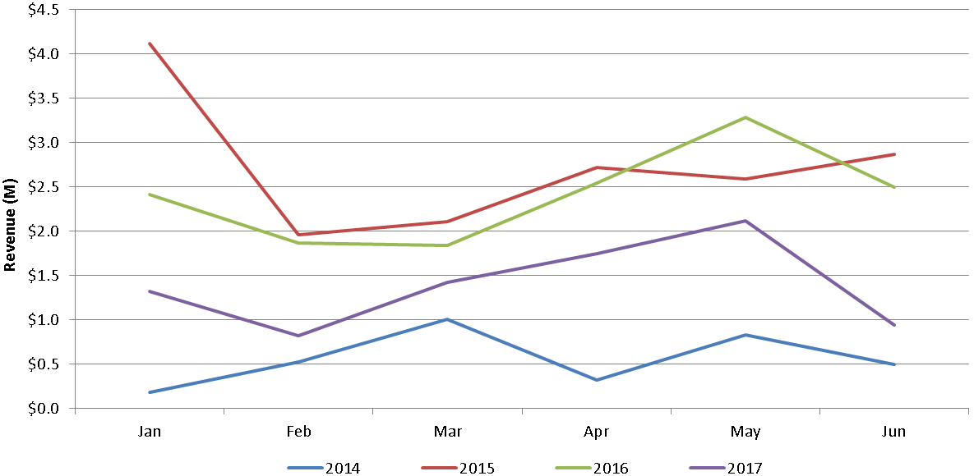
MVP: enews rewards link level
Rewards Section revenue has not increased with MVP
Rewards section Revenue
Notes:
100K MRCC (72% of TTL Delivered: 9.0 M) Clicks = 61 K / Conv% = 6.7%
Atlantis (17% of TTL Delivered 2.1 M) Clicks = 6 K / Conv% = 5.7%
MVC 20% Off (10% of TTL Delivered 1.2 ) Clicks = 6 K / Conv% = 9.5%
Hawaii might have been given the most around 900 K

Slide 36
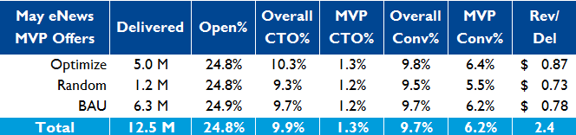
May eNews: MVP
MVP as a placement is improving
Top Offer2 generated the most clicks since Jun ’16
MVP offers in Rewards generated 4% more clicks MoM
More prominent placement means greater impact for dynamic content
Optimize group outperformed Random & BAU
Higher Rev/Del than Random (+15%) & BAU (+8%)
At both campaign and MVP section level
MVP showed signs of improvement in eNews
Segment Experience
Optimize: MVP-decisioned offers
Random: Random rotation of MVP offers
BAU: Curated, fixed, Offers (with targeting)
    MRCC
    Hertz/RAF
    Moments
Notes:
Note: Top Offer got zero clicks so need to guard against assumptions due to trickle down affect….

Slide 37
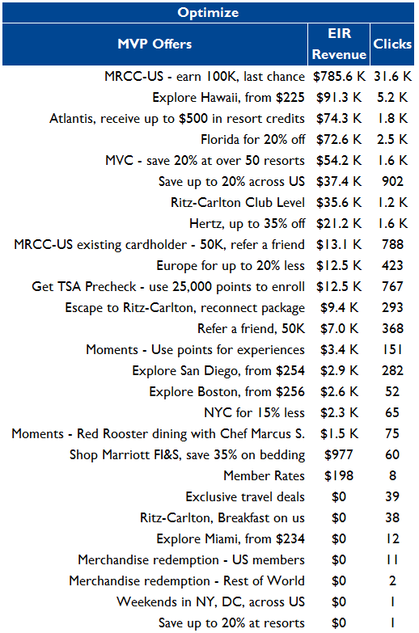
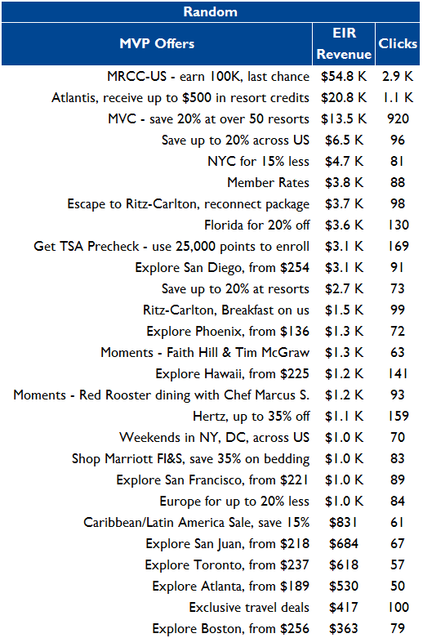
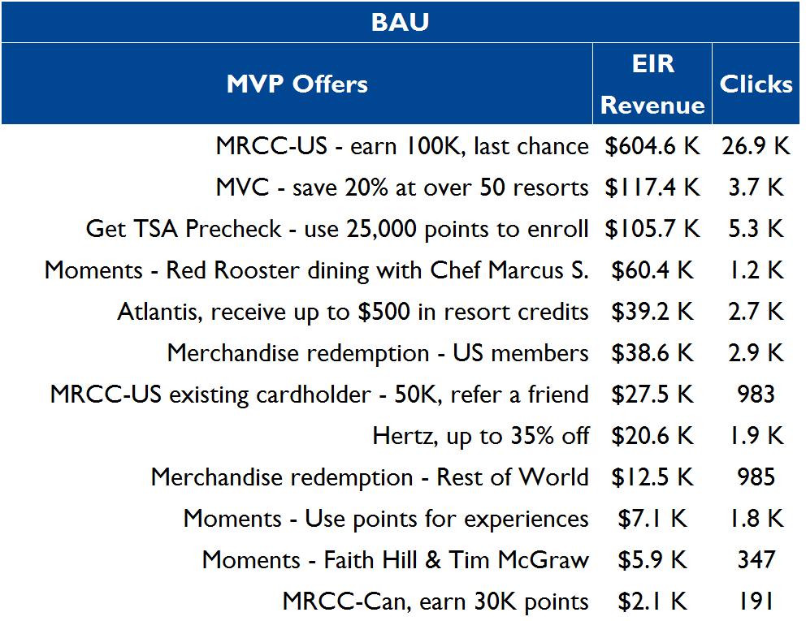
May eNews: MVP
MVP decisions appeared to result in offers being displayed more often to the right audience
Top Offer 2 MVP Offer
Offers generating high revenue, suggesting MVP optimization
Notes:
100K MRCC (72% of TTL Delivered: 9.0 M) Clicks = 61 K / Conv% = 6.7%
Atlantis (17% of TTL Delivered 2.1 M) Clicks = 6 K / Conv% = 5.7%
MVC 20% Off (10% of TTL Delivered 1.2 ) Clicks = 6 K / Conv% = 9.5%
Hawaii might have been given the most around 900 K

Slide 38
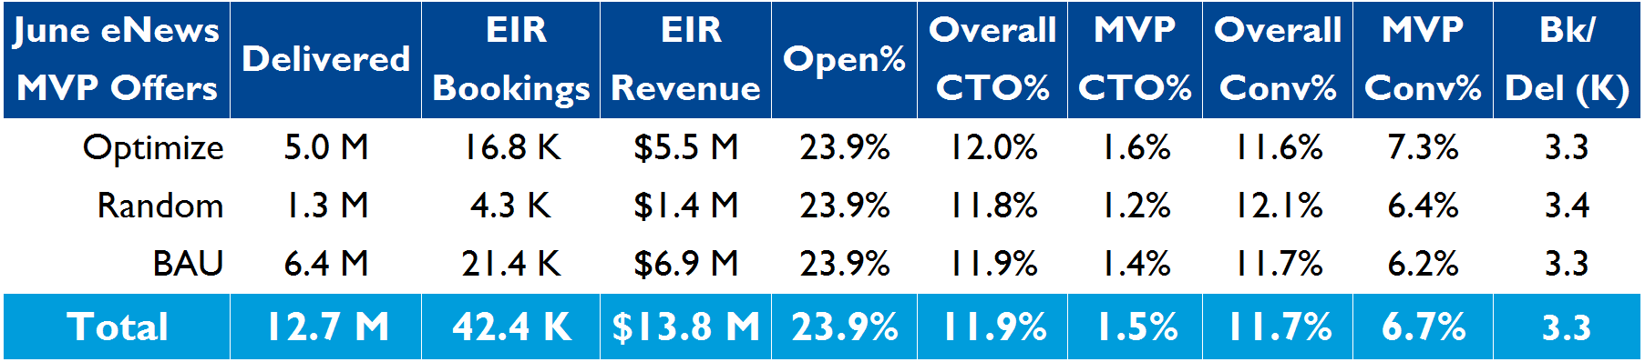
June enews: MVP
Optimize generated a higher CTO% & Conv% at a section level
Conv% results were mixed: Optimize group Conv% differed at the campaign & MVP section level
Optimize group generated the lowest campaign level Conv% but the highest MVP section level Conv%
Optimize group generated the highest CTO% on a campaign and MVP section level
Offer quality may not have been as compelling as previous months
Notes:
Higher section-level performance by Optimize suggests continued benefit in decisioning

Slide 39
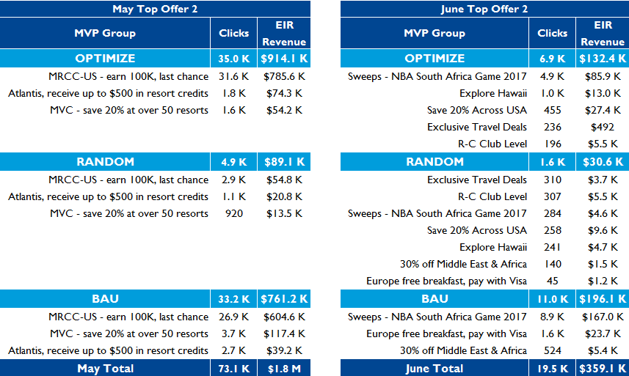
June enews: MVP Top Offer 2
offers in Top Offer2 did not generate the same clicks & revenue as May
There were significant differences in clicks & revenue between Top Offer 2 content from May; considerations:
Offer type
MegaBonus cannibalization
Technical issues?
Differences in offers
Non-booking CTAs: MRCC generated significantly more clicks & revenue than NBA Sweeps
May featured more resort offers
We need to understand the following
How does new content (e.g. Sweeps) get shown in Optimize group?
How are Top Offer2 & rewards synchronized?
Reporting requests:
Offers not showing up in report
Need month timestamp
Notes:
40% Optimize
10% Random
50% BAU
NBA sweeps doesn’t even show up in the message reports from Yuri
- Need date stamp not run dates
Sweepstakes may have been decisioned by Optimize
If you look at revenue per clicks, optimize is slightly higher than Random & BAU

Slide 40
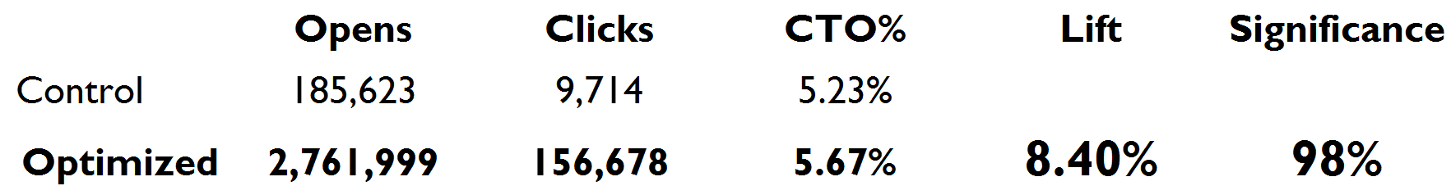
June Testing: eNews MB Top Offer Image Test
June eNews – MegaBonus Hero Optimization
Objective:
Optimize background image and banner size to determine which combination performed the best.
Criteria:
Optimize using only 1st party Marriott data. 5 background images and 2 banner sizes were provided, resulting in 10 possible variations.
The campaign was divided into Register and Book segments. The campaign optimization was applied to the entire audience and post-campaign analysis was performed on the individual segments.
Optimization Results:
Note: The image banner size did not play a significant role in lift.

Slide 41
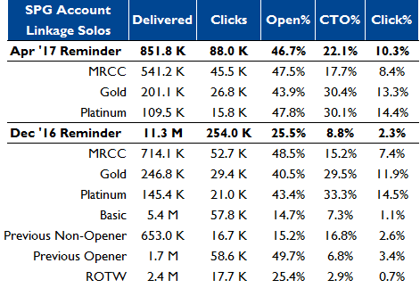
SPG Link Account Reminder Solo
Targeting message based on previous open may drive incremental account linkage
From Dec ‘16 Openers & Non-openers generated “2nd tier” Click%
As high a click response as MRCC
Large audience size, highest open rate
Notes:
Dec’16 target of previous openers generated more overall clicks than above segments (1.7 M audience)

