Slide 1
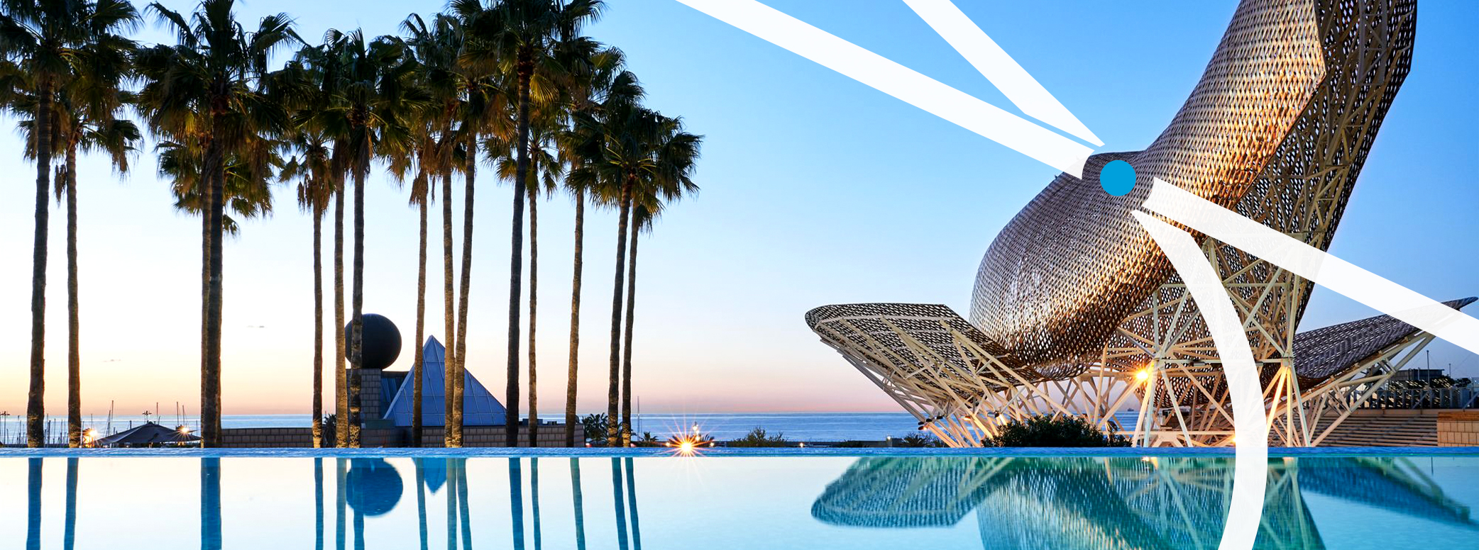
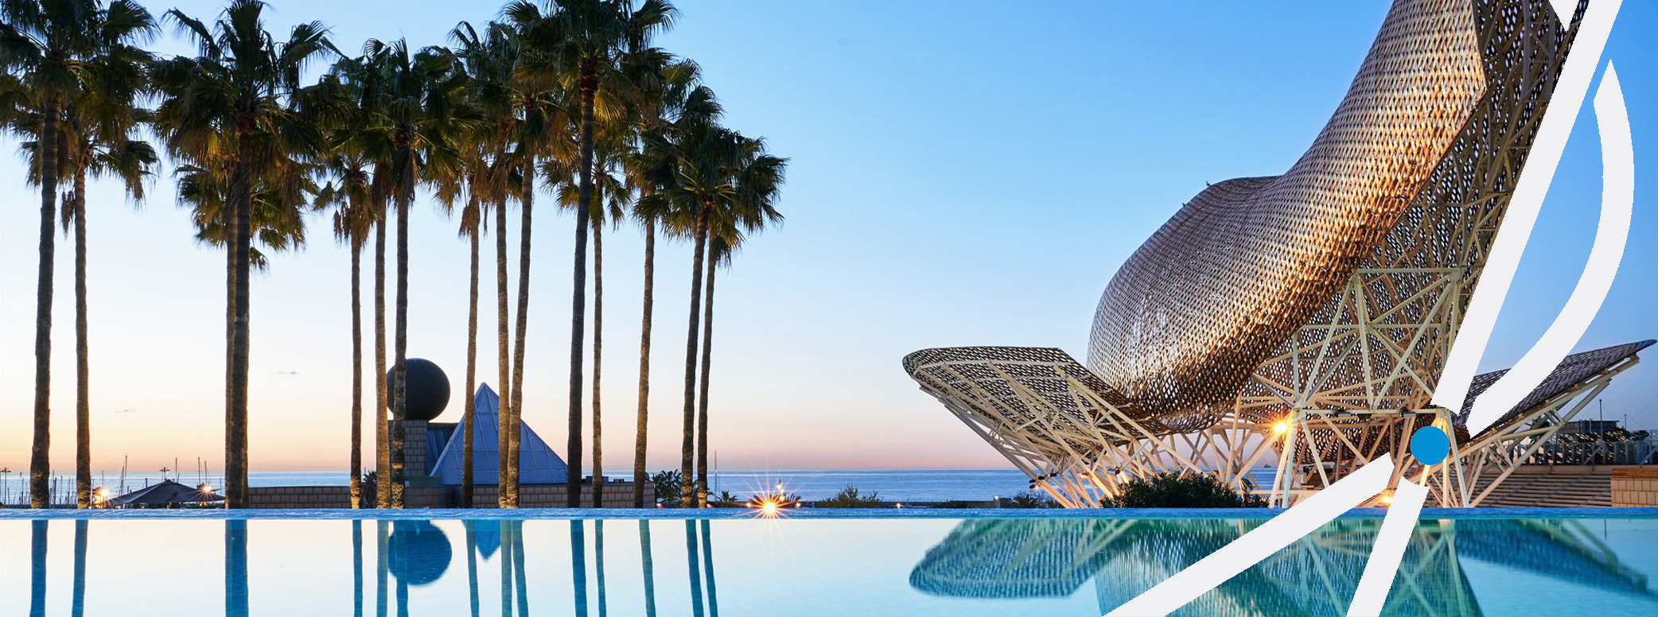


Marriott Bonvoy
Master Email Template Rebrand Kickoff
Jan ‘21

Slide 2
Agenda
Overall approach
Process
Our focus elements
Our goal
Open questions
Next steps
Wireframe review

Slide 3
1. Overall Approach
Take existing template and apply the new brand direction
Edit and retire unused modules
Addition of new modules

Slide 4
2. Process
Kickoff & Wireframe - 1/6
Wireframe approved - Week of 1/11
Design presentation - Week of 2/15
Design approval - Week of 3/8
Coding & QA finished - Week of 3/29
Hand-off to Epsilon - Week of 3/29
Setup & testing - TBD
Go live - TBD

Slide 5
3. Our Focus Elements
New header & path connector
Typography
Color
CTA’s
Member Status Module
Feature, secondary & tertiary options
Dark mode
ADA compliant
Footer

Slide 6
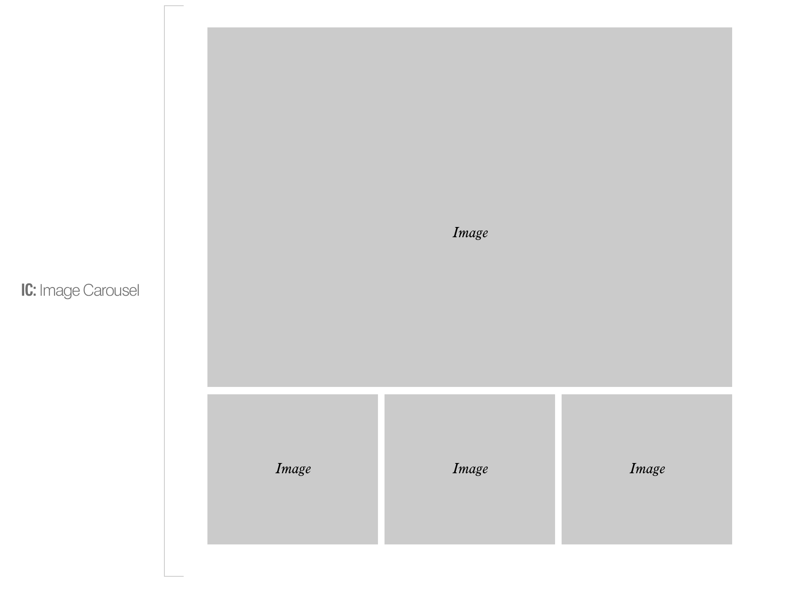
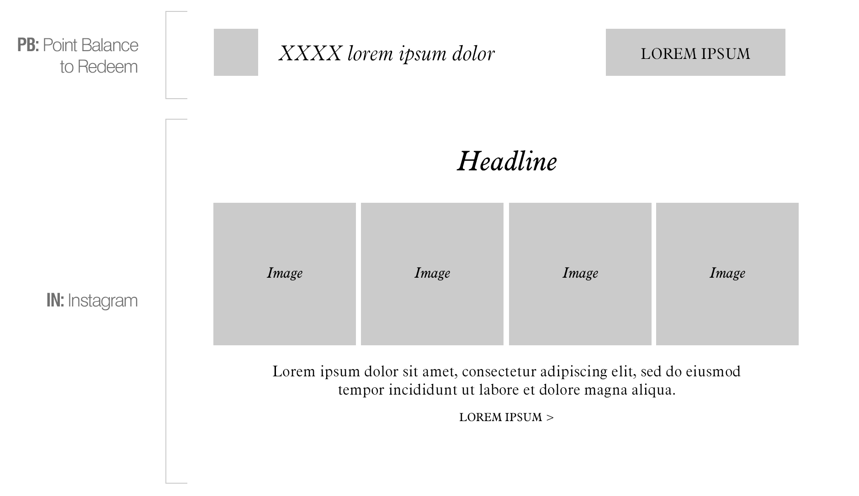
Additional Modules to Consider
    Point balance to redeem
    Instagram
    Image Carousel

Slide 7
Campaigns This Template Will Create
    We’ve reviewed the following campaigns to ensure they are accounted for:
      Welcome
      MAU
      Cobrand Acquisition
      Cobrand Cardholder
      Escapes
      Global Promo
      EMEA
      Retargeting (Ab. Search)
      Project Wanderlust
      Boutiques

Slide 8
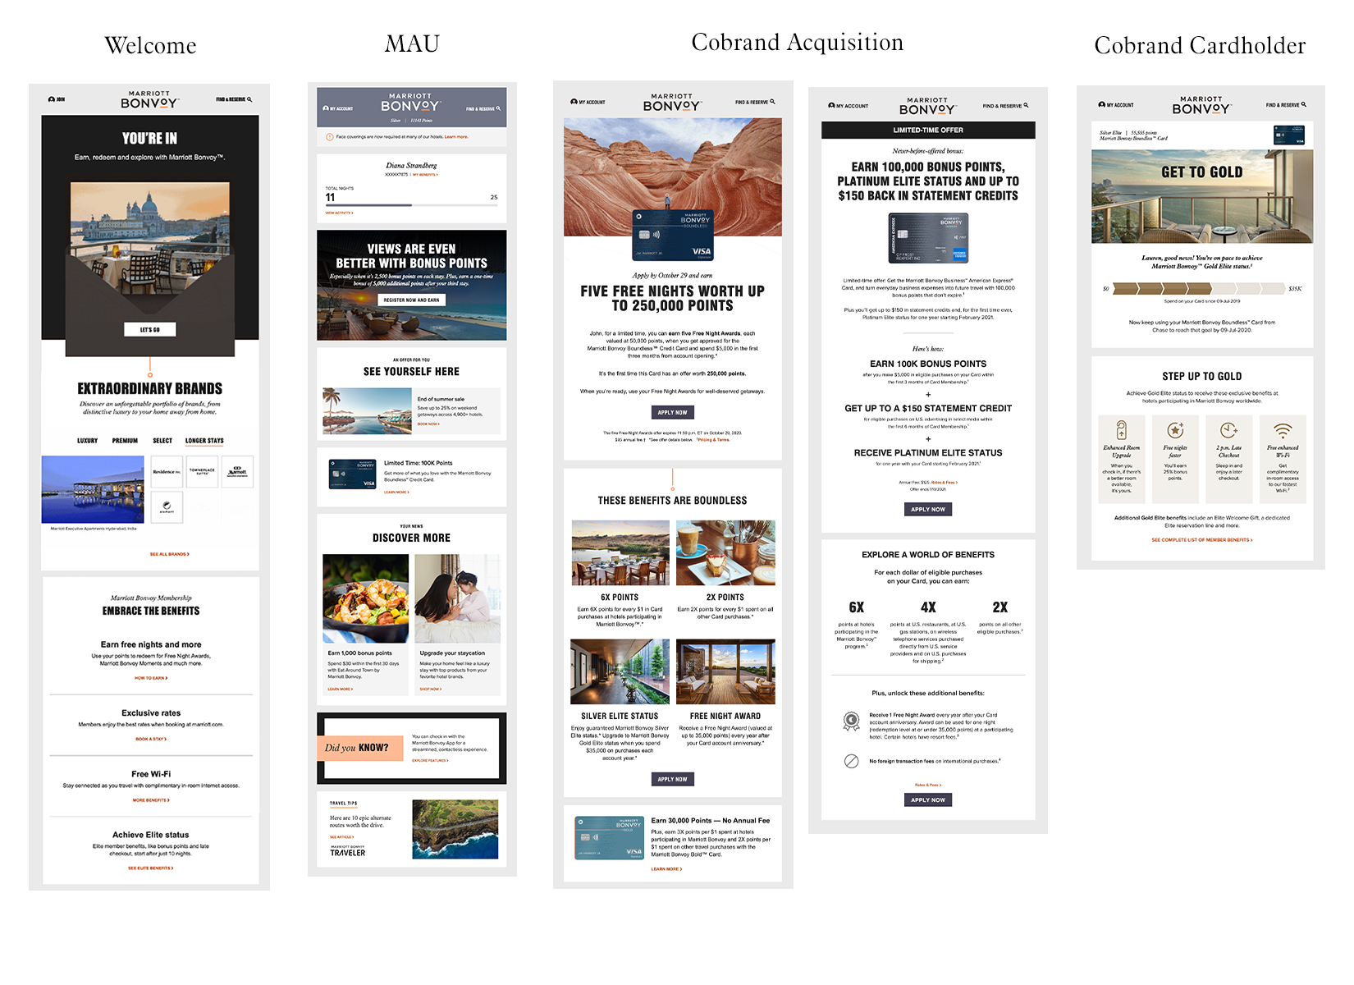

Slide 9
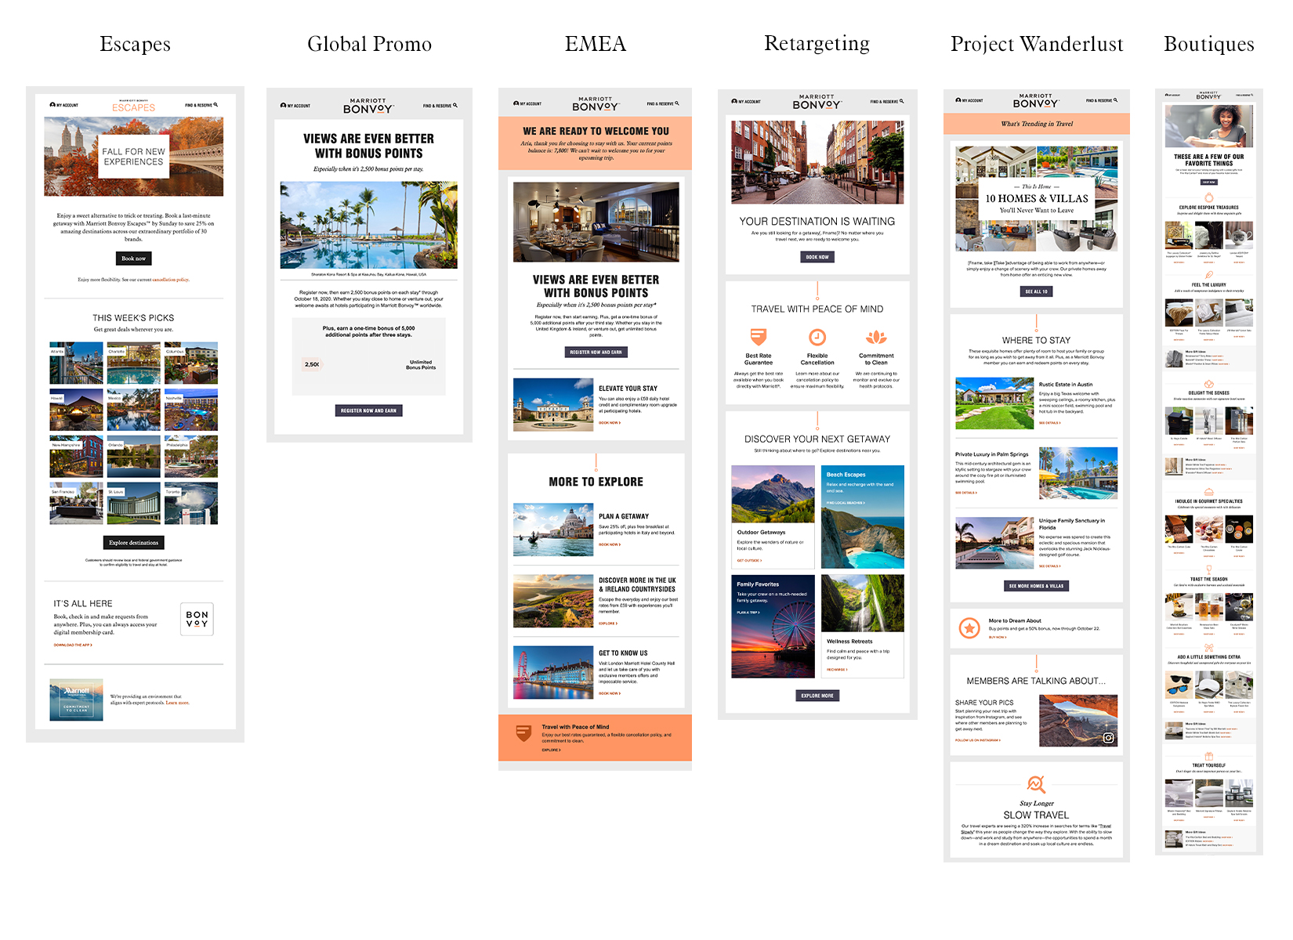

Slide 10
4. Our Goal
Update the existing Marriott master template and apply the new brand.
Elevate the design to a sophisticated, luxurious, entertaining, beautiful and readable layout.
Add new modules, retire unused modules and recode to faster and lighter loading.

Slide 11
5. Open Questions
Any specific new modules you’d like to see?
Brand bar
  Is 72&Sunny owning this?
- Any last questions or call outs /Are we missing anything?

Slide 12
6. Next Steps
Wireframe feedback, revisions & approval
Design presentation
  All sections master template
  Options for:
    Header
    Features
    Secondary & tertiary mods
    Footer
  Examples
    MAU
    Cobrand
    Global Promo

Slide 13
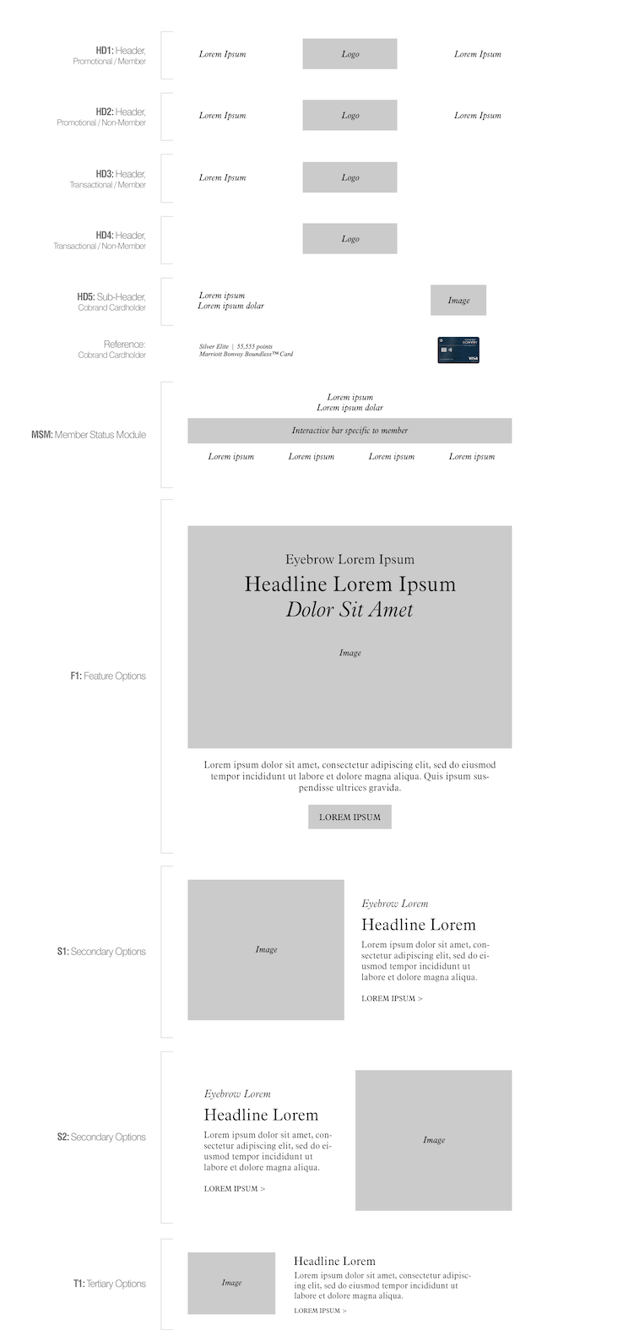
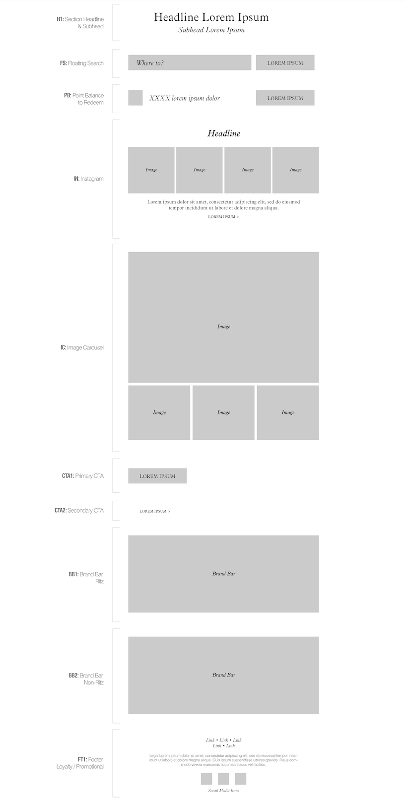
Wireframe
http://preview.4at5.net/email_domains/mar/0909/MBVwireframe.html

Slide 14
Thank you
Notes:
Housekeeping

