Slide 1
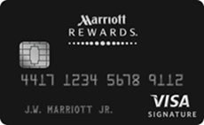
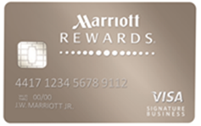
E-mail Image Guidelines
MR CREDIT CARD
U.S. Consumer
U.S. Business
Canada
Showcase “aspirational” imagery
  Resorts, beach, city
  Hotel exteriors, pools
  A few options that reflect seasonality (ie, around the holidays)
Limit lobby and F/B images, unless they highlight a unique property feature (architecture, fireplace, staircase)
Should have 2-3 Canada property options
Feature key U.S. markets (NY, FL, CA, AZ, WA, plus border states)
International options may include CALA, Europe)
Must be category 1-6
Showcase “aspirational” imagery
  Resorts, beach, city
  Hotel exteriors, pools
Limit lobby and F/B images, unless they highlight a unique property feature (architecture, fireplace, staircase)
Should be a mix of domestic / international
Skew more full service (all brands, except The Ritz-Carlton), but use all brands except Starwood brands (no permission to use those images in 2017)
No category limit
Will use the same imagery as the U.S. Consumer card

