Slide 1
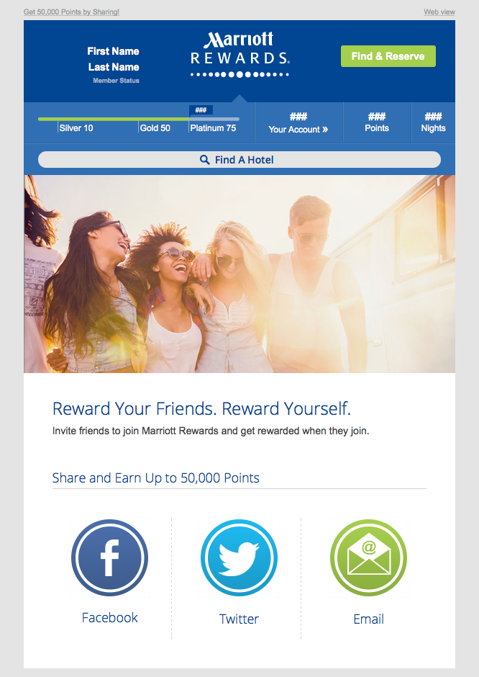

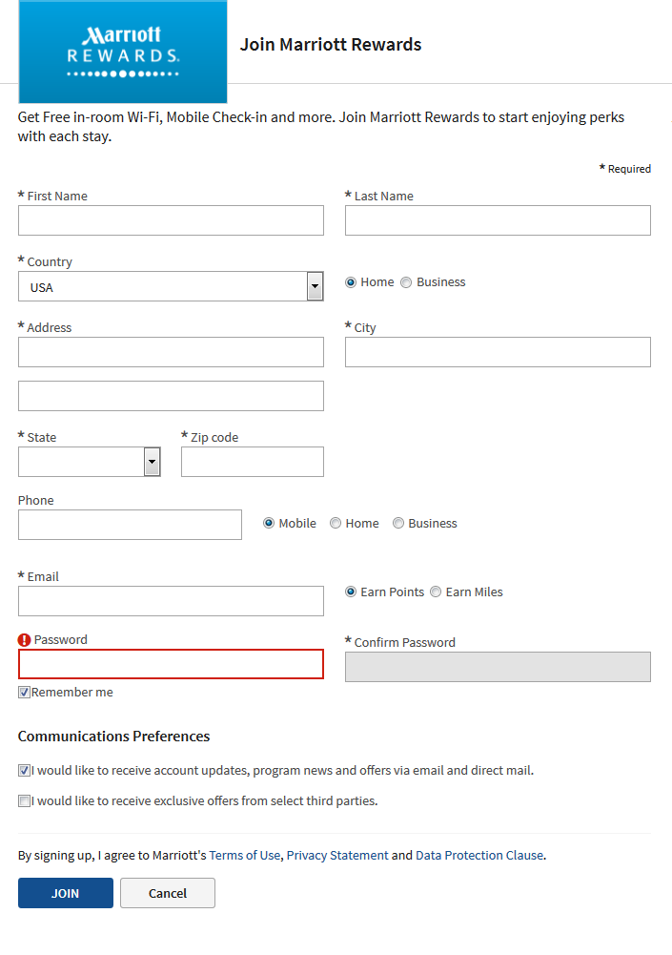
Email encourages members to refer friends via social
Member posts invitation to join on their social network
Member’s friends click through to landing page where they can join
Join Marriott Rewards
Get a free night & help me earn up to 50,00 bonus points

Slide 2
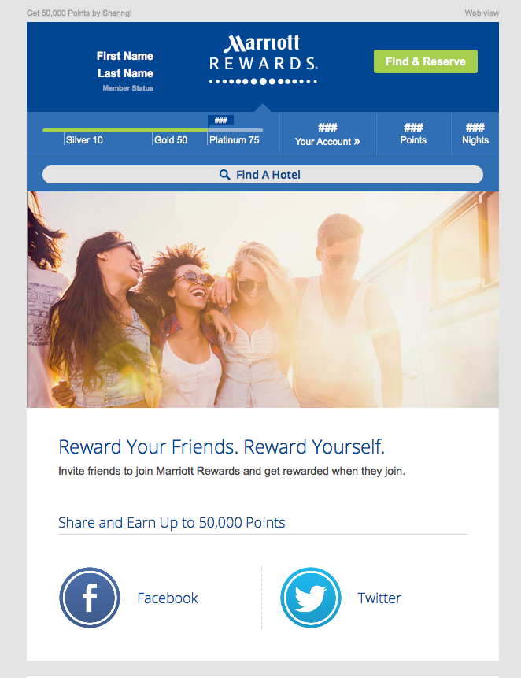
Email encourages members to refer friends via social
Member posts invitation to join on their social network
Member’s friends click through to landing page where they can join
Join Marriott Rewards
Get a free night & help me earn up to 50,00 bonus points

Slide 3

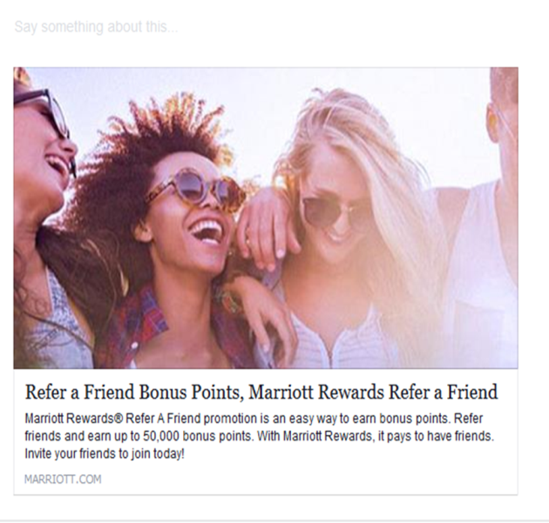

Email encourages members to refer friends via social
Member posts invitation to join on their social network
Member’s friends click through to landing page where they can join
Reward your friends. Reward yourself.
Earn up to 50,000 points when you get your friends to join Marriott Rewards.
Join Marriott Rewards
Get a free night & help me earn up to 50,00 bonus points

