Slide 1

[Activation]
Activate Orange Segments across Digital

Slide 2
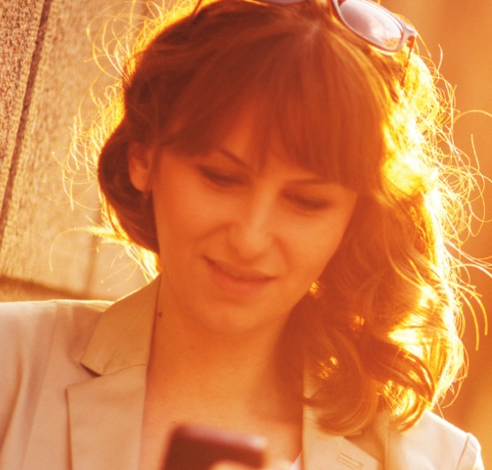
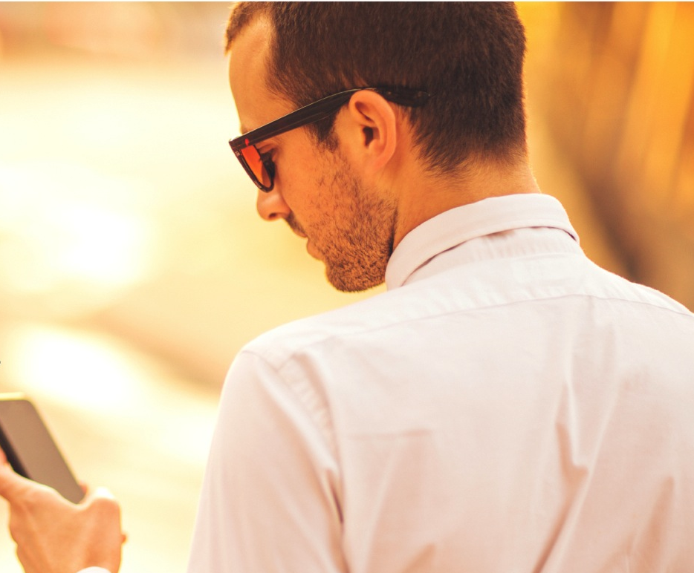

Project Orange Headlines
What: A behavioral-based segmentation that addresses business + leisure
Why: To serve up the right message to specific customer segments with the greatest lifetime value to our portfolio
Key Findings: 12 segments identified; the top 2 worth $10.2B in future value
Test: Impact of relevant messaging to drive booking behavior and loyalty

Slide 3
What we hope to learn:
What is the “current state” performance of Project Orange Segments
Can we improve performance by targeting/shifting spend toward top segments
Can we bolster performance by creating segment specific messaging/creative
Can we orchestrate a customer journey across paid, owned and earned for top segments

Slide 4
We are taking a phased approach to maximize learning and ramp up marketing efforts
2015
JAN | FEB | MAR | APR | MAY | JUN | JULY | AUG | SEPT | OCT
1. Onboard audiences into digital platform
M.COM/ADOBE/BLUE KAI
LIVERAMP
CRITEO/GOOGLE
M.COM
2. Track segments within existing (Destination focused) campaigns
RE
TARGETING
PAID
SEARCH
M.COM SEGMENT DISTRIBUTION
4/15
LAUNCH
EMAIL
AUDIENCE PLANNING/STRATEGY
3. Target segments + heavy up spend within existing (Destination focused) campaigns
RETARGETING PLANNING
RETARGETING
5/15
LAUNCH
PAID SEARCH PLANNING
PAID SEARCH
M.COM PLANNING
M.COM LAUNCH
4. Target segments within existing campaigns with customized message and dynamic landing page
RETARGETING PLANNING
RETARGETING LAUNCH
PAID SEARCH PLANNING
6/15
LAUNCH
PAID SEARCH LAUNCH
5. Add additional channels and enhance site experience to create a full customer journey
PROSPECTING PLANNING
PROSPECTING LAUNCH
EMAIL PLANNING
EMAIL LAUNCH

Slide 5

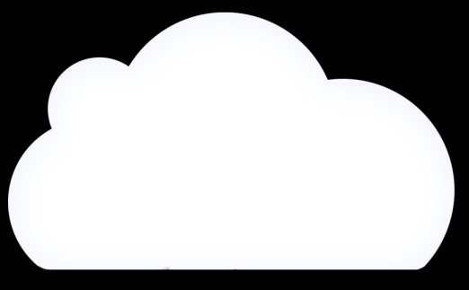











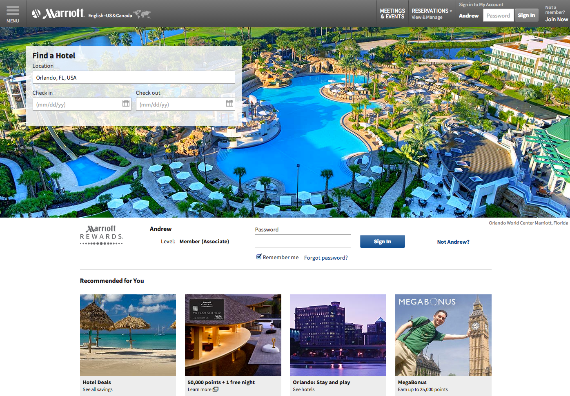










Onboarding and Propagating Orange Segment CEIs across Digital Channels is underway
Email
MARKETING EMAIL
3
MEMBER CEI’S
2
All CEI’S
CEI’s
SGI
Consumer Insight
MEMBERS @ SIGNIN
1
M.com
Mobile Web
Display
Search
Social
TV
Print
Radio
DM
Retail
CC

Slide 6
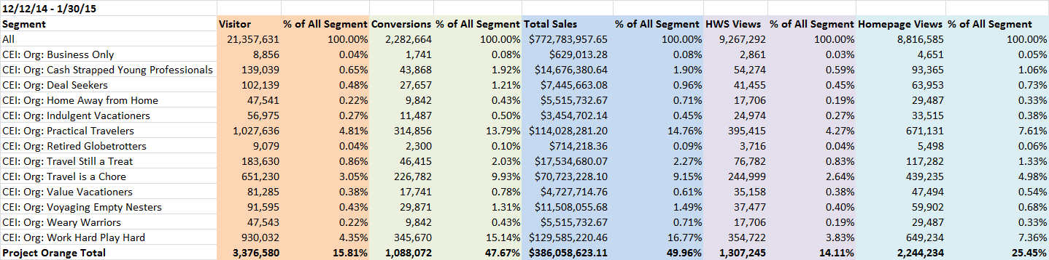
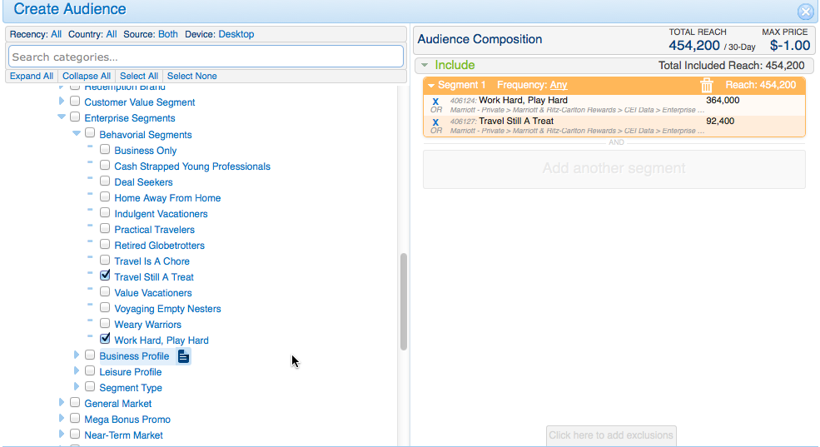
Segment performance is now being tracked across M.com via Adobe and Blue Kai, and additional channels to be added soon.
TV
Print
Radio
DM
Retail
CC

Slide 7
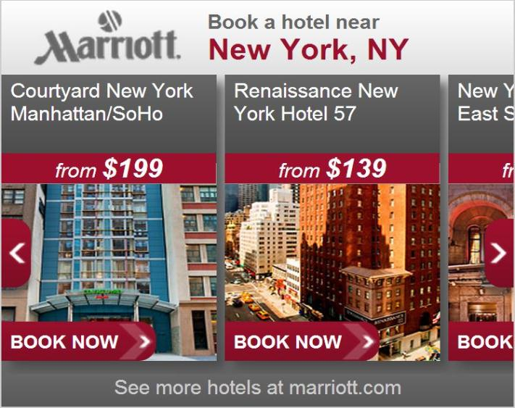
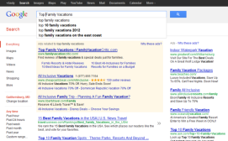
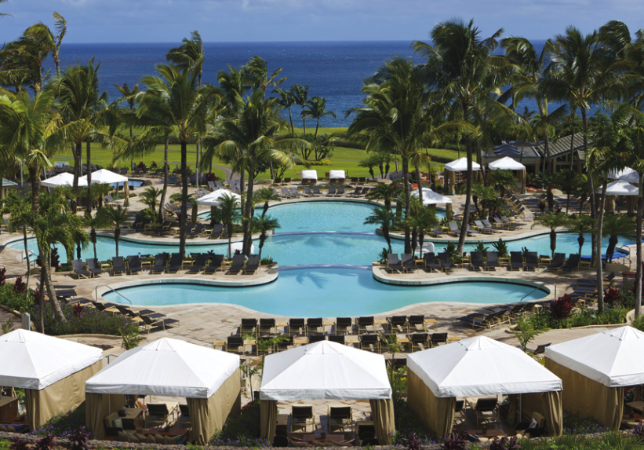
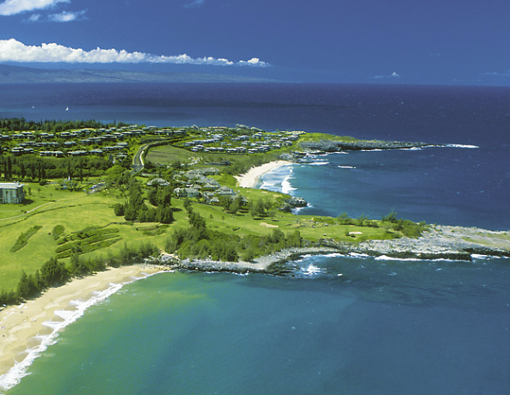


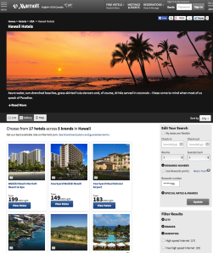

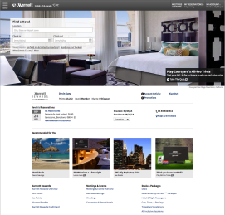
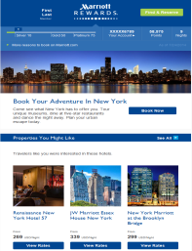
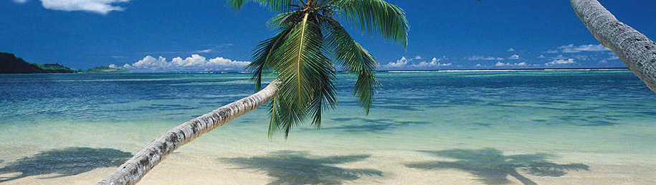
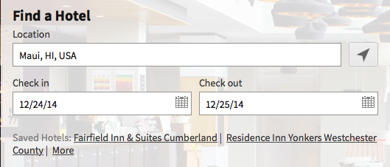


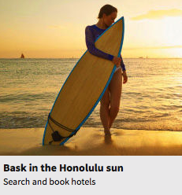
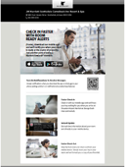
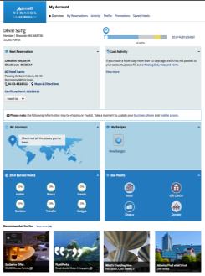
We will orchestrate an integrated customer journey across leveraging paid, owned, and earned channels for our top segments
Honolulu, HI
JW Marriott Ihilani
Ko Olina Resort Spa
Waikiki Beach Marriott Resort Spa
Targeted Display
Honolulu, HI
Audience-based search bidding
JW Marriott Ihilani
Ko Olina Resort Spa
Waikiki Beach Marriott Resort Spa
Retargeting/Display
Dynamic Landing page
Home page
Event Based
Email
My Account
Marketing Email

Slide 8
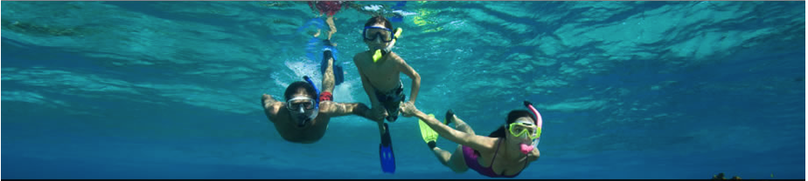

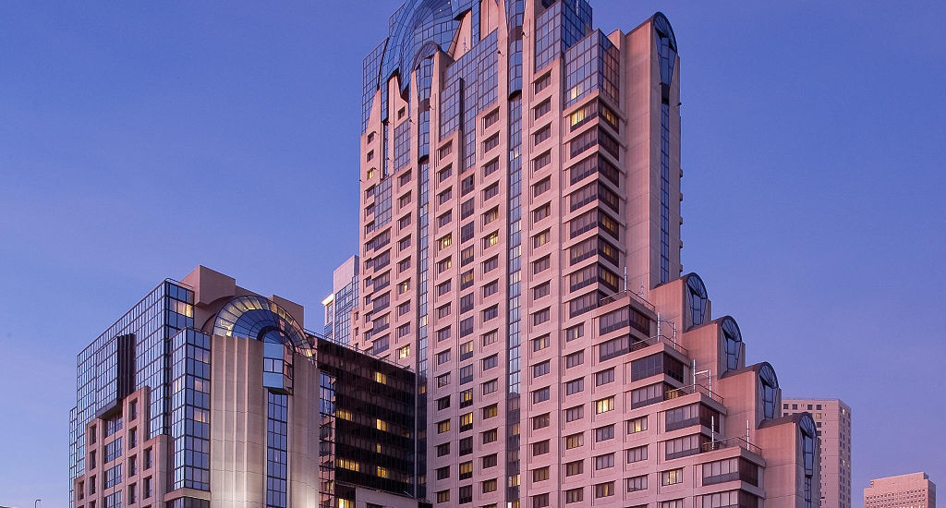
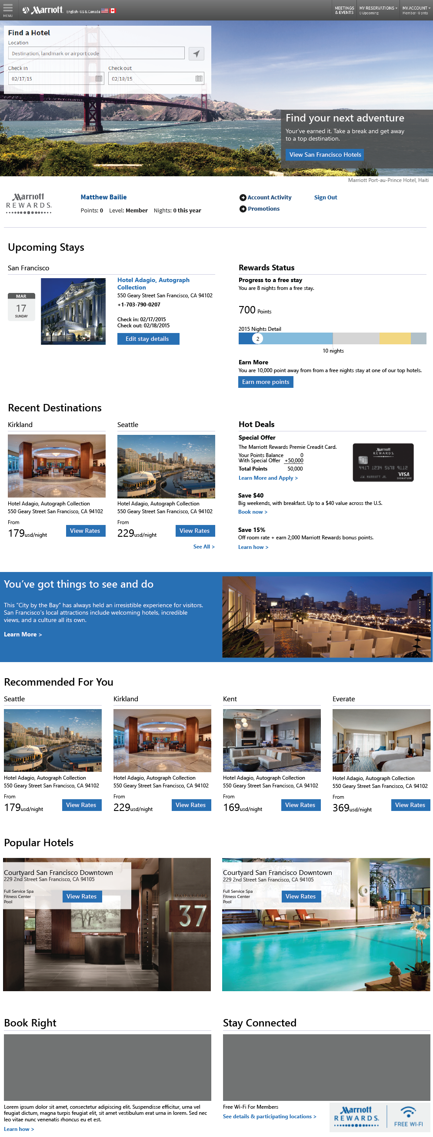
Our Segment Messaging Approach will combine customer segment messaging proof points + real time destination intent to create a personalized experience that drives results
SEGMENT
WORK HARD PLAY HARD
(E.G LIKES TO USE POINTS)
TRAVEL’S STILL A TREAT
(E.G. VALUES TIME WITH FAMILY
+
NON-MEMBER OR MEMBER
+
+
+
MESSAGE
SEGMENT MESSAGE
SEGMENT +
DESTINATION
SEGMENT+
PROPERTY

Slide 9
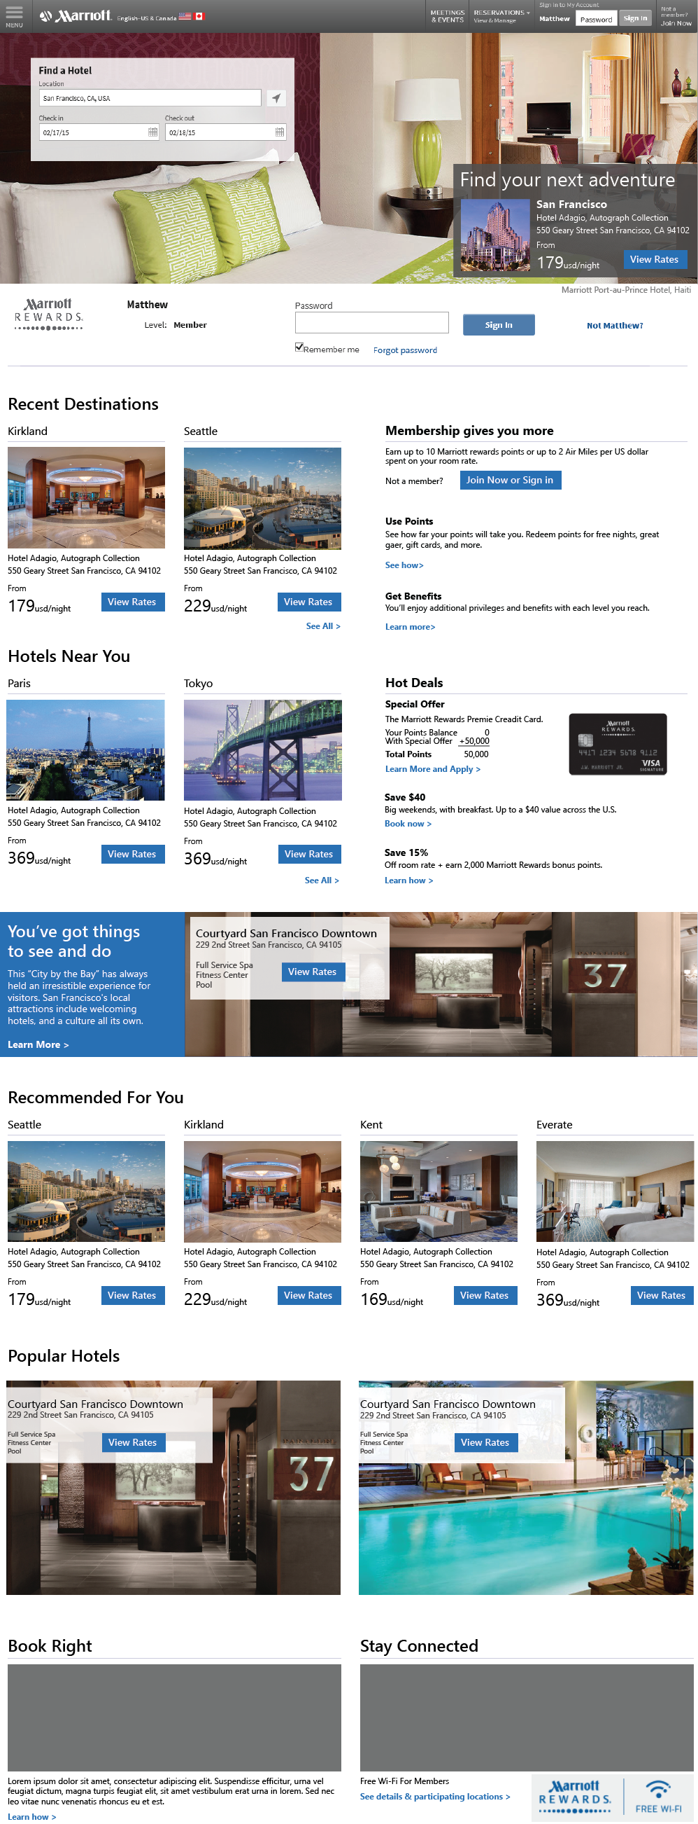
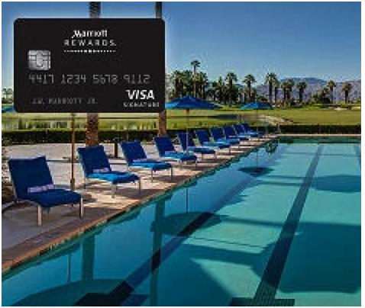
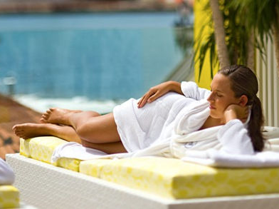

Segment + Anonymous Destination Intent Landing Page
FPO
Leisure
Research
Leisure
Booking
Pre
Stay
Leisure
Stay
Post
Stay
Leisure
Trigger
A2
A1
GOAL
REVENUE PER BOOKING
A3
DATA
Segment: Work Hard Play Hard
Business Profile: Weekly Project Traveler
Leisure Profile: Luxury Resort Next Gen
Behavioral 3rd party:
Behavioral 1st party:
IP: Seattle
Device: mac book
Browser: Chrome
Near By Hotels
B1
C1
Popular Booked Hotels – Trending Now
Redeem at Top Resorts
B2
Content
Segment:
A1: Lifestyle Image
A2: Booking Widget
A3: Segment Message
C1: Enroll/Member Benefits Message
C2: Ancillary/Amenities Content
C3:: Segment + Book Right
Destination
B1: Near By Hotels
B2: Popular Booked Hotels
B3: Popular Searched Hotels
C2
Relax + Refresh
Popular Searched Hotels – Trending Now
B3
C3
Notes:
Upon entering the site, we immediately learn some more environmental information about her:
She lives in Seattle (IP)
Uses a Mac book
And is using Crome
But, we still have the 3rd party intent - Hawaii
And her Segment intent - WHPH
Based on this information, we pre-pop the booking widget (A1) with Hawaii
Show a Luxury Hotel for Hawaii in the hero (A2)
And Show a targeted offer in A3 for WHPH Hawaii.
Also, leveraging Adobe’s recommendation engine, we could right a customer algorithm to show top booked hawaian hotels by WHPH’s.
Also, we could show a hometown offer (c1)
And her last booked hotel (C2)

Slide 10
Segment + Known Destination Intent Landing Page
FPO
Leisure
Research
Leisure
Booking
Pre
Stay
Leisure
Stay
Post
Stay
Leisure
Trigger
A2
A1
GOAL
REVENUE PER BOOKING
A3
DATA
Segment: Work Hard Play Hard
Business Profile: Weekly Project Traveler
Leisure Profile: Luxury Resort Next Gen
Behavioral 3rd party:
In-Marketing: San Francisco
Behavioral 1st party:
IP: Seattle
Device: mac book
Browser: Chrome
In-Marketing: San Francisco
Popular Hotels Based on Recently Viewed
B1
C1
Popular Hotels in San Francisco
Redeem at Top Resorts
B2
Content
Segment:
A1: Lifestyle Image
A2: Booking Widget
A3: Segment Message + Destination
C1: Enroll/Member Benefits Message
C2: Ancillary/Amenities Content
C3:: Segment + Book Right
Destination
B1: Popular Hotels Based on Recently Viewed/Searched Hotel
B2: Popular Hotels Based on Recently Viewed Destination
B3: Nearby Hotels
C2
Relax + Refresh
Near By Hotels
B3
C3
Notes:
Upon entering the site, we immediately learn some more environmental information about her:
She lives in Seattle (IP)
Uses a Mac book
And is using Crome
But, we still have the 3rd party intent - Hawaii
And her Segment intent - WHPH
Based on this information, we pre-pop the booking widget (A1) with Hawaii
Show a Luxury Hotel for Hawaii in the hero (A2)
And Show a targeted offer in A3 for WHPH Hawaii.
Also, leveraging Adobe’s recommendation engine, we could right a customer algorithm to show top booked hawaian hotels by WHPH’s.
Also, we could show a hometown offer (c1)
And her last booked hotel (C2)

Slide 11
Segment + Known Property Intent Landing Page
FPO
Leisure
Research
Leisure
Booking
Pre
Stay
Leisure
Stay
Post
Stay
Leisure
Trigger
A2
A1
GOAL
REVENUE PER BOOKING
A3
DATA
Segment: Work Hard Play Hard
Business Profile: Weekly Project Traveler
Leisure Profile: Luxury Resort Next Gen
Behavioral 3rd party:
In-Marketing: San Francisco
Behavioral 1st party:
IP: Seattle
Device: mac book
Browser: Chrome
In-Marketing: San Francisco
Recently Viewed Hotels
B1
C1
Popular Hotels Based on Recently Viewed
Redeem at Top Resorts
B2
Content
Segment:
A1: Lifestyle Image
A2: Booking Widget
A3: Segment Message + Destination
C1: Enroll/Member Benefits Message
C2: Ancillary/Amenities Content
C3:: Segment + Book Right
Destination
B1: Recently Viewed Hotels
B2: Popular Hotels Based on Recently Viewed
B3: Nearby Hotels
C2
Relax + Refresh
Near By Hotels
B3
C3
Notes:
Upon entering the site, we immediately learn some more environmental information about her:
She lives in Seattle (IP)
Uses a Mac book
And is using Crome
But, we still have the 3rd party intent - Hawaii
And her Segment intent - WHPH
Based on this information, we pre-pop the booking widget (A1) with Hawaii
Show a Luxury Hotel for Hawaii in the hero (A2)
And Show a targeted offer in A3 for WHPH Hawaii.
Also, leveraging Adobe’s recommendation engine, we could right a customer algorithm to show top booked hawaian hotels by WHPH’s.
Also, we could show a hometown offer (c1)
And her last booked hotel (C2)

Slide 12
Channel/Touch Point Work Stream Leads
 | Personalized Digital Touch Point | LEAD | AGENCY
 | Sponsor/Lead | SHEILA HOLMAN
 | Personalization Campaign/POC | ANDREW HAYNES
 | PROJECT MANAGER | DEBRA McDONALD
 | M.Com UX Lead | HOWARD SCHWARTZ
 | MCA Creative Lead | SHEILA deCASTRO
 | Data Targeting & Management | YINIAN HOU ANDREW HAYNES
 | Targeted Paid Search Bidding | COLIN O’GRADY | BCM
 | Target/Retargeting Display (Prospecting) | GRIFF GARWOOD | MEC
 | Email | TERRILYN TOURANGEAU
 | M.Com Landing page | ANDREW HAYNES BONNIE ALLEN LEE CARSON | ADOBE
 | M.com | BONNIE ALLEN KENDRA FLORIO | ADOBE
 | Measurement | YINIAN HOU CASEY CORCORAN

Slide 13
THANK YOU
Notes:
Let’s take a look at what a sample journey could look like for an orange segment

Slide 14
Work Hard Play Hard (WHPH) Segment Strategy
Objective-
Test the impact of segment-relevant messaging on destination landing pages to drive bookings.
Target-
WHPH adults in their 40s whose first choice program loyalty is Starwood
Segment Insights (see profile for full detail)-
WHPH are ambitious, always on-the-go and multi-tasking. They seek to maximize time and are able to fit it all in, but they know how to fully shut it down when needed.
WHPH are extremely savvy travelers in pursuit of experiences that make them feel on top of the world. Always looking for a new way to game the loyalty program. Points help them get to a well-deserved vacation pot at the end of the rainbow.
WHPH over-index at Starwood properties for business and leisure.
Creative Direction-
1- Hero Image
Imagery should be active vs. static, to convey a sense of movement and energy
2- Segment Headline
Copy should speak to being in control, maximizing time, multi-tasking or fitting it all in
3- Brand and Amenities Featured
-Full service brands, Courtyard. If leisure, luxury and lifestyle brands
-Fitness, technology, quick service F&B, bar
4- Loyalty Offers
Points incentive to earn points faster. Use leisure as carrot.
5- Local Area Content Featured
Running routes from the property, unique restaurants or bars within walking distance of hotel, wellness/organic markets within walking distance of hotel
1 – Hero Image
2 – Segment headline
3 –
Brands served up
Amenities featured
4 – Loyalty offers
5 –
Local area content

Slide 15
Travel is Still a Treat (TSAT) Segment Strategy
Objective-
Test the impact of segment-relevant messaging on destination landing pages to drive bookings.
Target-
TSAT adults in their 40s who typically book through OTAs
Segment Insights (see profile for full detail)-
TSAT are grounded and content people who prioritize work/life balance and appreciate the little things in life
TSAT doesn’t travel often, but when they do they prefer to travel in style. They have an aspirational view of travel and seek out a trip that isn’t cookie-cutter. They are buying the whole experience, not just the room.
TSAT has mixed booking channel usage, evenly distributed among hotel website and OTA
TSAT values on-property amenities, indulgences, and customer service.
Creative Direction-
1- Hero Image
Imagery should feel rich and luxurious, include people interacting with the property
2- Segment Headline
Copy should speak to the little perks while traveling, a chance to indulge or treat yourself right
3- Brand and Amenities Featured
-Luxury and lifestyle brands
-Spa, fitness, bath amenities, soaking tub in room (if available), unique F&B on-site
4- Loyalty Offers
Earn points beyond the hotel stay; earn on small perks, room upgrades
5- Local Area Content Featured
Unique local shopping, cafes, restaurants and bars. Cultural and local points of interest.
1 – Hero Image
2 – Segment headline
3 –
Brands served up
Amenities featured
4 – Loyalty offers
5 –
Local area content

Slide 16
SEGMENT MESSAGING MATRIX
22
48
Phase 1 | SEGMENT 1: WHPH | SEGMENT 2: TSAT
SEGMENT MESSAGE 1 | ARTWORK + COPY | ARTWORK + COPY
SEGMENT MESSAGE 2 | ARTWORK + COPY | ARTWORK + COPY
DESTINATION MESSAGE 1 | COPY | COPY
DESTINATION MESSAGE 2 | COPY | COPY
PROPERTY MESSAGE 1 | COPY | COPY
PROPERTY MESSAGE 2 | COPY | COPY
Enroll/Redeem Message | ARTWORK + COPY | ARTWORK + COPY
Amenities Message 1 | ARTWORK + COPY | ARTWORK + COPY
Amenities Message 2 | ARTWORK + COPY | ARTWORK + COPY
Book Right Message 1 | ARTWORK + COPY | ARTWORK + COPY
Book Right Message 1 | ARTWORK + COPY | ARTWORK + COPY
Phase 2 | SEGMENT 1: WHPH | SEGMENT 2: TSAT
Landing Page
Paid Search (12) | COPY | COPY
Email (12) | ARTWORK + COPY | ARTWORK + COPY
Display (12) | ARTWORK + COPY | ARTWORK + COPY
Merchandising (12) | ARTWORK + COPY | ARTWORK + COPY
Notes:
Map Brands + Luxuary
Recommended Brands for you:

Slide 17
NEXT STEPS

Slide 18


Orange Activation POC: Platform Readiness
 | Personalized Digital Touch Point | DMP | ETA
 | Targeted Paid Search Bidding |  | Q1 - COMPLETE
 | Targeted Display/Video (Prospecting) |  | Q1 - COMPLETE
 | Dynamic Re-targeting Display |  | TBD
 | Marriott.com Abandon e-mail |  | TBD
 | Marriott Rewards Newsletter e-mail |  | TBD
 | M.com Homepage |  | Q1 – COMPLETE
 | Dynamic Landing Page |  | Q1 - COMPLETE
1
2
2
3
3
4
4
Adobe Target Monitoring Campaign - Q1 - COMPLETE

Slide 19
Work Streams + Timing
2015
JAN | FEB | MAR | APR | MAY | JUN
STRATEGY
PLANNING
AUDIENCE PLANNING/STRATEGY
MCA CONTENT PLANNING
DELIVERY
CONTENT/CREATIVE
M.COM UX
DELIVERY
M.COM SEGMENT DISTRIBUTION
SEGMENTS LIVE
ON M.COM & DMP
DATA/TARGETING
M.COM
MONITORING CAMPAIGN
LIVERAMP PLANNING
SEGMENT LIVE IN DMP
M.COM LANDING PAGE
CAMPAIGN LAUNCH
M.COM/MERCHANDING
CAMPAIGN LAUNCH
MEDIA/CHANNEL
PAID SEARCH
4/15
LAUNCH
CAMPAIGN LAUNCH
DISPLAY/RETARGETING
CAMPAIGN LAUNCH
EMAIL
CAMPAIGN LAUNCH
MEASUREMENT
M&A Planning
CAMPAIGN LAUNCH

Slide 20
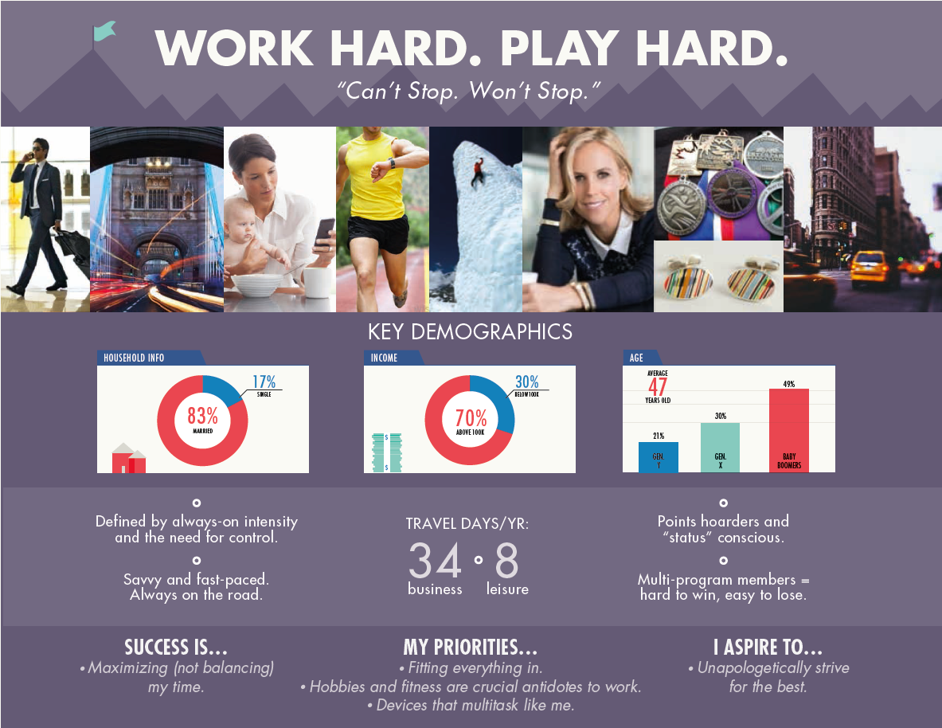

Slide 21
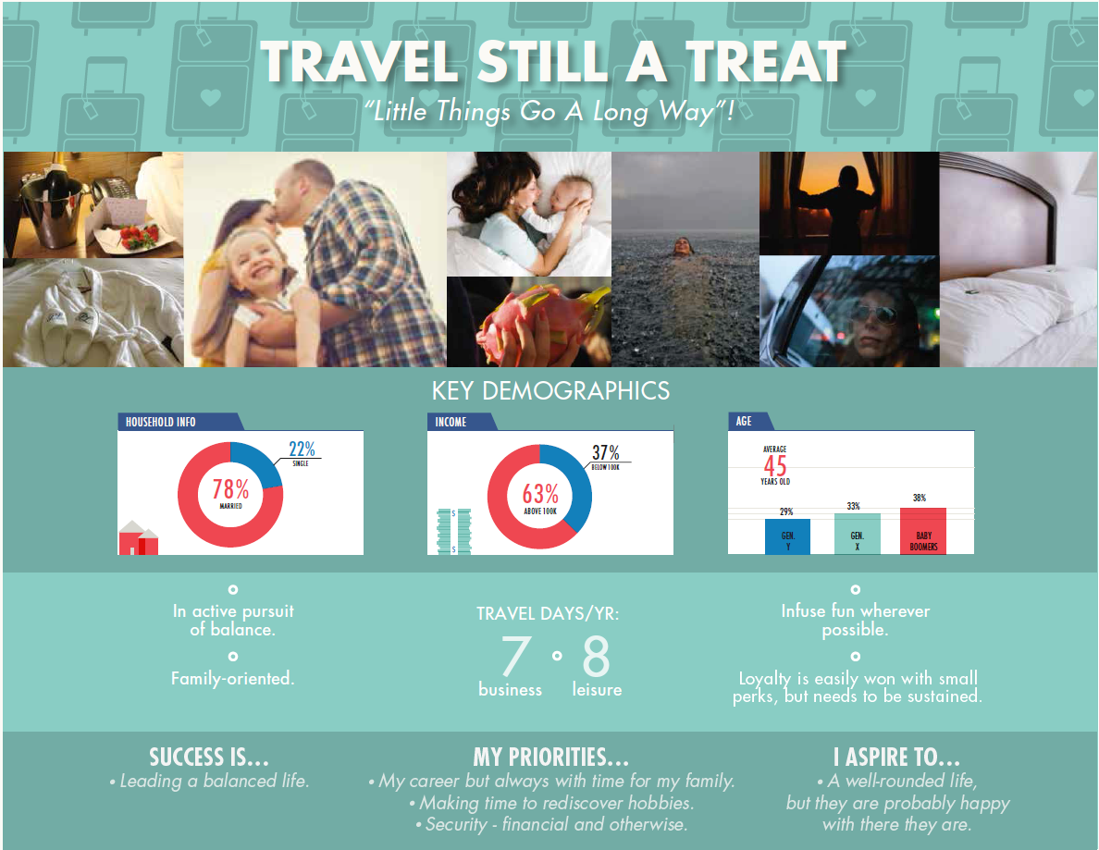

Slide 22
Enterprise Segmentation Brief
Audience:
  WHPH adults in their 40s whose first choice program loyalty is Starwood
  TSAT adults in their 40s who typically book through OTA’S
Objective:
  Test the impact of segment-relevant messaging as an integrated campaign across multiple MI channels to drive bookings
Message:
  WHPH: Combine active lifestyle imagery with messaging reflecting being in control, maximizing time, multi-tasking and fitting it “all in”
  TSAT: Combine luxury lifestyle imagery with messaging reflecting travel perks, pampering, indulgence and treating yourself right
Approach:
  Leverage targeted paid, owned and earned placements to contextually message each segment
KPI’s
  Immediate Term:
    Conversion Rate/Bookings
    Engagement/CTR
  Medium Term:
    Life Time Value

Slide 23
PROJECT ORANGE POC:
SEGMENT OVERVIEW
Notes:
Let’s take a look at what a sample journey could look like for an orange segment

Slide 24
Segment Specific Landing Pages
FPO
Leisure
Research
Leisure
Booking
Pre
Stay
Leisure
Stay
Post
Stay
Leisure
Trigger
A2
A1
GOAL
REVENUE PER BOOKING
A3
DATA
Behavioral 3rd party:
Behavioral 1st party:
IP: Seattle
Device: mac book
Browser: Chrome
Segment: Work Hard Play Hard
Business Profile: Weekly Project Traveler
Leisure Profile: Luxury Resort Next Gen
Near By Hotels
B1
C1
Popular Booked Hotels – Trending Now
Redeem at Top Resorts
B2
Content
A1: Lifestyle Image
A2: Booking Widget
A3: Segment Message
B1: Near By Hotels
B2: Popular Booked Hotels
B3: Popular Searched Hotels
C1: Enroll/Member Benefits Message
C2: Ancillary/Amenities Content
C3:: Segment + Book Right
C2
Relax + Refresh
Popular Searched Hotels – Trending Now
B3
C3
Notes:
Upon entering the site, we immediately learn some more environmental information about her:
She lives in Seattle (IP)
Uses a Mac book
And is using Crome
But, we still have the 3rd party intent - Hawaii
And her Segment intent - WHPH
Based on this information, we pre-pop the booking widget (A1) with Hawaii
Show a Luxury Hotel for Hawaii in the hero (A2)
And Show a targeted offer in A3 for WHPH Hawaii.
Also, leveraging Adobe’s recommendation engine, we could right a customer algorithm to show top booked hawaian hotels by WHPH’s.
Also, we could show a hometown offer (c1)
And her last booked hotel (C2)

Slide 25
Segment + Destination Landing Pages
FPO
Leisure
Research
Leisure
Booking
Pre
Stay
Leisure
Stay
Post
Stay
Leisure
Trigger
A2
A1
GOAL
REVENUE PER BOOKING
A3
DATA
Behavioral 3rd party:
Behavioral 1st party:
IP: Seattle
Device: mac book
Browser: Chrome
Segment: Work Hard Play Hard
Business Profile: Weekly Project Traveler
Leisure Profile: Luxury Resort Nex Gen
Popular Hotels Based on Recently Viewed
B1
C1
Popular Hotels in San Francisco
Redeem at Top Resorts
B2
Content
A1: Destination Image
A2: Booking Widget
A3: Segment Message
B1: Popular Hotels Based on Recently Viewed/Searched Hotel
B2: Popular Hotels Based on Recently Viewed Destination
B3: Nearby Hotels
C1: Enroll/Member Benefits Message
C2: Ancillary/Amenities Content
C3:: Segment + Book Right
C2
Relax + Refresh
Near By Hotels
B3
C3
Notes:
Upon entering the site, we immediately learn some more environmental information about her:
She lives in Seattle (IP)
Uses a Mac book
And is using Crome
But, we still have the 3rd party intent - Hawaii
And her Segment intent - WHPH
Based on this information, we pre-pop the booking widget (A1) with Hawaii
Show a Luxury Hotel for Hawaii in the hero (A2)
And Show a targeted offer in A3 for WHPH Hawaii.
Also, leveraging Adobe’s recommendation engine, we could right a customer algorithm to show top booked hawaian hotels by WHPH’s.
Also, we could show a hometown offer (c1)
And her last booked hotel (C2)

Slide 26
Segment + Property Landing Pages
FPO
Leisure
Research
Leisure
Booking
Pre
Stay
Leisure
Stay
Post
Stay
Leisure
Trigger
A2
A1
GOAL
REVENUE PER BOOKING
A3
DATA
Behavioral 3rd party:
Behavioral 1st party:
IP: Seattle
Device: mac book
Browser: Chrome
Segment: Work Hard Play Hard
Business Profile: Weekly Project Traveler
Leisure Profile: Luxury Resort Nex Gen
Recently Viewed Hotels
B1
C1
Popular Hotels Based on Recently Viewed
Redeem at Top Resorts
B2
Content
A1: Destination Image
A2: Booking Widget
A3: Segment Message
B1: Recently Viewed Hotels
B2: Popular Hotels Based on Recently Viewed
B3: Nearby Hotels
C1: Enroll/Member Benefits Message
C2: Ancillary/Amenities Content
C3:: Segment + Book Right
C2
Relax + Refresh
Near By Hotels
B3
C3
Notes:
Upon entering the site, we immediately learn some more environmental information about her:
She lives in Seattle (IP)
Uses a Mac book
And is using Crome
But, we still have the 3rd party intent - Hawaii
And her Segment intent - WHPH
Based on this information, we pre-pop the booking widget (A1) with Hawaii
Show a Luxury Hotel for Hawaii in the hero (A2)
And Show a targeted offer in A3 for WHPH Hawaii.
Also, leveraging Adobe’s recommendation engine, we could right a customer algorithm to show top booked hawaian hotels by WHPH’s.
Also, we could show a hometown offer (c1)
And her last booked hotel (C2)

Slide 27

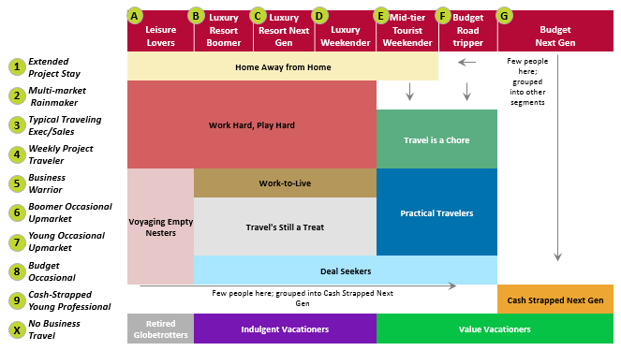
Work Hard, Play Hard:
Notes:
Project Orange is made of up 12 segments (center), which are a combination of 10 business profiles (left) and 7 leisure profiles (top)
The Work Hard Play Hard and Travel still a treat audiences have been identified as the top priority based on spend and potential spend
Today, we are going to take you through a work hard play hard journey, for a Weekly Project Traveler (4) + Luxury Resort Next Gen (C)

Slide 29
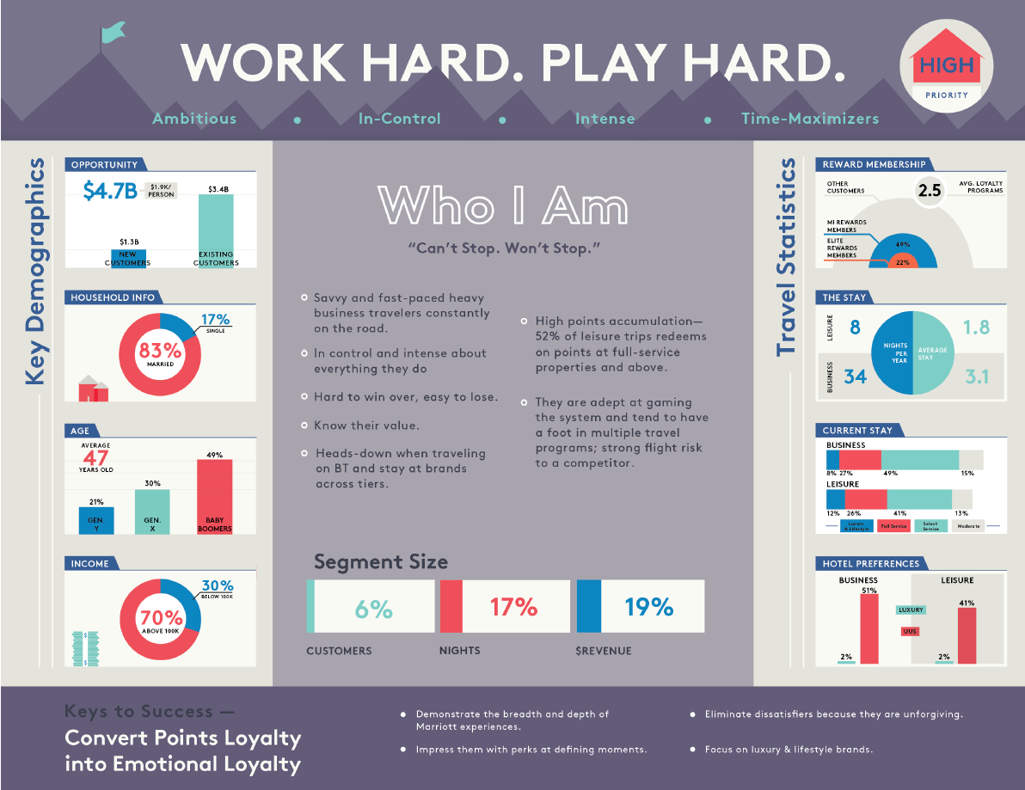

Slide 30
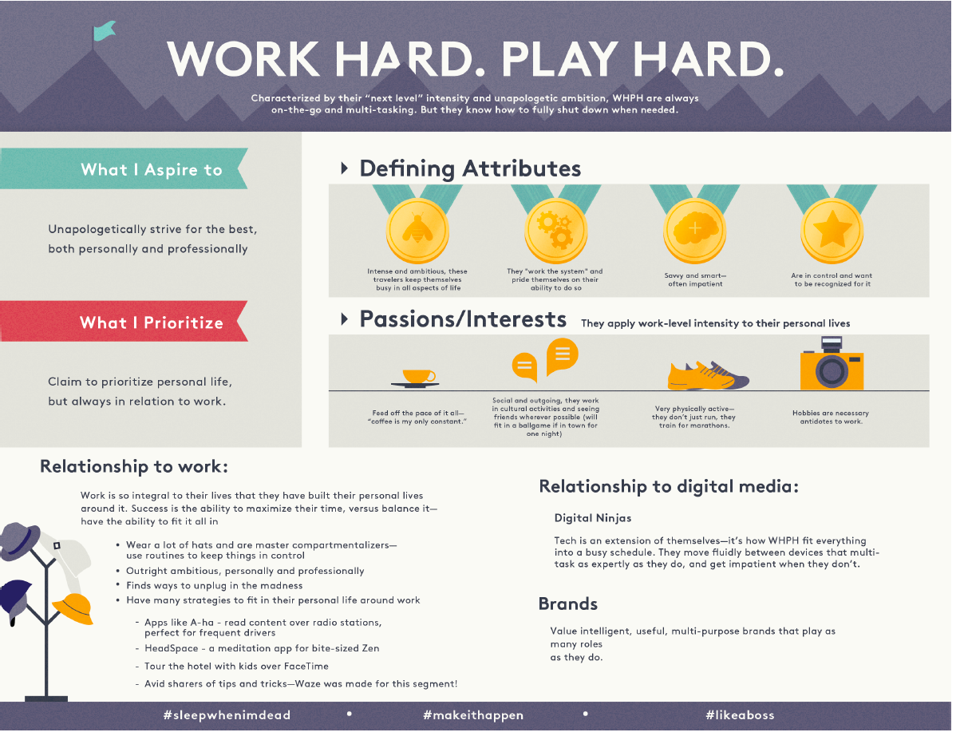

Slide 31
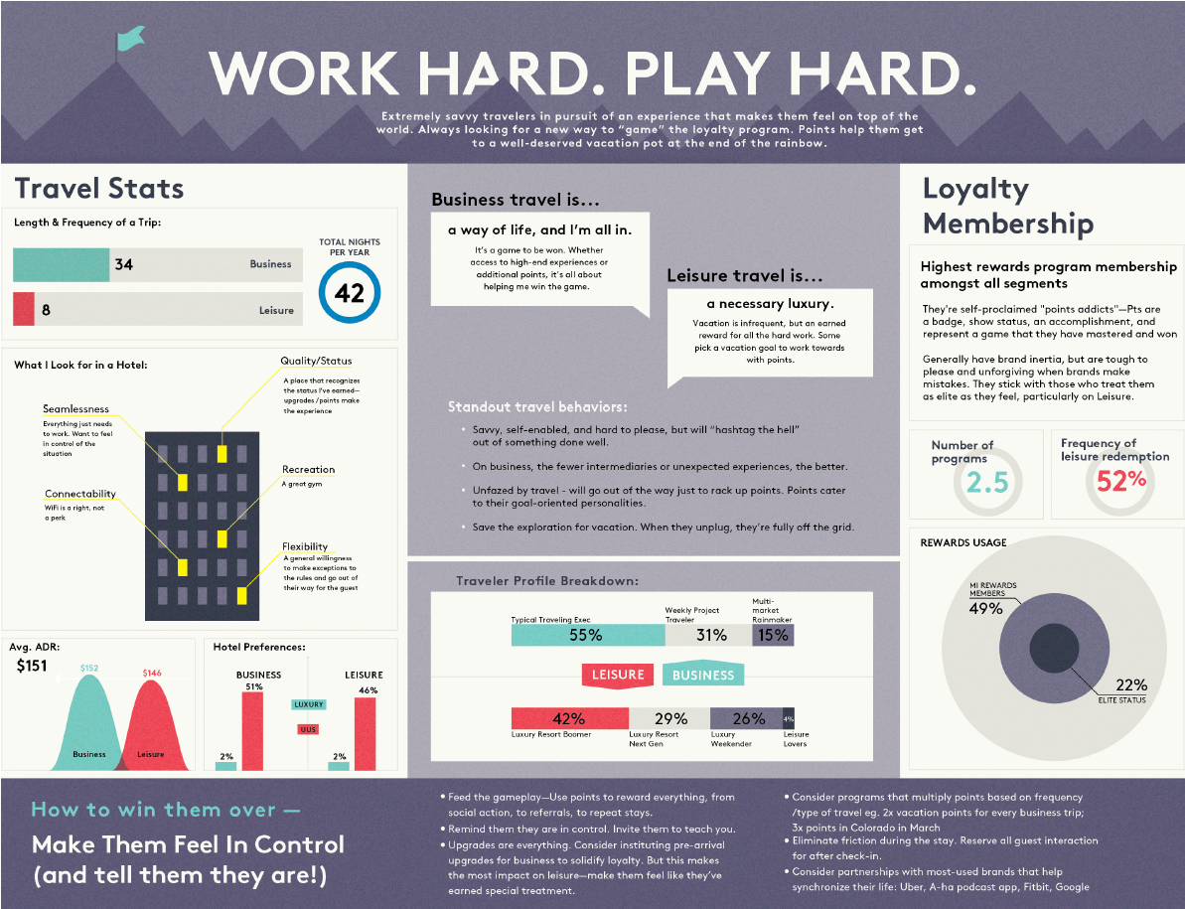

Slide 33
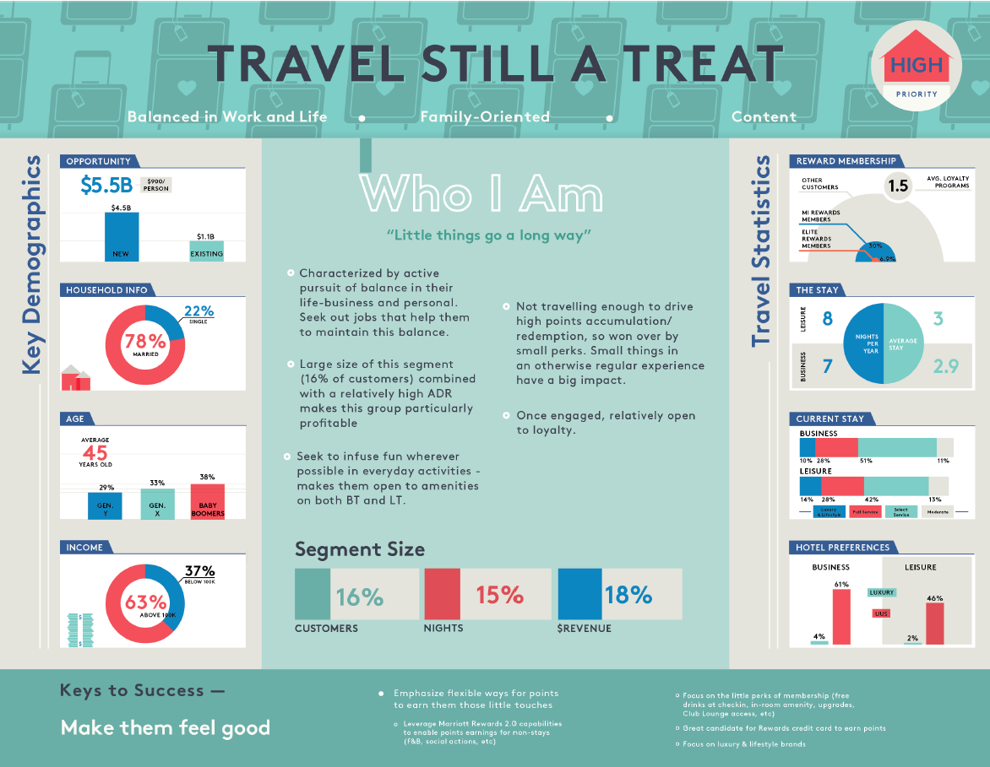

Slide 34
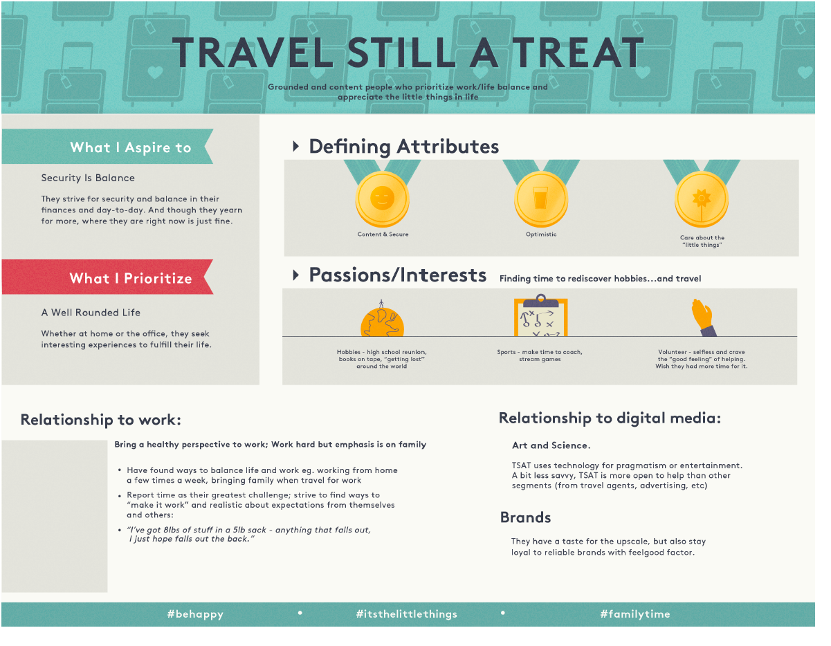

Slide 35
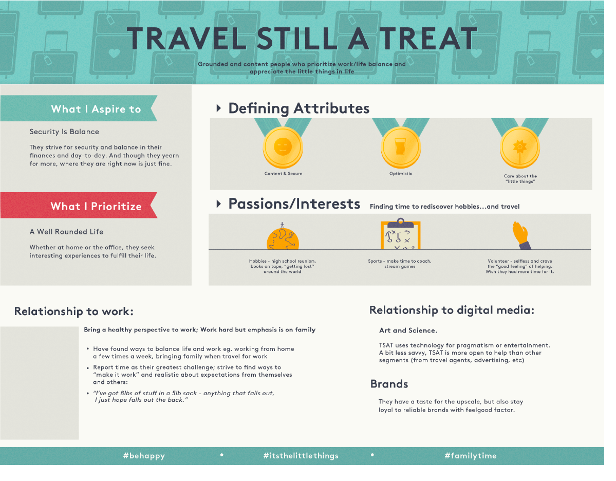

Slide 36
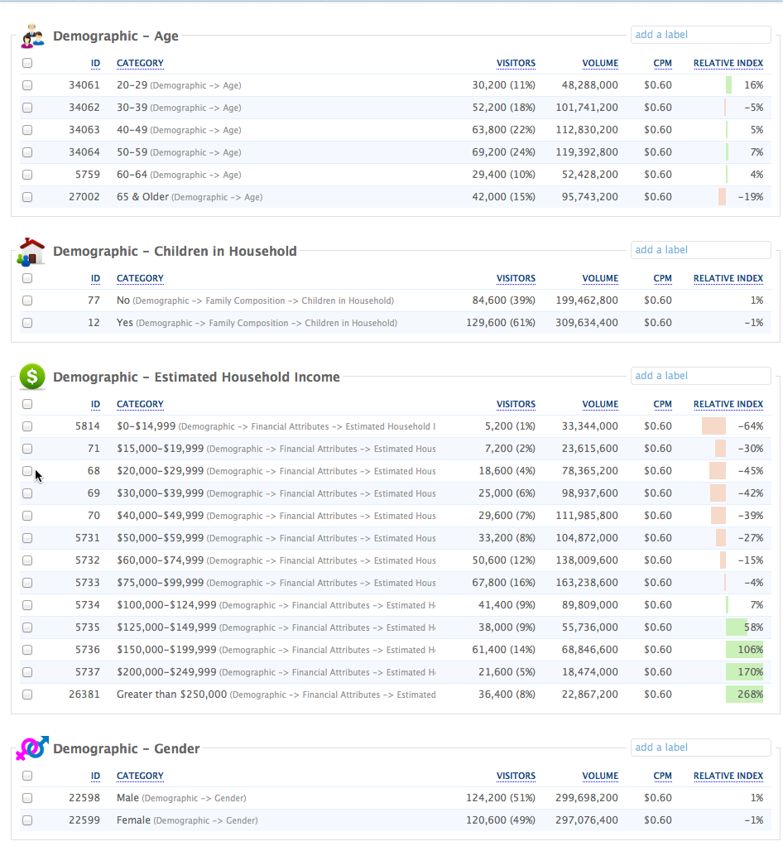
REAL-TIME AUDIENCE PROFILE – WORK HARD PLAY HARD

Slide 37
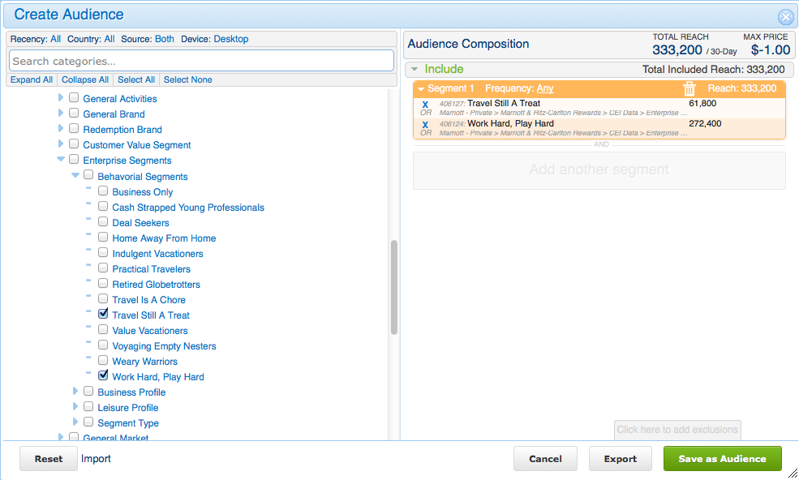
SEGMENT AUDIENCE PLANNING – REAL-TIME SIZING

Slide 38
PROJECT ORANGE POC:
MESSAGING STRATEGY
Notes:
Let’s take a look at what a sample journey could look like for an orange segment

Slide 39
SEGMENT MESSAGING APPROACH
SEGMENT
WORK HARD PLAY HARD
(E.G LIKES TO USE POINTS)
TRAVEL’S STILL A TREAT
(E.G. VALUES TIME WITH FAMILY
+
NON MEMBER/MEMBER
+
+
+
MESSAGE
PROOF POINT +
BRANDS
DESTINATION
PROPERTY

Slide 40
SEGMENT MESSAGING APPROACH
CAMPAIGN 1
MESSAGE
WORK HARD PLAY HARD
(E.G LIKES TO USE POINTS)
Segment
TRAVEL’S STILL A TREAT
(E.G. VALUES TIME WITH FAMILY
MESSAGE
CAMPAIGN 2
WORK HARD PLAY HARD
(E.G LIKES TO USE POINTS)
+
DESTINATION
+
PROPERTY
Segment
TRAVEL’S STILL A TREAT
(E.G. VALUES TIME WITH FAMILY
+
DESTINATION
+
PROPERTY

Slide 41
SEGMENT MESSAGING DECISION TREE
Member Marsha Recommendation
Segment
Marsha
Member
Y
Y
Y
Non Member Marsha Recommendation
N
N
N
Member Destination Recommendation
DEFAULT
Destination
Member
Y
Y
Non Member Destination Recommendation
N
N
Member Segment Default
Member
Y
N
Non Member Segment Default
*Marsha/Destination prioritized by Referral Source

Slide 42
Core enterprise proofpoints and offers will be layered with segment benefit messaging
SEGMENT BENEFIT
DESTINATION
WORK HARD PLAY HARD
(E.G LIKES TO USE POINTS)
TRAVEL’S STILL A TREAT
(E.G. VALUES TIME WITH FAMILY
PROPERTY
HOTELS
MEMBER BENEFITS
REDEEM
ENROLL
AMENTIES
ANCILLARY
OFFERS
HOTELS
MEMBER BENEFITS
REDEEM
ENROLL
AMENTIES
ANCILLARY
OFFERS
LAK
LAK
WIFI
WIFI

Slide 43
PROJECT ORANGE POC: TOUCH POINTS/CHANNELS
Notes:
Let’s take a look at what a sample journey could look like for an orange segment

Slide 45

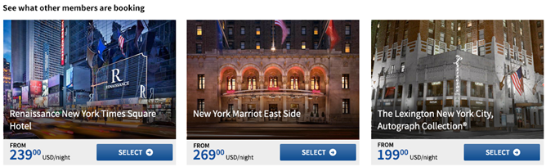
Segment-Specific Landing Pages
Leisure
Research
Leisure
Booking
Pre
Stay
Leisure
Stay
Post
Stay
Leisure
Trigger
A2
GOAL
REVENUE PER BOOKING
A1
A3
DATA
Behavioral 3rd party:
Behavioral 1st party:
IP: Seattle
Device: mac book
Browser: Chrome
Segment: Work Hard Play Hard
Business Profile: Weekly Project Traveler
Leisure Profile: Luxury Resort Nex Gen
XXXXXX
B1
C1
XXXXXX
B2
Content
A1: Lifestyle Image
A2: Booking Widget
A3: Segment Message
B1: Most Popular Destination
B2: Near By Hotels
B3: Most Popular Hotels
C1: Enroll/Member Benefits Message
C2: Ancillary/Amenities Content
C3:: Member/Non Member Offers
D1: Segment + Free Wi-Fi
D2: Segment + Book Right
XXXXXX
C2
B3
FPO
D1
D2
C3
Notes:
Upon entering the site, we immediately learn some more environmental information about her:
She lives in Seattle (IP)
Uses a Mac book
And is using Crome
But, we still have the 3rd party intent - Hawaii
And her Segment intent - WHPH
Based on this information, we pre-pop the booking widget (A1) with Hawaii
Show a Luxury Hotel for Hawaii in the hero (A2)
And Show a targeted offer in A3 for WHPH Hawaii.
Also, leveraging Adobe’s recommendation engine, we could right a customer algorithm to show top booked hawaian hotels by WHPH’s.
Also, we could show a hometown offer (c1)
And her last booked hotel (C2)

Slide 46
Segment Landing Page (Marsha)
M.com
Leisure
Research
Leisure
Booking
Pre
Stay
Leisure
Stay
Post
Stay
Leisure
Trigger
A2
GOAL
REVENUE PER BOOKING
A1
A3
DATA
Behavioral 3rd party:
Behavioral 1st party:
IP: Seattle
Device: mac book
Browser: Chrome
Segment: Work Hard Play Hard
Business Profile: Weekly Project Traveler
Leisure Profile: Luxury Resort Nex Gen
XXXXXX
B1
C1
XXXXXX
B2
Content
A1: Lifestyle Image + Hotel
A2: Booking Widget
A3: Segment Message + Hotel
B1: Last Viewed/Booked Hotel
B2: Near By Hotels
B3: Rec based on viewed hotel
C1: Enroll/Member Benefits Message
C2: Ancillary Content + Hotel
C3:: Member/Non Member Offers + Hotel
D1: Segment + Free Wi-Fi
D2: Segment + Book Right
XXXXXX
C2
B3
D1
D2
C3
Notes:
Upon entering the site, we immediately learn some more environmental information about her:
She lives in Seattle (IP)
Uses a Mac book
And is using Crome
But, we still have the 3rd party intent - Hawaii
And her Segment intent - WHPH
Based on this information, we pre-pop the booking widget (A1) with Hawaii
Show a Luxury Hotel for Hawaii in the hero (A2)
And Show a targeted offer in A3 for WHPH Hawaii.
Also, leveraging Adobe’s recommendation engine, we could right a customer algorithm to show top booked hawaian hotels by WHPH’s.
Also, we could show a hometown offer (c1)
And her last booked hotel (C2)

Slide 47
Segment Landing Page (Destination)
M.com
Leisure
Research
Leisure
Booking
Pre
Stay
Leisure
Stay
Post
Stay
Leisure
Trigger
A2
GOAL
REVENUE PER BOOKING
A1
A3
DATA
Behavioral 3rd party:
Behavioral 1st party:
IP: Seattle
Device: mac book
Browser: Chrome
Segment: Work Hard Play Hard
Business Profile: Weekly Project Traveler
Leisure Profile: Luxury Resort Nex Gen
XXXXXX
B1
C1
XXXXXX
B2
Content
A1: Lifestyle Image
A2: Booking Widget
A3: Segment Message
B1: Last Viewed/Booked Hotel
B2: Near By Hotels
B3: Rec based on viewed hotel
C1: Enroll/Member Benefits Message
C2: Ancillary Content
C3:: Member/Non Member Offers
D1: Segment + Free Wi-Fi
D2: Segment + Book Right
XXXXXX
C2
B3
D1
D2
C3
Notes:
Upon entering the site, we immediately learn some more environmental information about her:
She lives in Seattle (IP)
Uses a Mac book
And is using Crome
But, we still have the 3rd party intent - Hawaii
And her Segment intent - WHPH
Based on this information, we pre-pop the booking widget (A1) with Hawaii
Show a Luxury Hotel for Hawaii in the hero (A2)
And Show a targeted offer in A3 for WHPH Hawaii.
Also, leveraging Adobe’s recommendation engine, we could right a customer algorithm to show top booked hawaian hotels by WHPH’s.
Also, we could show a hometown offer (c1)
And her last booked hotel (C2)

Slide 48
PROJECT ORANGE POC:
DATA MANAGEMENT & PLATFORM
Notes:
Let’s take a look at what a sample journey could look like for an orange segment

Slide 49
Propagating Orange Segment CEIs across Digital Channels
Email
MARKETING EMAIL
3
MEMBER CEI’S
1
All CEI’S
CEI’s
SGI
Consumer Insight
MEMBERS @ SIGNIN
2
M.com
Mobile Web
Display
Search
Social
TV
Print
Radio
DM
Retail
CC

Slide 50
Orange Activation POC: PLATFORM READNIESS
 | Personalized Digital Touch Point | DMP | ETA
 | Targeted Paid Search Bidding |  | Q1 - COMPLETE
 | Targeted Display/Video (Prospecting) |  | Q1 - COMPLETE
 | Dynamic Re-targeting Display |  | TBD
 | Marriott.com Abandon e-mail |  | TBD
 | Marriott Rewards Newsletter e-mail |  | TBD
 | M.com Homepage |  | Q1 – COMPLETE
 | Dynamic Landing Page |  | Q1 - COMPLETE
1
2
2
3
3
4
4
Adobe Target Monitoring Campaign - Q1 - COMPLETE

Slide 51
PROJECT ORANGE POC:
MEASUREMENT + KPI’S
Notes:
Let’s take a look at what a sample journey could look like for an orange segment

Slide 52
Measurement/KPI plan
  Primary – Leisure booking
  Secondary – Business booking + Share

Slide 53
PROJECT ORANGE POC:
ROLES AND RESPONSIBLITIES
Notes:
Let’s take a look at what a sample journey could look like for an orange segment

Slide 54
APPENDIX

Slide 55
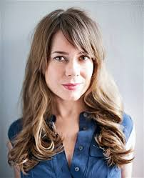
SCENARIO 1 – Winning over the Work Hard, Play Hard
Sarah
Sarah is a rising star at Accenture. She’s been consulting for a year now, and she works hard and plays hard. She lives in Seattle, and has been traveling a lot in California – mostly LA and San Francisco. She uses Concur to booker her business travel and spends 3-4 days each week traveling and staying at hotels – primarily Courtyard Marriott. She is a Marriott Rewards members and has redeemed her points in the past on Marriott.com She’s looking forward to her wedding and honeymoon in six months time.
Marriott objective: Grow Sarah’s loyalty to Marriott by delighting her during business stays and encouraging her to redeem her MR points for a leisure stay.
OUR GOAL: WIN THE LEISURE BOOKING
Notes:
Meet Sarah –
She works for Accenture
Lives in Seattle
Travels to LA and SF (3-4 days a week)
Books via Concur
Is a MR member and has redeemed points on M.com
She is getting married and planning an honeymoon in six months.

Slide 56
SAMPLE ACTIVATION: PERSONALIZED JOURNEY
Notes:
Let’s take a look at what a sample journey could look like for an orange segment

Slide 57
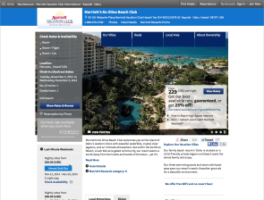
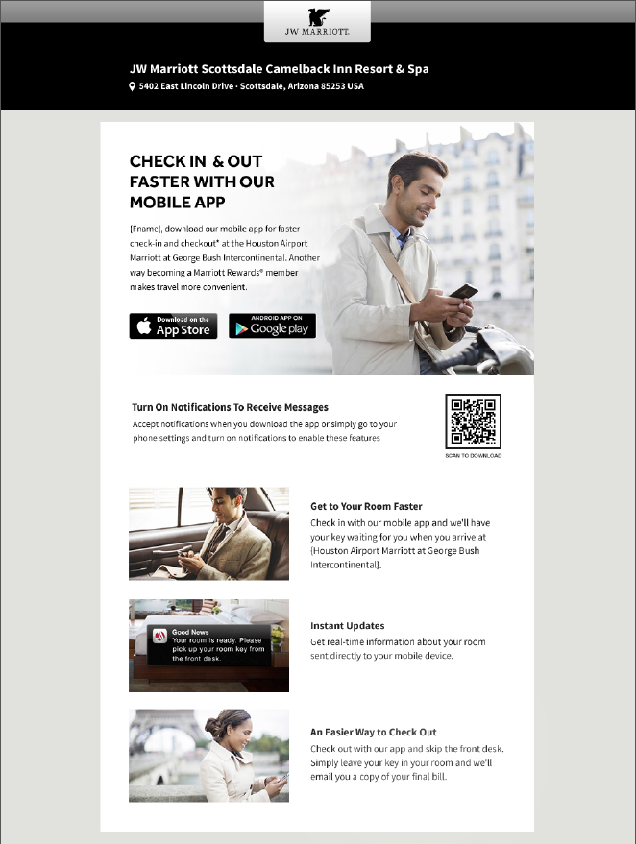
Sarah’s Personalized Journey
w
2
3
4
1
Honolulu, HI
JW Marriott Ihilani
Ko Olina Resort Spa
Waikiki Beach Marriott Resort Spa
Audience-based search bidding
Dynamic display ad targets Hawaii Destination
Home page highlights
Hawaii destination
Hotel web site pages have content tailored to WHPH
Googles ‘Best Hawaii Hotels’
Browses OTAs and then Wall Street Journal Travel Section
Visits Marriott.com and reaches the home page
Searches for hotels in Hawaii and browses HWS
Abandons search and leaves M.com
Pre-Arrival Period
Redeems for Hawaii stay on M.com
Clicks thru abandon email and arrives at landing page
7
6
5
Personalized ancillary offers on reservation confirmation email
Abandoned Search
email highlights Hawaii
Email landing page tailored to abandoned Hawaii search
Notes:
Let’s walk through a personalized journey for Sarah…
In this journey we will leverage 7 touchpoints:
Search
Display
M.com Homepage
M.com HWS
Email
M.com Landing Page
Email

Slide 58
Leisure
Research
Leisure
Booking
Pre
Stay
Leisure
Stay
Post
Stay
Leisure
Trigger
Sarah is in the process of planning her honeymoon and is interested in Hawaii. She goes to Google and does a search for ‘Best Hawaii Hotels”

Slide 59
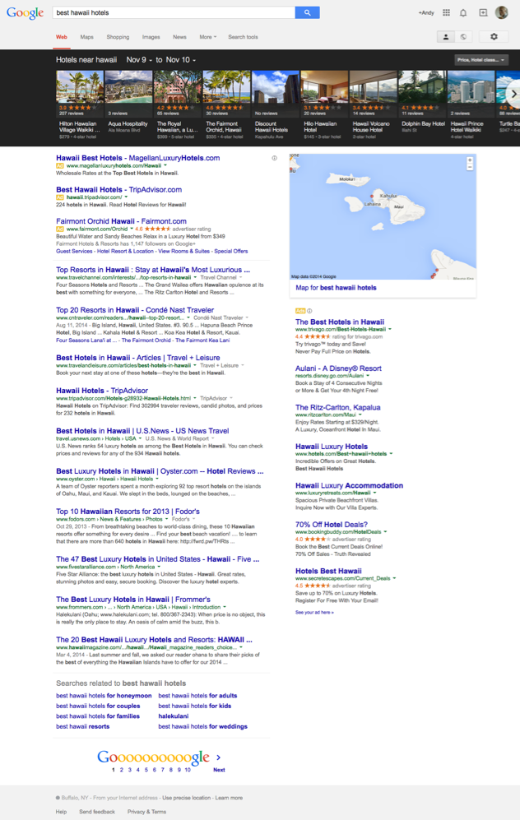
Retargeting List Search Ads (RLSA)
Search
Leisure
Research
Leisure
Booking
Pre
Stay
Leisure
Stay
Post
Stay
Leisure
Trigger
GOAL
REVENUE PER BOOKING
A
DATA
Behavioral 3rd party: N/A
Behavioral 1st party: Hawaii Intent (kw)
Segment: Work Hard Play Hard
Business Profile: Weekly Project Traveler
Leisure Profile: Luxury Resort Nex Gen
Content
A) Leisure Redemption Offer + Hawaii
Notes:
Upon entering her search….
Marriott combines her search behavior (KW) + her Segment Profile (identified from a pervious visit to M.com)
to bid into the top spot and present a targeted message for a Leisure Redemption Offer in Hawaii

Slide 60
Leisure
Research
Leisure
Booking
Pre
Stay
Leisure
Stay
Post
Stay
Leisure
Trigger
Sarah does not click on the ad, but instead visits Kayak.com, Expedia.com, and Booking.com to check out different hotels in Hawaii and then decides to catch up the daily news on WSJ.com

Slide 61
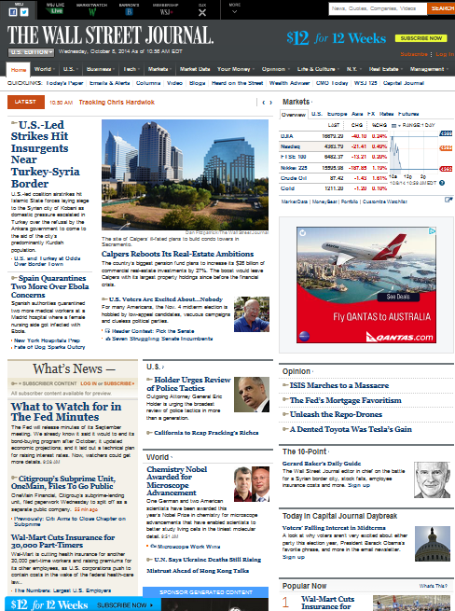
Paid Media: Digital Display Prospecting
Display
Leisure
Research
Leisure
Booking
Pre
Stay
Leisure
Stay
Post
Stay
Leisure
Trigger
GOAL
REVENUE PER BOOKING
DATA
Behavioral 3rd party: Hawaii Intent
Behavioral 1st party:
Segment: Work Hard Play Hard
Business Profile: Weekly Project Traveler
Leisure Profile: Luxury Resort Nex Gen
A
Content
A) Recommended WHPH Luxury Hawaiian Hotels + Leisure Redemption Offer
Notes:
As she moves around the site, she is targeted with a dynamic display banner:
This banner leverages her 3rd party intent (from blue kai based on OTA shopping) to show her:
Recommended WHPH Luxury Hawaiian Hotels combined with Leisure Redemption Offer

Slide 62
Leisure
Research
Leisure
Booking
Pre
Stay
Leisure
Stay
Post
Stay
Leisure
Trigger
Sarah does not click on the ad
That weekend, Sarah visits Marriott.com’s homepage

Slide 63
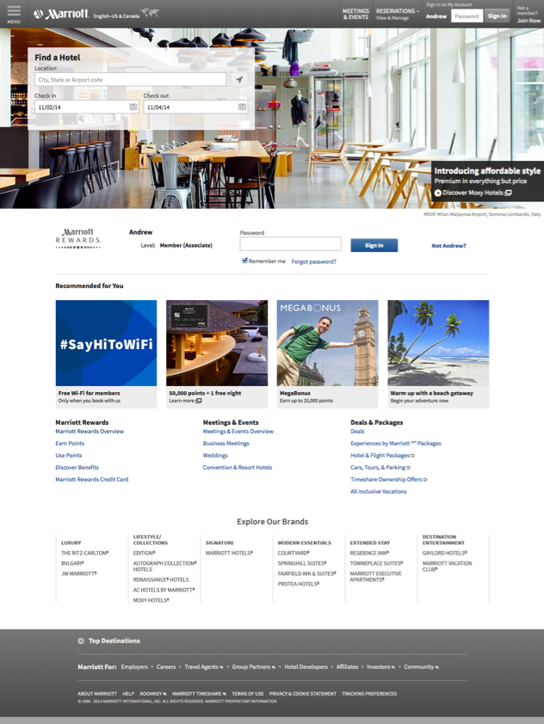
Marriott.com Homepage
M.com
Leisure
Research
Leisure
Booking
Pre
Stay
Leisure
Stay
Post
Stay
Leisure
Trigger
A1
A2
GOAL
REVENUE PER BOOKING
AA
A3
DATA
Behavioral 3rd party: Hawaii Intent
Behavioral 1st party:
IP: Seattle
Device: mac book
Browser: Chrome
Segment: Work Hard Play Hard
Business Profile: Weekly Project Traveler
Leisure Profile: Luxury Resort Nex Gen
B
C1
C2
Content
A1: Pre-Pop Hawaii Destination
A2: Hawaii Hotel for WHPH or Brand Affinity Hotel
A3: Hawaii + WHPH Redeem Offer
B: Recommended Most Popular Booked Hotels by WHPH or based on Hawaii Search
C1: Hometown Offer (Seattle)
C2: WHPH Last Hotel Booked (Business)
Notes:
Upon entering the site, we immediately learn some more environmental information about her:
She lives in Seattle (IP)
Uses a Mac book
And is using Crome
But, we still have the 3rd party intent - Hawaii
And her Segment intent - WHPH
Based on this information, we pre-pop the booking widget (A1) with Hawaii
Show a Luxury Hotel for Hawaii in the hero (A2)
And Show a targeted offer in A3 for WHPH Hawaii.
Also, leveraging Adobe’s recommendation engine, we could right a customer algorithm to show top booked hawaian hotels by WHPH’s.
Also, we could show a hometown offer (c1)
And her last booked hotel (C2)

Slide 64
Leisure
Research
Leisure
Booking
Pre
Stay
Leisure
Stay
Post
Stay
Leisure
Trigger
Sarah clicks on the hero image for the JW Marriott Ihilani Ko Olina Resort & Spa
and looks at the specific location, services, and amenities

Slide 65
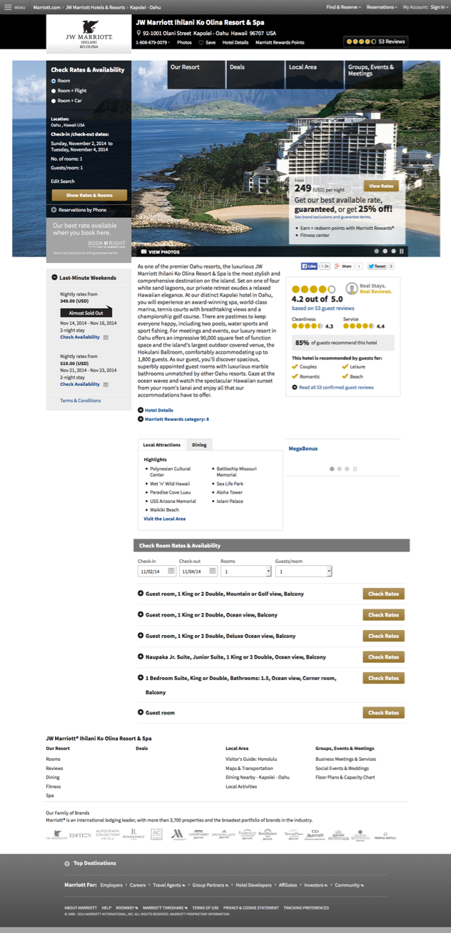
Marriott.com Hotel Websites
M.com
Leisure
Research
Leisure
Booking
Pre
Stay
Leisure
Stay
Post
Stay
Leisure
Trigger
A
GOAL
REVENUE PER BOOKING
B
DATA
Behavioral 3rd party: Hawaii Intent
Behavioral 1st party:
IP: Seattle
Device: mac book
Browser: Chrome
Pervious Search: Hawaii
Hotels Viewed: hnljw
Segment: Work Hard Play Hard
Business Profile: Weekly Project Traveler
Leisure Profile: Luxury Resort Nex Gen
C
Content
Recommended Next Best Luxury Hotel Image for WHPH
B) Recommended WHPH Luxury Hawaiian Hotels + Leisure Redemption Offer or Amenity Highlight
C) Sort/Highlight Amenities based on trip purpose/redemption
D) Recommended Best Luxury Room Rate for WHPH/redemption
D
Notes:
Upon entering the HWS, we personalize the HWS hero image, and show her a targeted offer.
Also, perhaps we reorder the room rates to show to push a suite.

Slide 66
Leisure
Research
Leisure
Booking
Pre
Stay
Leisure
Stay
Post
Stay
Leisure
Trigger
Sarah looks at several other Hawaiian properties, but decides not to buy today.
The next day she receives an email from Marriott Rewards with some recommendations for Hawaii.

Slide 67
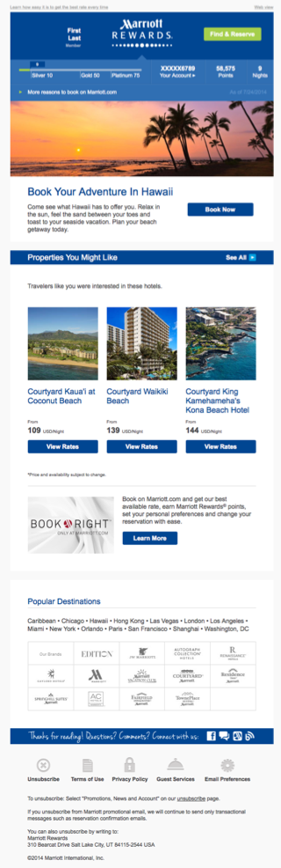
Marriott.com Abandon Shopper Email
EMAIL
Leisure
Research
Leisure
Booking
Pre
Stay
Leisure
Stay
Post
Stay
Leisure
Trigger
GOAL
REVENUE PER BOOKING
A
DATA
Behavioral 3rd party: Hawaii
Behavioral 1st party:
Pervious Search: Hawaii
Hotels Viewed: hnlko, hnlmc, hnljw
Member: Gold
Email: Opted-in
Segment: Work Hard Play Hard
Business Profile: Weekly Project Traveler
Leisure Profile: Luxury Resort Nex Gen
B
Content
Luxury Hawaii Destination Image for WHPH
Recommended Hawaii + WHPH Redeem Next Best Offer
Recommended Hotels based on Hawaii Search and Hotels viewed
C
Notes:
When she opens this email, we push her a luxury Hawaii destination image, targeted offer, and recommended hotels base on her pervious search

Slide 68
Leisure
Research
Leisure
Booking
Pre
Stay
Leisure
Stay
Post
Stay
Leisure
Trigger
Sarah clicks the offer and enters Marriott.com

Slide 69
Marriott.com Personalized Landing page
M.com
Leisure
Research
Leisure
Booking
Pre
Stay
Leisure
Stay
Post
Stay
Leisure
Trigger
GOAL
REVENUE PER BOOKING
A
DATA
Behavioral 3rd party: Hawaii Intent
Behavioral 1st party:
IP: Seattle
Device: mac book
Browser: Chrome
Pervious Search: Hawaii
Hotels Viewed: hnlko, hnlmc, hnljw
Segment: Work Hard Play Hard
Business Profile: Weekly Project Traveler
Leisure Profile: Luxury Resort Nex Gen
B
C
Content
Recommended Best Luxury Hawaii Destination Image for WHPH
Recommended Hawaii + WHPH Redeem Offer
Recommended Hotels based on Hawaii Search and Hotels viewed
Notes:
A dynamic landing page is assembled show offer details, relevant imagery, and recommended hotels

Slide 70
Leisure
Research
Leisure
Booking
Pre
Stay
Leisure
Stay
Post
Stay
Leisure
Trigger
Success!
Sarah books a redemption stay at theJW Marriott Ihilani Ko Olina Resort & Spa
for a 2 weeks in a oceanfront junior suite for April 2015
Six months later……Sarah receives a pre-arrival email from Marriott for her upcoming stay

Slide 71
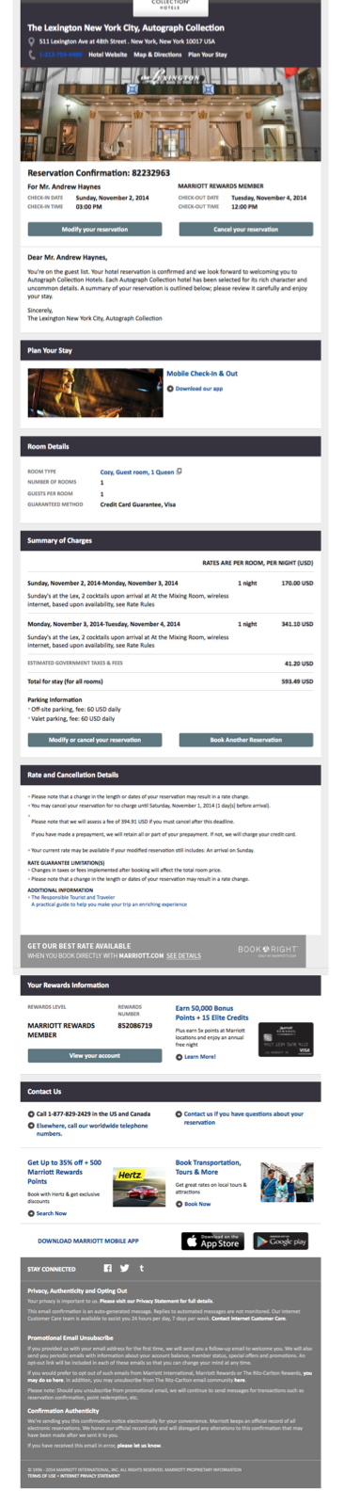

Marriott.com Pre-Arrival Email
EMAIL
Leisure
Research
Leisure
Booking
Pre
Stay
Leisure
Stay
Post
Stay
Leisure
Trigger
GOAL
REVENUE PER BOOKING
A
DATA
Behavioral 3rd party:
Behavioral 1st party:
Booked hnljw
Traveling 2 People
Segment: Work Hard Play Hard
Business Profile: Weekly Project Traveler
Leisure Profile: Luxury Resort Nex Gen
Content
Highlight top WHPH Hotel Activities for Redemption for couples
B) Mobile Check-in Message + Leisure Benefit
C1) Recommended WHPH Amenity Redemption Offer (SPA, Golf, F&B)
C2) Recommended WHPH Room Upgrade/Extension Offer
B
C1
C2
Notes:
In this email we show some

Slide 72
Propagating Orange Segment CEIs across Digital Channels
6
@ EMAIL OPEN / LANDING PAGE
Email
MARKETING EMAIL
TRANSACTIONAL
EMAIL
4
5
MEMBER CEI’S
1
All CEI’S
CEI’s
SGI
Consumer Insight
MEMBERS @ SIGNIN
NON MEMBERS @ BOOKING
2
3
M.com
?
Display
Search
Social
Mobile
TV
Print
Radio
DM
Retail
CC

Slide 73
Orange Activation Plan across Digital Touch Points
 | Personalized Digital Touch Point | Q4 ‘14 | Q1 ‘15 | Q2 ‘15 | Q3’ 15 | Q4 ‘15
 | Targeted Paid Search Bidding
 | Targeted Display/Video (Prospecting)
 | Dynamic Re-targeting Display
 | Marriott.com Abandon e-mail
 | Marriott Rewards Marketing e-mail
 | M.com Homepage
 | MR MyAccount
 | Search Results
 | Hotel Websites
 | Reservations
 | E-Interface
 | Mobile Check-In e-mail
 | Reservation Confirmation e-mail
 | Mobile App
 | LocalPerks campaign
1
1
2
FPO
4
4
1
2
3
1
2
3
1
2
1
2
5
5

Slide 74
A Personalized Journey
w
2
3
4
1
Honolulu, HI
JW Marriott Ihilani
Ko Olina Resort Spa
Waikiki Beach Marriott Resort Spa
Audience-based search bidding
Dynamic display ad targets Hawaii Destination
Home page highlights
Hawaii destination
Hotel web site pages have content tailored to WHPH
Googles ‘Best Hawaii Hotels’
Browses OTAs and then Wall Street Journal Travel Section
Visits Marriott.com and reaches the home page
Searches for hotels in Hawaii and browses HWS
Signs into MR My Account page
Redeems for Hawaii stay on M.com
Clicks thru abandon email and arrives at landing page
Abandons search and leaves M.com
6
5
8
7
Honolulu, HI
JW Marriott Ihilani
Ko Olina Resort Spa
Waikiki Beach Marriott Resort Spa
Dynamic display retargeting ad targets Hawaii Destination
Abandoned Search
email highlights Hawaii
Personalized member offers including Hawaii Destination highlight
Email landing page tailored to abandoned Hawaii search
Notes:
Let’s walk through a personalized journey for Sarah…
In this journey we will leverage 7 touchpoints:
Search
Display
M.com Homepage
M.com HWS
Email
M.com Landing Page
Email

Slide 75
WORK HARD, PLAY HARD MESSAGING MATRIX
WHPH
MEMBER
LEISURE REMPTION OFFERS
Y
Y
N
N
DEFAULT
LIFESTYLE LEISURE JOIN OFFER

Slide 76
WORK HARD, PLAY HARD MESSAGING MATRIX
WHPH
MEMBER
DESTINATION
DESTINATION LEISURE REMPTION OFFERS
Y
Y
Y
N
N
N
DEFAULT
DESTINATION
LIFESTYLE LEISURE CASHOFFER
N
Y
LIFESTYLE LEISURE CASHOFFER

Slide 77
WORK HARD, PLAY HARD MESSAGING MATRIX
WHPH
BUSINESS
MEMBER
BUSINESS MESSAGE
Y
Y
Y
N
N
N
DEFAULT
MEMBER
LEISURE JOIN OFFER
N
Y
LEISURE OFFER/REDEEM

Slide 78
Core enterprise proof points and offers will be layered with segment benefit messaging
CORE MESSAGE
BOOK RIGHT
SEGMENT BENEFIT
WORK HARD PLAY HARD
(E.G LIKES TO USE POINTS)
PERSONALIZED MESSAGE
FREE WIFI
LEISURE OFFER
LEISURE ENROLLMENT OFFER
TRAVEL’S STILL A TREAT
(E.G. VALUES TIME WITH FAMILY
STAYING IN TOUCH WITH FAMILY JUST GOT EASIER WITH FREE WIFI
EARN POINTS WHEN YOU BOOK DIRECT FOR YOUR NEXT VACATION

Slide 79
Core enterprise proofpoints and offers will be layered with segment benefit messaging
CORE MESSAGE
BOOK RIGHT
OFFER
MEMBER LEISURE OFFER
SEGMENT BENEFIT
FREE WIFI
MEMBER ENROLLMENT OFFER
TRAVEL’S STILL A TREAT
(E.G. VALUES TIME WITH FAMILY
WORK HARD PLAY HARD
(E.G LIKES TO USE POINTS)
MOBILE CHECK-IN

Slide 80
Orange Activation POC: Update
M.com/mobile
  Landing Page
  Homepage
Targeting/Data
  M.com signed in members (12/31)
    Tag Man (1/5)
    Adobe (1/5)
    Blue Kai (1/25)
  Member/Non Members
    Liveramp (TBD)
    Blue Kai (TBD)
    Adobe (TBD)
    Facebook (TBD)
  Members with Email opt-in (q4 14)
  Adobe Monitoring campaign (1/5)
Measurement/KPI plan
  Primary – Leisure booking
  Secondary – Business booking + Share
Stakeholders:
  Sponsor: Portfolio
  Core Team: Portfolio, CIA, Digital
  Lead Agency: Choreograph
  Supporting: BCM (search) MEC (media) Adobe (m.com) Rewards (email)
Audience Planning + Contract Strategy:
  Segment Overview (Complete)
  Master Brief (1/31)
  Additional Creative, Data, and Media briefs (TBD)
Content Creation:
  Choreograph leading production (TBD)
  3 core messages + segment benefit
    Free Wifi
    Mobile Check-in
    Book Right
  Determine # of destinations
  Access # of creatives needed
Touch points:
  Paid Search (RLSA)
  Display
    Prospecting (Look-a-like)
    Retargeting
  Email
    Newsletter
    Shopper Email

Slide 81
FOCUS: IMPACT OF SHIFT TO PORTFOLIO VIEW & SEGMENTS

Slide 82


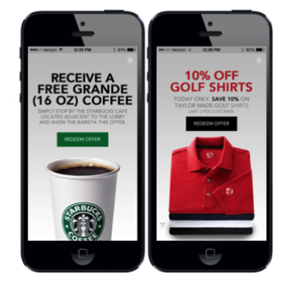
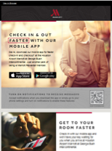
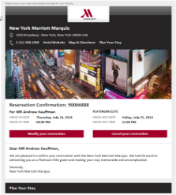

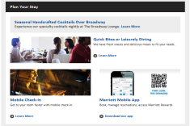
PERSONALIZED GUEST JOURNEYS:
Win the Booking and Win the Stay by increasing digital relevancy
2
3
1
4
Audience-based search bidding
Dynamic display ad targets NYC destination
Abandoned Search email
highlights NYC
Home page highlights
NYC destination
Googles ‘New York City Hotels’
Browses other travel sites for NYC destination info
Visits Marriott.com, searches NYC and abandons
Returns to Marriott.com
Signs into MR My Account page
Guest Arrives on Property
Pre-Arrival Period
Books NYC reservation on M.com
5
8
7
6
1
Personalized member offers including NYC Destination highlight
On-property, contextual offers pushed in App via Beacons
Personalized Mobile app invitation email
Personalized ancillary offers on reservation confirmation email

Slide 83
PIVOTING OUR DIGITAL MARKETING:
Portfolio Management and Project Orange Impacts
digital channels
Campaign
search
display
email
m.com
sms
social
video
app
✓
✓
✓
✓
✓
A
B
✓
✓
✓
C
D
segments
Notes:
TRADITIONAL [BRAND] MARKETING: Tell them what we want them to know about us, hope something is relevant enough to stick. SPRAY AND PRAY.
NEW INTENT-BASED MARKETING: By their behavior, shoppers are telling us what they are looking for – we need to listen, and respond quickly. SENSE AND RESPOND.

Slide 84
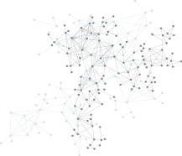






























Depth of Guest Identification Informs Personalization & Messaging Capabilities
Real-Time
Contextual
Marriott Behavior
Marriott Behavior
Project Orange
Segment
Project Orange
Segment
Project Orange
Segment
?
AND/OR
3rd Party Intent
3rd Party Intent
3rd Party Intent
ANONYMOUS
KNOWN PROSPECT
KNOWN TO MARRIOTT
REAL-TIME PROFILE
DEFAULT
MESSAGE
MESSAGE IN
SEGMENT VOICE
OR WITH
DESTINATION
INTENT
MESSAGE PERSONALIZED WITH MARRIOTT-SPECIFIC PROPENSITIES
CONTEXTUAL OVERRIDES

Slide 85
Segment Landing Page (Member/Non Member)
M.com
Leisure
Research
Leisure
Booking
Pre
Stay
Leisure
Stay
Post
Stay
Leisure
Trigger
A2
GOAL
REVENUE PER BOOKING
A1
A3
DATA
Behavioral 3rd party:
Behavioral 1st party:
IP: Seattle
Device: mac book
Browser: Chrome
Segment: Work Hard Play Hard
Business Profile: Weekly Project Traveler
Leisure Profile: Luxury Resort Nex Gen
XXXXXX
B1
C1
XXXXXX
B2
Content
A1: Lifestyle Image
A2: Booking Widget
A3: Segment Message
B1: Most Popular Destination
B2: Near By Hotels
B3: Most Popular Hotels
C1: Enroll/Member Benefits Message
C2: Ancillary/Amenities Content
C3:: Member/Non Member Offers
D1: Segment + Free Wi-Fi
D2: Segment + Book Right
XXXXXX
C2
B3
D1
D2
C3
Notes:
Upon entering the site, we immediately learn some more environmental information about her:
She lives in Seattle (IP)
Uses a Mac book
And is using Crome
But, we still have the 3rd party intent - Hawaii
And her Segment intent - WHPH
Based on this information, we pre-pop the booking widget (A1) with Hawaii
Show a Luxury Hotel for Hawaii in the hero (A2)
And Show a targeted offer in A3 for WHPH Hawaii.
Also, leveraging Adobe’s recommendation engine, we could right a customer algorithm to show top booked hawaian hotels by WHPH’s.
Also, we could show a hometown offer (c1)
And her last booked hotel (C2)

