Slide 1
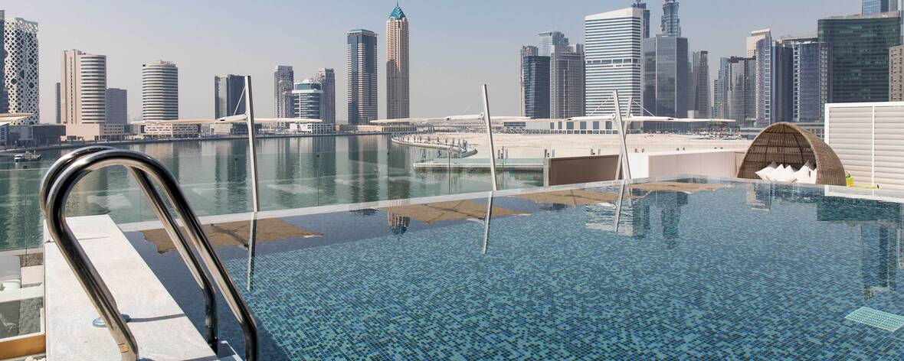
THE ST. REGIS SAADIYAT ISLAND RESORT, ABU DHABI
The St. Regis Downtown, Dubai
Marriott EMEA & Data Axle Q4 2021 Content Planning Session
August ‘21

Slide 2
Today’s Agenda
Achievements
Q4 Content Planning
Outstanding Items

Slide 3
Q3 Achievements

Slide 4
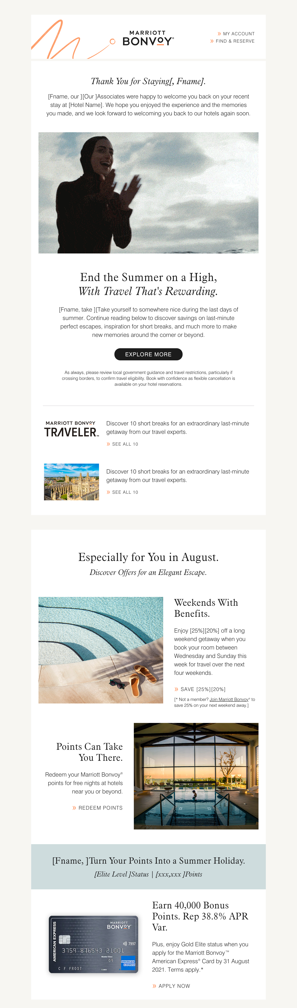
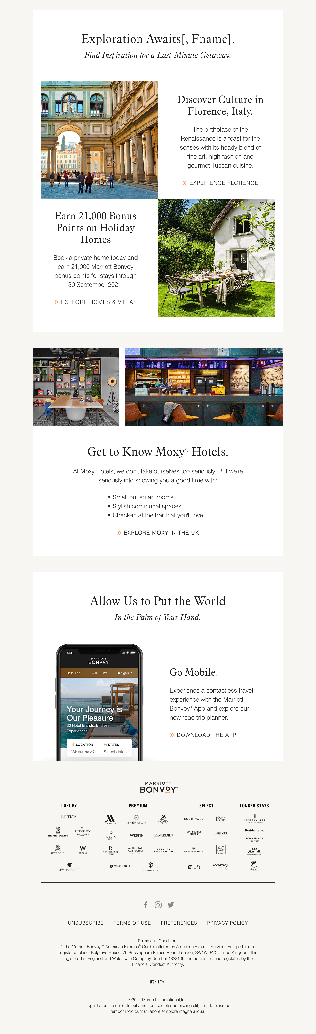
Q3 Achievements
Launched NEW Template!
August 2021
- Elevated look and feel
- Intro video animation
- Personalized content

Slide 5
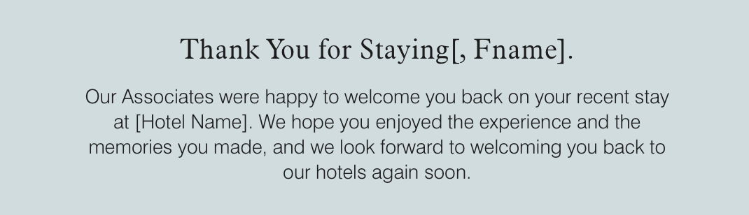
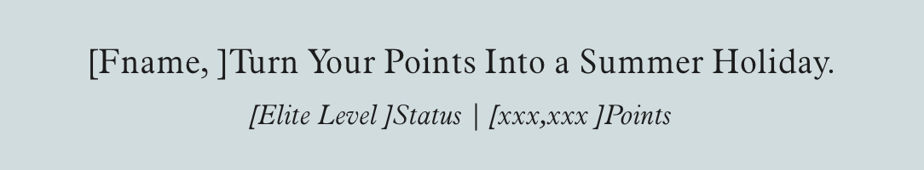
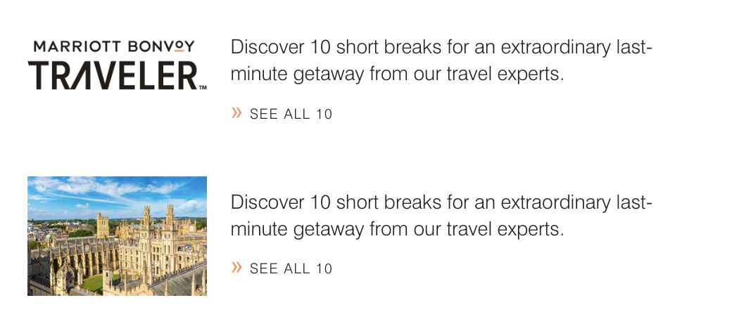
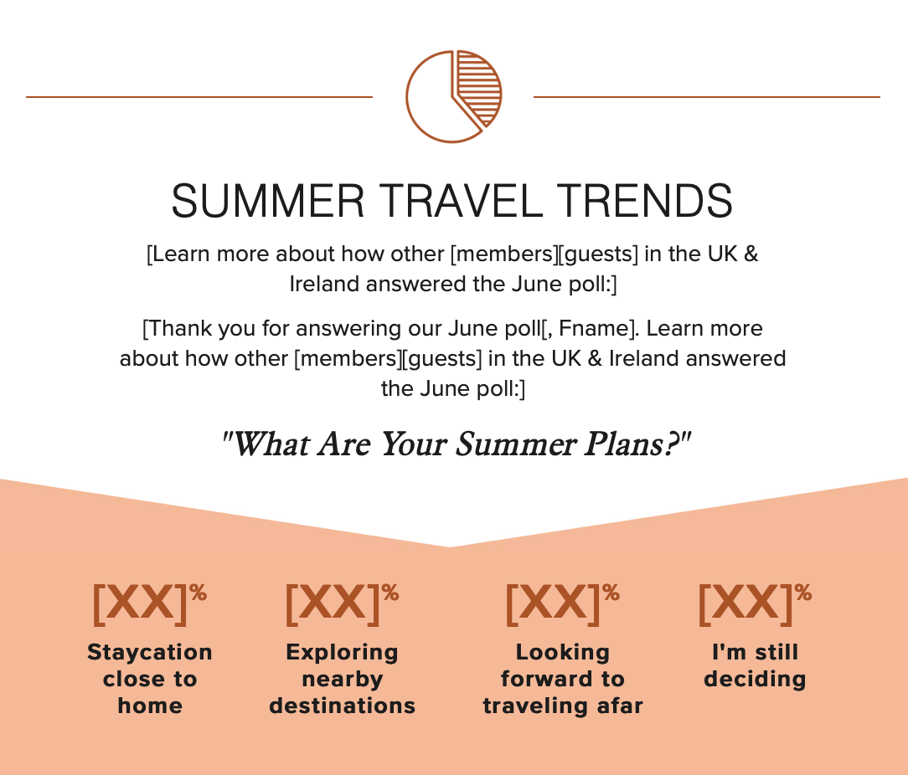
More Q3 Achievements
Continued PCIQ for SL optimization August - UK & Ireland and UAE, September to ALL
Increased Personalization Thank you for traveling / Points Balance / Upcoming Trip (August, September)
CTA testing in Hero (July, August)
Traveler testing logo vs image in August
Brand Education enhancements Reveal the Brand (July) Get to Know the Brand (August, September)
Poll Results from the June email (July)
Non-Member acquisition Join MBV messaging (July, August, September)

Slide 6
Q4 Content Planning

Slide 7
Q2 Review Learnings
What's Working?
Hero modules continue to drive engagement generating the highest % of clicks
June hero generated the highest % of clicks in Q2; promoted summer travel within market using data points
Interactive poll under the hero in June was also a strong click-catcher; 9% of clicks Most readers plan to staycation closer to home
May new openings content was #2 most clicked for several markets
Brand awareness module consistently drove engagement with click activity ranging from 5% to 7%; April and June had the highest overall engagement
Luxury content in May also captured the attention of readers: Luxury Homes (HVMI) and Traveler luxury experiences article

Slide 8
Q2 Learnings to Impact Q4
Hero modules continue to drive engagement generating the highest % of clicks
Focus optimization and testing efforts on Hero placement
June hero generated the highest % of clicks in Q2; promoted summer travel within market using data points
Keep looking for ways to include personalized data in emails (member module, YIR, etc.)
Interactive poll under the hero in June was also a strong click-catcher; 9% of clicks Most readers plan to staycation closer to home
Determine next poll opportunity – December 2022 plans?
May new openings content was #2 most clicked for several markets
Consider higher placement for new openings module

Slide 9
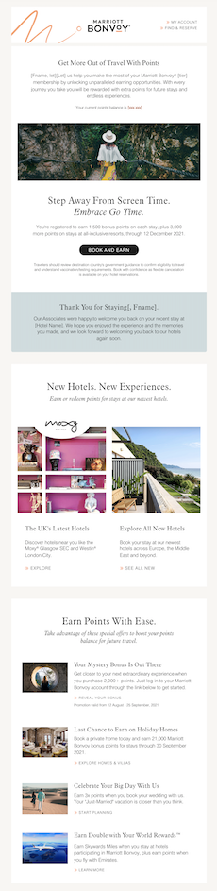
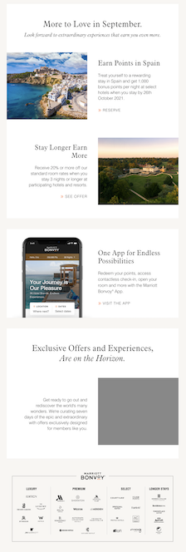
Q4 Promotions and Plans
Promotions:
Week of Wonders - October
Flash Sale? - November
Holiday Campaign? – December
Plans:
New Member Module – Starting October, track for several months
New Hotels in Higher Placement – November/December
End of Year Poll – what are your 2022 travel plans? (Dec/Jan)
Brand Education Evolution

Slide 10
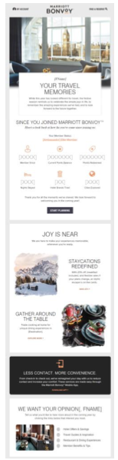
Q4 End of Year Wrap Up
Member-focused hero message
Inclusions: Member Status, Member Since, Points Balance, Points Redeemed, Nights Stayed, Brands Tried, Cities Explored
How do we make it even more engaging?
Consider Project Wanderlust content (i.e. member favorites, pools, etc.)
Other Marriott milestones (i.e. Moments relaunch)
New Hotel Openings
Add opportunities to earn and redeem more points, try more brands, explore more cities

Slide 11
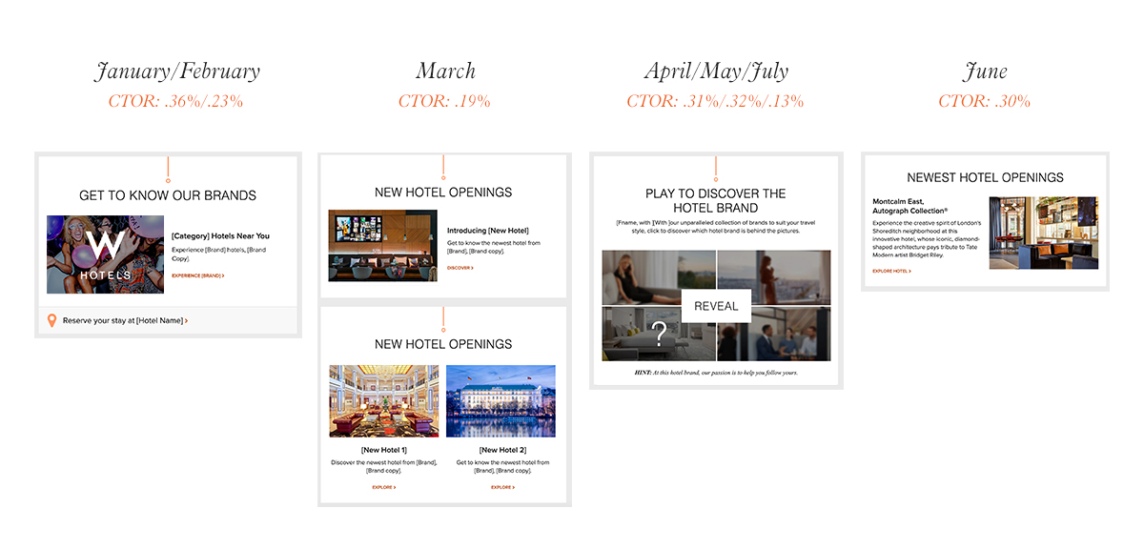
Brand Education - Results

Slide 12
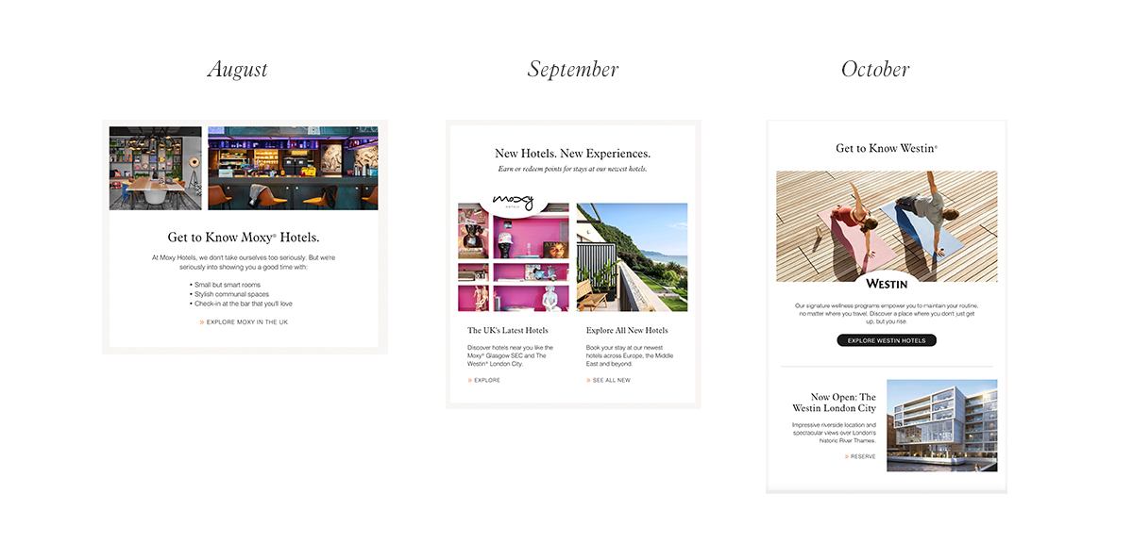
Brand Education - Recent

Slide 13
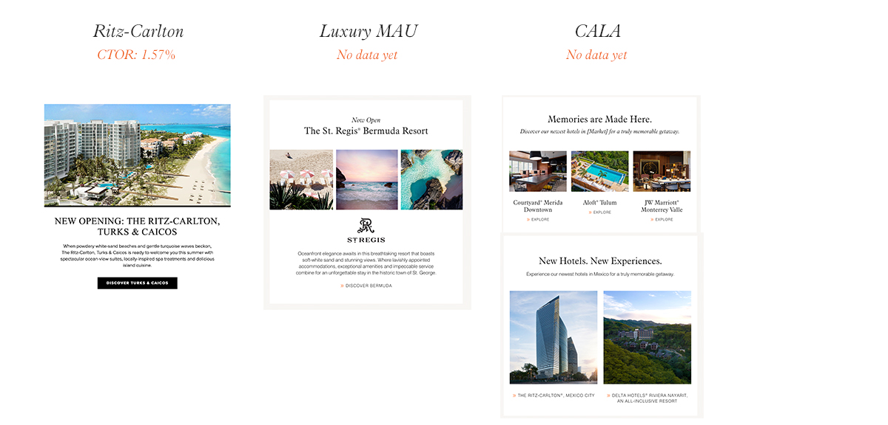
Brand Education - Other Brands

Slide 14
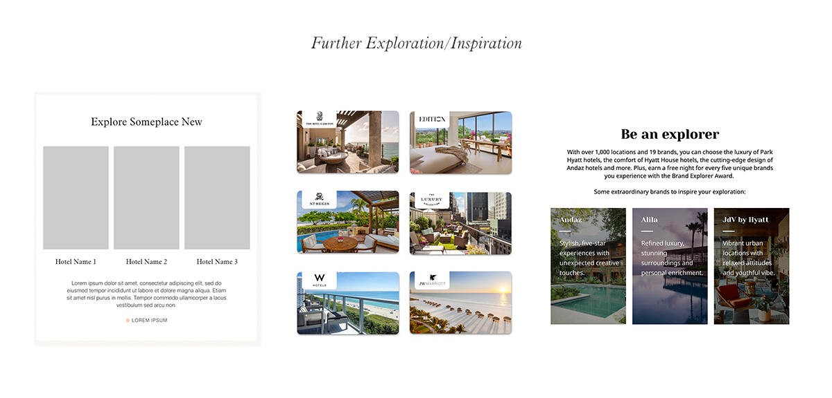
Brand Education

Slide 15
Outstanding Items

Slide 16
Outstanding Items
Closest Hotels
Epsilon Widgets – countdown timer, poll
Update on other widgets and workarounds (video, progress bar, carousel, weather, store locator)
Image Library

Slide 17
APPENDIX

Slide 18
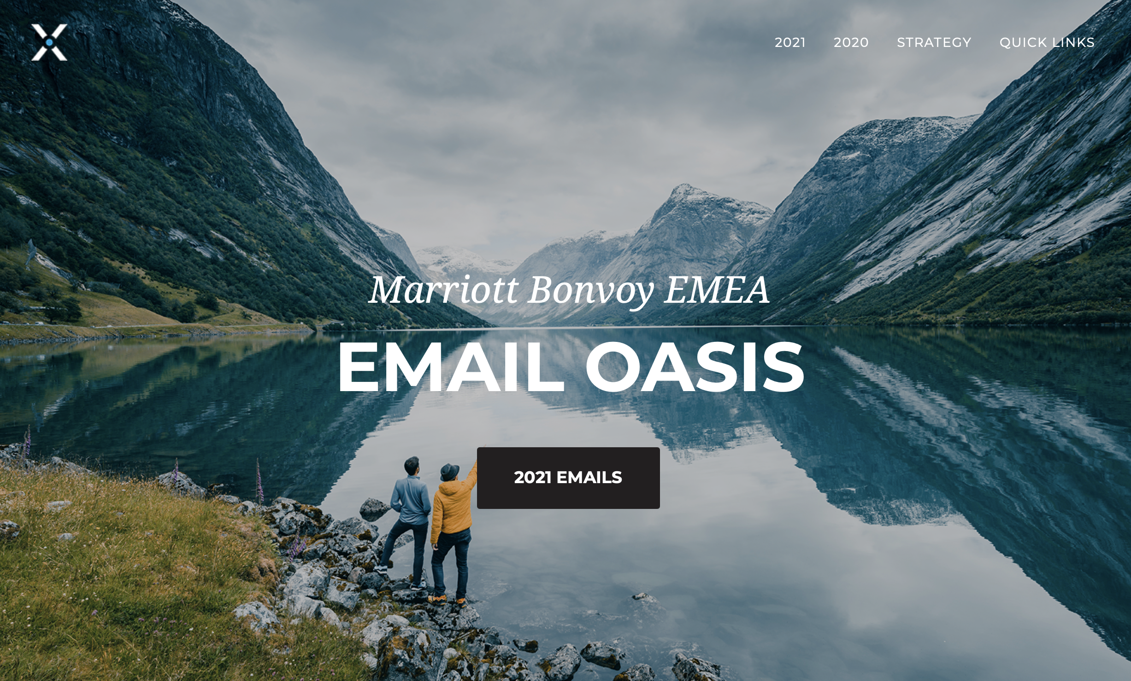
Oasis
http://preview.4at5.net/email_domains/mar/0001/mar_0001.html

Slide 19
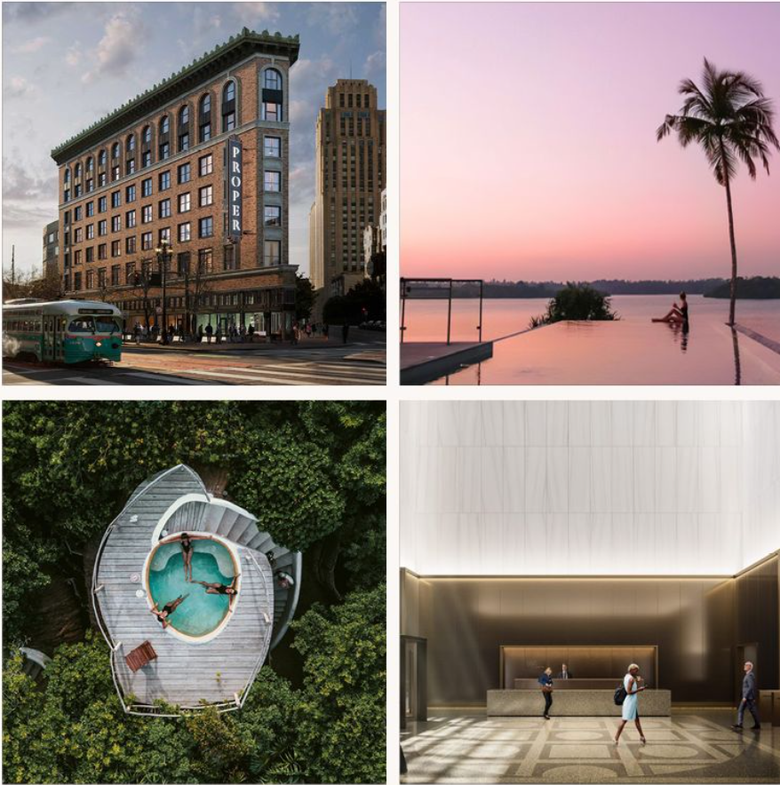
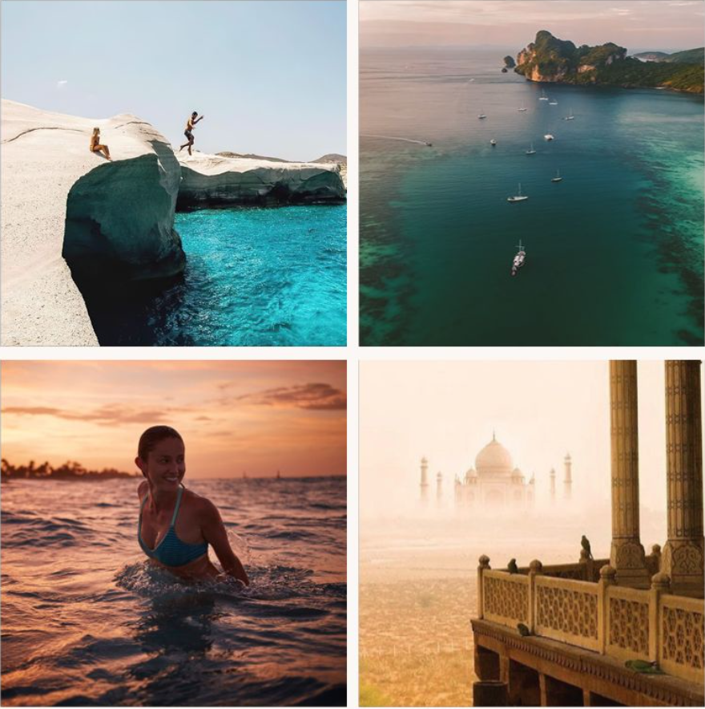
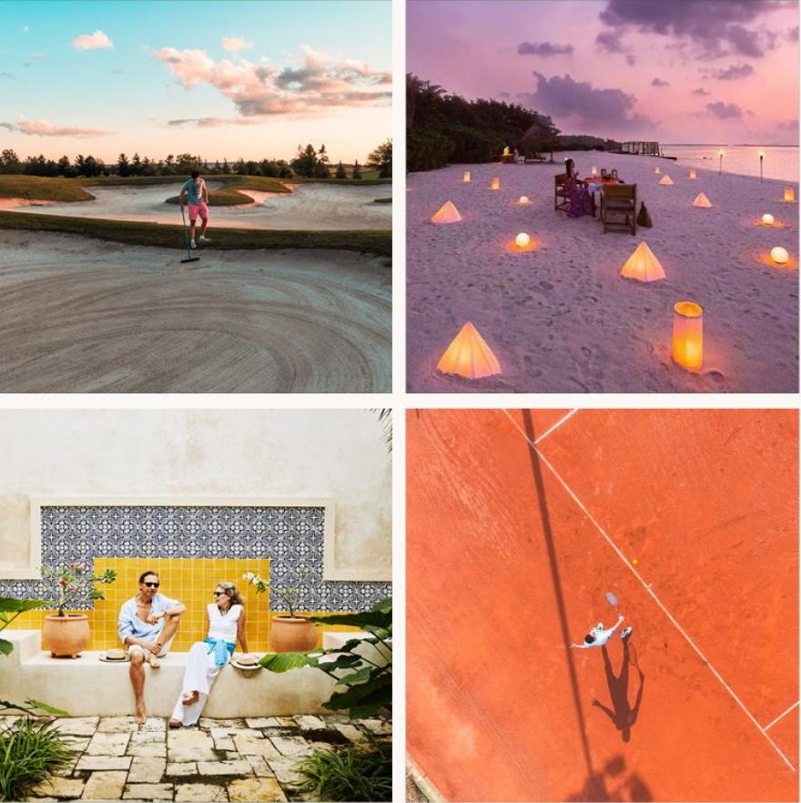
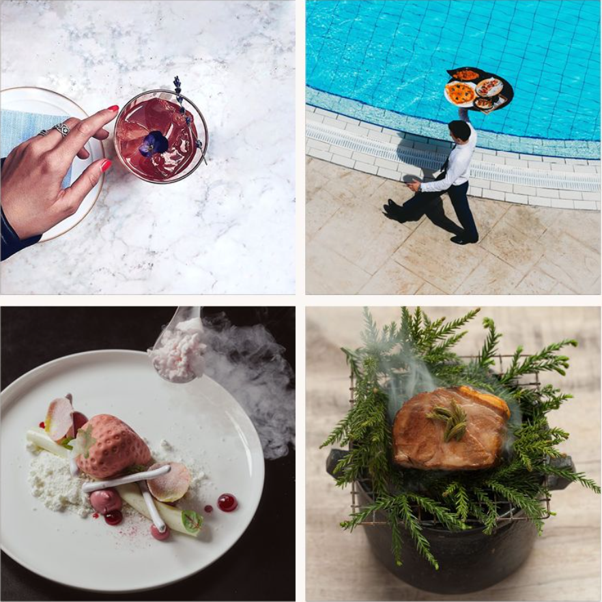
Image Library
Properties
Destinations
Imagery
Image guidelines
New photography direction
Singularly focused
Compositionally clean
Fewer, stronger colors (vibrant & bold)
"Not all destinations are places" (Ex: F&B imagery, compelling & grand)
Sourcing images
Would you still like to own this or would you like us to source images?
If we begin sourcing, are there any additional guidelines you have in the imagery you prefer?
Create image library
Could be great opportunity to partner together on image sourcing
Each country could give us the images they'd prefer to use, will also help inform our efforts
All images would be approved by your team before implementing in campaigns
Experiences
Food & Beverage

