Slide 1
Members Get It Blue Overlay Recommendations
Yesmail Creative Team

Slide 2
Agenda
Overview
Observations
Alt Recommendations
Recap / Summary
Image Testing

Slide 3

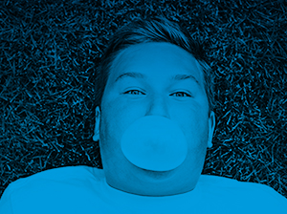

Overview: Blue Treatment
Blue Overlay consists of Blue gradient overlay on images
Image Types: Lifestyle Images

Slide 4
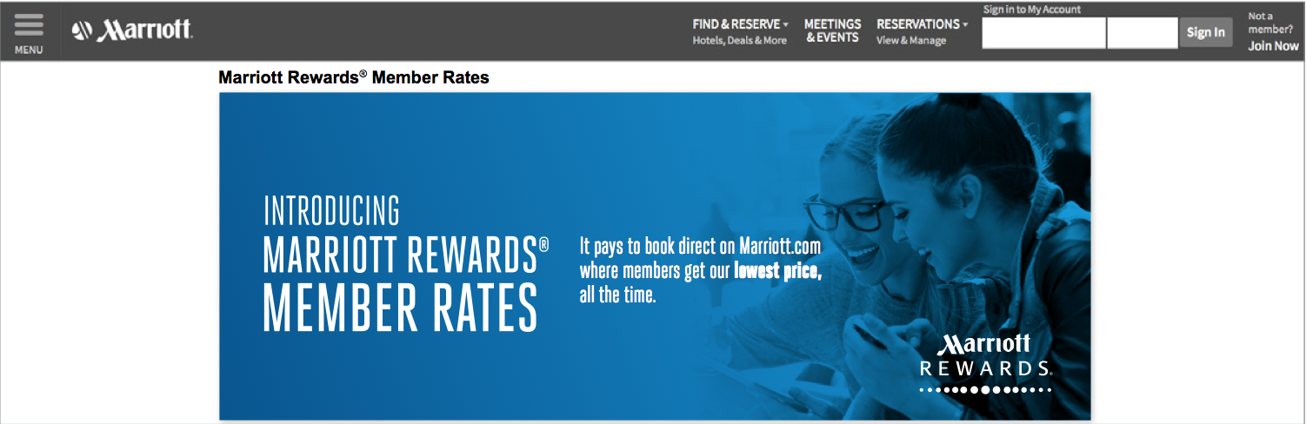
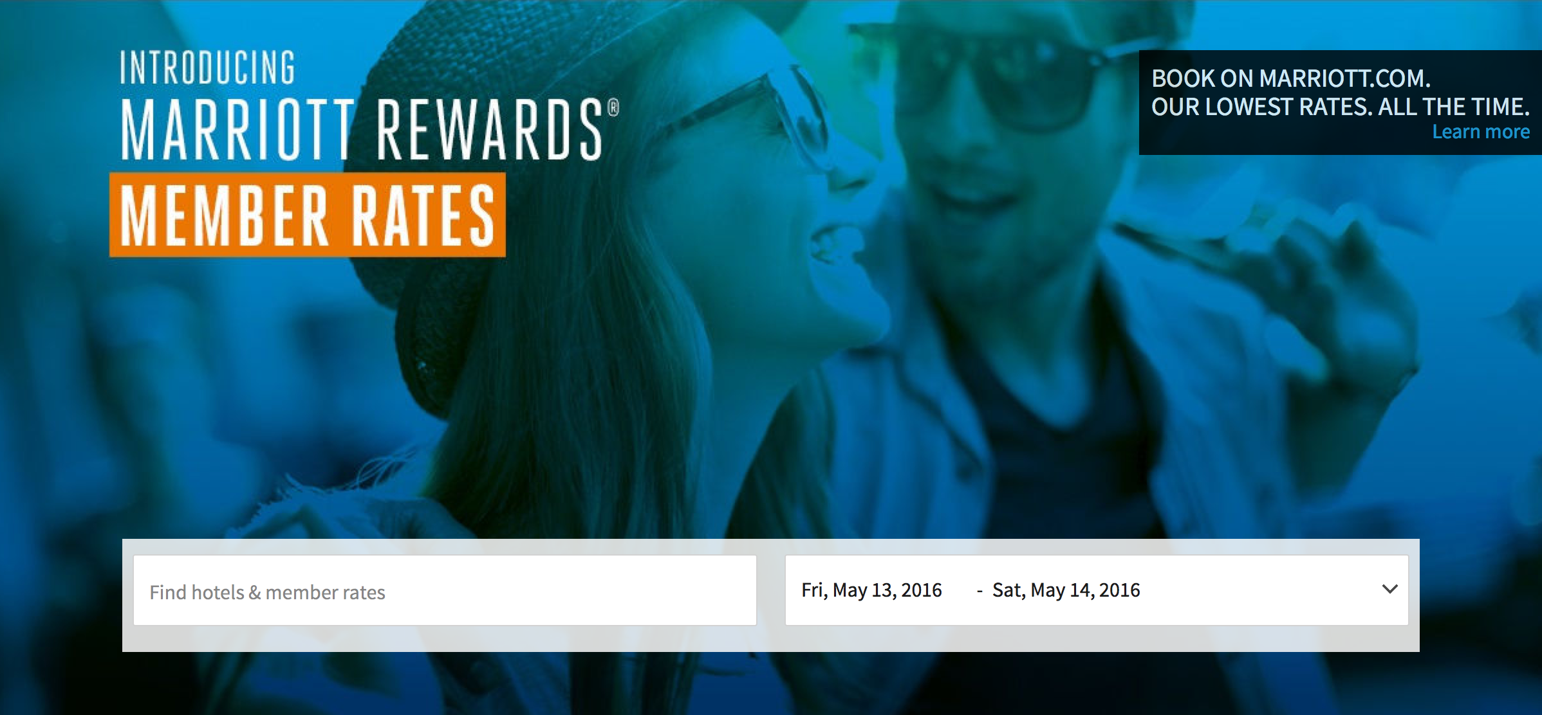
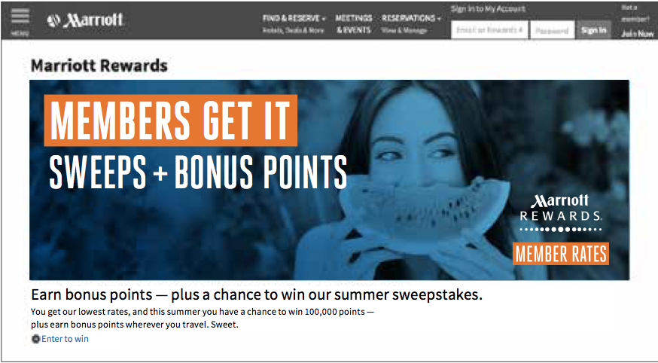
Overview: Blue Treatment
Treatment covers all “Members Get It” campaigns including:
MR Member Rates
Summer Sweepstakes
Elite Benefits
Future Campaigns

Slide 5
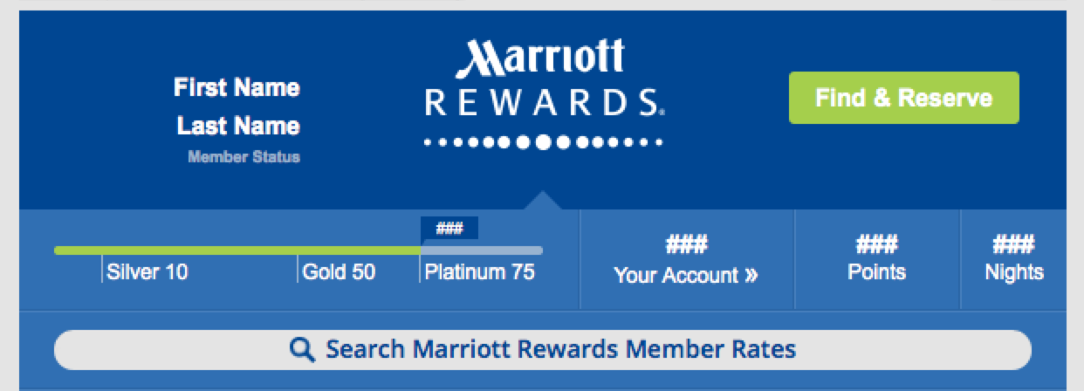
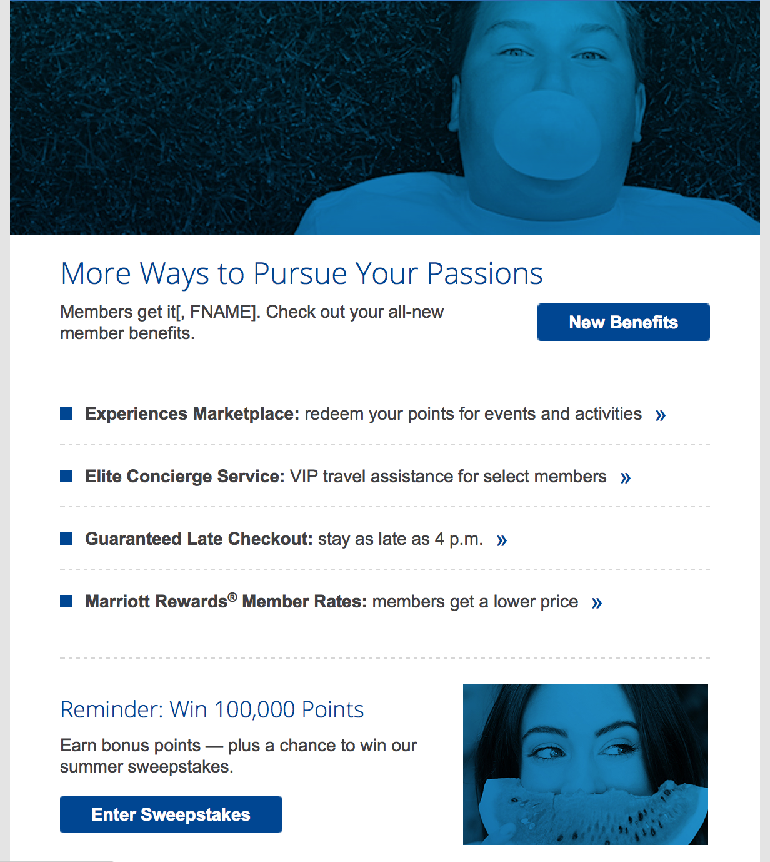
Observations: June eNews
Observations
Difficult to differentiate campaigns – when all the same, nothing is special
Smaller image harder to visually identify
Recommendations
testing
differentiate the two
text overlay
remove blue treatment on non-heroes
improve image clarity
provide alt enhancements
Elite Benefits
Summer Sweeps

Slide 6
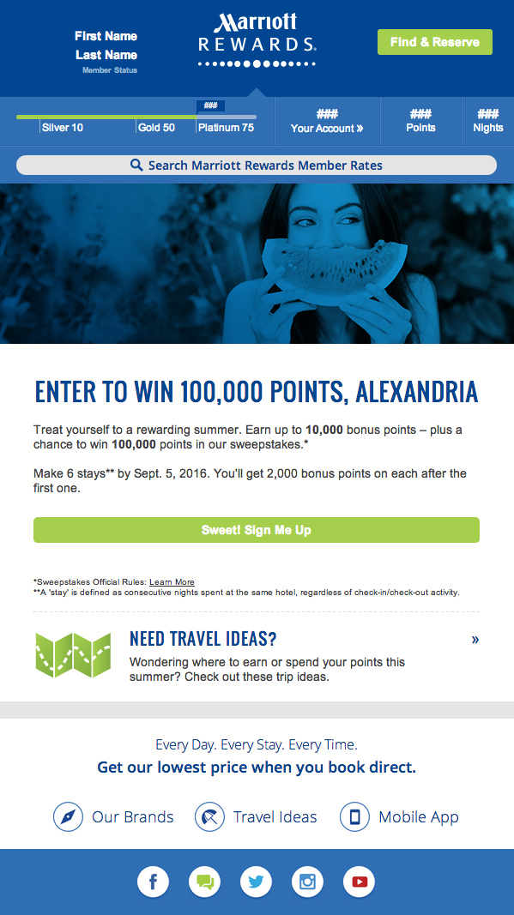
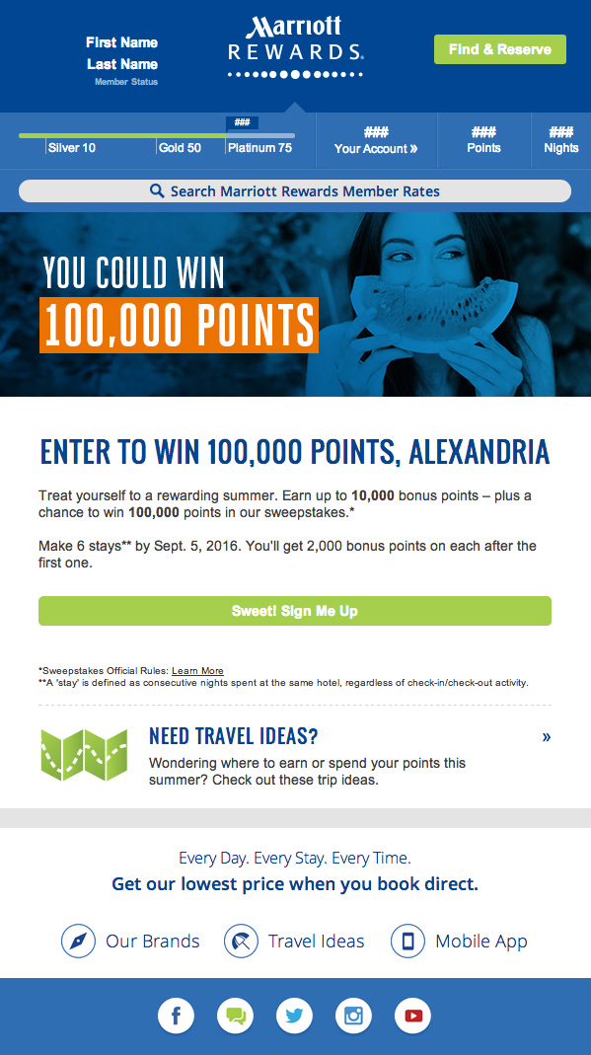
Alt Treatment: Copy Over Images
Where it works
Best used in hero
Copy in image should be reinforced in HTML text in headline or prominent location
Where it doesn’t work
Smaller sections, articles as the reduction in clarity due to size negates accessibility
Approved
Alternative

Slide 7
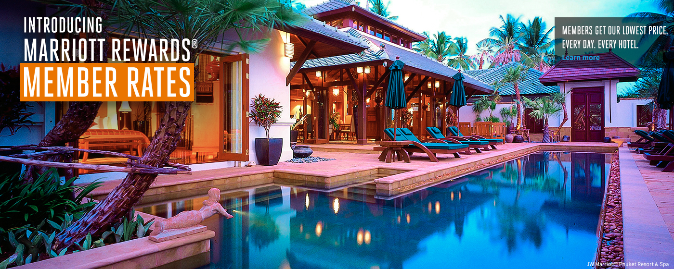
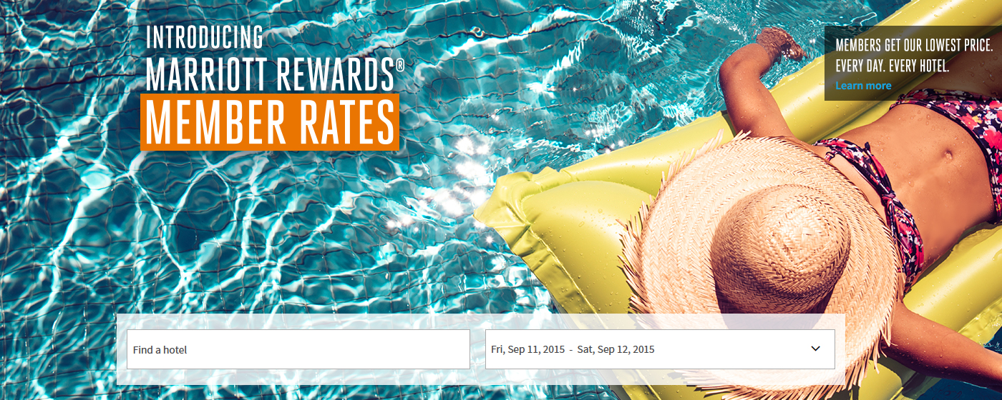
Alt Treatment: Graphic Over Color Image
PO April Landing Pages utilized the MR MR lock-up with orange bar to still signify Member Rates and also test imagery to gather useful data
Blue overlay may not be necessary on imagery when font and orange color are present to signify campaign

Slide 8

Alt Treatment: Text Highlight Color
Consider similar treatment, but different color for other promotions:
Orange = MR
Blue = Elite Benefits
Green = Summer Sweeps

Slide 9
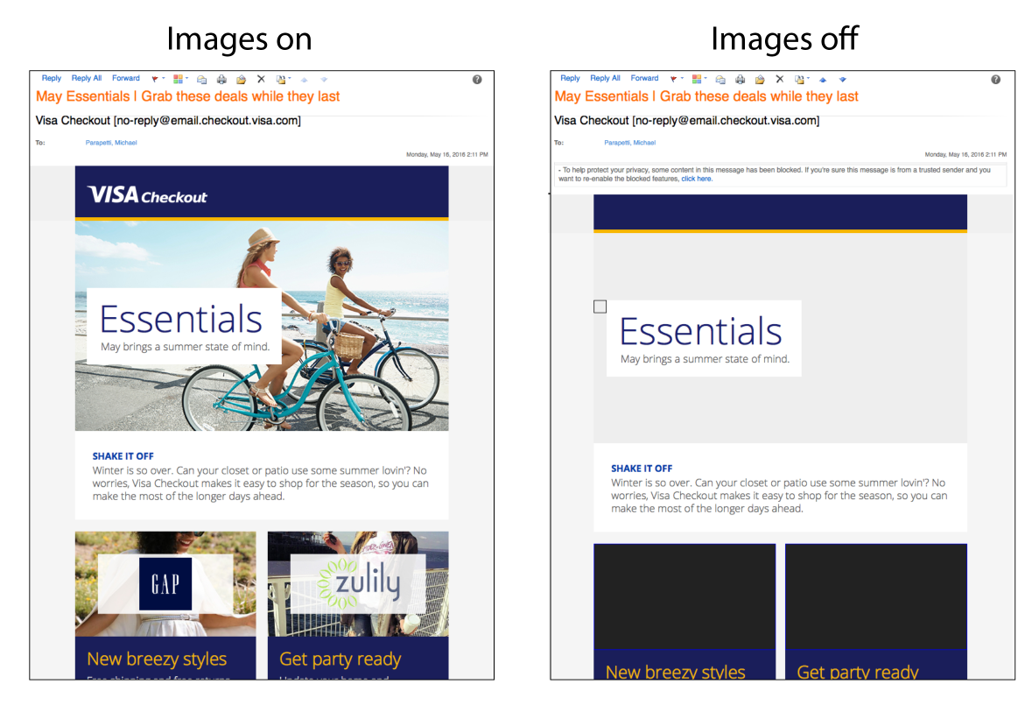
Alt Treatment: Text Module w/ Background Image
Develop module with background image and text block.
Whole Image might not be clickable (Example from Visa, 5-16-2016)

Slide 10



Alt Treatment: Color + Background Blue Overlay
Blue overlay in the background with focus on the subject through full color. This will display well in all digital concepts, regardless of size and help differentiate campaigns through photography choices.

Slide 11
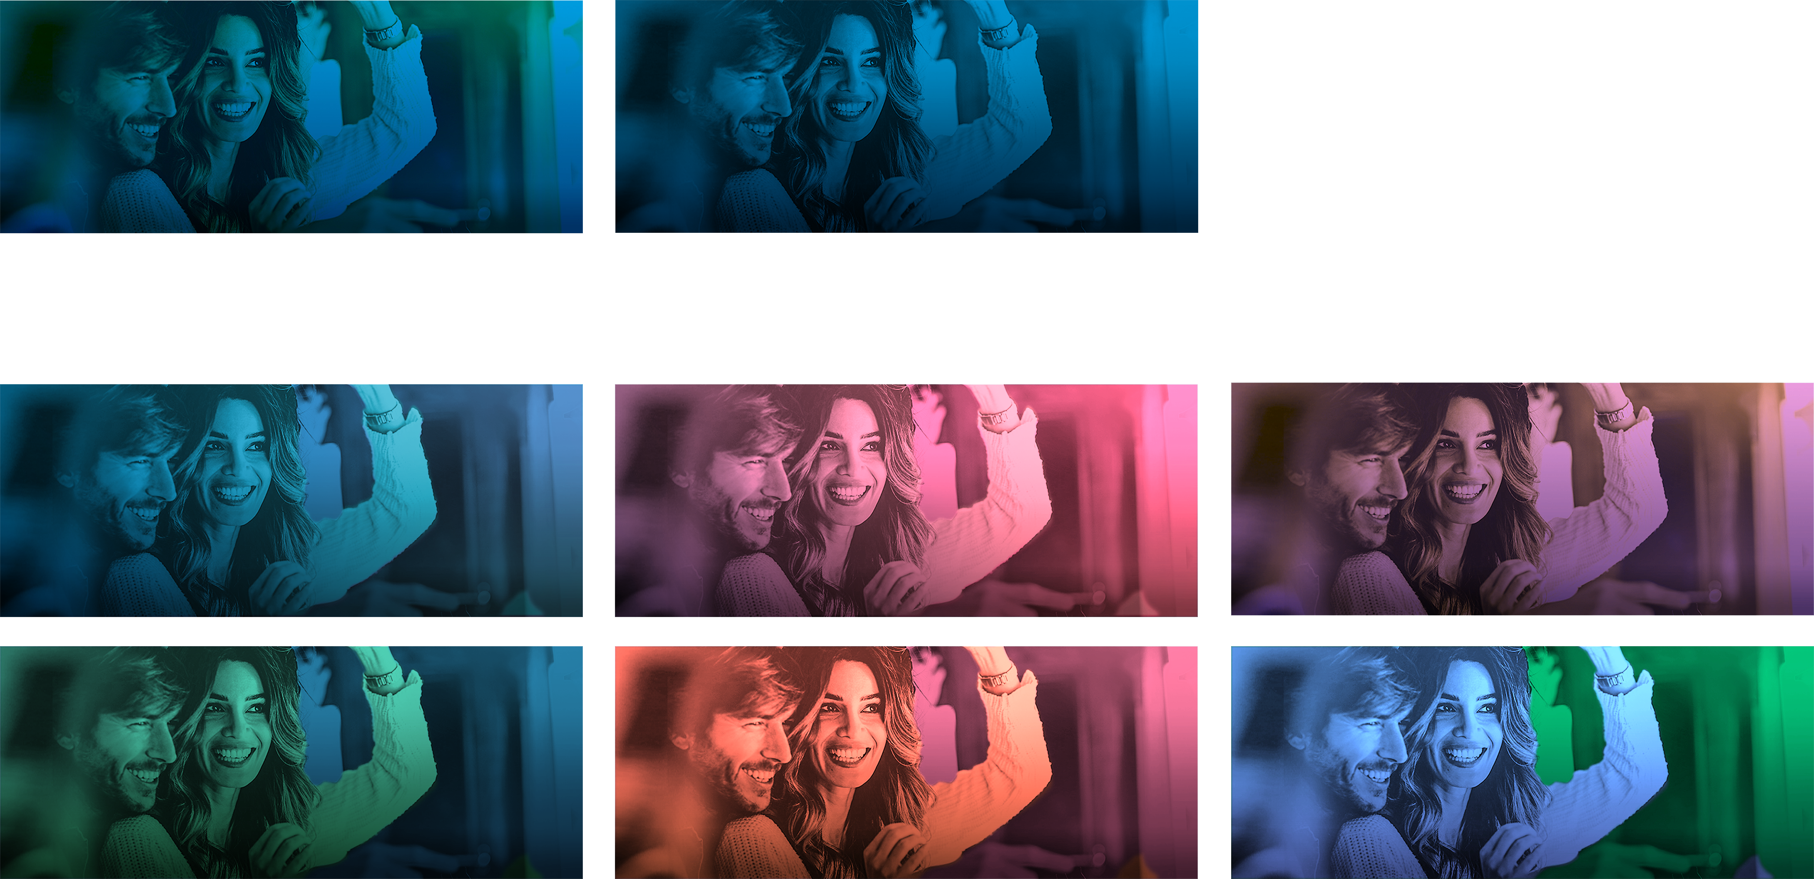
Alt Treatment: Color Overlay Enhancements
MR Examples
Color Explorations

Slide 12
Recap
Image testing: full color vs blue overlay
Copy over image with blue overlay (hero modules)
Graphic lockup over color image
Text highlight color (orange, blue, green)
Text module with background image
Full color subject + blue overlay on background
Color overlay enhancements

Slide 13
Summary
We hope to improve user engagement and accessibility through image testing for the CORE, WHPH, and TSAT audiences in conjunction with email best practices.

Slide 14
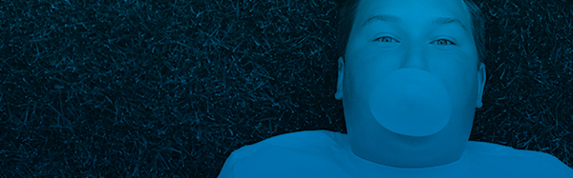



Image Testing: June eNews
Wylei Image Test #1
Message: June eNews
Campaigns:
Elite Benefits &
Summer Sweeps
Test: Blue vs. Full color in 2 different locations
Goal: Optimize Engagement
Audience:
CORE
WHPH (primary only)
TSAT (primary only)
A1
Primary (A)
A2
B1
Secondary (B)
B2

Slide 15
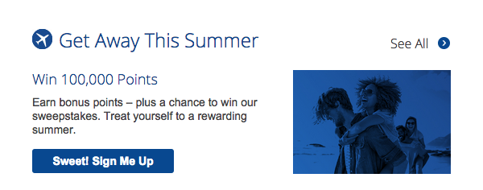
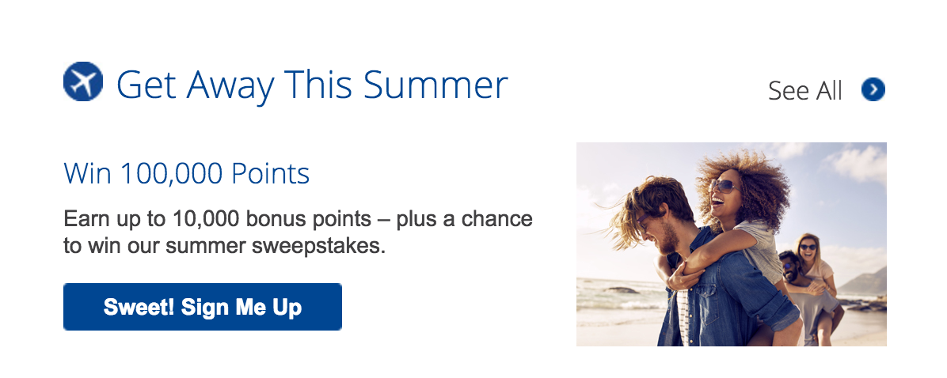
Image Testing: May Hotel Specials
Wylei Image Test #2
Message: May Hotel Specials
Campaigns:
Summer Sweeps
Test: Blue vs. Full color
Goal: Optimize Engagement
Audience:
CORE
A1
A2

