Slide 1


Logitech Project Orbit: Transactional Template Brief
Yes Marketing | 12/7/2018

Slide 2
Content
Overview
Transactional Communications Architecture
Design Inspiration
Next Steps
Appendix

Slide 3
Project Orbit Overview
The Assignment
The Audience
Create five new transactional email templates that feels unique to each of the individual master brands:
  Logitech
  Ultimate Ears
  Logitech G
  Jaybird
  Astro
The transactional emails will be deployed to users who purchased on one of the Logitech master brand websites.
Region & Language Consideration
  North America, English only is immediate focus

Slide 4
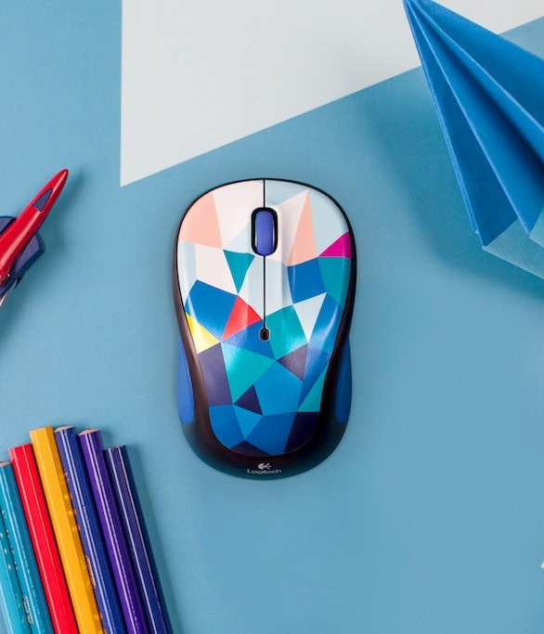
Logitech Transactional Email Communications Architecture

Slide 6
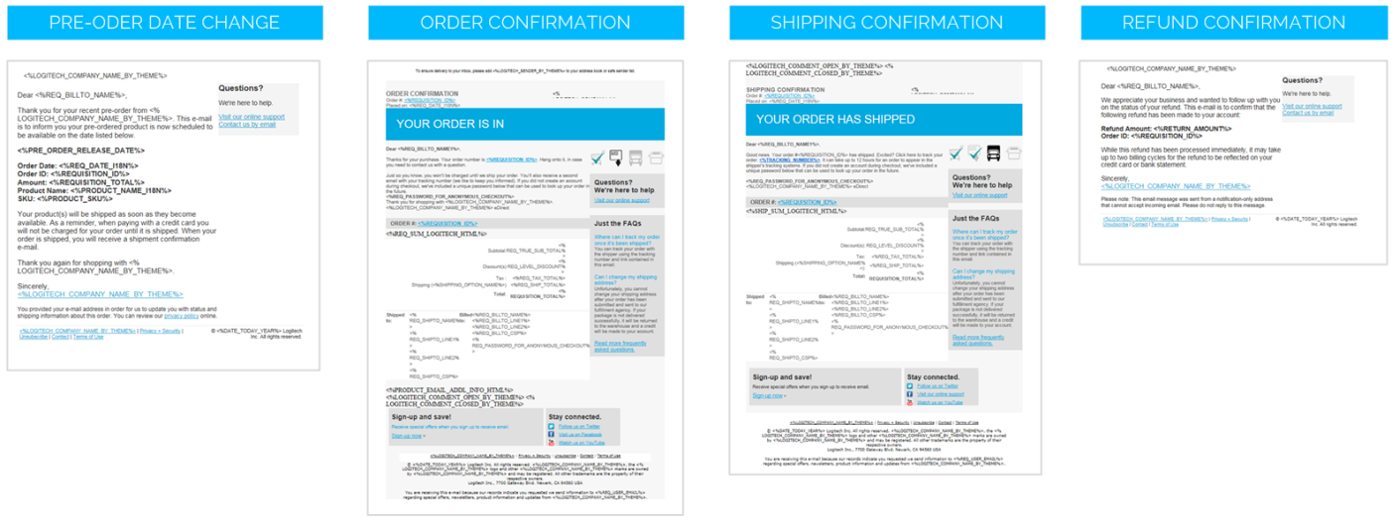

Transactional Template Framework
Five Branded Templates:
  Logitech
  Ultimate Ears
  Logitech G
  Astro
  Jaybird
Four Email Types:
  Pre-order date change
  Order confirmation
  Shipping confirmation
  Refund confirmation
20 Total Transactions Emails:
  Four unique transactional email types for each of the five brands

Slide 7
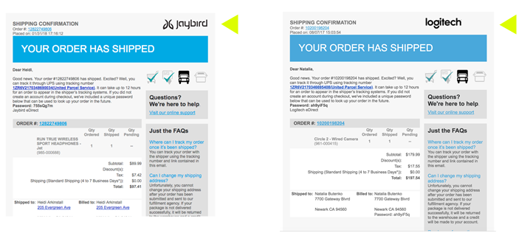

Transactional Versioning is Limited Due to Platform
Due to Digital River platform, limited brand versioning options are available
  Today, only customization is the individual brand logo
Future emails will continue to deploy from the Digital River and are built on a single grid, but need to reflect look and feel of the five individual brands

Slide 8
Transactional Template Requirements
Fixed Elements Unique to Each Brand
Logo, Fonts, Copy, Product Images Color Palette & Design per Individual Brand Guidelines
Localization
Focus on English only to support North America
Narvar Order Tracking Experience
Order Confirmation and Shipping emails will link directly to Narvar order tracking experience, so need to consider this in our email designs for consistent and cohesive feel (Narvar examples included in appendix)
Considerations As Applicable to Digital River Platform:
Mobile first ADA compliant Easily scanable Enable efficiencies

Slide 9
Transactional Email Content Mandatories
Order Confirmation & Shipping Confirmation
Refund Confirmation & Pre-Order Date Change
Order #
Intro thanking them
Product information (Copy, Image)
FAQs indicated in email w/ link to FAQ / Support
Social handles
Email sign up
Footer
No Marketing Content to be Included
All content is valuable, but needs a better design and a look at the copy
No Marketing Content to be Included

Slide 10

Design Inspiration

Slide 11
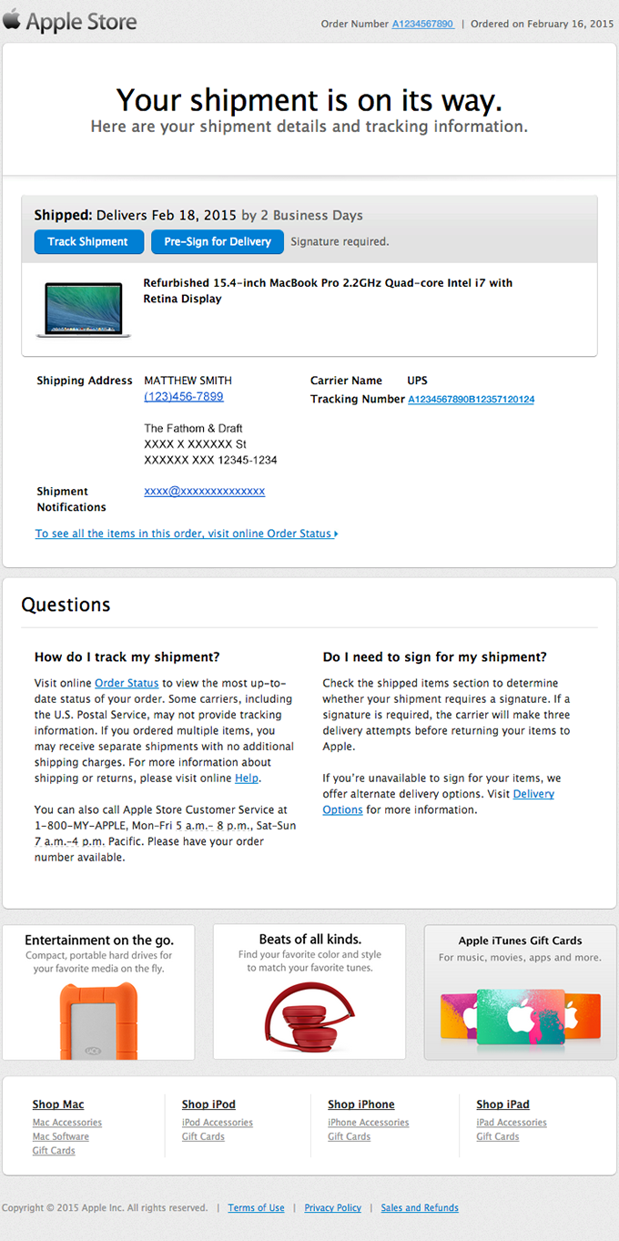
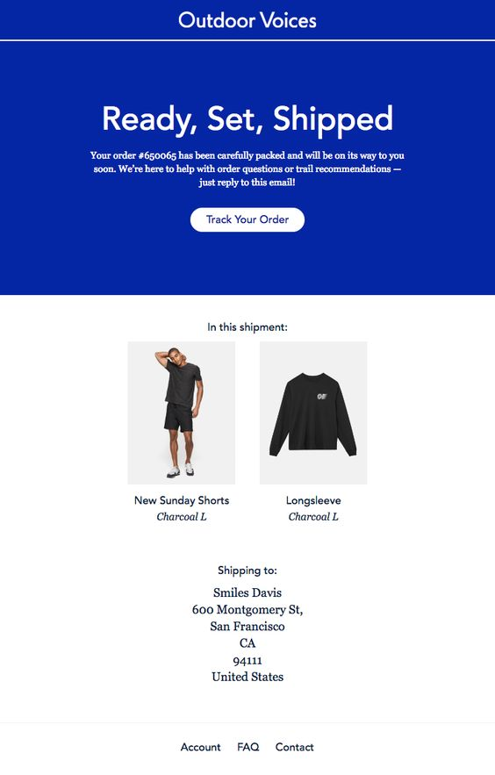
Message Hierarchy
Quick recognition and concise message to give the customer the information they need without having to dig for it

Slide 12
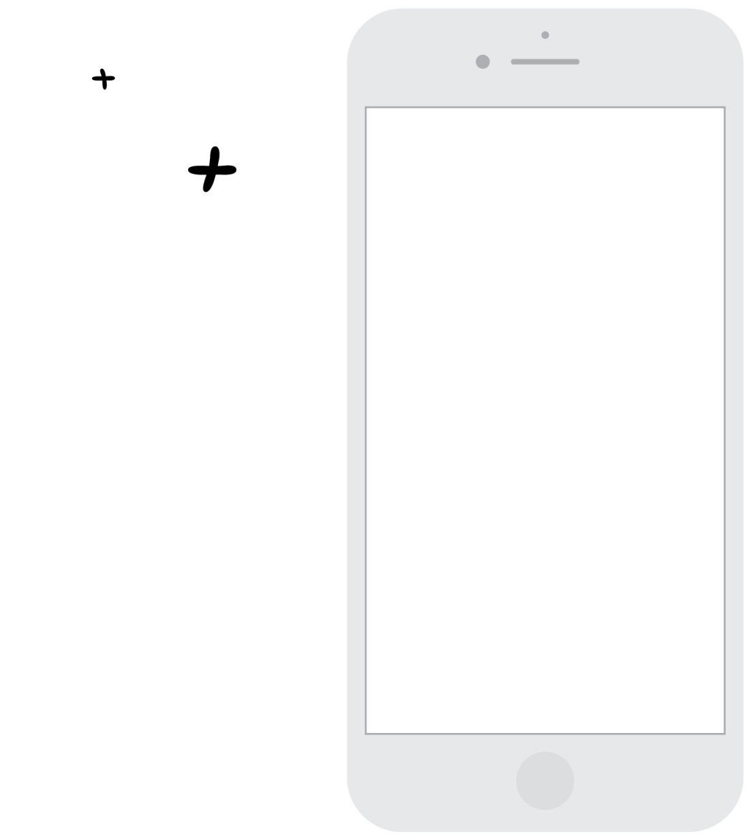
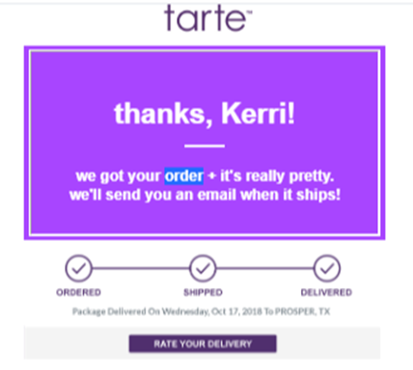
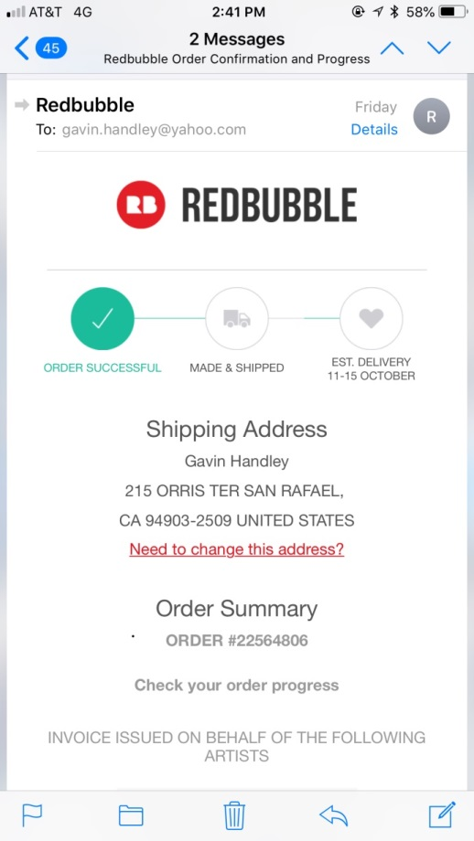
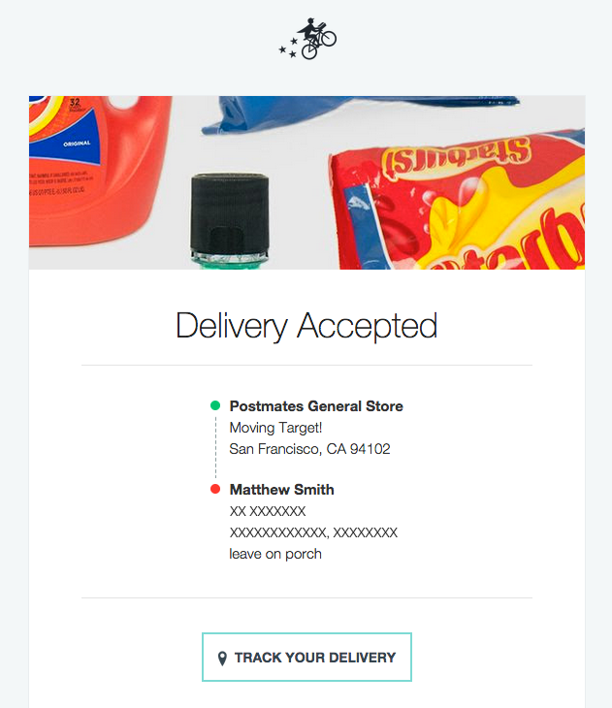
Progress Bar
A visually impactful and simple way to show order status

Slide 13
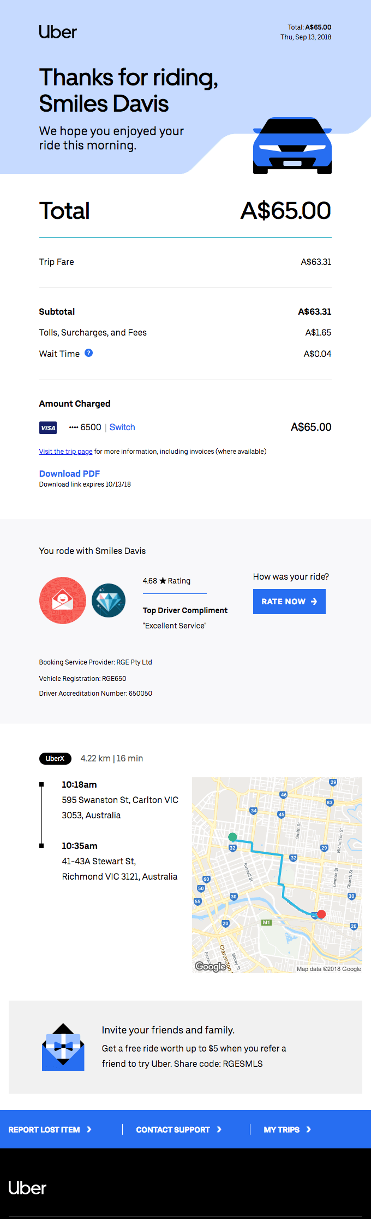
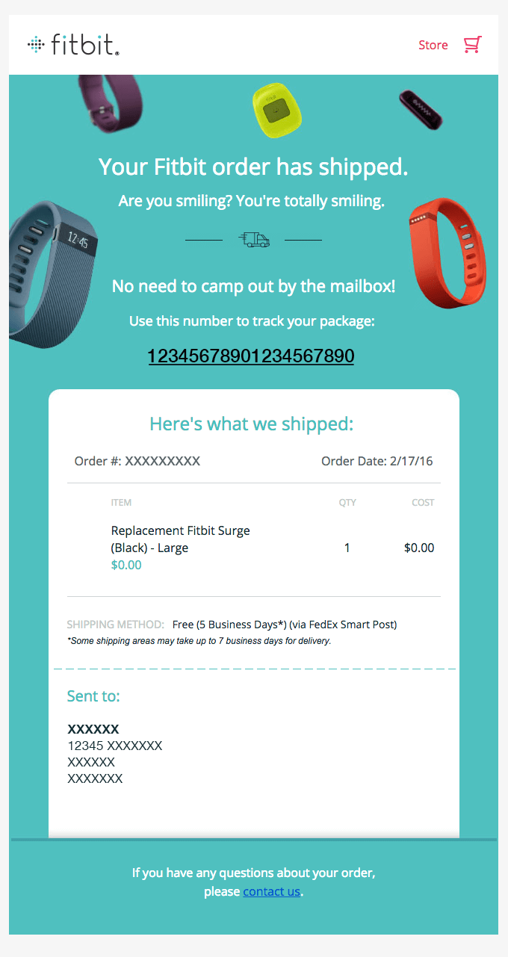
Bold Use of Color
Great tactic to clearly differentiate the brand
The use of background color is an effective way to break-up sections of the message

Slide 14
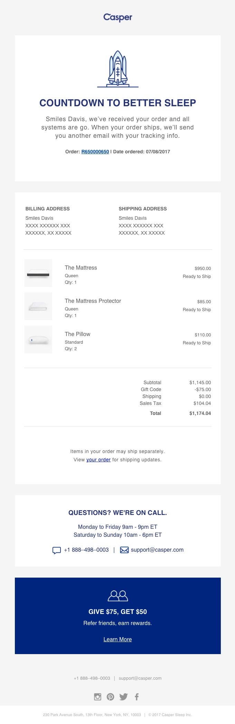
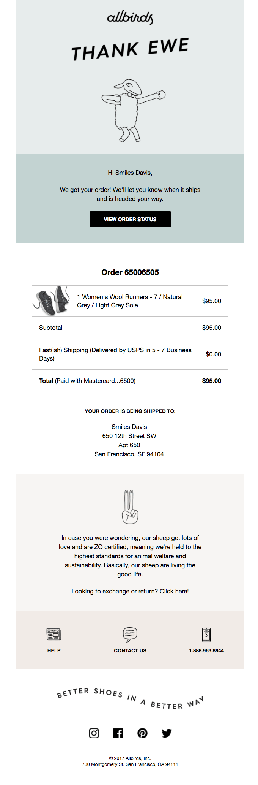
Keeping it Simple
Only show what is required – let the website provide the additional information to support the transaction

Slide 15
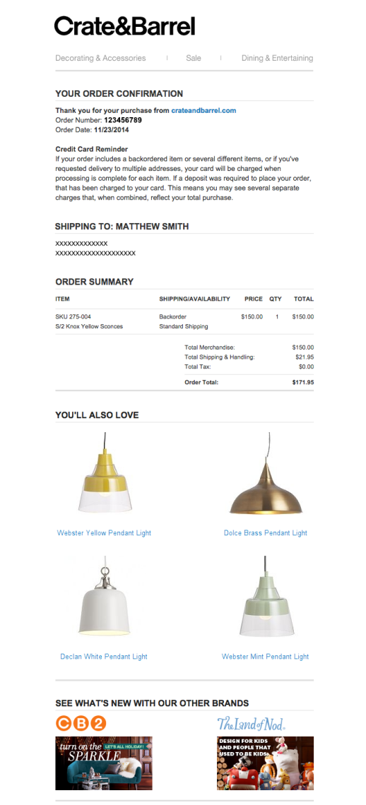
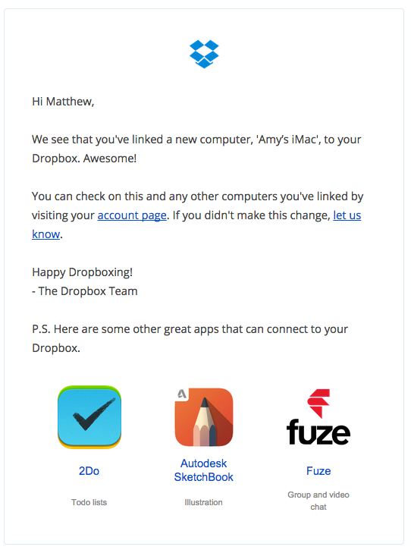
Added Value Content
Increase customer satisfaction and drive incremental sales with strategically placed content to complement the transaction

Slide 16

Next Steps

Slide 17
Moving Forward
Strategy to present transactional brief 12/7
Creative to present initial transactional wireframes 12/7
Review timeline transactional template 12/7
Sabrina to provide trans timeline/key milestones for client

Slide 18

Thank you!
Yes Marketing | 12/7/2018

Slide 19
Narvar Order Tracking Experience

Slide 20

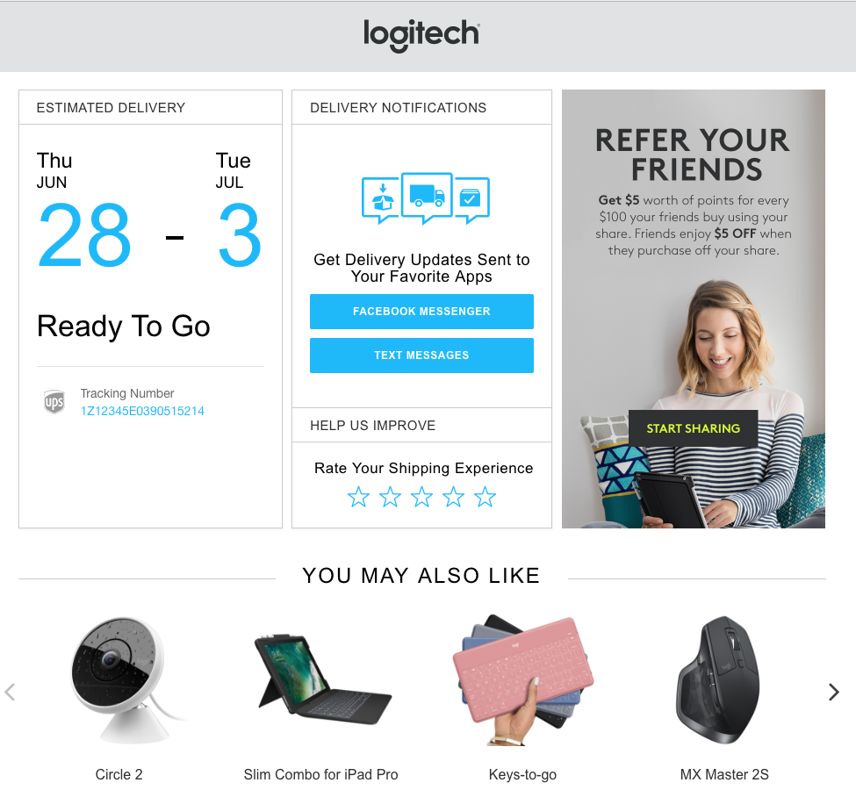
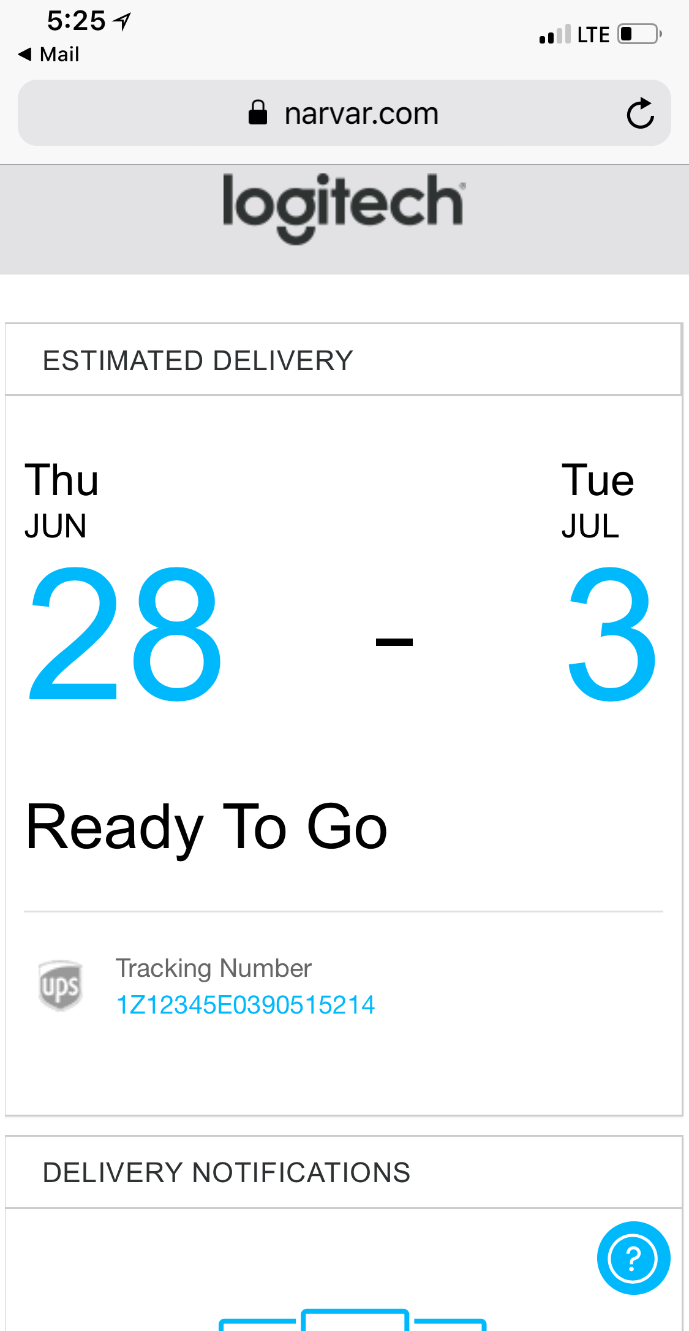
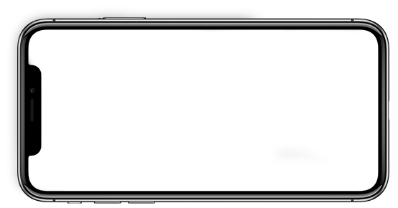

UPGRADE EXPERIENCE - Logitech
*Live in US

Slide 21

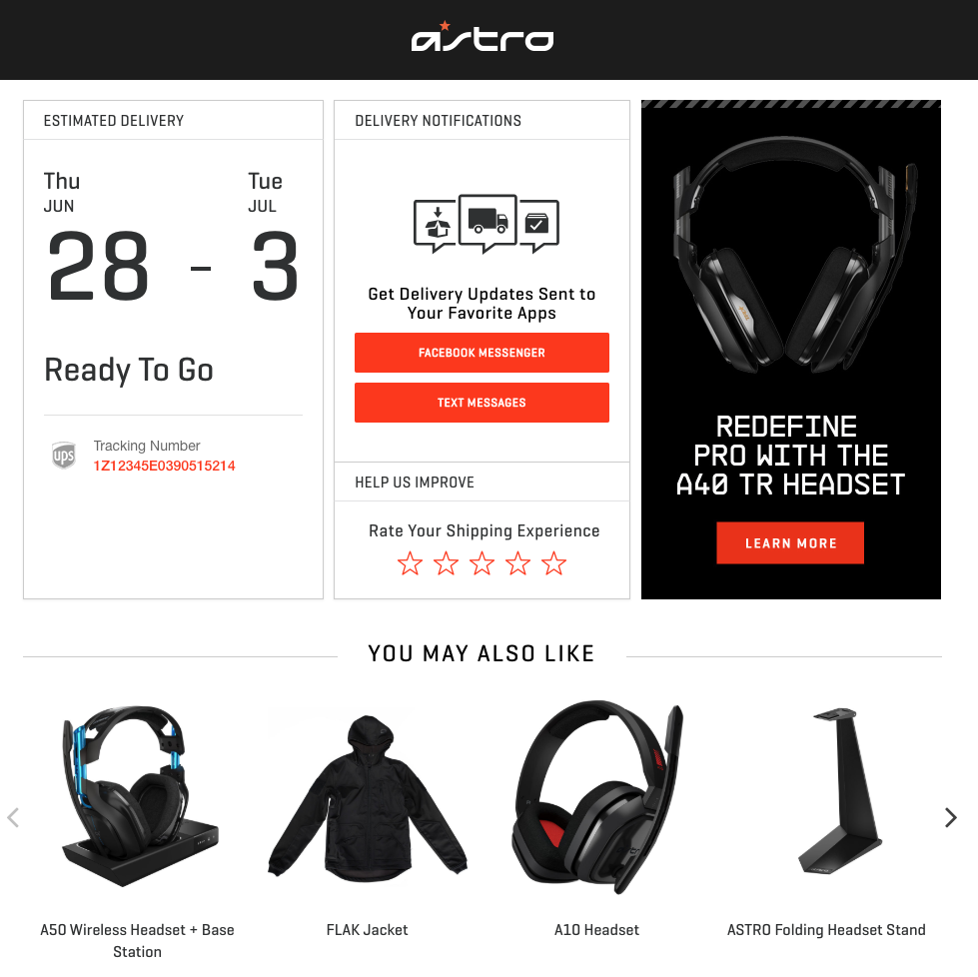
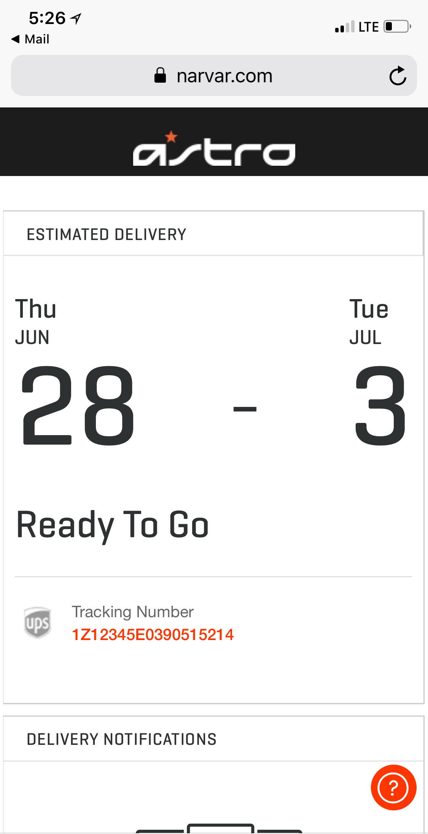

SUPPORT ALL MASTER BRANDS - Astro Gaming
*Live in US

Slide 22
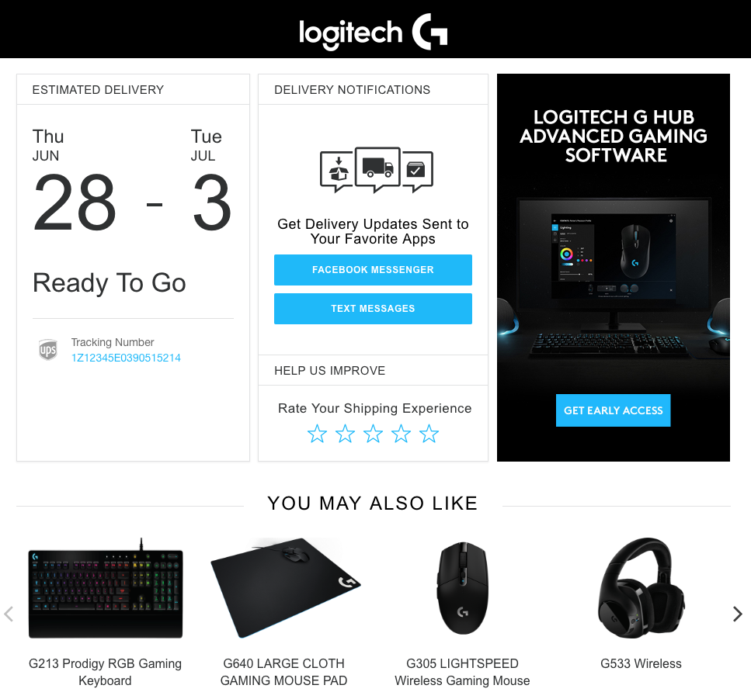
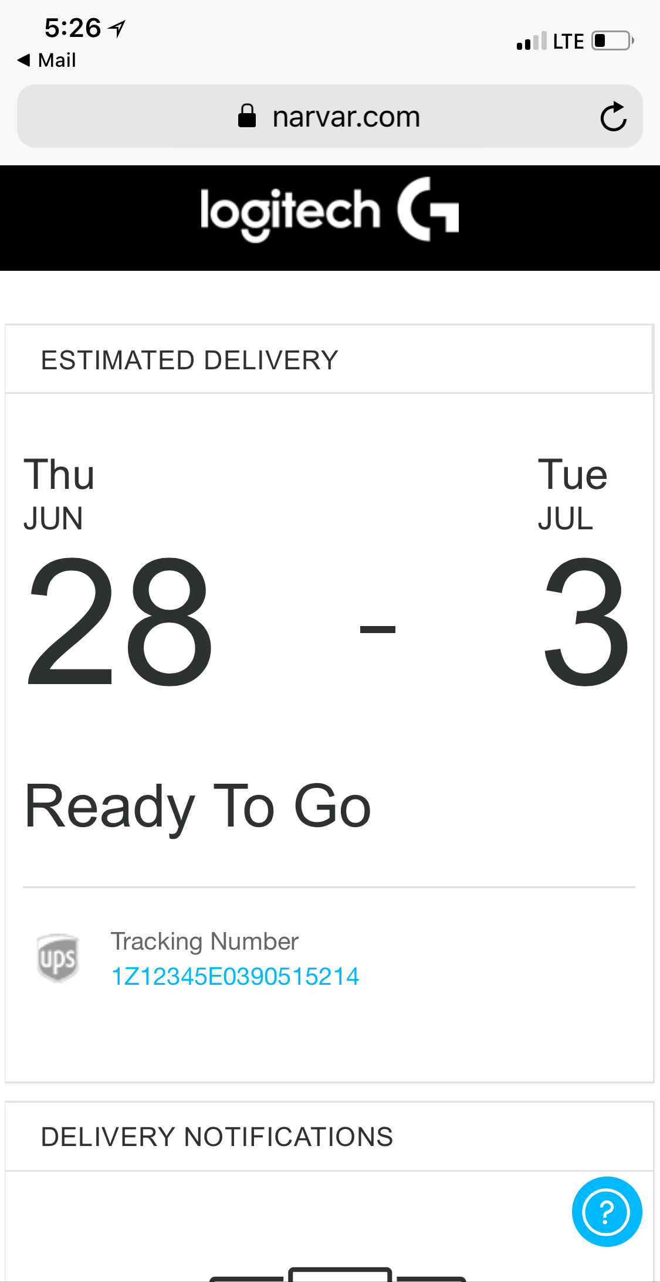
SUPPORT ALL MASTER BRANDS - Logitech G
*Live in US

Slide 23

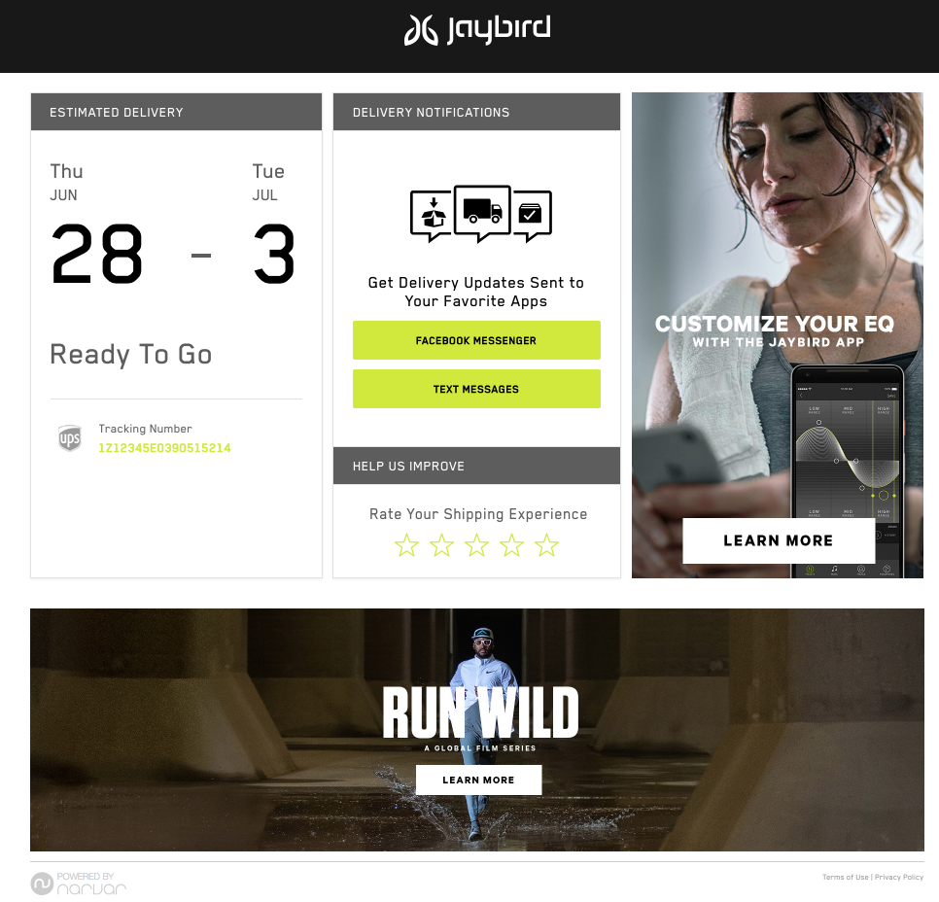
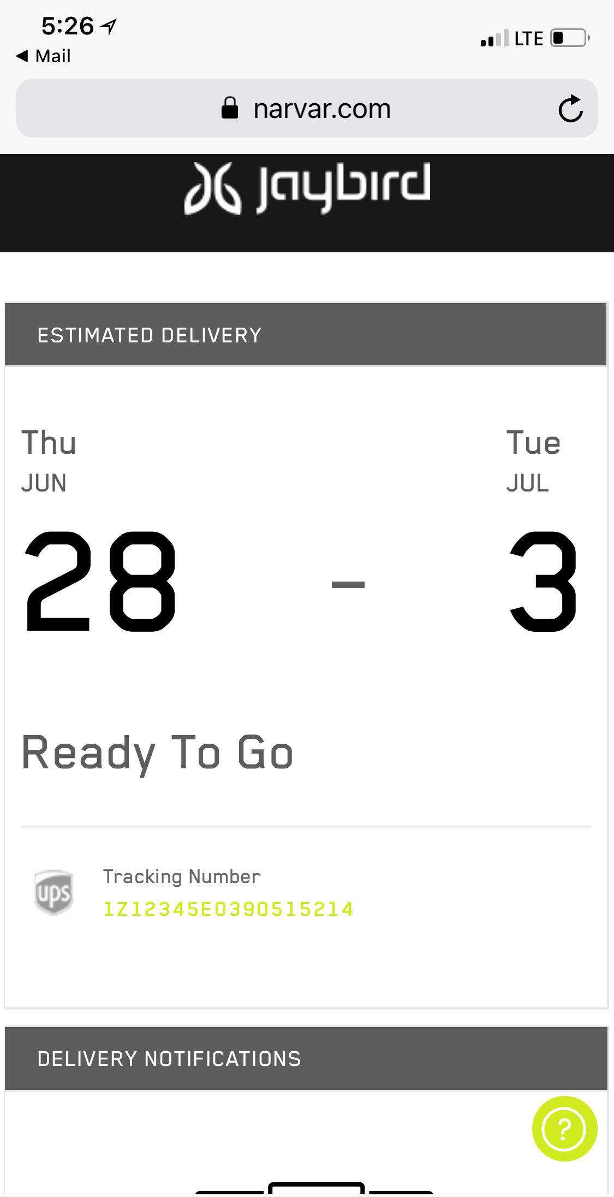

SUPPORT ALL MASTER BRANDS - Jaybird
*Live in US

Slide 24

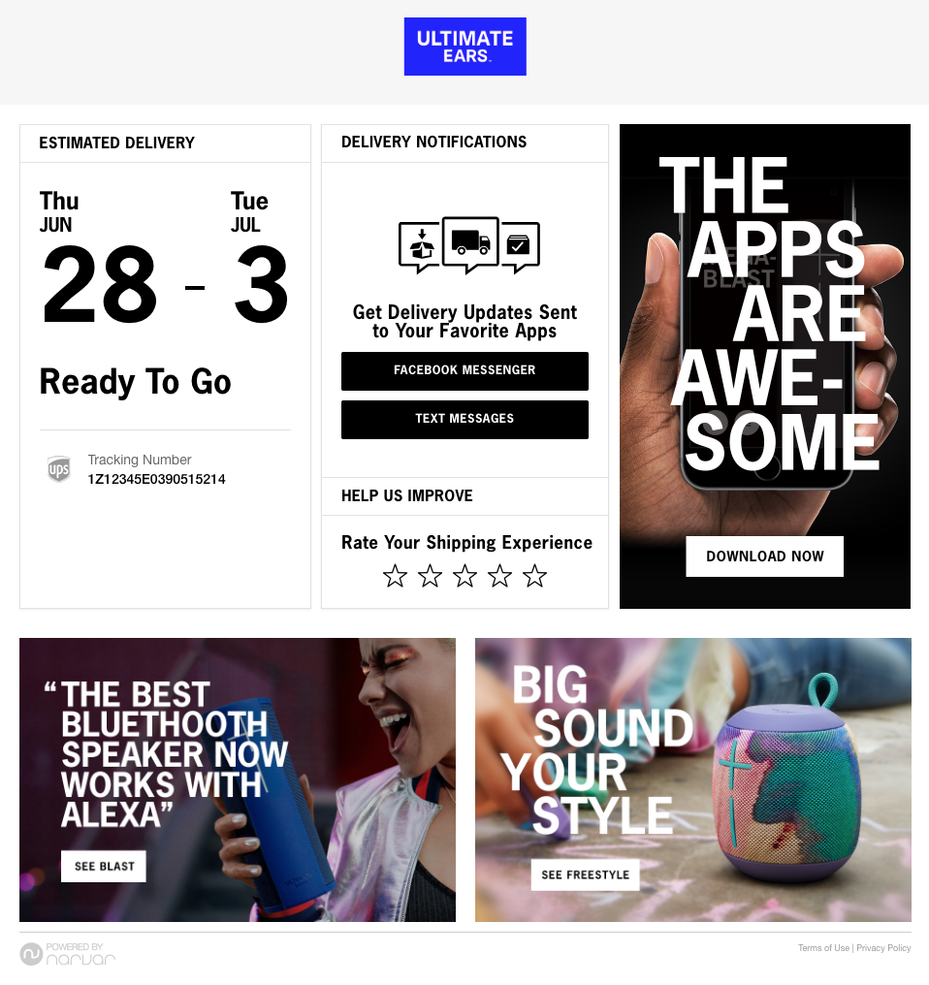
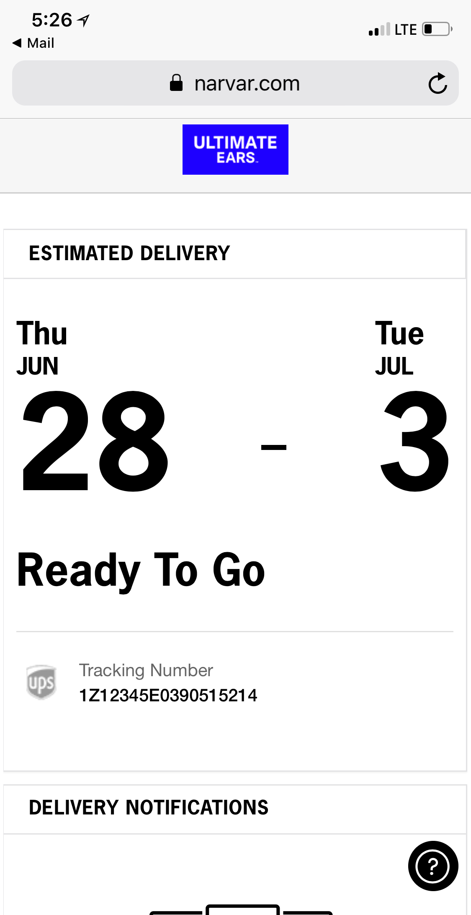

SUPPORT ALL MASTER BRANDS - Ultimate Ears
*Live in US

