Slide 1
May 2013 email blast to HP RPS subscribers
Launch goal: week of 5/14 or 5/16/13

Slide 2






Special Dads & Grads Edition I
Retail Photo Services
Easy, fun, and made while you shop
All 4 topics will link to: http://hp.com/go/wakeupyourwalls
Coupons Décor Tips Videos Ezine
Best Dad and Grad gift ever
Now with NEW HP coupons that are combinable with retailer offers.
Mounted photos and photo canvas shown
Available with $5 HP coupons
Get coupons – links to http://hp.com/go/wakeupyourwalls
Get All Coupons
Rollbacks—up to 50% savings
on Same-Day photo posters and canvas. Offer combinable with applicable HP coupons.
Create online, pickup same-day
Regular retail price from $5.86
Save up to 50%—for a limited time
on 1-Hour photo posters, canvas and Mounted Photos. Offer combinable with applicable HP coupons.
Create posters online with 1-Hour pickup
Regular retail price from $3.96
Walmart Photo button– links to http://walmart.com/photopickuptoday
Walmart Photo
Meijer Photo button– links to http://meijerphoto.com
Walmart Photo
Meijer Photo

Slide 3



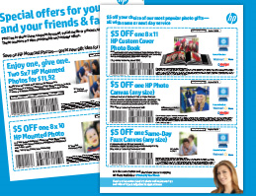
Meet Genevieve
Noted interior designer shares her photo wall décor tips and tricks.
Link to: hp.com/go/wakeupyourwalls
View Tips and Video
Two 5x7 mounted photos for $11.92
$6 in savings when you buy 2.
Regular retail price $17.92
Get Coupon
Link to: hp.com/go/wakeupyourwalls
$5 off our most popular photo gifts
Save up to 50% off with coupon + retailer promotions for a limited time.
Get Coupons
Link to: hp.com/go/wakeupyourwalls

Slide 4


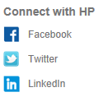
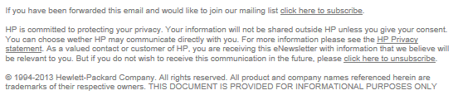
LINKS
HP Retail Photo Services
Videos– http://hp.com/go/wakeupyourwalls
Décor Tips – http://hp.com/go/wakeupyourwalls
Ezine -http://hp.com/go/wakeupyourwalls
Coupons - http://hp.com/go/wakeupyourwalls
Walmart Photo
Same-Day Creations– http://walmart.com/photopickuptoday
Photo Wall Décor – http://photos.walmart.com/walmart/storepage/storePageId=Wall+Art/
Posters & Banners - http://photos.walmart.com/walmart/storepage/storePageId=Posters/
Photo Books - http://photos.walmart.com/walmart/storepage/storePageId=Photo+Books
Special Offers – http://photos.walmart.com/walmart/storepage/storePageId=Special+Offers
Meijer Photo
1-Hour Creations – http://meijerphoto.com
Next-Day Canvas- http://www2.snapfish.com/meijer/home-decor/personalized-photo-canvases
Posters – http://www1.snapfish.com/meijer/home-decor/photo-poster-prints
Photo Books - http://www.snapfish.com/meijer/fe/photo-books/campaignName=meijer.com_photobooks/partner=MEIJER/channel=OLX
Special Offers - http://www2.snapfish.com/meijer/photo-gifts/coupon-codes
Connect with HP
FB – (HP for Home) https://www.facebook.com/HPhome?ref=ts&fref=ts
Twitter – (HP Print) https://twitter.com/HPPrint
Pinterest – http://pinterest.com/hpcreate
NEW: Photo Wall Décor
Digital Magazine
Get inspired with the new spring edition.
Available for PCs, tablets and smartphones.
Walmart Photo Ezine
Meijer Photo Ezine
HP Retail Photo Services
Videos
Décor Tips
Ezine
Coupons
Walmart Photo
Same-Day Creations
Photo Wall Décor
Posters & Banners
Photo Books
Special Offers
Meijer Photo
1-Hour Creations
Next-Day Canvas
Posters
Photo Books
Special Offers
You are receiving this email because you signed up with House Party or the Wake Up Your Walls sweepstakes. If you no longer want to receive emails from HP Retail Photo Services, you may opt-out via the link at the bottom of this email.
You are receiving this email because you signed up with House Party (add register mark) or the HP Wake Up Your Walls sweepstakes. If you no longer want to receive emails from HP Retail Photo Services, you may opt-out via the link at the bottom of this email.

