Slide 1

Best in Class Retail Email Comparisons
How HP Shopping stacks up against other successful retails email programs
Presented by:
Creative Services

Slide 2
Contents:
Comparison 1 – Technical items in good retail emails
Comparison 2 – Design, copy and audience customization
Focus on Customization & Targeting
HP Shopping New Template in depth
Future Ideas & Recommendations

Slide 3
COMPARISON 1 Best in Class Email - Technical items

Slide 4
COMPARISON 1 Best in Class Email - Technical items
Can be read w/ image off?
Mobile- Ready Scalable layout?
Bulletproof buttons (buttons can be seen w/ images off?)
Strong Navigation? (top, inner, bottom catchall)
Dynamic ready? Easy to merge
Social Linking / Social Sharing / Social Dispatches?

Slide 5
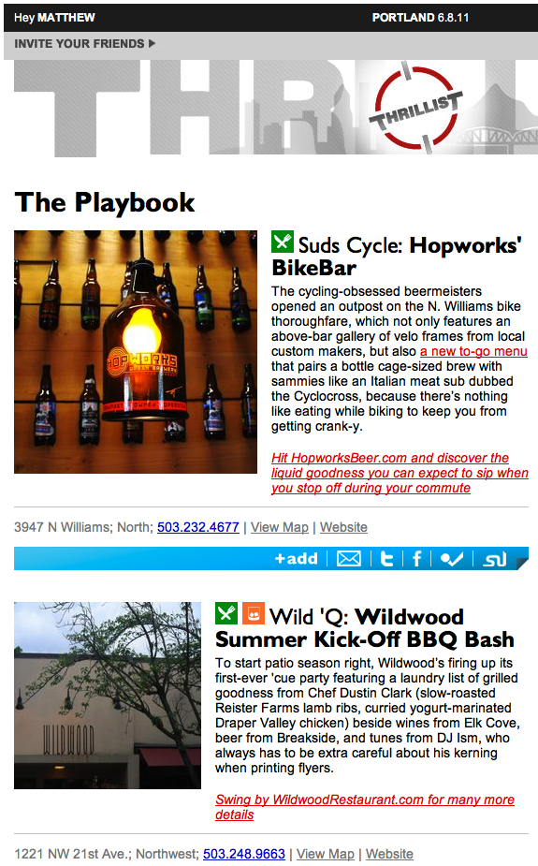
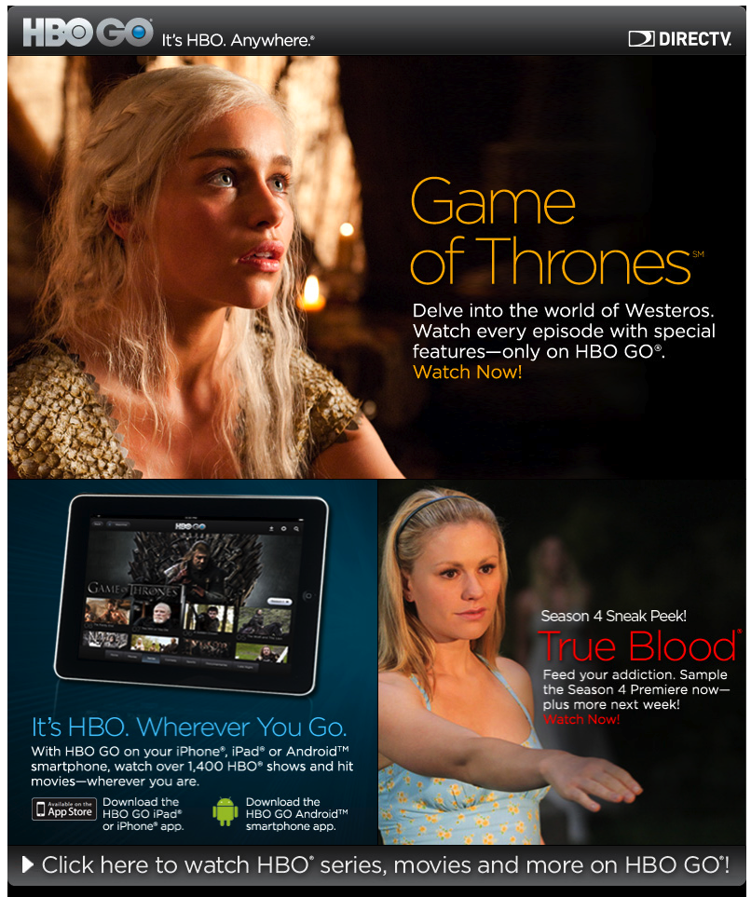
Before we start…
2 email approaches:
Hybrid vs All-Images

Slide 6
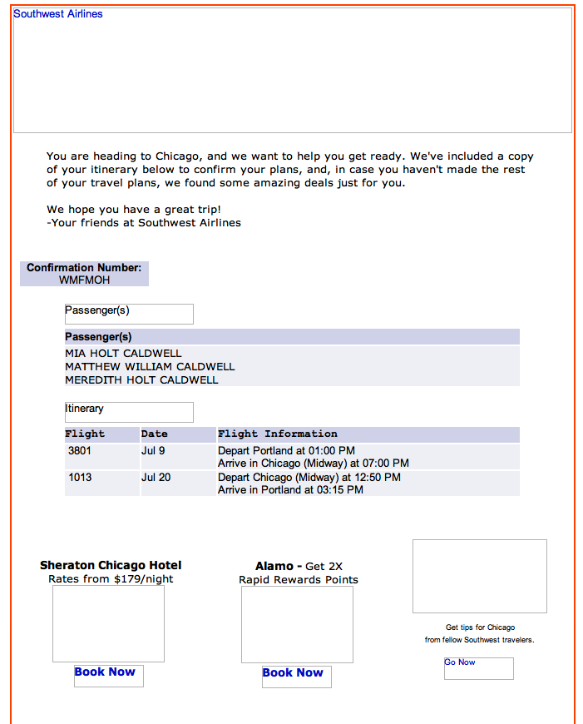
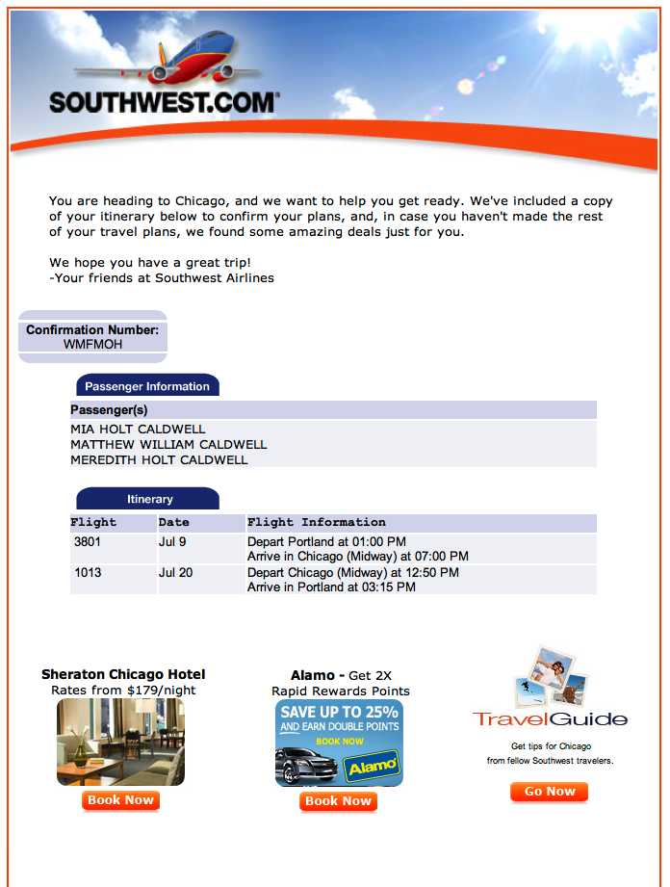
Hybrid Emails - Pros & Cons
PROS:
Can be read with images off
Loads faster
Is Dynamic ready
Easy to change / edit
CONS:
Less control over the code and formatting
Takes more code, can be truncated
More restricted must adhere to template

Slide 7
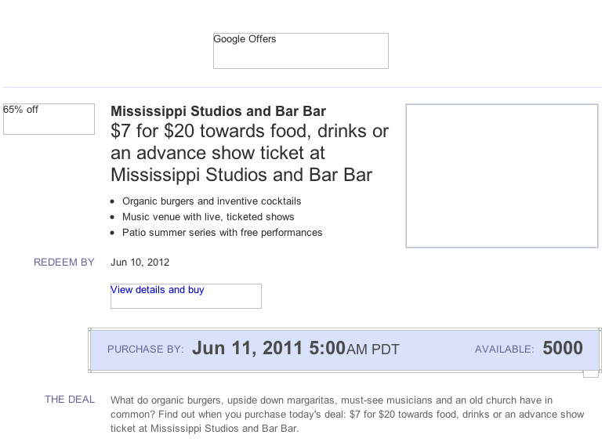
Hybrid Email example 2 –
Google Offers – can be read and used without images

Slide 8
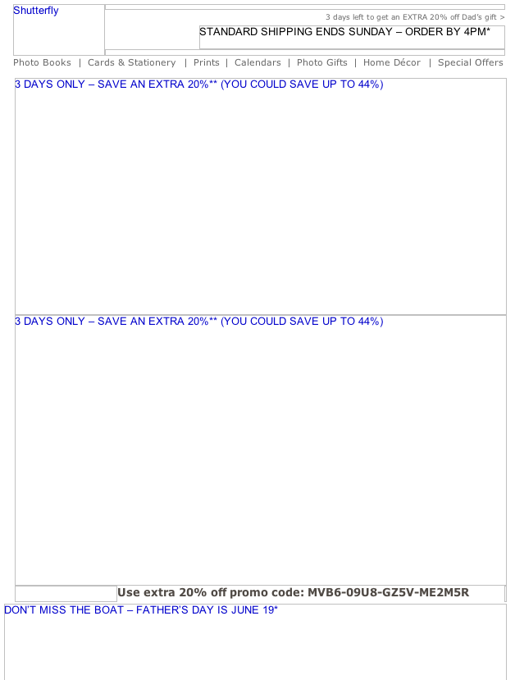
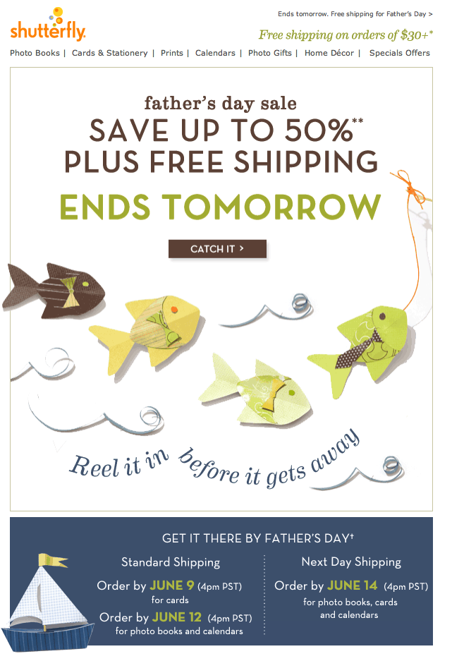
All Image Emails - Pros & Cons
PROS:
Complete control of layout
Unlimited fonts, design choices
CONS:
Cannot be seen with images off
Message versioning takes more time (in Photoshop)
Is time-consuming to edit and change
Slower loading
Without images ⬆
With images ➔

Slide 9
COMPARISON 1 Best in Class Email - Technical items

Slide 10
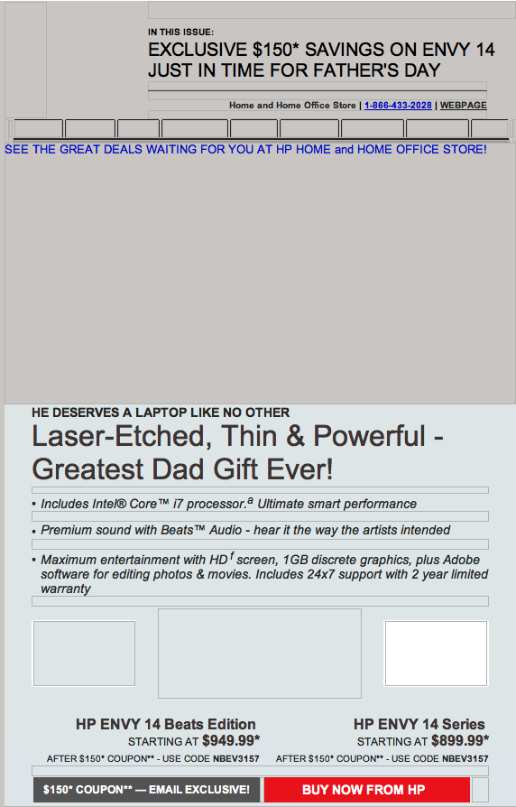
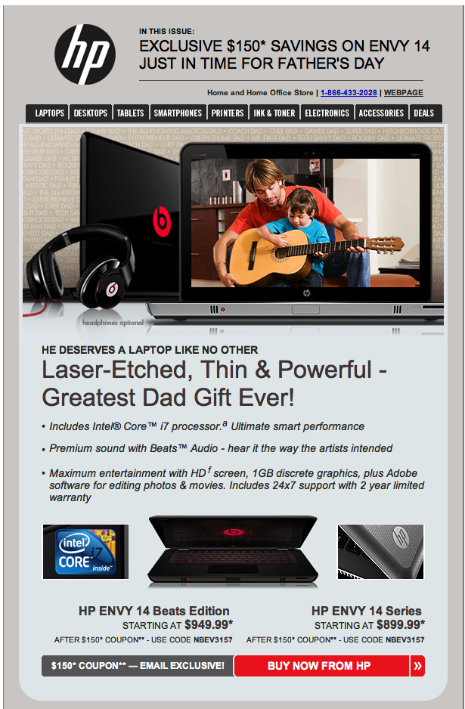
COMPARISON 1 Best in Class Email - Technical items
1. Can the email be read w/ images off?

Slide 11
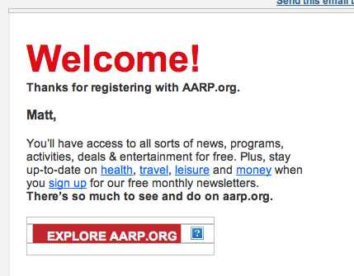
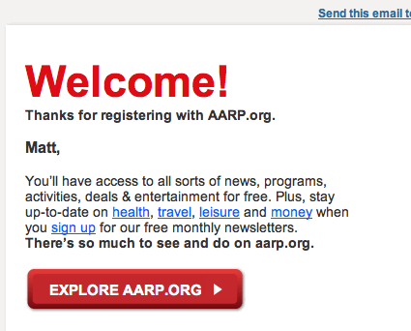
COMPARISON 1 Best in Class Email - Technical items
2. Bulletproof buttons
Can the calls to action still be seen with images off?

Slide 12
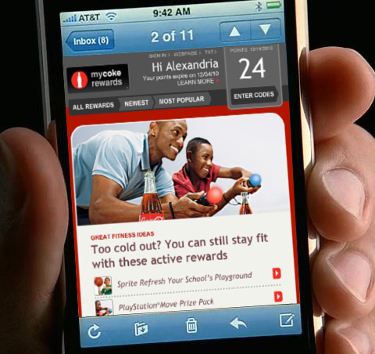
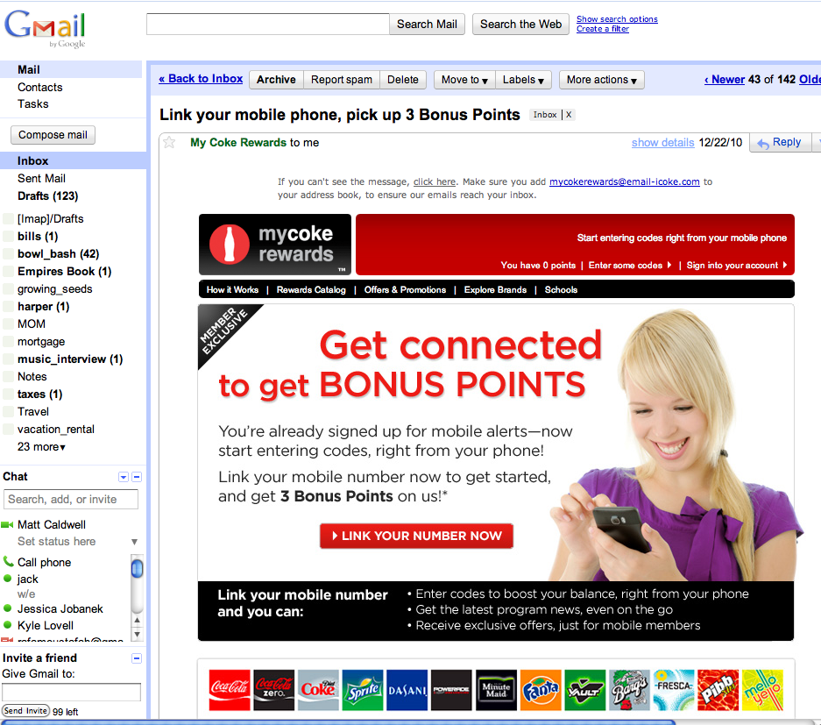
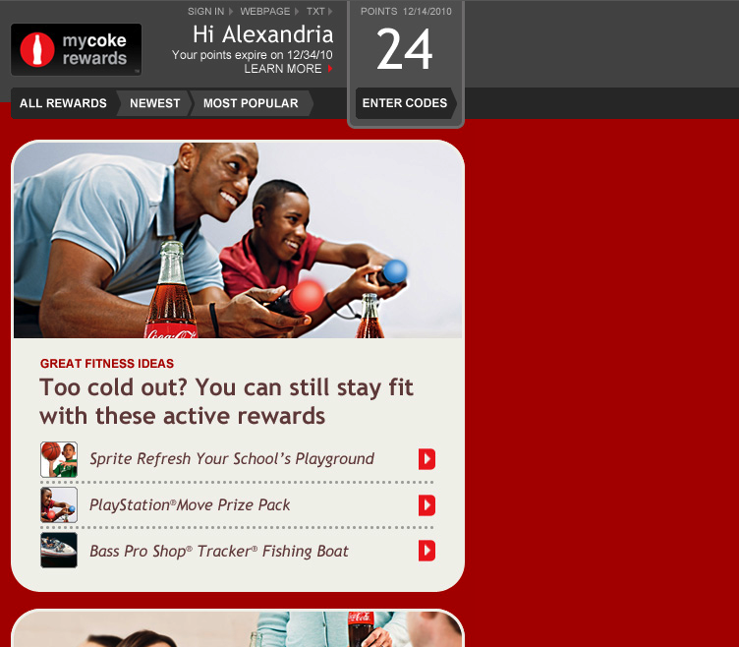
COMPARISON 1 Best in Class Email - Technical items
3. Mobile-Ready Scalable layout?
When the layout scales down for smart phones, can it still be read & used?

Slide 13
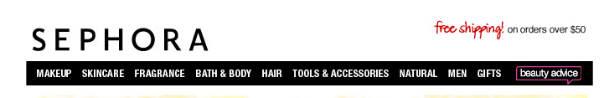
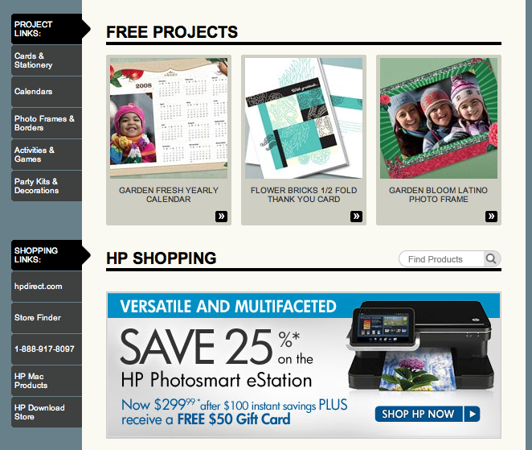
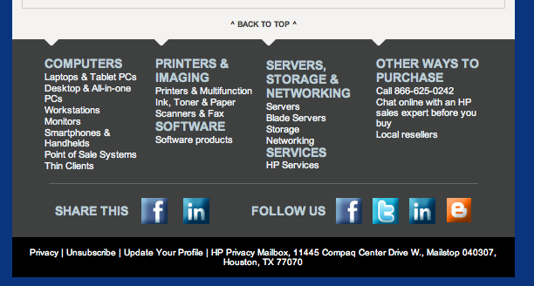
COMPARISON 1 Best in Class Email - Technical items
4. Strong Navigation?
Navigation works well in retail email. This includes top horizontal nav, inner sectional nav and bottom catch-all nav.
TOP NAV ➔
INNER NAV
⬇
BOTTOM NAV
⬇

Slide 14
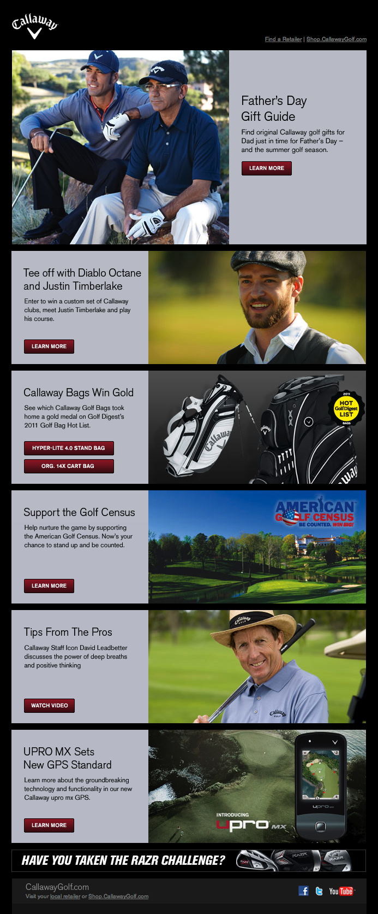
COMPARISON 1 Best in Class Email - Technical items
5. Dynamic Ready?
Is it easy to merge in different sections? Change copy?

Slide 15
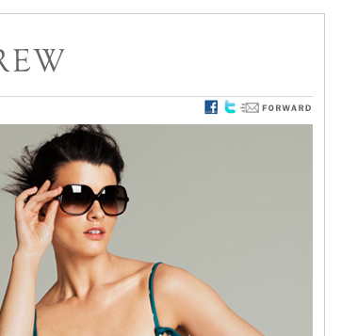
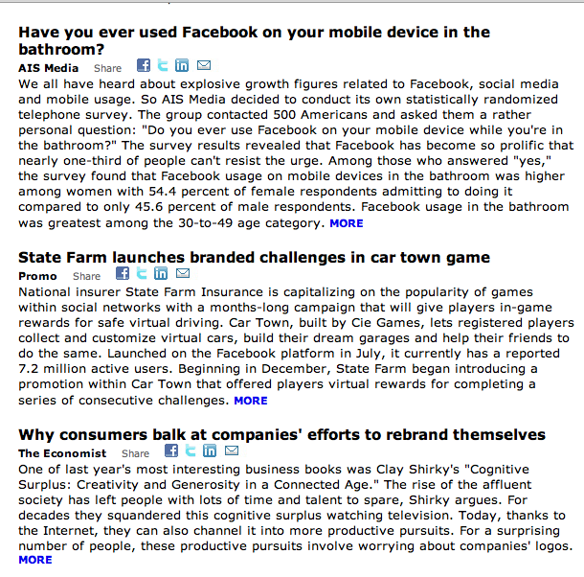
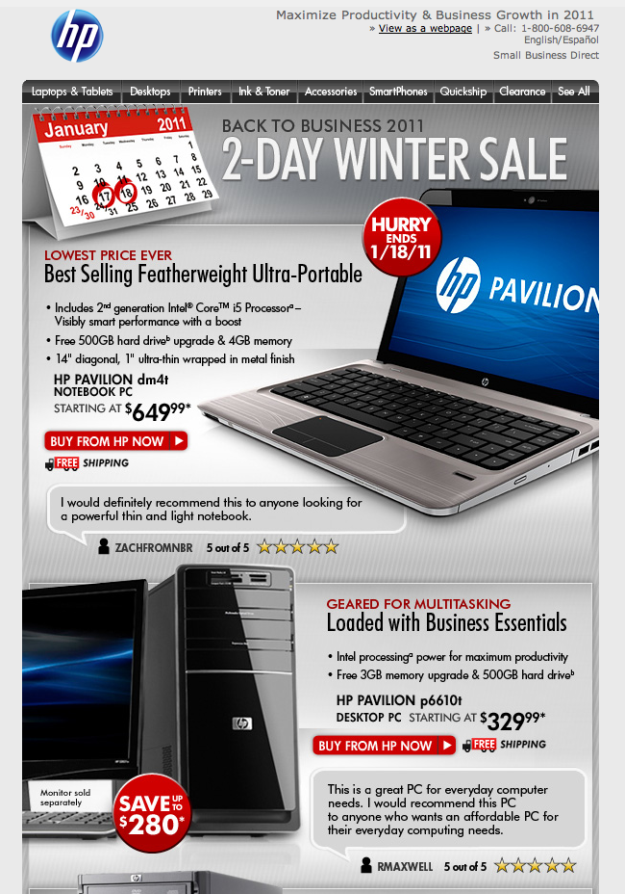
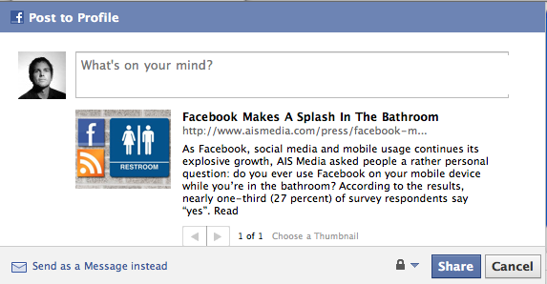
COMPARISON 1 Best in Class Email - Technical items
6. Social Ready?
3 ways to bring social to email :
1. Linking 2. Sharing 3. Dispatches

Slide 16
COMPARISON Who was reviewed? Other best in class retail email programs
HHOS Current template
HHOS New Template
Victoria Secret
Apple
Urban Outfitters
Ikea
Crate & Barrel
Home Depot
Sephora
J. Crew

Slide 17
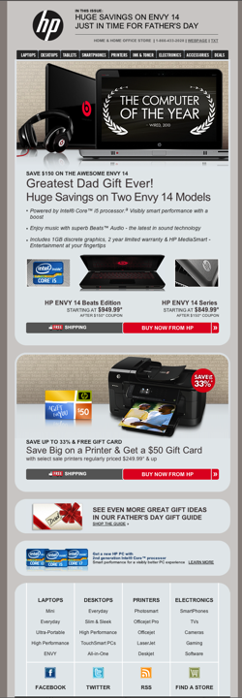

New HP Shopping Template

Slide 18
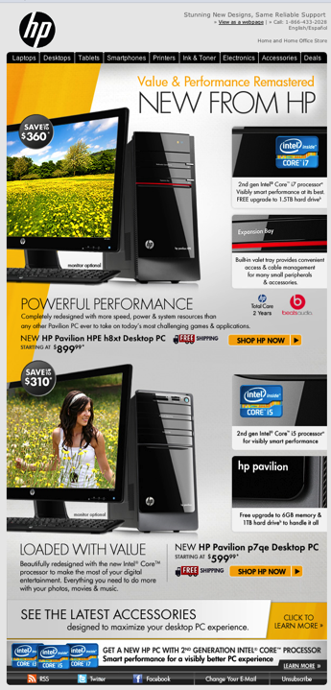
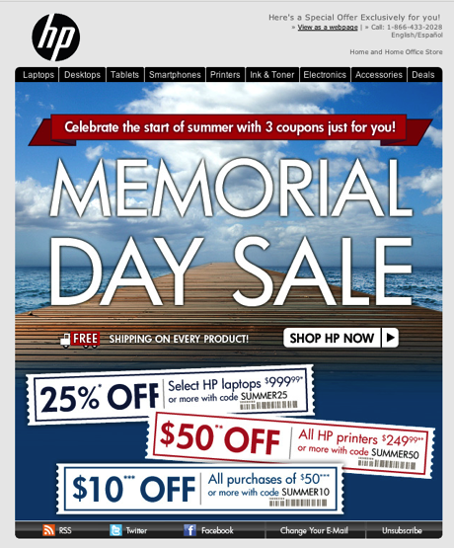
Current HP Shopping

Slide 19
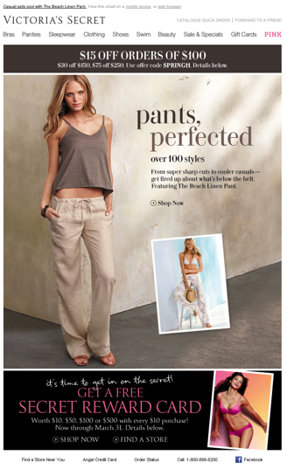

Victoria Secret

Slide 20
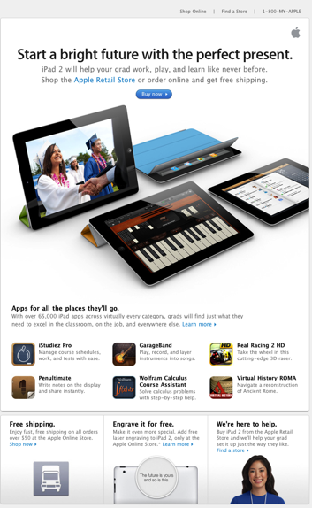
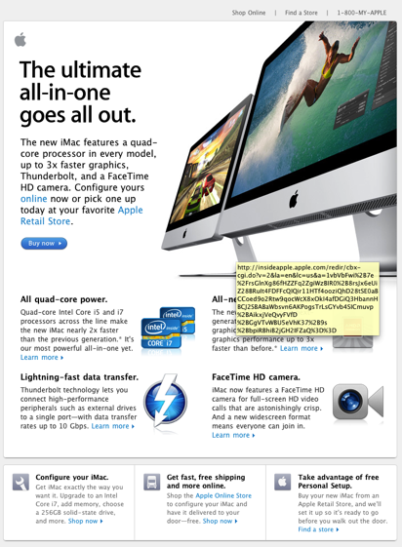
Apple

Slide 21
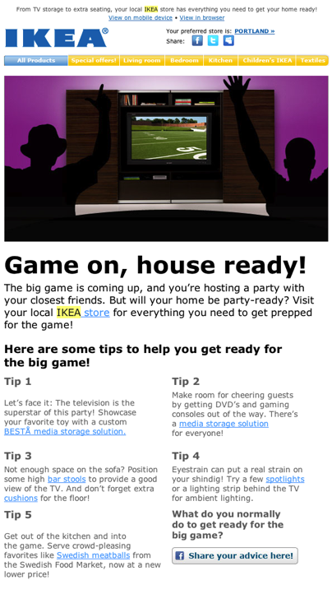
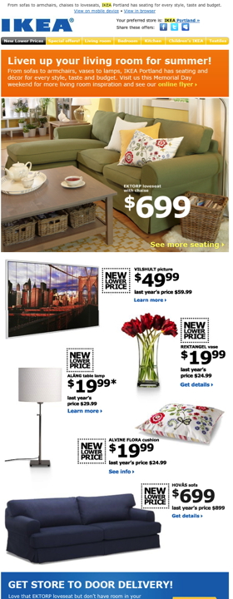
Ikea

Slide 22
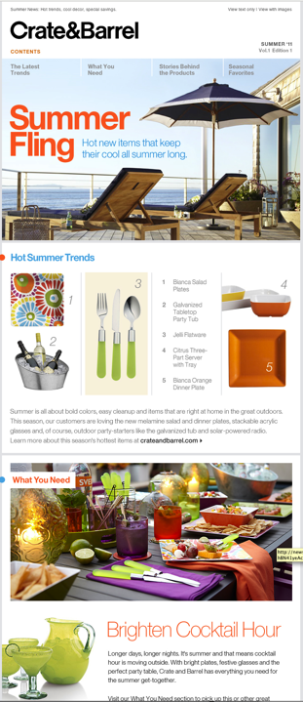
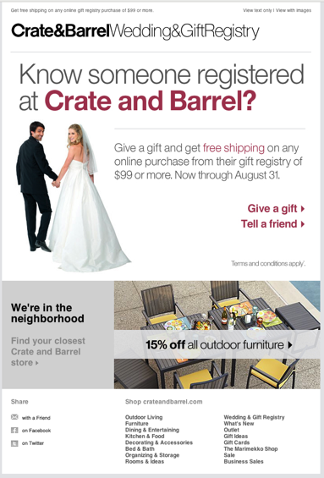
Crate & Barrel

Slide 23
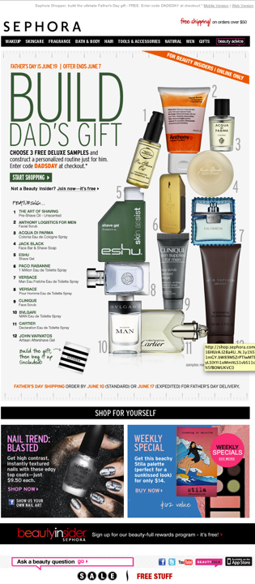
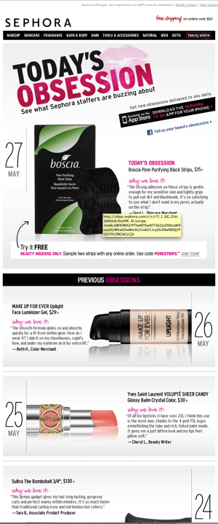
Sephora

Slide 24
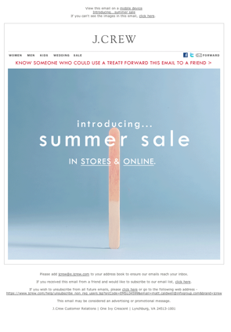
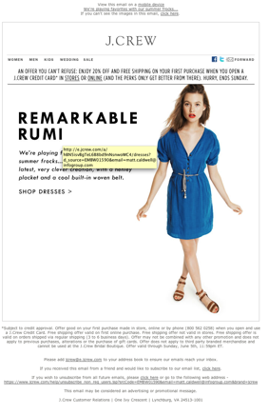
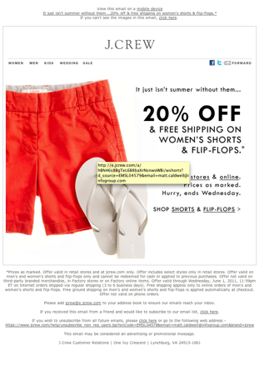
J.Crew

Slide 25
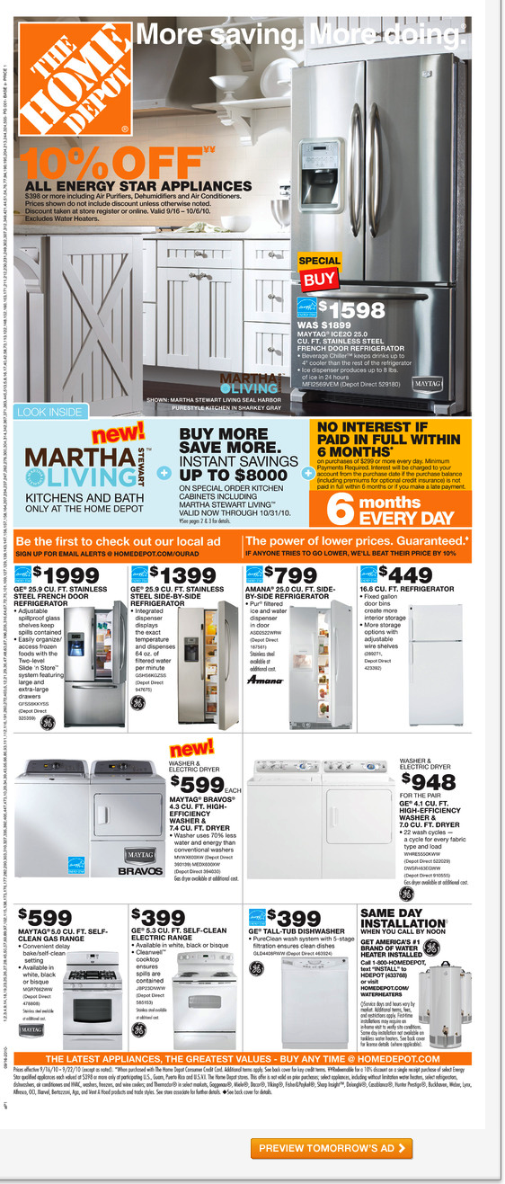
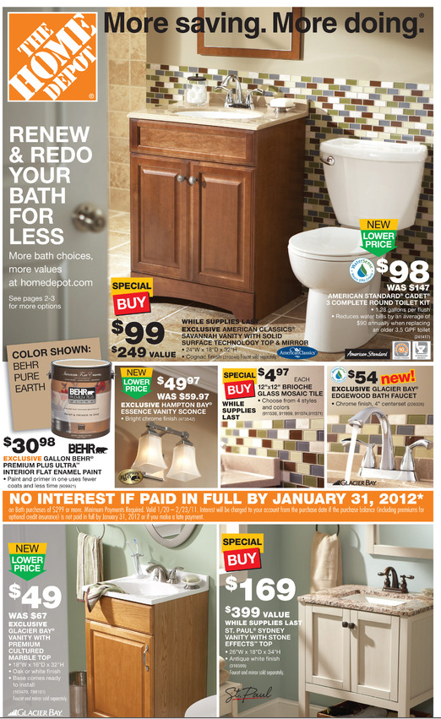
Home Depot

Slide 26
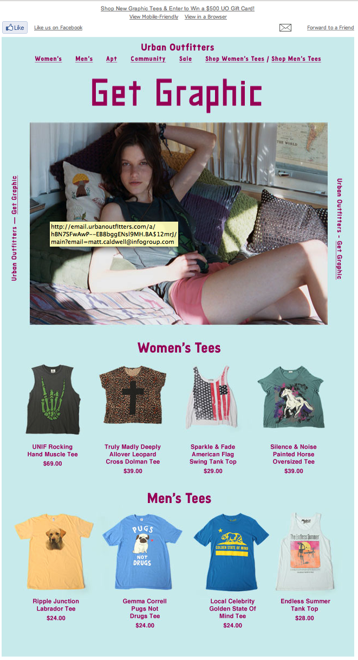
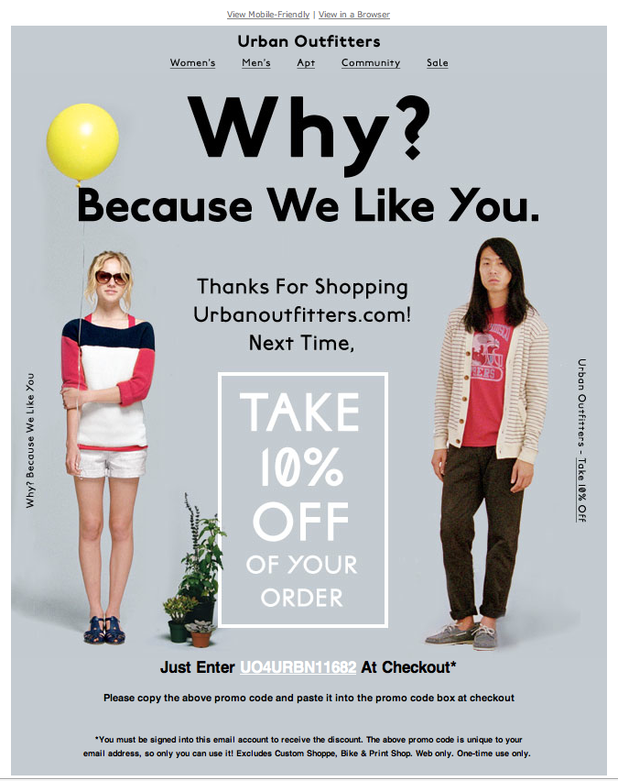
Urban Outfitters

Slide 27
COMPARISON 1 Results
Can be read w/ images off?
✗ ✔ ✗ ✗ ✗ ✔ ✗ ✔ ✗ ✗
HHOS Current | HHOS New | Victoria Secret | Apple | Urban Outfitters | Ikea | Crate & Barrel | Home Depot | Sephora | J. Crew
Mobile- Ready Scalable layout?
✗ ✔ ✗ ✗ ✗ ✗ ✔ ✗ ✗ ✗
HHOS Current | HHOS New | Victoria Secret | Apple | Urban Outfitters | Ikea | Crate & Barrel | Home Depot | Sephora | J. Crew
Bulletproof buttons (buttons can be seen w/ images off?)
✗ ✔ ✗ ✗ ✗ ✗ ✗ ✗ ✗ ✗
HHOS Current | HHOS New | Victoria Secret | Apple | Urban Outfitters | Ikea | Crate & Barrel | Home Depot | Sephora | J. Crew
Strong Navigation? (top, inner, bottom catchall)
✗ ✔ ✗ ✗ ✗ ✔ ✔ ✔ ✗ ✗
HHOS Current | HHOS New | Victoria Secret | Apple | Urban Outfitters | Ikea | Crate & Barrel | Home Depot | Sephora | J. Crew
Dynamic ready? Easy to merge
✗ ✔ ✗ ✗ ✗ ✔ ✗ ✗ ✗ ✗
HHOS Current | HHOS New | Victoria Secret | Apple | Urban Outfitters | Ikea | Crate & Barrel | Home Depot | Sephora | J. Crew
Social Linking / Social Sharing / Social Dispatches?
✔ ✔ ✗ ✗ ✔ ✗ ✗ ✗ ✔ ✗
HHOS Current | HHOS New | Victoria Secret | Apple | Urban Outfitters | Ikea | Crate & Barrel | Home Depot | Sephora | J. Crew

Slide 28
COMPARISON 1 Conclusions & Take-aways
The new template is highly optimized for all the major technical aspects of retail email
Can be read, clicked sans-image
Has best navigation of any in retail class
The new template is one of the few truly “scalable” mobile-ready email layouts of all retailers
The new template is 100% dynamic ready
Overall HP Shopping meets or exceeds the “technical” items of great retail email.

Slide 29
COMPARISON 2 Best in Class Email - Design & Copy items

Slide 30
COMPARISON 2 Best in Class Email - Design & Copy items
Design
Easy to Scan & Read? The 6 Second Rule
Energetic Images? Bright, interesting copy?
Distinct Calls to Action?
Is message customized & targeted?
Day-to-day emails
Trigger emails
Is there value added content? Non-product editorial content?

Slide 31
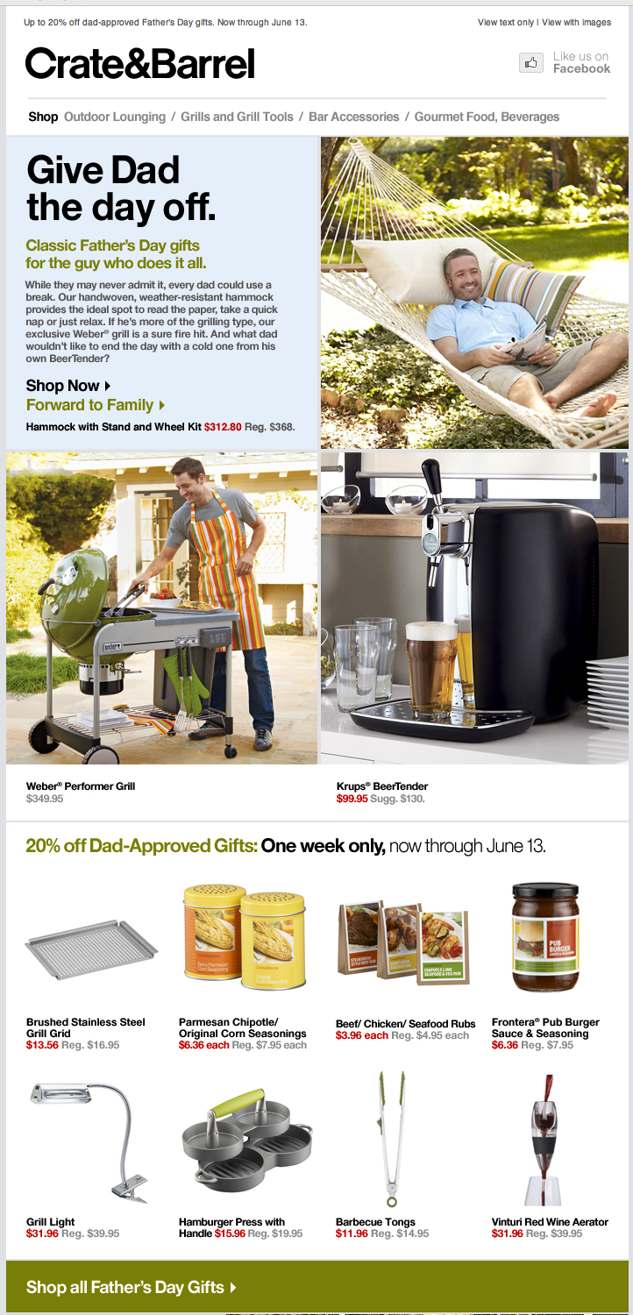
COMPARISON 2 Best in Class Email – Design & Copy
1. The Six Second Rule
Can the email be scanned & read quickly?

Slide 32
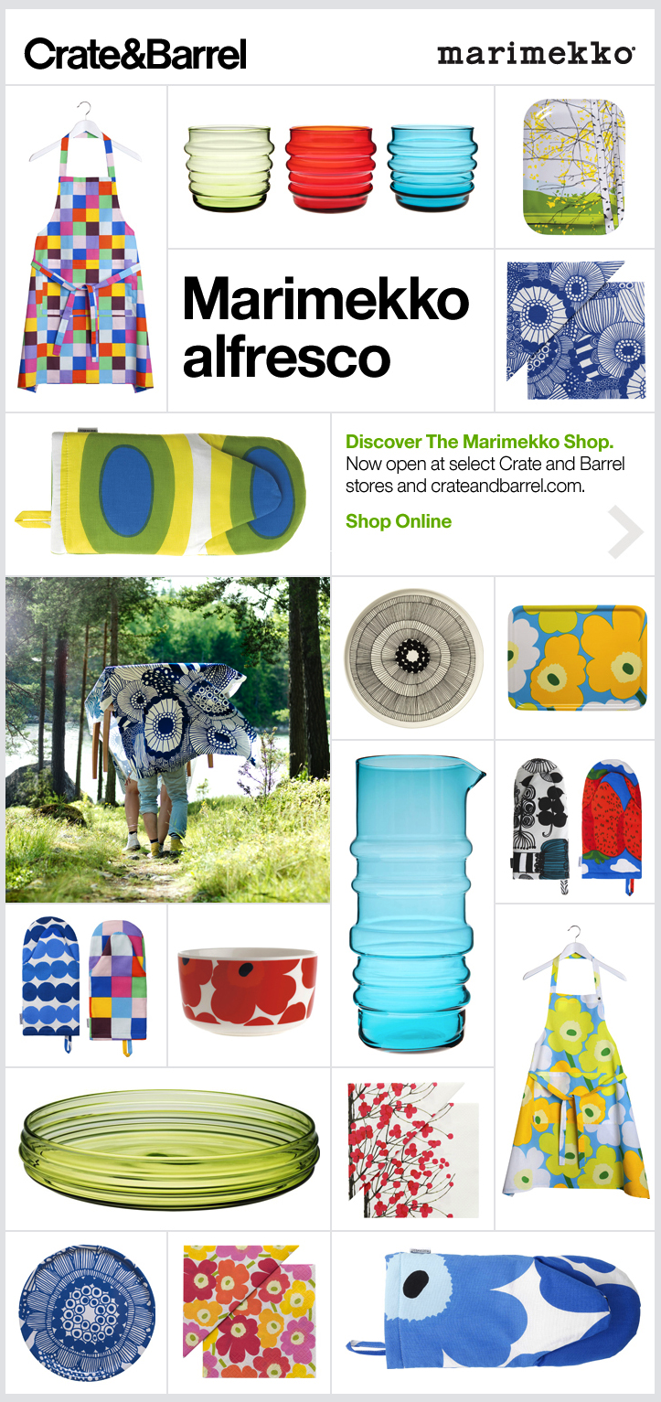
COMPARISON 2 Best in Class Email – Design & Copy
1b. Energetic Imagery
Has shown to increase observation time. The “magazine cover” effect.

Slide 33
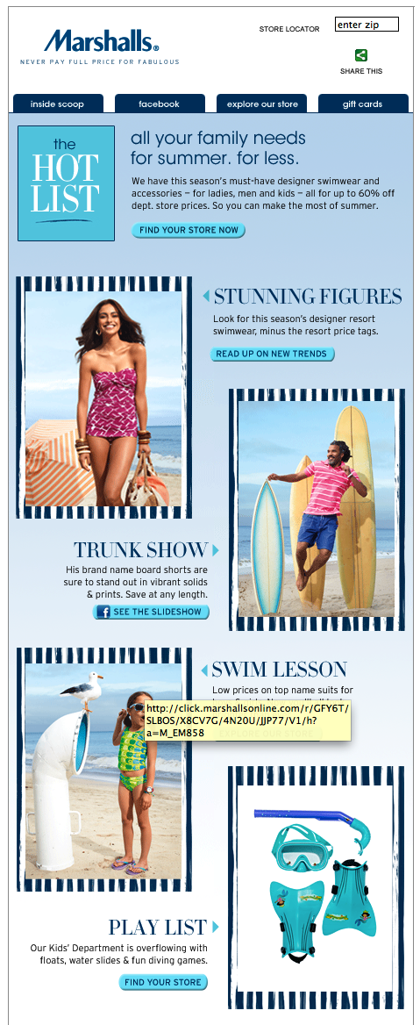
COMPARISON 2 Best in Class Email – Design & Copy
1c. Distinct Calls to Action

Slide 34
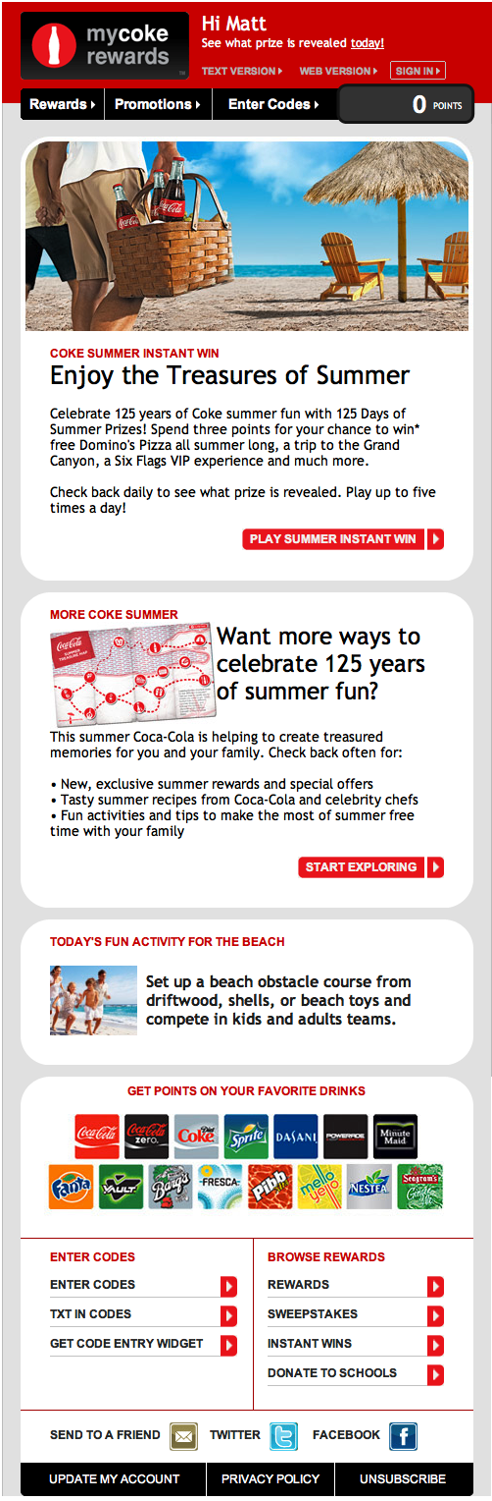
COMPARISON 2 Best in Class Email – Design & Copy
2. Customization & Targeting
Is it done daily? Occasionally? In Triggers?

Slide 35
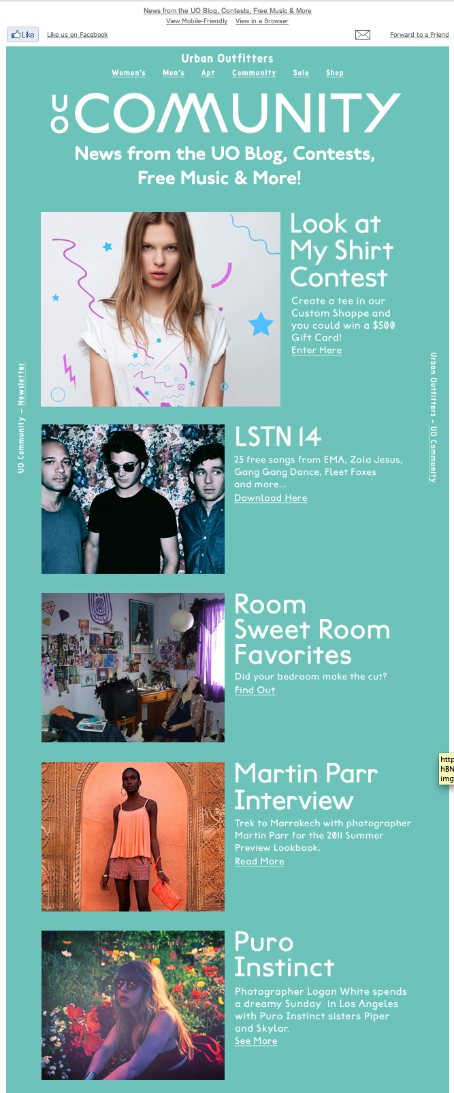
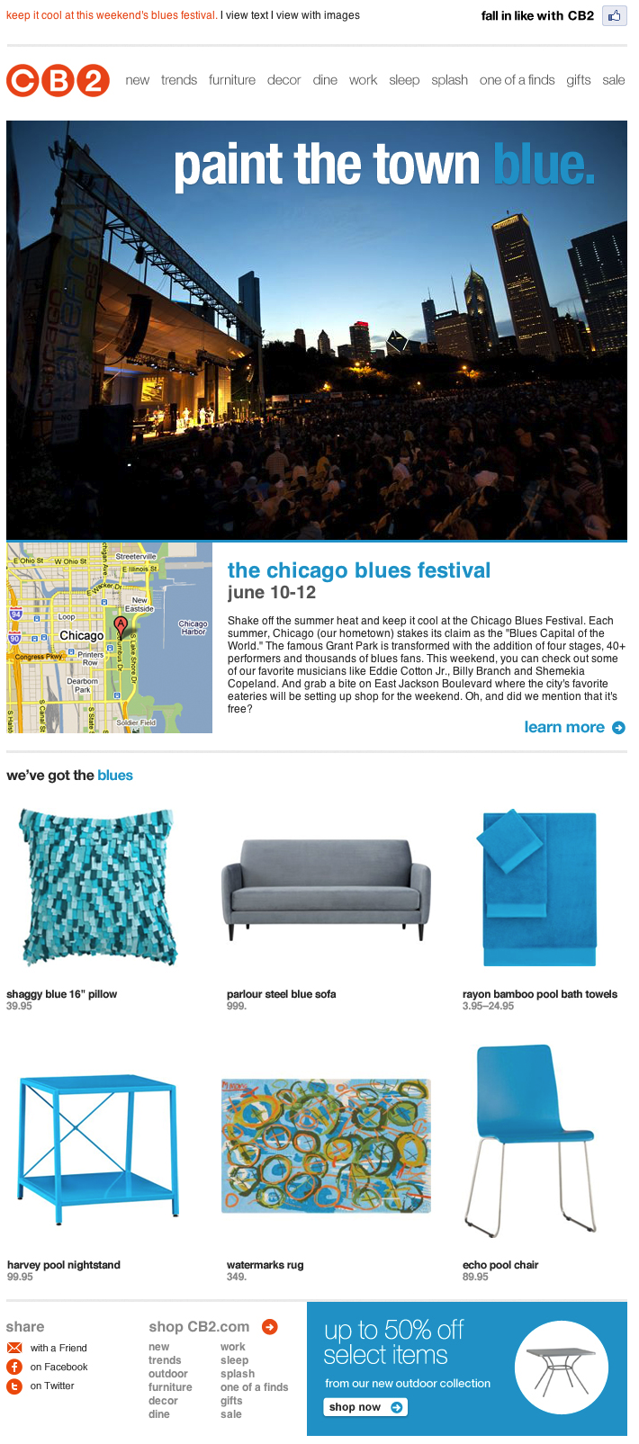

COMPARISON 2 Best in Class Email – Design & Copy
3. Value-added non-product editorial content?
Users demand more than just product information.

Slide 36
COMPARISON 2 Results
6 second rule? Easy to scan and read?
✔ ✔ ✔ ✔ ✔ ✔ ✔ ✗ ✔ ✔
HHOS Current | HHOS New | Victoria Secret | Apple | Urban Outfitters | Ikea | Crate & Barrel | Home Depot | Sephora | J. Crew
Energetic Imagery?
✔ ✔ ✔ ✔ ✔ ✔ ✔ ✔ ✔ ✔
HHOS Current | HHOS New | Victoria Secret | Apple | Urban Outfitters | Ikea | Crate & Barrel | Home Depot | Sephora | J. Crew
Distinct calls to action?
✔ ✔ ✗ ✔ ✗ ✔ ✗ ✗ ✗ ✗
HHOS Current | HHOS New | Victoria Secret | Apple | Urban Outfitters | Ikea | Crate & Barrel | Home Depot | Sephora | J. Crew
Targeted – day to day emails?
✗ ✗ ✗ ✗ ✗ ✗ ✗ ✔ ✗ ✗
HHOS Current | HHOS New | Victoria Secret | Apple | Urban Outfitters | Ikea | Crate & Barrel | Home Depot | Sephora | J. Crew
Target – Trigger emails?
✔ ✔ ✔ ✔ ✔ ✗ ✗ ✗ ✔ ✔
HHOS Current | HHOS New | Victoria Secret | Apple | Urban Outfitters | Ikea | Crate & Barrel | Home Depot | Sephora | J. Crew
Value added, non-product editorial?
✗ ✗ ✗ ✔ ✔ ✔ ✔ ✔ ✔ ✗
HHOS Current | HHOS New | Victoria Secret | Apple | Urban Outfitters | Ikea | Crate & Barrel | Home Depot | Sephora | J. Crew

Slide 37
COMPARISON 2 Conclusions & Take-aways
Most retail emails are “all-image” based.
Hybrid - HP shopping emails previously were all-image, but new template shifts to “hybrid”.
Hybrid emails have many positives but do have challenges:
Less control over look and feel
4 times as much code ‘under the hood’ but overall message is lighter because less large image files
Value added – many other retail email offer “non-product, editorial” style content, HP Shopping does not.
HP Shopping relies soley on product shots. Other retailer’s images may tend to be even more energetic / lifestyle.
Very few if any retailers use “soft” targeting on a day to day basis.
Most retailers have “hard” targeting triggers in place.

Slide 38
Targeting & Customization

Slide 39
Targeting & Customization
Here’s what we’ll cover:
2 general categories of targeting / customization
Hard targeting – fact based
Soft targeting – theory based
Case study – HP Personas

Slide 40
Targeting & Customization
2 general categories for targeting & customization:
HARD TARGETING: Facts
Based on simple, direct facts Ex. Gender, product-purchased, product-browsed
Easier to execute
Typically results are more definitive
Typically better results
SOFT TARGETING: Theories
Based on theories of who the audience is Ex Demographic snapshots
More difficult to execute
Results tend to be mixed
Much greater effort to create, review

Slide 41
Hard Targeting Example
Browsed But Didn’t Buy
User browses a product, is sent offer on that product category
Frequency: Weekly, Tuesday at 12:00 PM
Content Elements:
Take 5% off select customized product category that was browsed.
Code expires 05/31/11
Merges: image on left hand size, first name, SUPC
Targeting:
Records sent by HP in the Omniture feed.
Has not received Abandon Shopping Cart, Omniture or Revival 1 in past 30 days.
Has not received Clicked But Didn’t Buy in past 5 days.

Slide 42
Hard Targeting Example
Abandoned Shopping Cart
User carts a product but no purchase. Email is sent with product & offer.
Frequency: Mails daily at 1:00 AM
Content Elements:
Save 5% on select items in your next order
Coupon Code expires 05/31/11
Merges: image, product name, URL, first name, SUPC
Tiers: General Store
Targeting:
Records sent by HP in ASC feed.
Has not received this message in past 31 days.
Has not received Lapsed 1, Revival 1 or Best Offer
Activation in past 7 days.

Slide 43
Hard Targeting Example
Next most logical product
Based on past product purchased, modeling predicts next purchase need.
Frequency: Daily at 11:00 AM
Dynamically generates copy and big image based on product category
Targeting:
First time buyers who purchased 45 days ago - records sent by HP in NMLP feed

Slide 44
Hard Targeting Example
60 Days Activation
If no opens or clicks for 60 days, user is sent offer
Frequency: Monthly – Day 14 at 10:00 AM
Save an extra 5%
SUPC Coupon Code
Coupon expires 5/31/11
Tiers: General Store
Targeting:
Members who are not active - has not received “RM_HHOS_Attach_Printer_master” (Upsell) or “RM_hhos_5373_Attach_PC_NB_Accessories”(Attach 2) less than 2 days ago.

Slide 45
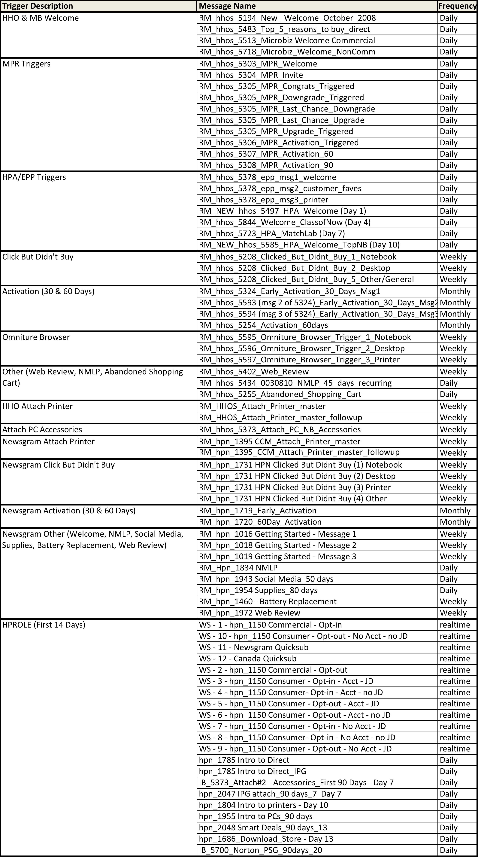
Currently there are over 20 active, customized & targeted triggers consisting of 72 emails that go out daily, weekly or in real-time: HHO & MB Welcome My Print Rewards Triggers HP Academy /Employee Purchase Program Triggers Click But Didn't Buy Activation (30 & 60 Days) Omniture Browse Web Review Next Most Logical Product Abandoned Shopping Cart HHO Attach Printer Attach PC Accessories Newsgram Attach Printer Newsgram Click But Didn't Buy Newsgram Activation (30 & 60 Days) Newsgram Welcome Newsgram Next Most Logical Product Social Media Supplies Battery Replacement Web Review HP ROLE (First 14 Days)

Slide 46
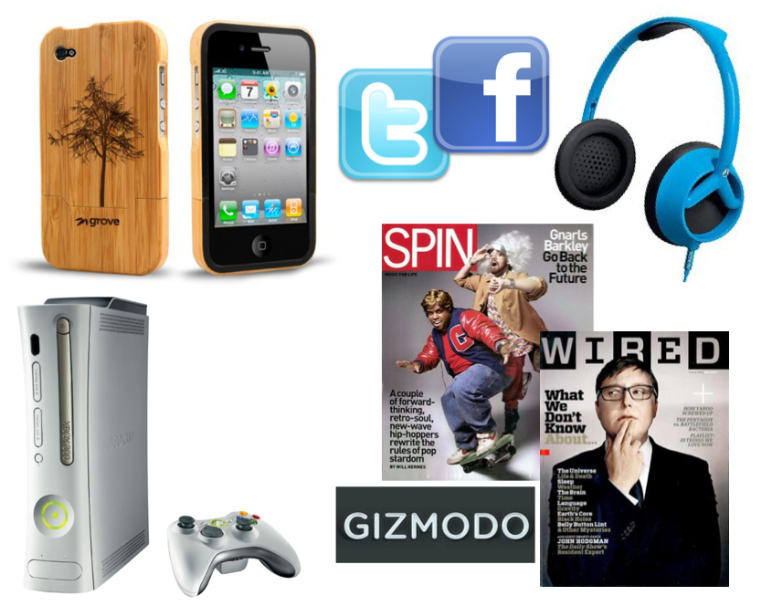

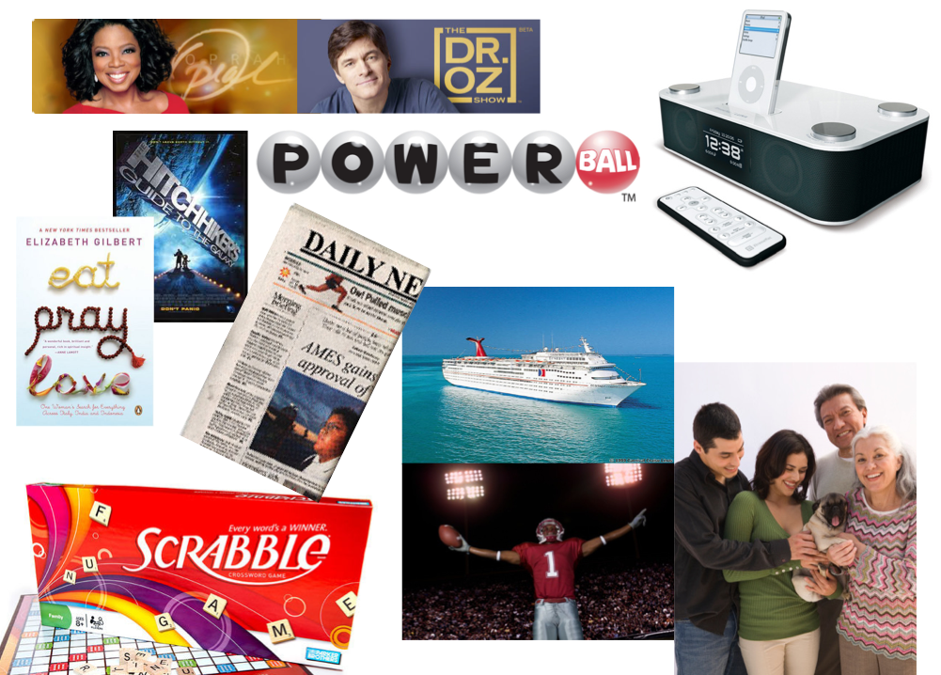



Soft Targeting Example
HP Shopping Personas Project Create unique email layouts based on personas:
SENTIMENTAL TRADITIONALIST DIGITAL TRIBALIST SUCCESSFUL ADAPTER
POWER USER ENTERTAINMENT SAVVY FREEBIE SEEKER

Slide 47




Soft Targeting Example
HP Shopping Personas Project emails
Each email had copy, images and products adjusted to demographic
General Store Tribalists Traditionalists Adopters

Slide 48
Soft Targeting Example
HP Shopping Personas Project
RESULTS:
Unique Persona Segments: Email response rates and purchase behavior vary across the Persona Segments (confirms potential value of targeting by Persona Segments)
Creative: Persona-based creatives were tested with mixed results
Three segments were tested creative were not strikingly different
Products & Product Combination: Results directionally show that certain products resonate stronger with specific Persona Segments
DOTW dynamic template used to determine optimal product/product slot combination by Persona Segment (10/21 Comprehensive Persona Test – Phase II)
AOIDs tracked by Persona Segment during Q1 2011 Holiday period (Phase III)
Results mixed but a few segments appear to be attracted to value-based products and others to hot tech products

Slide 49
Soft Targeting Example
HP Shopping Personas Project Take aways
Varied results, not definitive
Writing and design for demographics is subjective
Multiple versions is very labor intensive
Copywriting time - 300% higher than average
Design time – 5 times the average
Revisions – 67 revisions vs 12 on average message
Overall cost increases for each additional version

Slide 50
New HP Shopping Template

Slide 51
New HP Shopping Template
Requirements of new design
Efficiency – must be able to be authored more quickly than current
True Hybrid – Create a layout where most, if not all the copy is HTML not images. Can be read cleanly with images off; will load quickly
Flexible – can be used for a large variety of messaging, from single postcards to long multi-product layouts
Mobile – should look good and be readable/clickable on a smart phone
Dynamic – any part of the layout should be able to be dynamically populated to adjust to persona style messaging.
Inner Nav – should contain a section for further linking by product category
Grid System – should be aligned to an underlying system of pixel-based columns and gutters
Social – should integrate social review comments
Editorial – Should incorporate option sections that can contain more editorial copy
Integrate - should incorporate designs from any ongoing HP campaigns

Slide 52



Slide 53
New HP Shopping Template
Totally redesigned to have all best in class requirements
Mobile-Scalable Ready – 100% of the email can be read and interacted with on a smart phone. One of the only large retailers to have this functionality.
100% readable with images off with bulletproof buttons
Dynamic ready. Everything can be merged. It is not all-images
Minimal photoshop efforts to change layout
Color-adjustable to keep layouts fresh and meet changing marketing demands
Loads quickly in in-box

Slide 54



Slide 55



Slide 56

New HP Shopping Template
Looks good on Big or Small screen, because users now use both

Slide 57

New HP Shopping Template
An outside experts view – Chad White, Retail Email Blog
“HP makes big improvements in email redesign.
HP has redesigned their email template, making a number of improvements that make their emails easier to read, especially on mobile devices. “
Chad White
RETAIL EMAIL BLOG

Slide 58

New HP Shopping Template
What makes it more customizable & dynamic?
Single-column stacked sections – customized modules can be swapped in and out

Slide 59


New HP Shopping Template
What makes it more customizable & dynamic?
A variety of different plug n’ play sections – customized modules can be swapped in and out
8 Optional modules
like
“INNER NAV”
And
“SOCIAL DISPATCHES”

Slide 60

New HP Shopping Template
What makes it more customizable & dynamic?
A variety of different plug n’ play sections continued example – customized modules can be swapped in and out
Blocks group and hold Modules
Modules tell the story
blocks
modules

Slide 61

New HP Shopping Template
What makes it more customizable & dynamic?
True Hybrid Template - All copy, buttons, prices are HTML based, not images. That means they can be inserted by database merge.

Slide 62

New HP Shopping Template
What makes it more customizable & dynamic?
Trigger-like functionality as a module – now, stand-alone trigger emails like “browsed but didn’t buy”, can be inserted as a module into an existing day to day message.
Stand alone email
Now Triggered module can be inserted into day-to-day email

Slide 63

New HP Shopping Template
What makes it more customizable & dynamic?
Color Flexible – we designed it so we can shift color easily in the underlying code. This will always us to get ‘fresh” looks, even though we’re bound to a template.

Slide 64
Future Considerations & Recommendations for HP Shopping

Slide 65
Future Considerations for HP Shopping
VALUE-ADDED EDITORIAL CONTENT
Keeps subscribers opening and engaged.
Consider a longer-term plan of creating and cultivating this content specifically for email.
Examples:
Levi’s Founder Sessions MP3
Urban Outfitters Design & Music Blog excerpts
Home Depot Household Tips and Tricks

Slide 66
Future Considerations for HP Shopping
2. SIMPLIFY
Color pallete - Could be more subtle allowing the products to come forward.
Currently many heavily saturated color schemes are used (as dictated by HP Shopping style guides).
Subtle colors examples: HP Palm, Apple, Crate & Barrel
Less Copy? Many top retailers reviewed use far less words per email than HP.

Slide 67
Future Considerations for HP Shopping
3. PHOTOGRAPHY
Plays a large HUGE factor in what an email looks like
Currently all photography comes from HP
It is only product, no people
No in-use or lifestyle shots
Most retailers reviewed utilize high-quality lifestyle or “in-use” shots
Expand Photography – consider quarterly lifestyle photoshoots.
This would reduce stock photography usage
Exclusive HP look and feel

Slide 68
Closing notes: The email design landscape
Some factors to consider in the creation of HP shopping email.
7 out of 10 emails follow design direction from larger HP campaigns (ex. HP Beats) or HPshopping.com site design (ex. Memorial Day)
Emails must be created within 5 working days from briefing
Creative design team of 1 Creative Director, 6 Designers and 1 Copywriter create more than 24 unique emails per month.
Partners not suppliers – inputs from HP Shopping plays a large factor in final message outcome
Photography plays a large part in the look of a layout. All photography is supplied by HP

Slide 69
Thank you

